Slide 1
Backtesting Systems & Biases

Slide 2
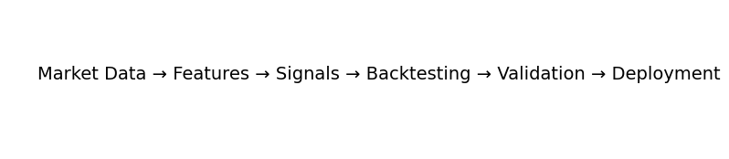
Quant Research Workflow
Market Data
Features
Signals
Backtesting
Validation
Deployment

Slide 3
The Problem
A trading idea is not evidence
How do we know a signal works?
Need objective evaluation

Slide 4
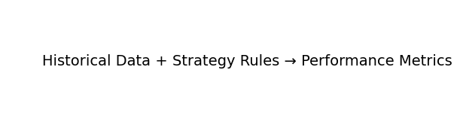
What is Backtesting?
Apply rules to historical data
Measure returns and risk
Evaluate behavior before deployment

Slide 5
Why Backtesting Matters
Evidence over intuition
Estimate return and drawdowns
Identify weaknesses early

Slide 6
Research vs Production
Research = experimentation
Production = real capital
Different standards and controls

Slide 7
Biggest Misconception
Good Backtest ≠ Good Strategy
Biases can inflate results
Validation is essential

Slide 8
Quick Quiz
Why do quants backtest?
Estimate historical performance
Not to guarantee profits

Slide 9
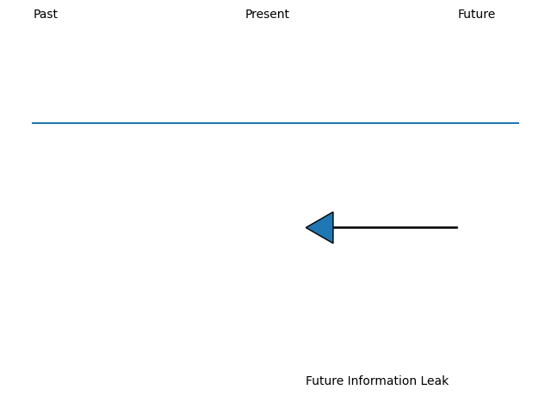
Lookahead Bias
Using future information
Most dangerous backtest bias
Creates unrealistic returns

Slide 10
Newspaper Example
Imagine seeing tomorrow's news today
Easy to make money
Equivalent to cheating

Slide 11
Trading Example
Monday = 100
Tuesday = 110
Buying Monday because you know Tuesday is invalid

Slide 12
Lookahead Bias in Code
Bad: signal * returns
Good: signal.shift(1) * returns
Trade after signal generation

Slide 13
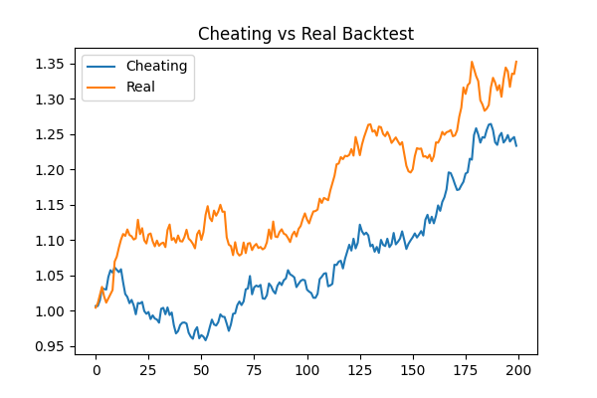
Cheating vs Real Backtest
Compare equity curves
Future information inflates performance
Realistic results are lower

Slide 14
Industry Failures
Timestamp mistakes
Data availability errors
False confidence

Slide 15
Preventing Lookahead Bias
Validate timestamps
Check information availability
Use realistic execution

Slide 16
Quiz
Using tomorrow's close today?
Answer: Lookahead Bias

Slide 17
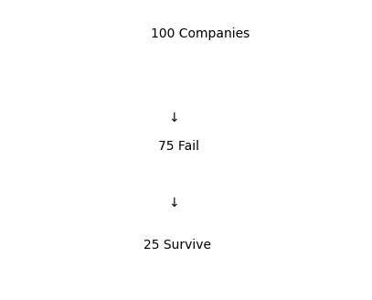
Survivorship Bias
Studying winners only
Ignoring failed assets
Inflates performance

Slide 18
Mutual Fund Example
Poor funds disappear
Only survivors remain
Results look better than reality

Slide 19
Index Example
Today's index members are survivors
Historical constituents matter

Slide 20
Inflated Results
Removing failures improves returns
Dataset quality matters

Slide 21
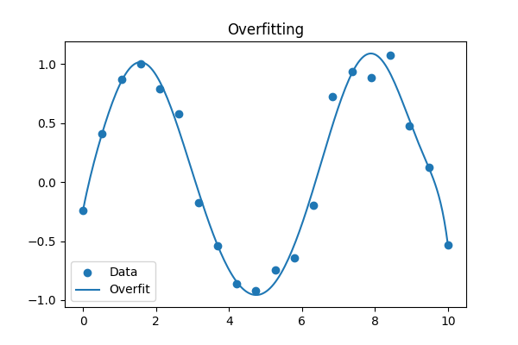
What is Overfitting?
Learning noise instead of signal
Excellent historical fit
Poor future performance

Slide 22
Noise vs Signal
Markets contain randomness
Humans see patterns everywhere

Slide 23
Why Researchers Overfit
Too many parameters
Repeated optimization
False discoveries

Slide 24
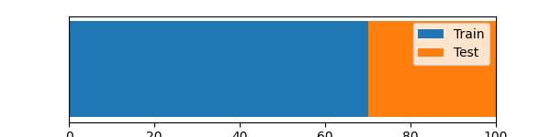
Train vs Test
Train on one sample
Evaluate on unseen sample
Check generalization

Slide 25
Validation Workflow
Train
Validate
Test

Slide 26
Quiz
Perfect train performance, poor test performance
Answer: Overfitting

Slide 27
Data Leakage
Future information enters training
Hard to detect
Inflates results

Slide 28
Financial Example
Future earnings in features
Revised economic data
Accidental leakage

Slide 29
Why Leakage is Dangerous
Creates false confidence
Leads to poor capital allocation

Slide 30
The Reality Problem
Even valid strategies face market friction
Backtest Profit → Real Profit

Slide 31
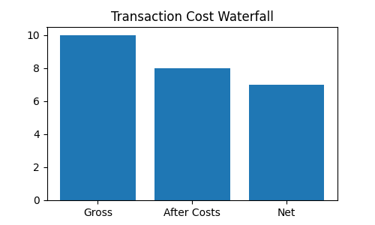
Transaction Costs
Commissions
Exchange fees
Bid-ask spread

Slide 32
Transaction Cost Example
10% gross return
3% costs
7% net return

Slide 33
Slippage
Expected price ≠ execution price
Small impact per trade
Large cumulative impact

Slide 34
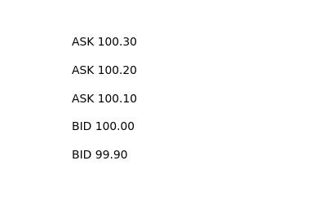
Order Book
Liquidity available at different levels
Large orders move through levels

Slide 35
Liquidity Constraints
Small strategy may not scale
Large trades impact prices

Slide 36
Position Sizing
Risk scales with allocation
Good signal can still be dangerous

Slide 37
Numerical Quiz
10% return
3% costs
2% slippage
Net = 5%

Slide 38
Backtest Checklist
No lookahead bias
No leakage
No survivorship bias
Costs included
Validation performed

Slide 39
Professional Workflow
Idea
Research
Backtest
Validate
Deploy

Slide 40
Lab Preview
Lab A: Lookahead Bias
Lab B: Realistic Backtesting

Slide 41
Key Takeaways
Good backtests can be wrong
Validation matters
Costs matter
Overfitting is dangerous

Slide 42
Q&A
Most of the work is proving alpha is real

