Slide 1
Lesson 2 — OHLCV Data & Market Microstructure
Understanding market data and execution systems

Slide 2
What is OHLCV Data?
Open
High
Low
Close
Volume

Slide 3
Understanding Open, High, Low & Close
Open = first traded price
High = highest traded price
Low = lowest traded price
Close = final traded price

Slide 4
Why Volume Matters
Volume measures market activity
High volume often means better liquidity

Slide 5
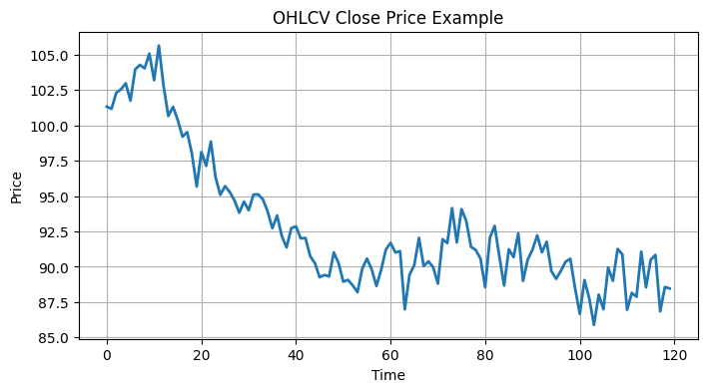
OHLCV Data Example
Real trading systems use OHLCV datasets

Slide 6
What Happens When You Press BUY?
Who sells to you?
How are trades matched?
Why does price move?

Slide 7
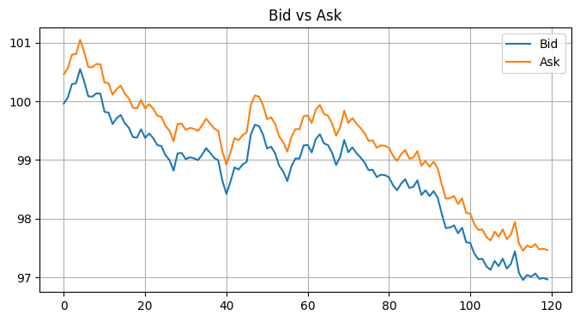
Bid & Ask Prices
Bid = highest buyer price
Ask = lowest seller price
Difference = spread

Slide 8
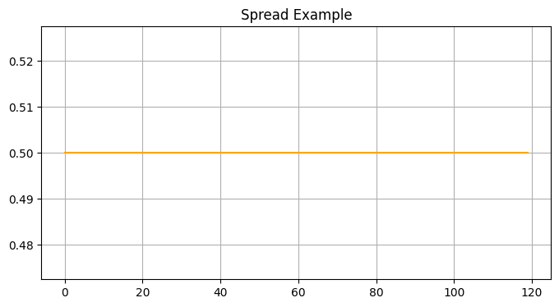
Understanding the Spread
Spread represents transaction cost

Slide 9
Liquidity
Ability to trade without moving price significantly

Slide 10
Market Orders vs Limit Orders
Market = execution priority
Limit = price priority

Slide 11
Slippage & Market Impact
Large trades can move markets
Execution quality matters

Slide 12
Quick Quiz
What does OHLCV stand for?
Which order guarantees execution?

Slide 13
Lab Session
Build OHLCV dataset
Visualize spreads
Simulate execution

Slide 14
Assignment
Build mini exchange simulator

