Slide 1
Strategy Robustness & Final Project Guidance

Slide 2
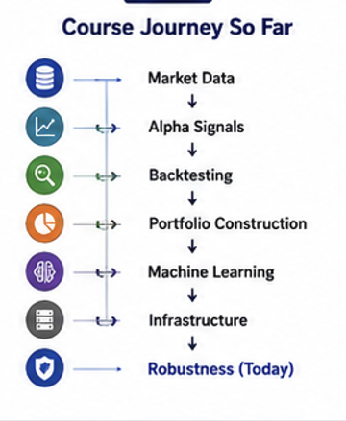
Course Journey So Far
Market Data
Alpha Signals
Backtesting
Portfolio Construction
Machine Learning
Quant Infrastructure

Slide 3
A Simple Question
Strategy CAGR = 20%
Sharpe = 2.0
Should we deploy it tomorrow?

Slide 4
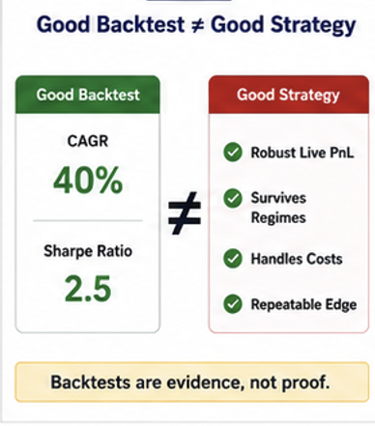
The Most Important Lesson In Quant
Good Backtest ≠ Good Strategy

Slide 5
Why Strategies Fail
Overfitting
Market Regime Changes
Transaction Costs
Competition
Bad Assumptions

Slide 6
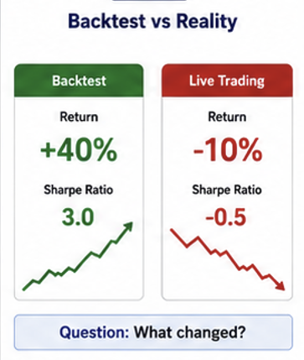
Backtest vs Reality
Backtest: +40%
Live Trading: -10%
What happened?

Slide 7
Case Study: The 40% Backtest
CAGR = 40%
Sharpe = 3.0
Live Results Losing Money
What went wrong?

Slide 8
Common Causes
Overfitting
Data Snooping
Hidden Costs
Regime Shift
Pure Luck

Slide 9
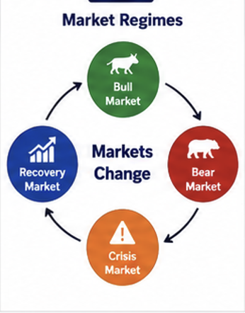
What Is A Market Regime?
Volatility
Trend
Liquidity
Investor Behavior

Slide 10
Examples Of Regimes
Bull Markets
Bear Markets
Crisis Markets
Sideways Markets

Slide 11
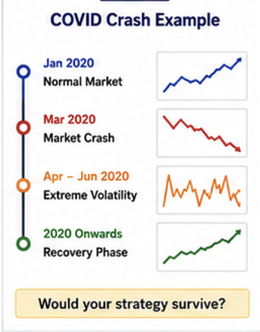
Example: COVID Crash
Extreme Volatility
Panic Selling
Rapid Recovery

Slide 12
Example: Interest Rate Hikes
Rising Rates
Falling Growth Stocks
Sector Rotation

Slide 13
Example: AI Boom
Strong Tech Performance
Momentum Dominance
Concentrated Leadership

Slide 14
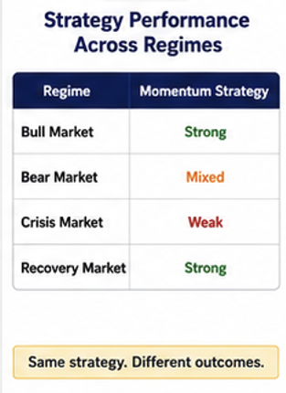
Strategy Performance Across Regimes
Bull: Good
Bear: Mixed
Crisis: Weak
Recovery: Strong

Slide 15
Case Study: COVID Broke My Strategy
Strong 2017–2019
Failed During 2020
Why?

Slide 16
Key Lesson
Strategies Are Not Permanent
Markets Evolve

Slide 17
Overfitting Revisited
Learning Noise Instead Of Signal

Slide 18
Signal Or Noise?
Repeatable Performance?
Or Random Outcome?

Slide 19
Warning Signs
Too Many Parameters
Too Many Rules
Too Much Optimization

Slide 20
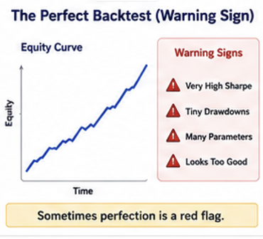
The Perfect Backtest
Very High Sharpe
Smooth Equity Curve
Unrealistic Results

Slide 21
Train vs Test
Training Data
Testing Data

Slide 22
Example
25 Parameters
98% Accuracy
Trust It?

Slide 23
Case Study: The Perfect Backtest
Amazing Backtest
Terrible Out-of-Sample
What happened?

Slide 24
Key Lesson
Simple Strategies Often Generalize Better

Slide 25
Out-of-Sample Testing
Testing On Unseen Data
Measure Generalization

Slide 26
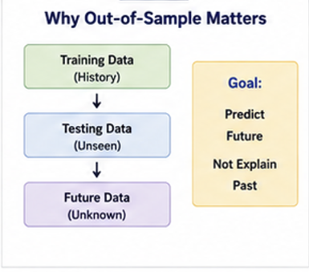
Why It Matters
Predict Future Performance
Not Explain Past Performance

Slide 27
Typical Workflow
Train
Validate
Test

Slide 28
Professional Research Process
Idea
Signal
Backtest
Validation
Deployment Decision

Slide 29
Example
Train Sharpe = 2.5
Test Sharpe = 0.4
Deploy?

Slide 30
Case Study: Should We Deploy?
Positive Test Performance
Large Performance Drop
Need More Evidence

Slide 31
Key Lesson
Backtest Quality Matters
Robustness Matters More

Slide 32
Walk-Forward Testing
Repeatedly Retrain
Repeatedly Test

Slide 33
Walk-Forward Framework
Train → Test
Train → Test
Train → Test

Slide 34
Why Use Walk-Forward?
Markets Change
Models Must Adapt

Slide 35
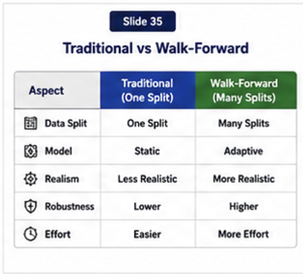
Traditional vs Walk-Forward
One Split vs Many Splits
Static vs Adaptive
Less vs More Realistic

Slide 36
Example
Train 2018–2020
Test 2021
Retrain
Test 2022

Slide 37
Benefits
More Realistic
Detects Regime Sensitivity
Better Validation

Slide 38
Discussion
One Backtest
or Ten Walk-Forward Tests?

Slide 39
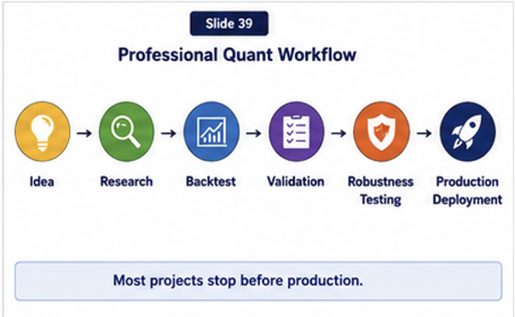
Professional Quant Workflow
Idea
Research
Validation
Robustness
Production

Slide 40
Most Strategies Fail
Most Ideas Never Reach Production

Slide 41
Why That's Normal
Research Is A Filtering Process
Reject Weak Ideas

Slide 42
Successful Quant Teams
Process
Validation
Risk Management
Not Just Returns

Slide 43
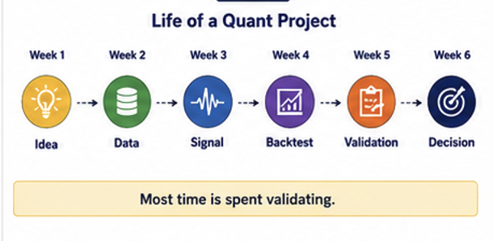
Case Study: Life Of A Quant Project
Week 1 Idea
Week 2 Data
Week 3 Signal
Week 4 Backtest
Week 5 Validation
Week 6 Decision

Slide 44
Final Project Expectations
Dataset
Indicators
Signal Logic
Backtest Results
Visualizations
Analysis

Slide 45
Common Project Mistakes
No Benchmark
No Interpretation
Overfitted Logic
Missing Charts
Weak Conclusions

Slide 46
What Makes A Good Quant?
Curiosity
Skepticism
Discipline
Validation

Slide 47
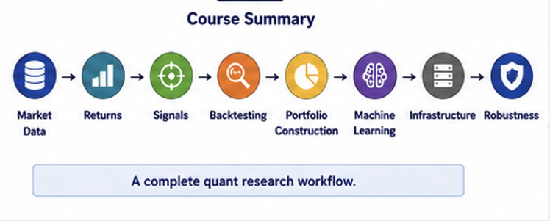
Course Summary

Slide 48
Final Takeaways
Backtests Can Mislead
Markets Change
Validation Is Critical
Robustness Matters

Slide 49
Final Thought
The goal is not to find strategies that worked.
The goal is to find strategies that continue to work.

Slide 50
Questions & Discussion
Course Questions
Project Questions
Career Questions

