Slide 1
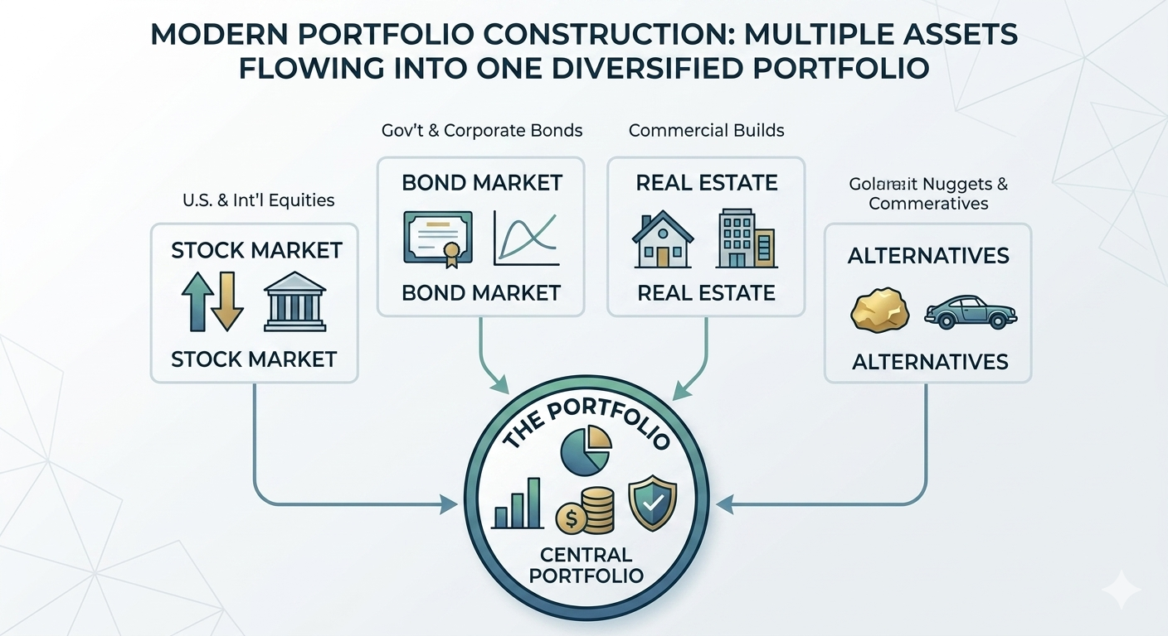
Portfolio Construction & Risk Management

Slide 2
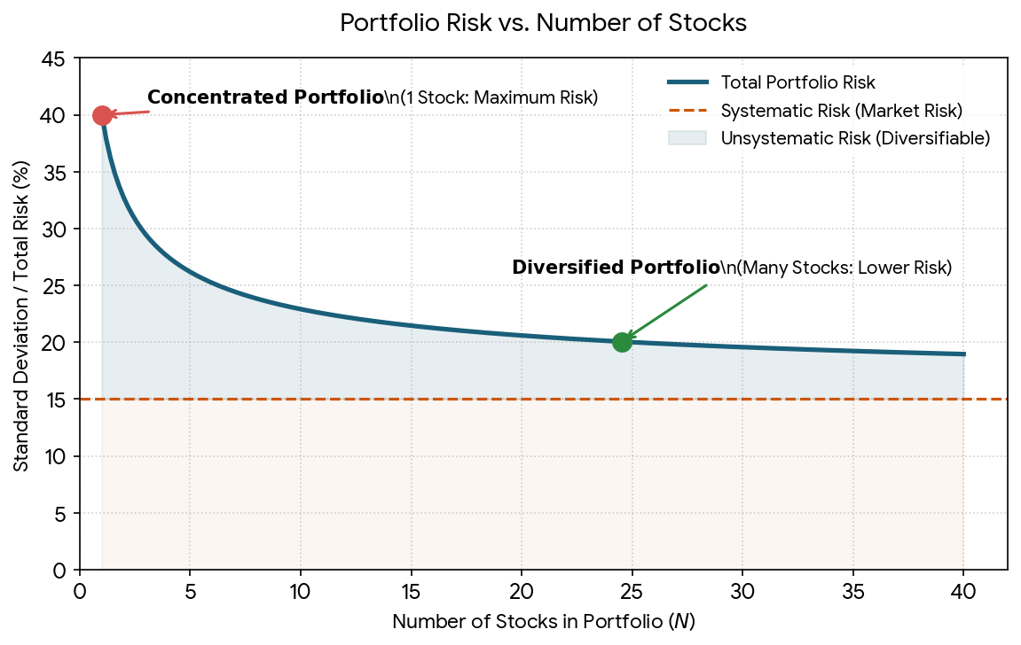
Why Portfolios Exist
Reduce concentration risk
Spread capital across assets
Improve risk-adjusted returns

Slide 3
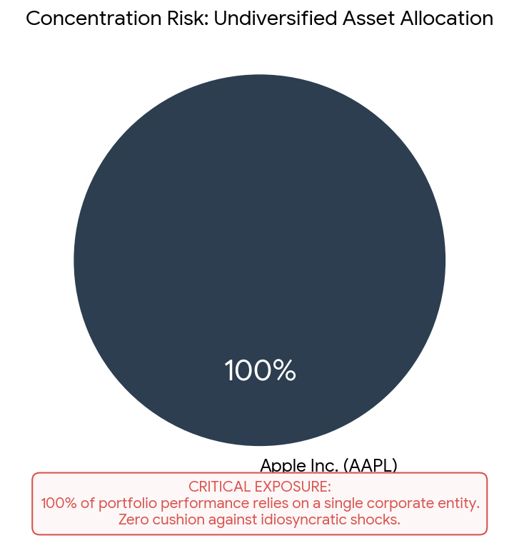
Concentration Risk
Too much capital in one asset
Large gains possible
Large losses possible

Slide 4
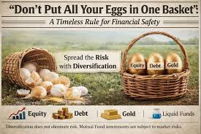
Diversification
Spread risk
Reduce dependence on one outcome
Improve portfolio stability

Slide 5
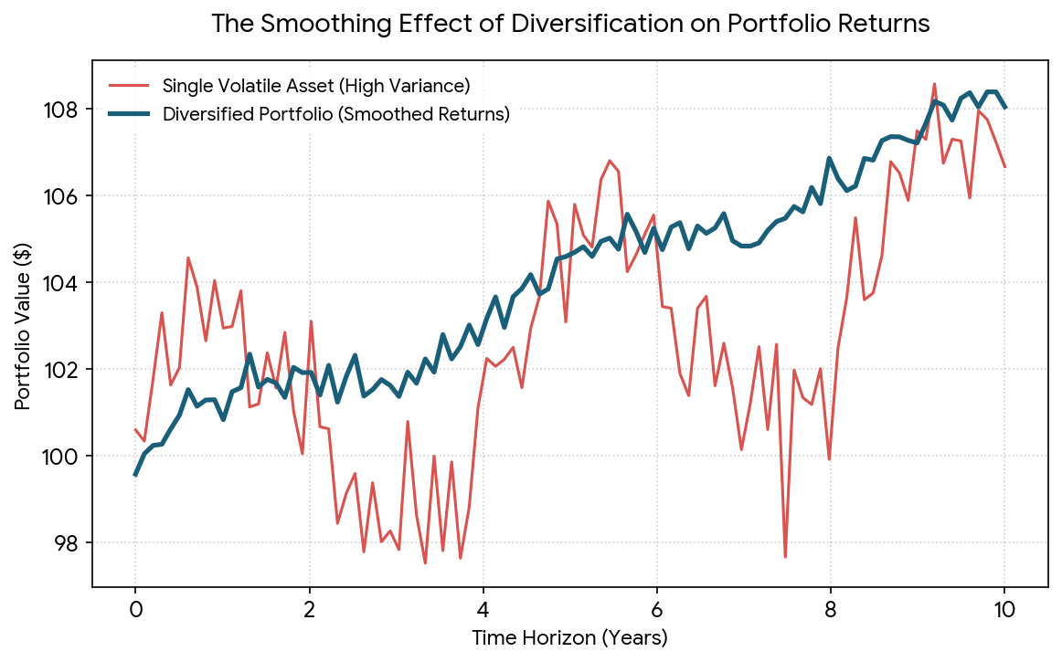
Benefits of Diversification
Add Visual Here
Lower volatility
Reduced concentration risk
Smoother returns
Better stability

Slide 6
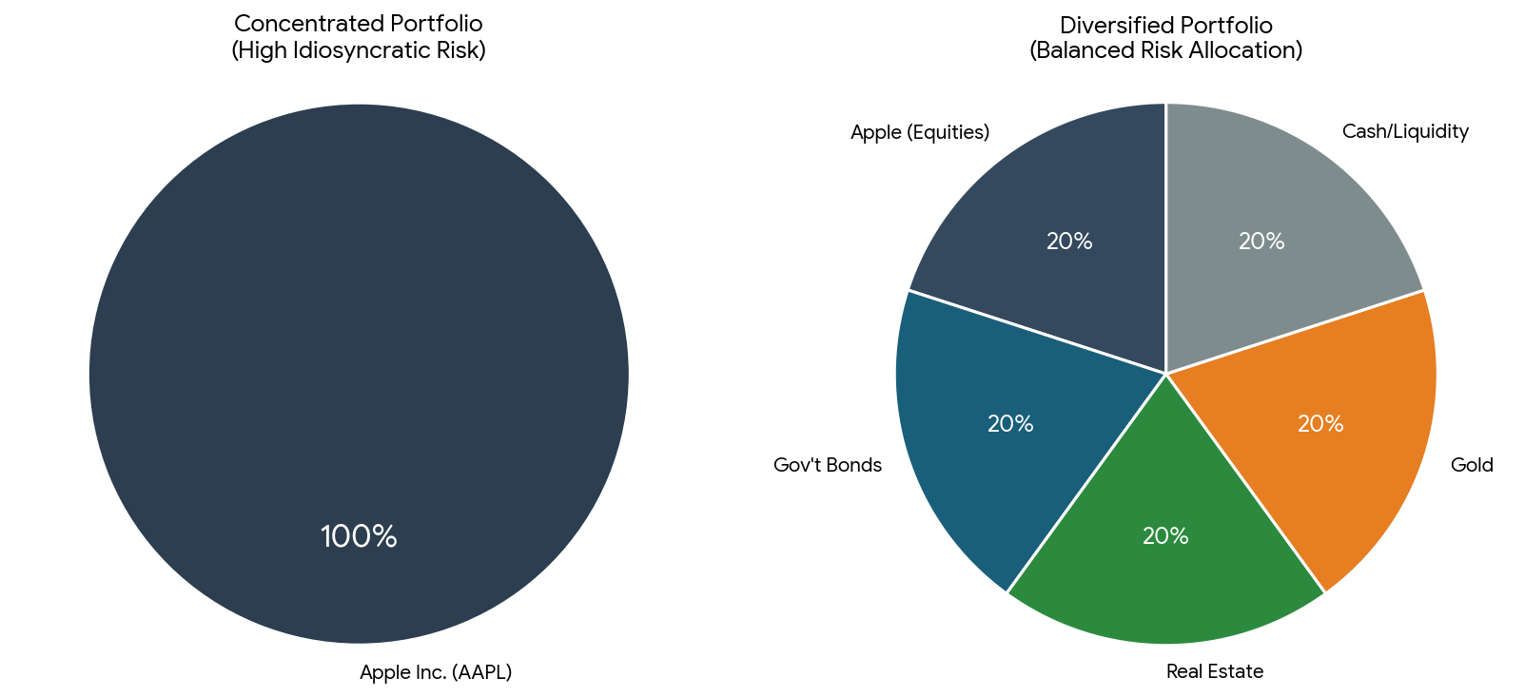
Diversification Example
Portfolio A: 100% Apple
Portfolio B: Diversified basket

Slide 7
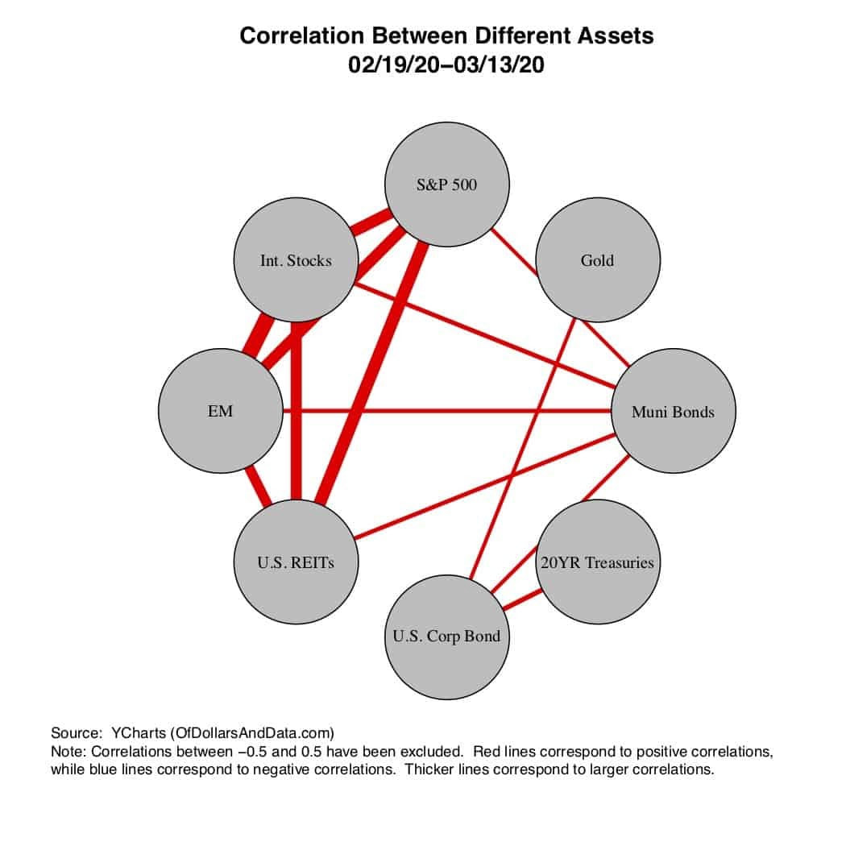
Correlation Intuition
Diversification depends on correlation
More assets ≠ more diversification

Slide 8
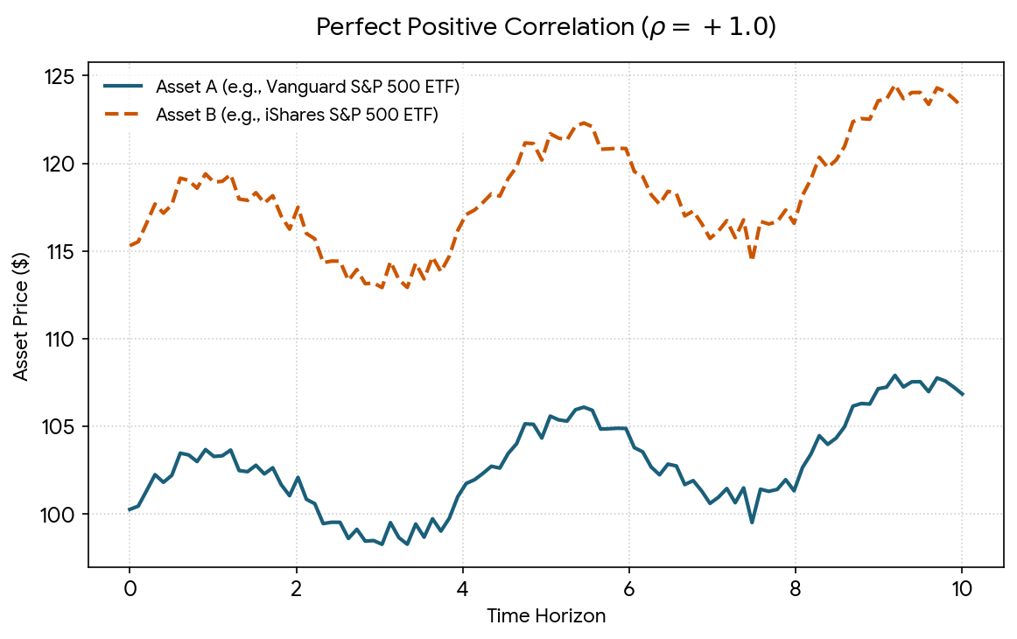
Correlation = 1
Perfect co-movement
No diversification benefit

Slide 9
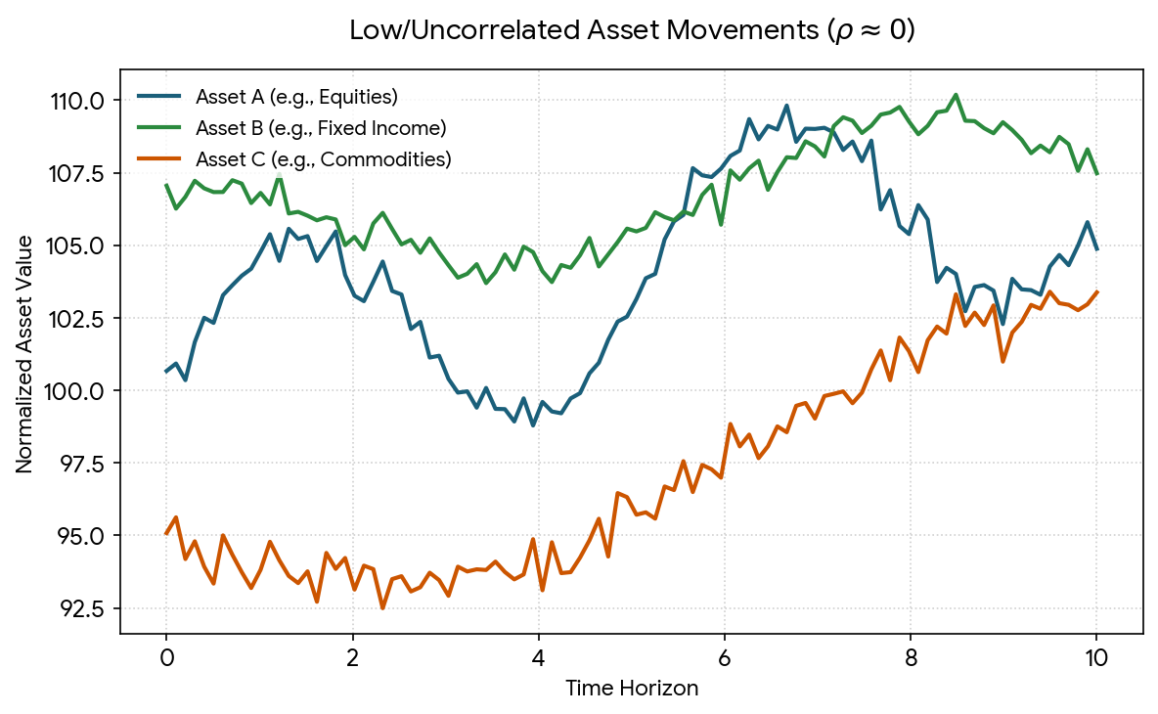
Low Correlation
Assets move differently
Better diversification

Slide 10
Portfolio Allocation
Capital allocation decisions
Determines portfolio behavior

Slide 11
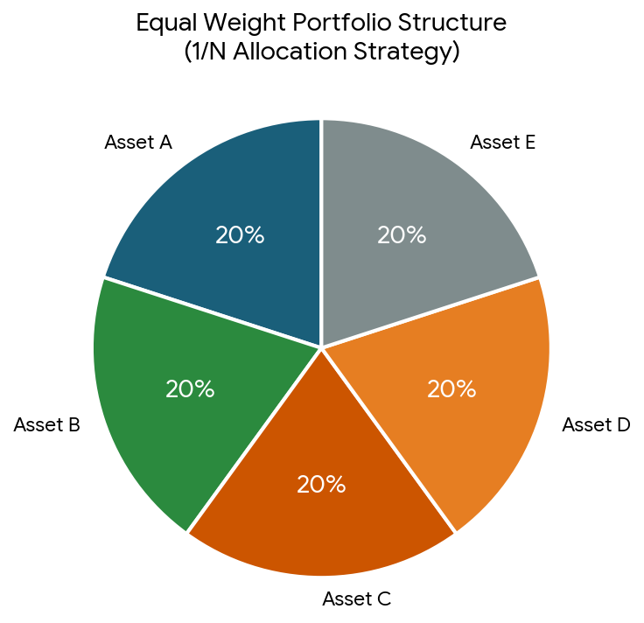
Equal Weight Portfolio
20%
20%
20%
20%
20%

Slide 12
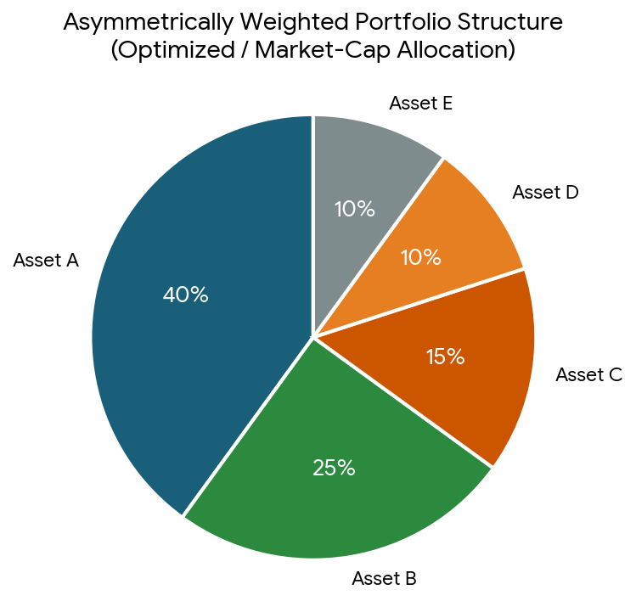
Weighted Portfolio
40%
25%
15%
10%
10%

Slide 13
Quiz
Add Visual Here
50% + 30% + 20% = ?

Slide 14
Portfolio Construction Pipeline
Add Visual Here
Assets → Returns → Weights → Portfolio → Performance

Slide 15
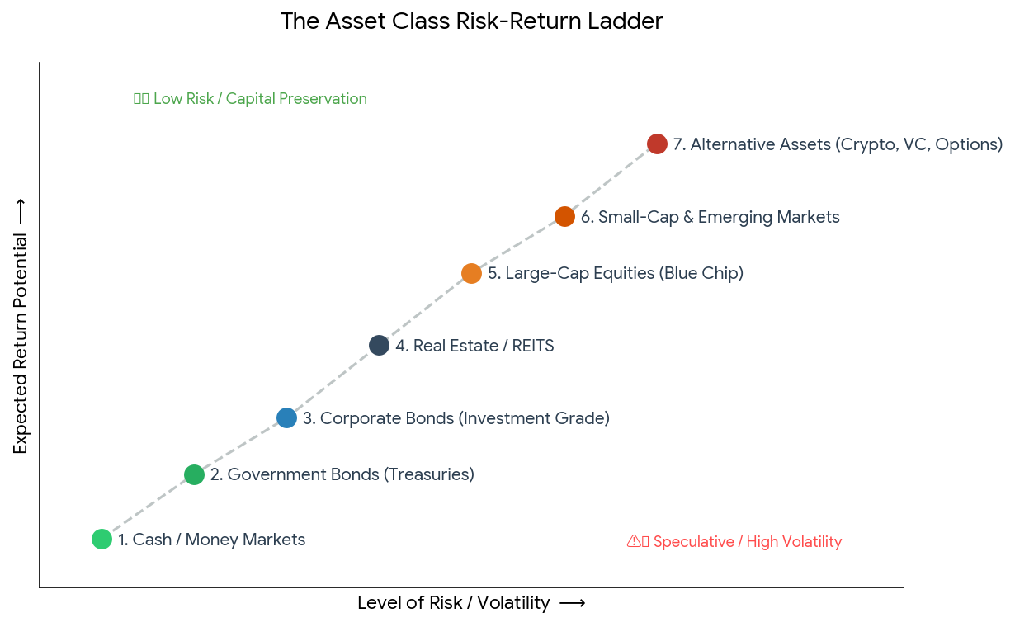
What Is Risk?
Risk = Uncertainty
Future outcomes unknown

Slide 16
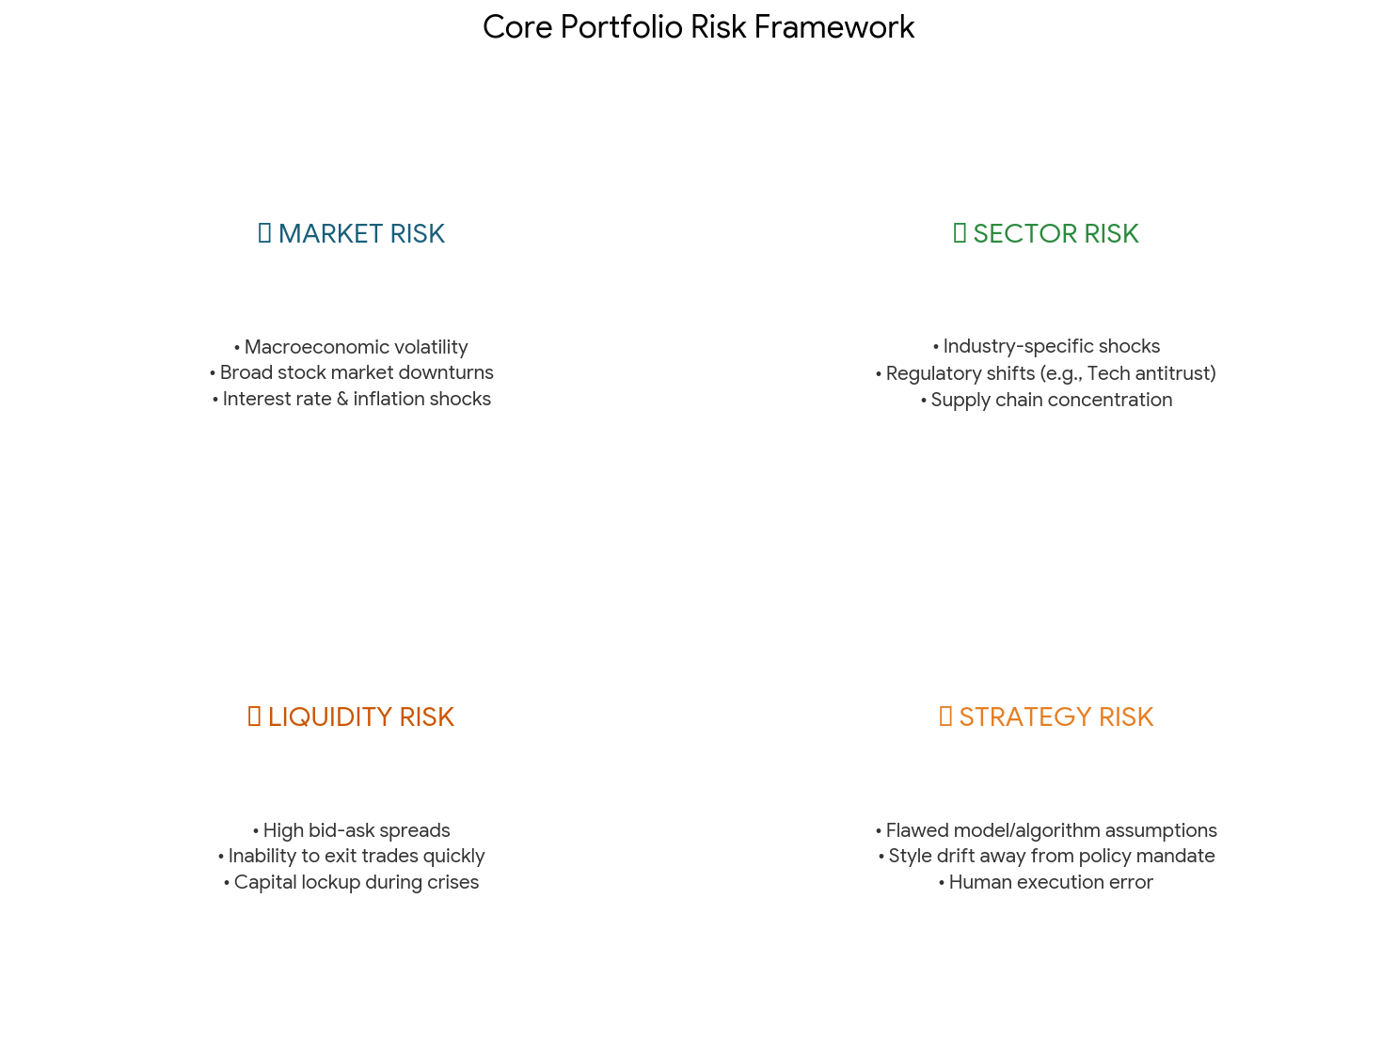
Types of Risk
Market
Sector
Liquidity
Strategy

Slide 17
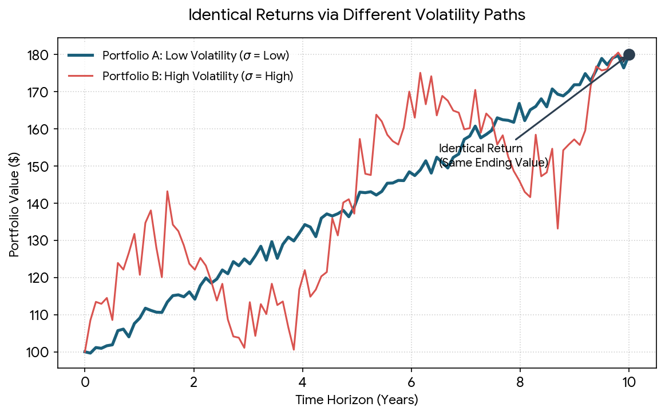
Volatility
Measures return variability

Slide 18
Why Volatility Matters
Higher volatility = higher uncertainty

Slide 19
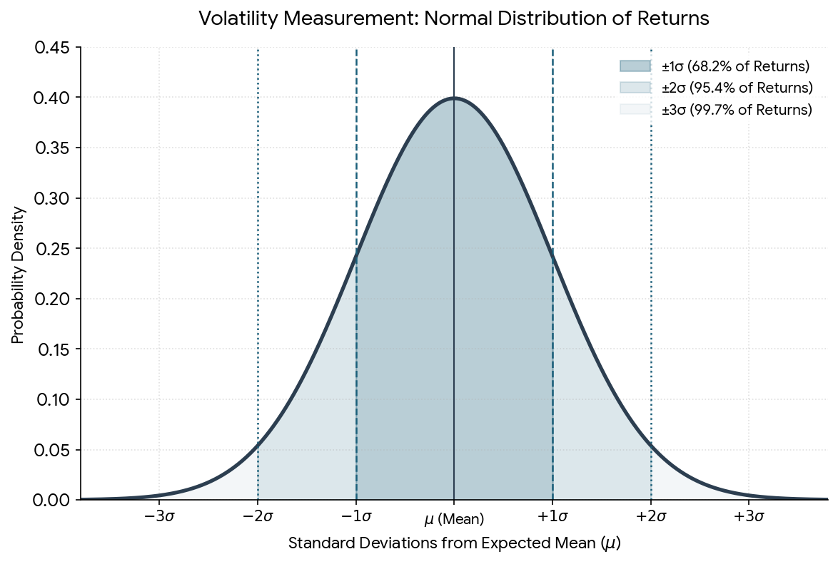
Measuring Volatility
Standard deviation of returns

Slide 20
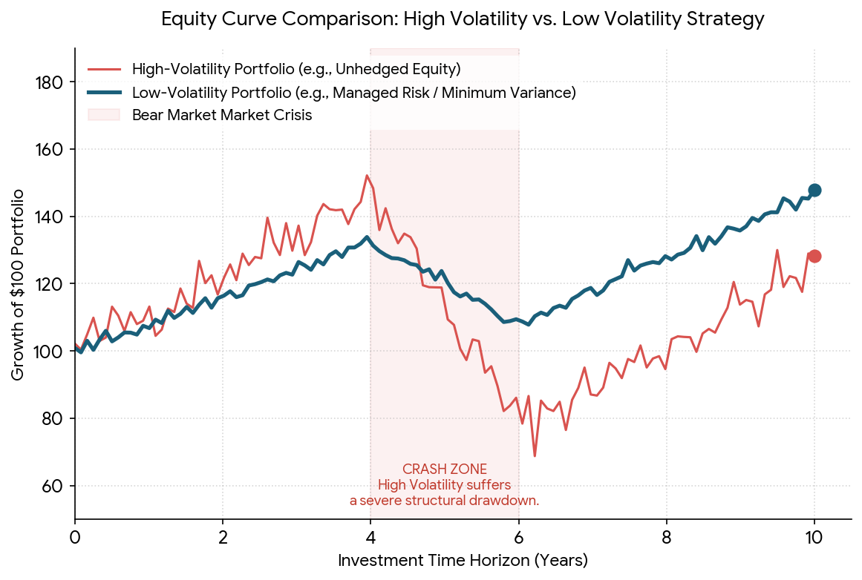
Volatility Example
Stable vs unstable portfolio

Slide 21
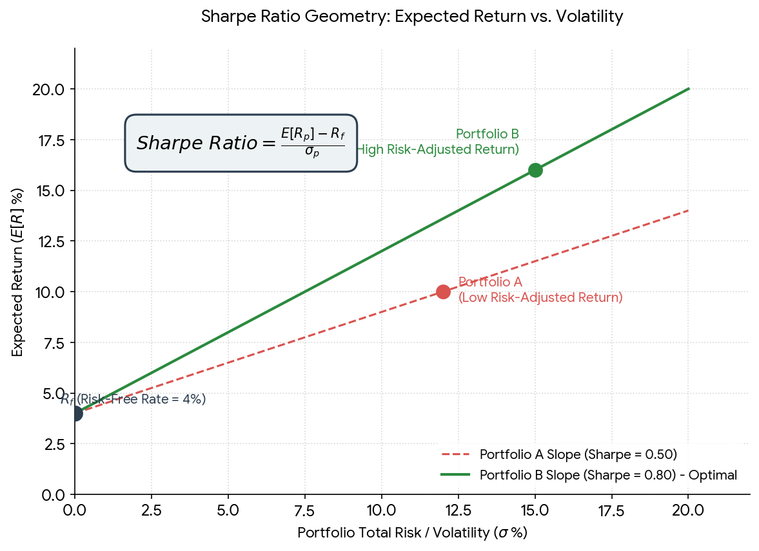
Sharpe Ratio
Return per unit risk

Slide 22
Sharpe Ratio Intuition
Higher Sharpe preferred

Slide 23
Sharpe Example
A: 10%/5%=2
B: 15%/15%=1

Slide 24
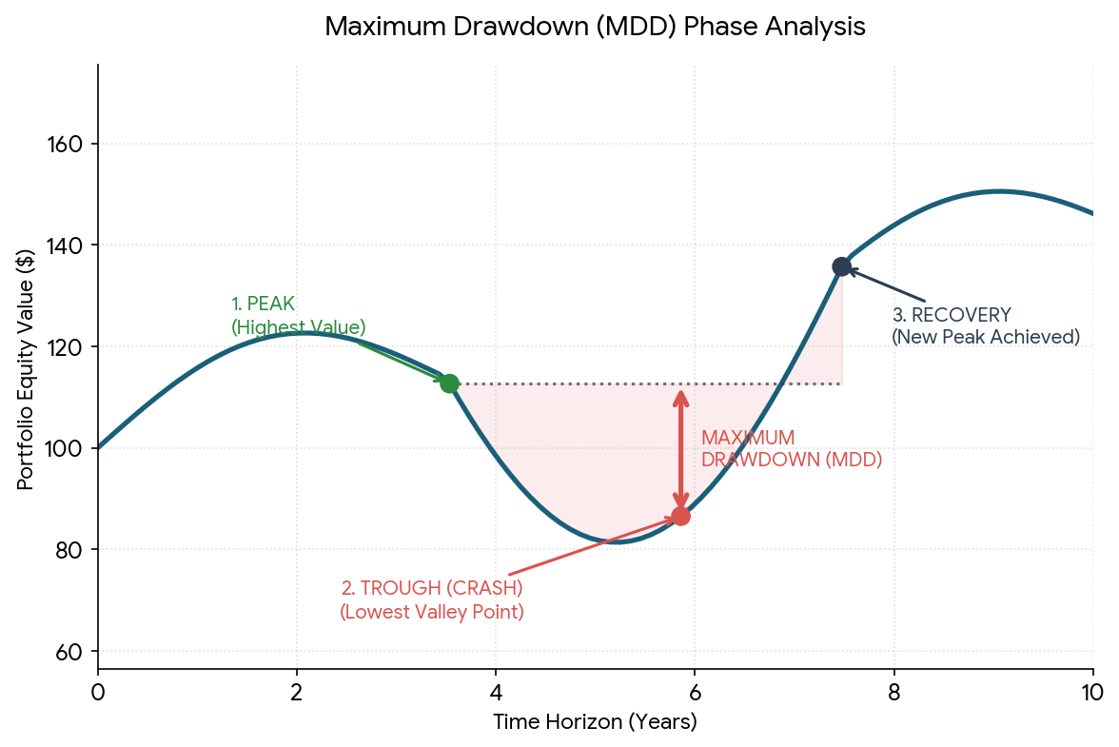
Maximum Drawdown
Largest peak-to-trough decline

Slide 25
Drawdown Example
Peak → Decline → Recovery

Slide 26
Win Rate
Winning trades / Total trades

Slide 27
Why Win Rate Misleads
High win rate ≠ profitable strategy

Slide 28
Quiz
Return=12%, Vol=6%, Sharpe=?

Slide 29
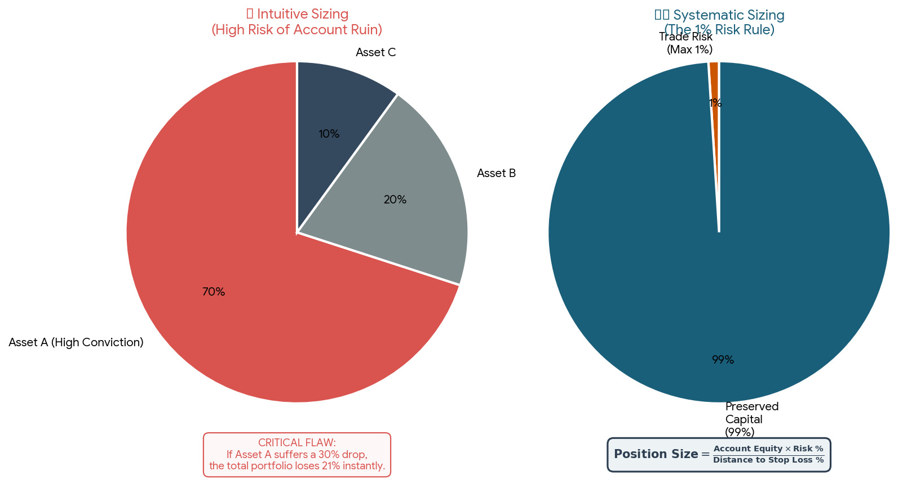
Position Sizing
How much should we buy?
Position Size X Stop Loss % = The dollar amount you want to risk

Slide 30
Capital Allocation Example
Capital ₹100,000
Allocation 10%
Position ₹10,000

Slide 31
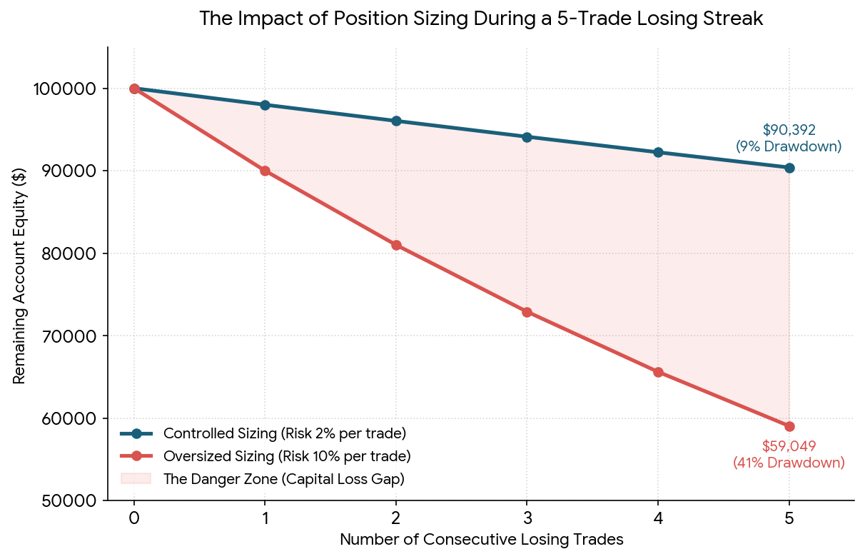
Why Position Sizing Matters
Good signal + bad sizing = bad outcome

Slide 32
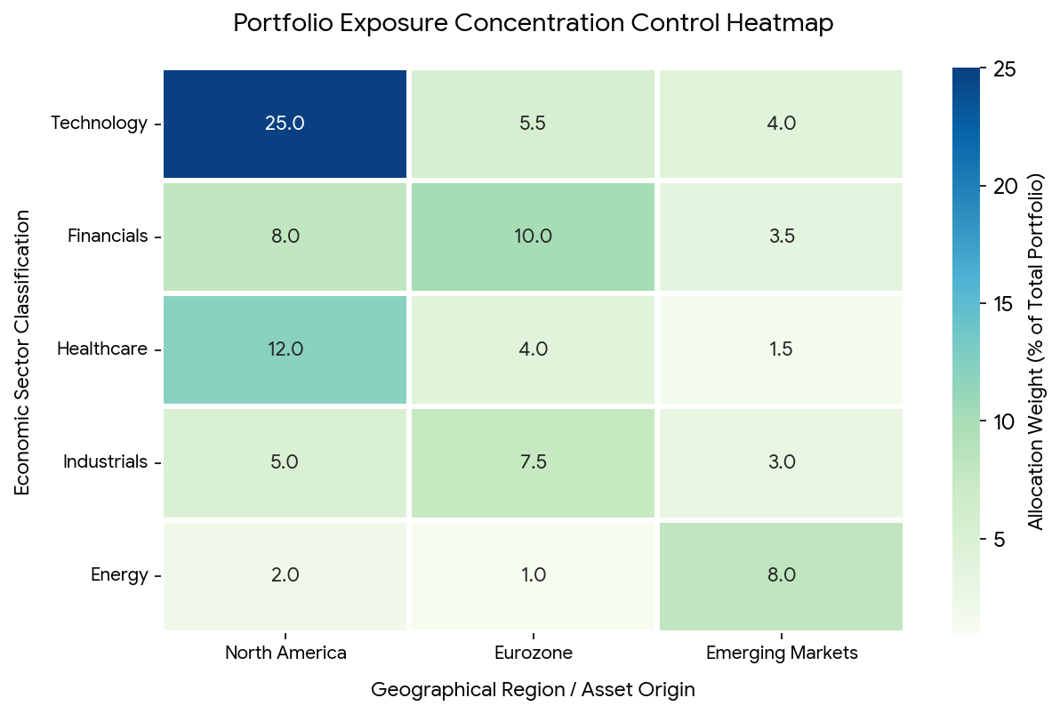
Exposure Control
Add Visual Here
Avoid hidden concentration

Slide 33
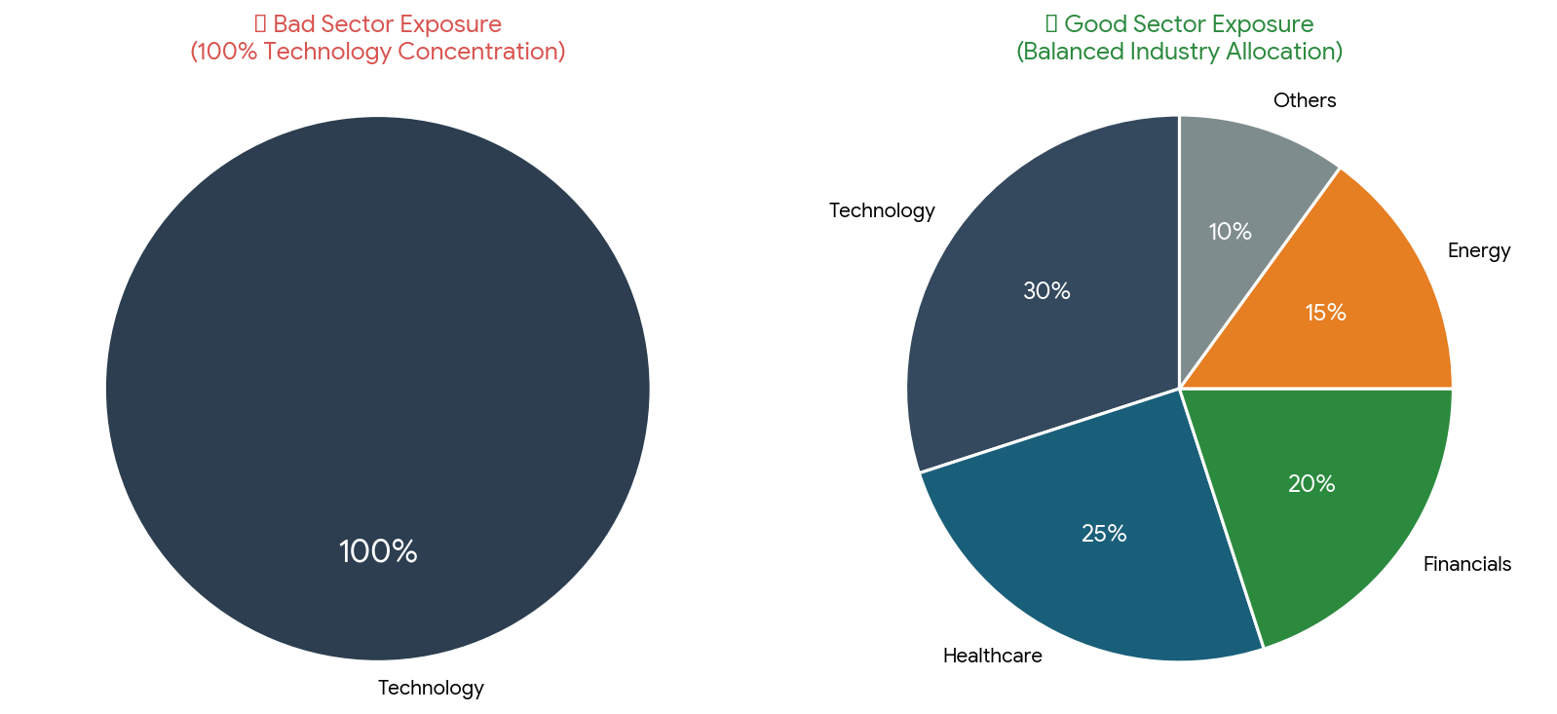
Sector Exposure
Technology
Healthcare
Financials
Energy

Slide 34
Position Limits
Max position size
Max sector exposure

Slide 35
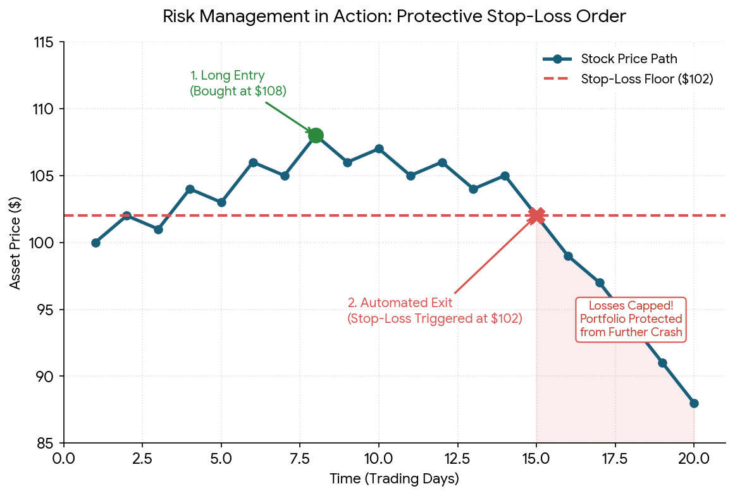
Stop Losses
Protect capital
Limit downside

Slide 36
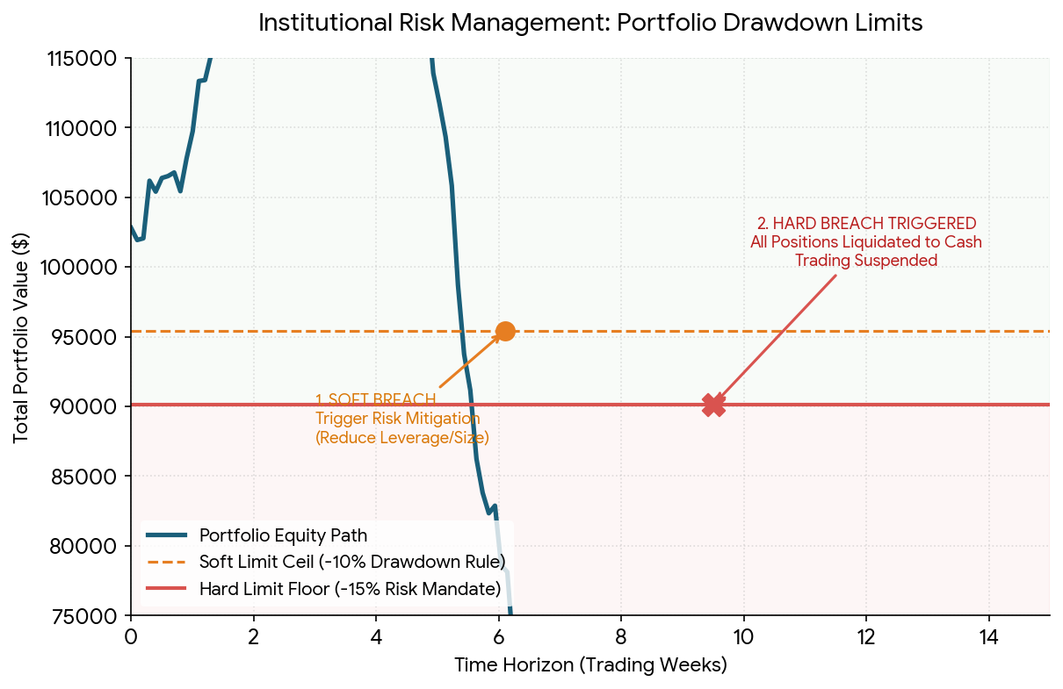
Portfolio Drawdown Limits
Reduce exposure
Preserve capital

Slide 37
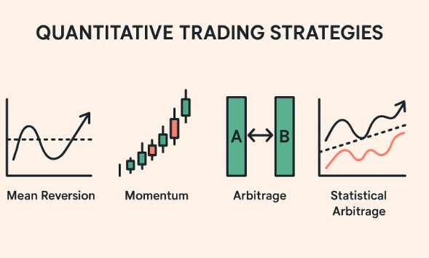
Combining Strategies
Momentum
Mean Reversion
Pairs Trading

Slide 38
Portfolio of Strategies
Diversify ideas
Reduce strategy risk

Slide 39
Industry Perspective
Risk Management
Exposure Monitoring
Stress Testing

Slide 40
Lab 1 Preview
Download Data
Correlation
Portfolio Construction

Slide 41
Lab 2 Preview
Volatility
Sharpe
Drawdown
Win Rate

Slide 42
Key Takeaways
Diversification Matters
Correlation Matters
Risk Matters
Position Sizing Matters
Risk Management Matters

