Slide 1





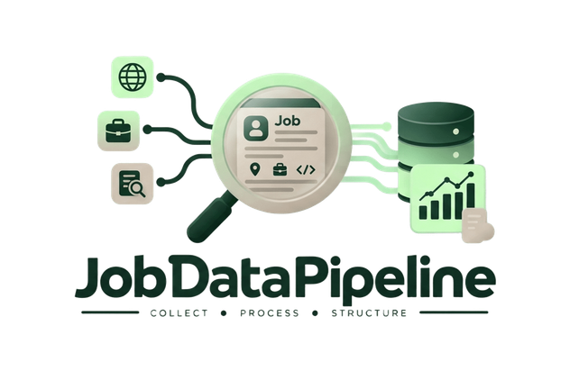

Tech Jobs Data Pipeline in KSA
Presented by Team C

Slide 2
Table of contents
01
Project Overview
02
Data Sources & Coverage
03
Data Collection & Ingestion
04
Challenges encountered
05
Pipeline Architecture
06
Data Cleaning & Transformation
07
Data Quality & Validation
08
Data Model & Design Decisions
09
Final Dataset
10
Downstream Applications

Slide 3
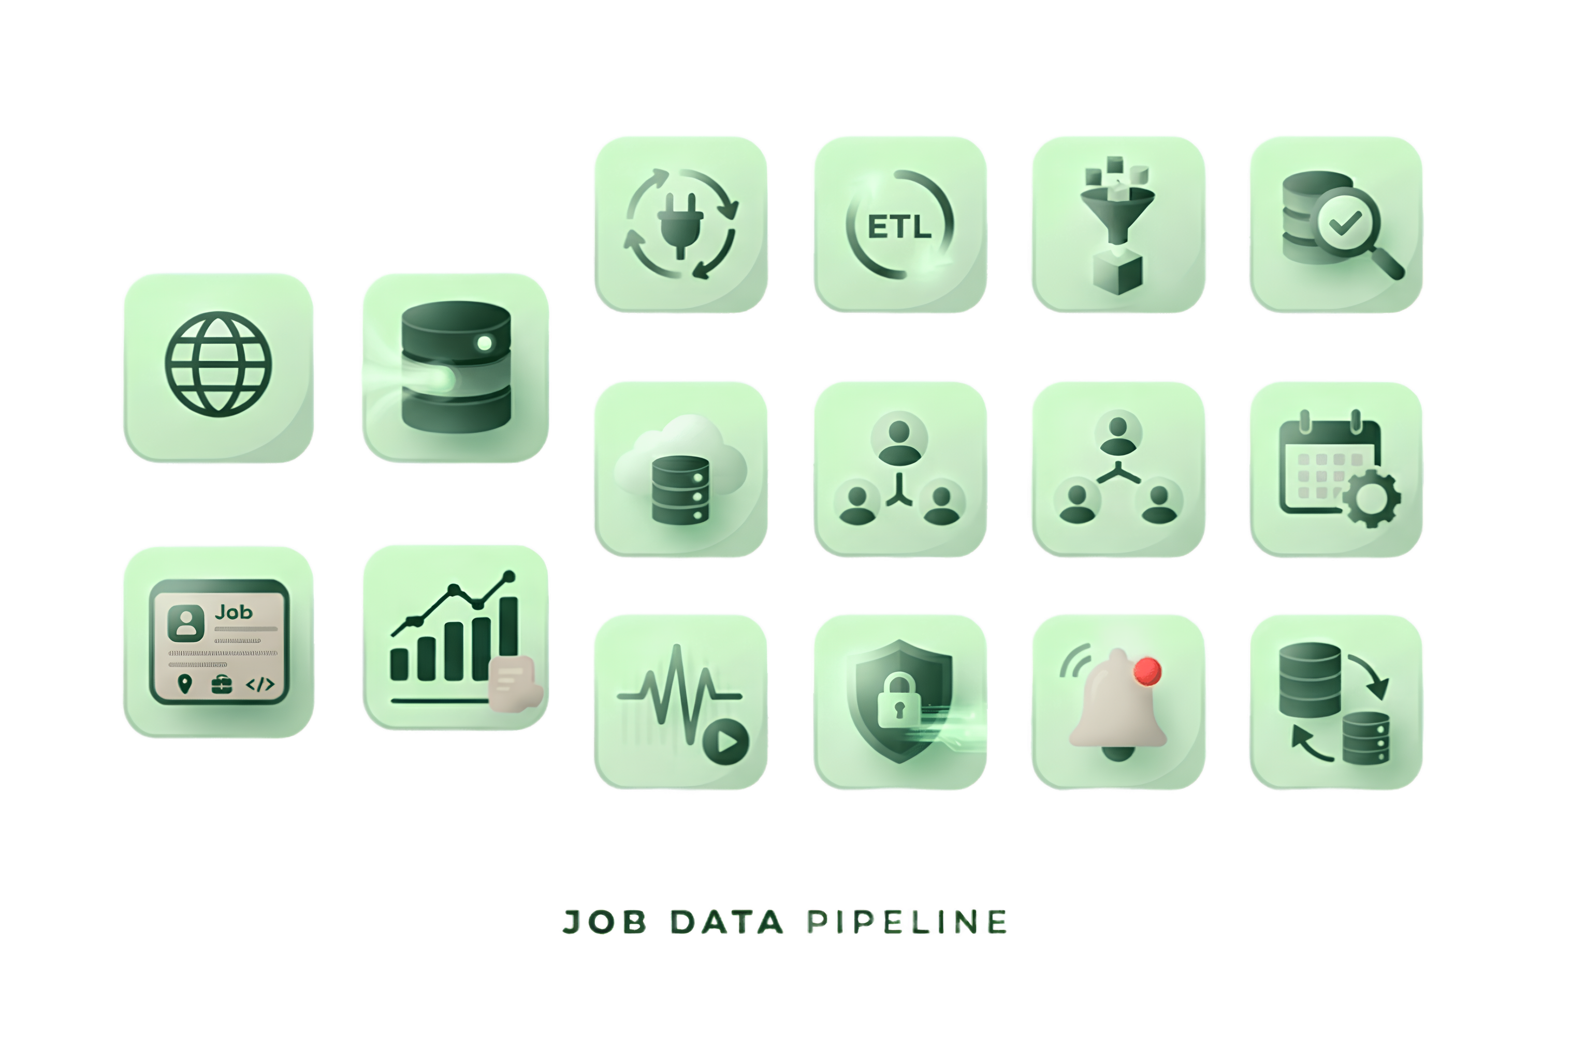
01
Project Overview

Slide 4

Project Overview
  A data pipeline that collects, cleans, and organizes job market listings
  Focus: Tech jobs in the Saudi Arabian market
  Solves the problem of scattered, inconsistent job data spread across multiple websites and platforms
  Turns raw, messy listings into clean, structured, reliable data
  Enables analysis of hiring trends: in-demand skills, active companies, and job distribution across cities

Slide 5
02
Data Sources & Coverage

Slide 6




Data Sources
Jsearch
tanqeeb
Jooble
Freehire
tapneo

Slide 7

Region of Project
  Geographic Focus: Saudi Arabia
  Why Saudi Arabia: growing tech/data job market, Vision 2030 digital transformation initiatives, underrepresented in existing datasets
  Regional relevance for local CV-matching applications
KSA

Slide 8
03
Data Collection & Ingestion

Slide 9
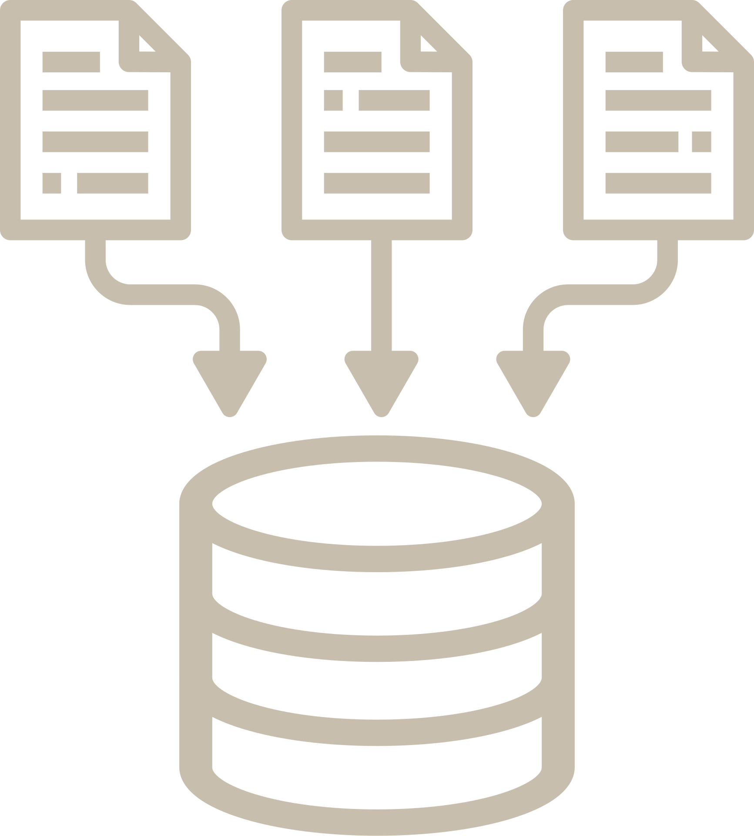
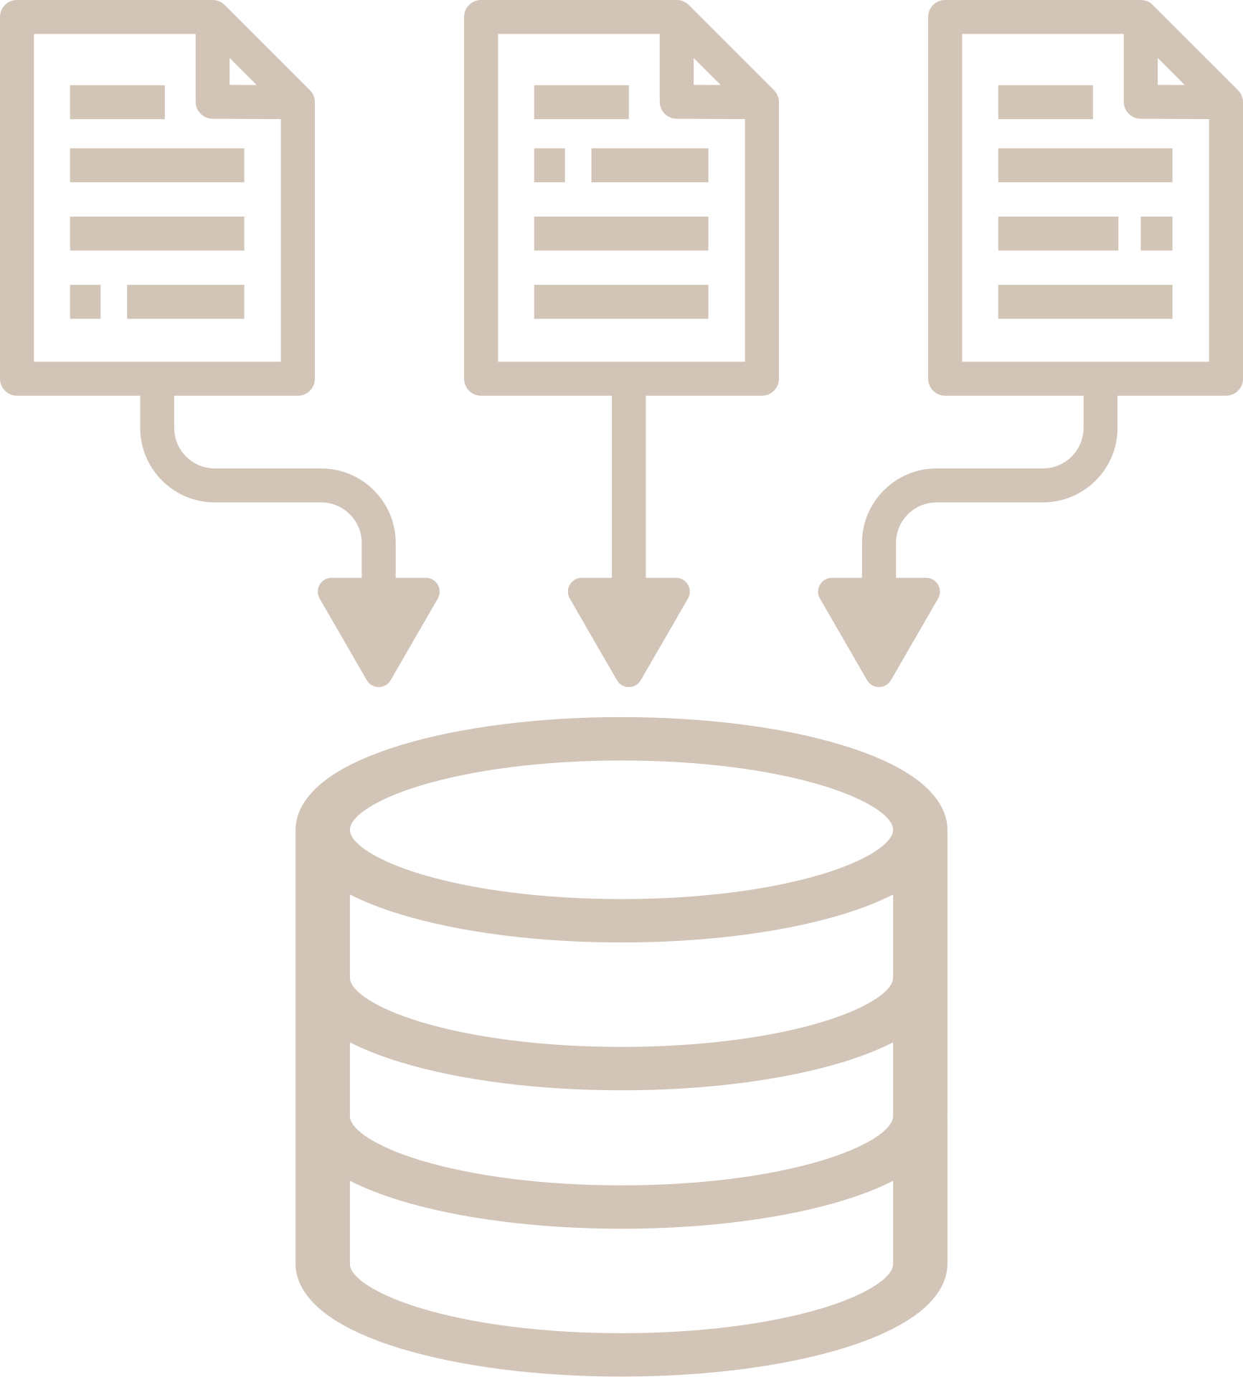

DA
TA
Data Collection & Ingestion
Collection
Ingestion
  Python scripts pull from 4 sources (APIs + scraping)
  Scheduled runs, automatic retry on failure
  Raw data lands in Azure Data Lake
  Connected Azure Data Lake Storage (ADLS) to Snowflake to seamlessly load data

Slide 10
04
Challenges encountered

Slide 11

Challenges encountered
DA
TA
Data Extraction Challenges :
API Rate Limits ( API quota restrictions )
Data Cleaning & Modeling :
Hidden Duplication in Jooble ( Text truncation causing duplicate rows )
Skill Name Variations ( Scattered skill synonyms )
Missing Essential Values ( Null values in key attributes )
Tanqeeb Platform Issues ( Arabic text parsing )
Data Fan-Out Prevention ( Row inflation in Fact tables )
Challenges
Pipeline Orchestration :
Private Repository Access
  Prefect access control
Local vs. Cloud Execution
  Decoupling code execution from local machines

Slide 12
05
Pipeline Architecture

Slide 13
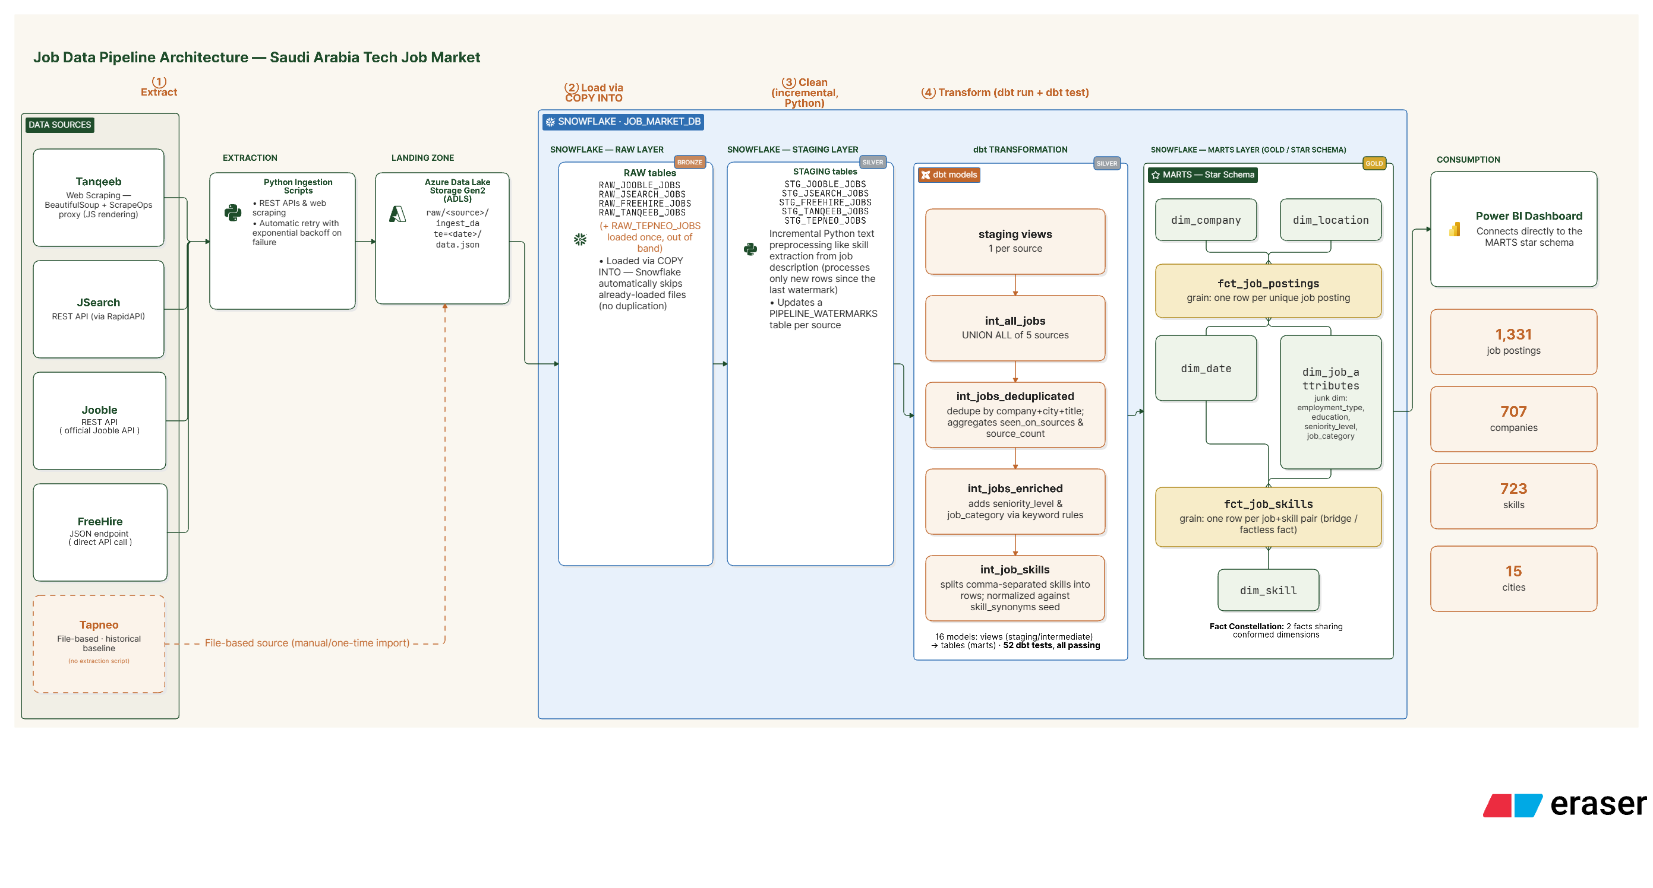
Pipeline Architecture

Slide 14

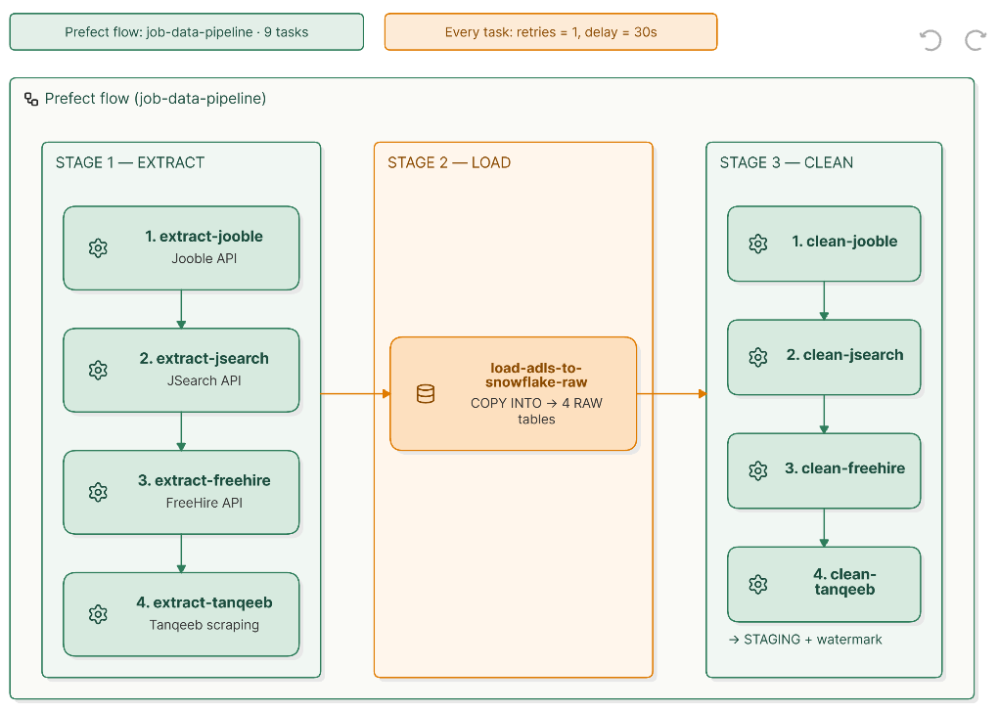
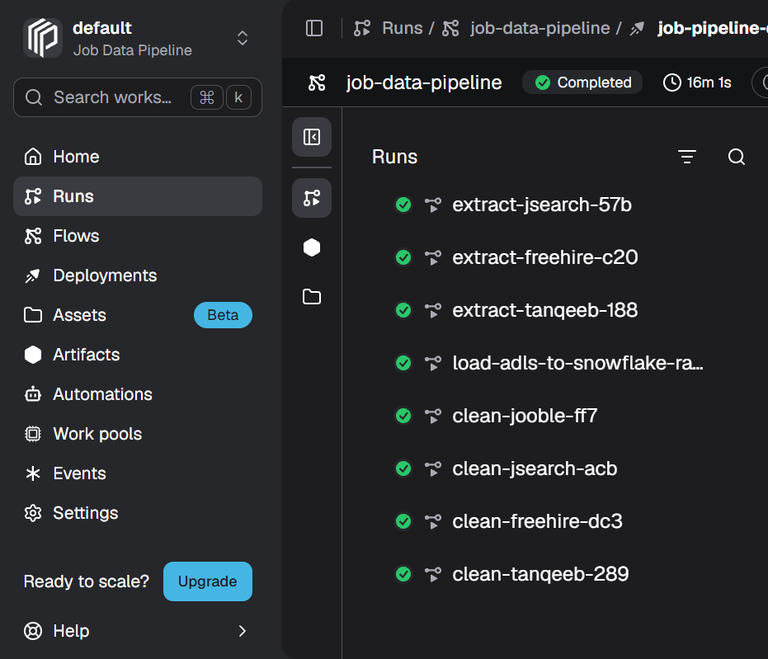
Orchestrator — Prefect Flow (job-data-pipeline)

Slide 15
06
Data Cleaning & Transformation

Slide 16







Data Cleaning & Transformation
| From raw postings to 1,331 trusted jobs
  UNION ALL 5 sources
  Deduplicate across platforms
  (company+city+location+country+title)
  Categorize jobs & Standardize skills
  Build a star model
  Quality testing
  Filter non-Tech jobs
  strip HTML
  Arabic / English Text normalizatoin
  Standarized company / city / data
  Extract 300+ tech skills
Sources
Python Initial Cleaning
SNOWFLAKE STAGING
dbt Transform
Analytics-Ready Data
5 Sources FREEHIRE,JOOBLE
JSEARCH, TANQEEB, TEPNEO
  Loading structured data to 5 STG tables.
  Unified schema (10 cols).
  CSV + snowflake dual save.
  The data is now ready for more advanced processing using dbt.
Final GOLD: 1,331 Jobs Ready for BI

Slide 17
07
Data Quality & Validation

Slide 18


Data Quality & Validation
DA
TA
1. Completeness
  Verification: 22 not_null tests PASS (Company, Title, Location, skill_name, job_posting_key)
  Missing Values: 0 - Standardized as Unknown / Not Specified
  Integrity: 52 data tests 100% PASS in 34.69s
100%
2. Uniqueness
  1 Job = 1 Row (fct_job_postings 1,331)
  No duplicate Primary Keys - unique tests PASS
  Grain: One Row Per Job Posting
  Deduplication verified: company+city+title unique combination PASS
69/69 TESTS PASSED
0 errors • 0 warnings
3. Referential Integrity
  Every job linked to valid dim
  The fact is linked to: Company | Location | Date | Job Attributes | Skills
  10 relationships tests PASS - No orphan records
  Verified: 15 locations, 78 attributes, 707 companies, 723 skills
  Star Schema validated
•1,331 jobs
• 7,883 skill links
• 723 skills
4. Business Rules
  Value Validation: Employment Type, Seniority, Category - accepted_values PASS
  Accepted Values Only
  Level Standardization: Fixed grain per job posting
  Skill Standardization: 10 synonyms seed - Skill Normalization & Synonyms
  Result: Standardization of 78 job categories + deduplication across 5 sources

Slide 19
08
Data Model & Design Decisions

Slide 20





DATA MODEL - LOGICAL STAR
(CONFORMED DIMENSIONS)
FCT_JOB_POSTINGS
(1,331 rows) • central fact
Grain: company + city + country + location + title
Keys:
• job_posting_key PK
• company_key• location_key
• job_attributes_key
• date_key
CONFORMED DIMENSIONS
Job_posting_key FK (Drill Across)
Dim_company (707)
Dim_Location(15)
FK
  location key PK
  Company_key PK
FCT_JOB_SKILLS
(7,883 rows) • Factless Bridge
LOGICAL FK
LOGICAL FK
Grain: 1 Job-Skill Pair
Keys:
• job_posting_key
• skill_key
• company_key
• location_key
• job_attributes_key
• date_key
Dim_Data
(1461 - Unknown)
Dim_Job_Attributes(78)
  date_key PK
  job_attributes_key PK
Dim_skill(723)
  Skill_key PK
Design Decision: Conformed Dimensions allow filtering both facts by Company / Location / Attributes / Date. No need to JOIN facts.Sub-footer: All dimensions are conformed — shared across both fact tables for consistent analysis.

Slide 21
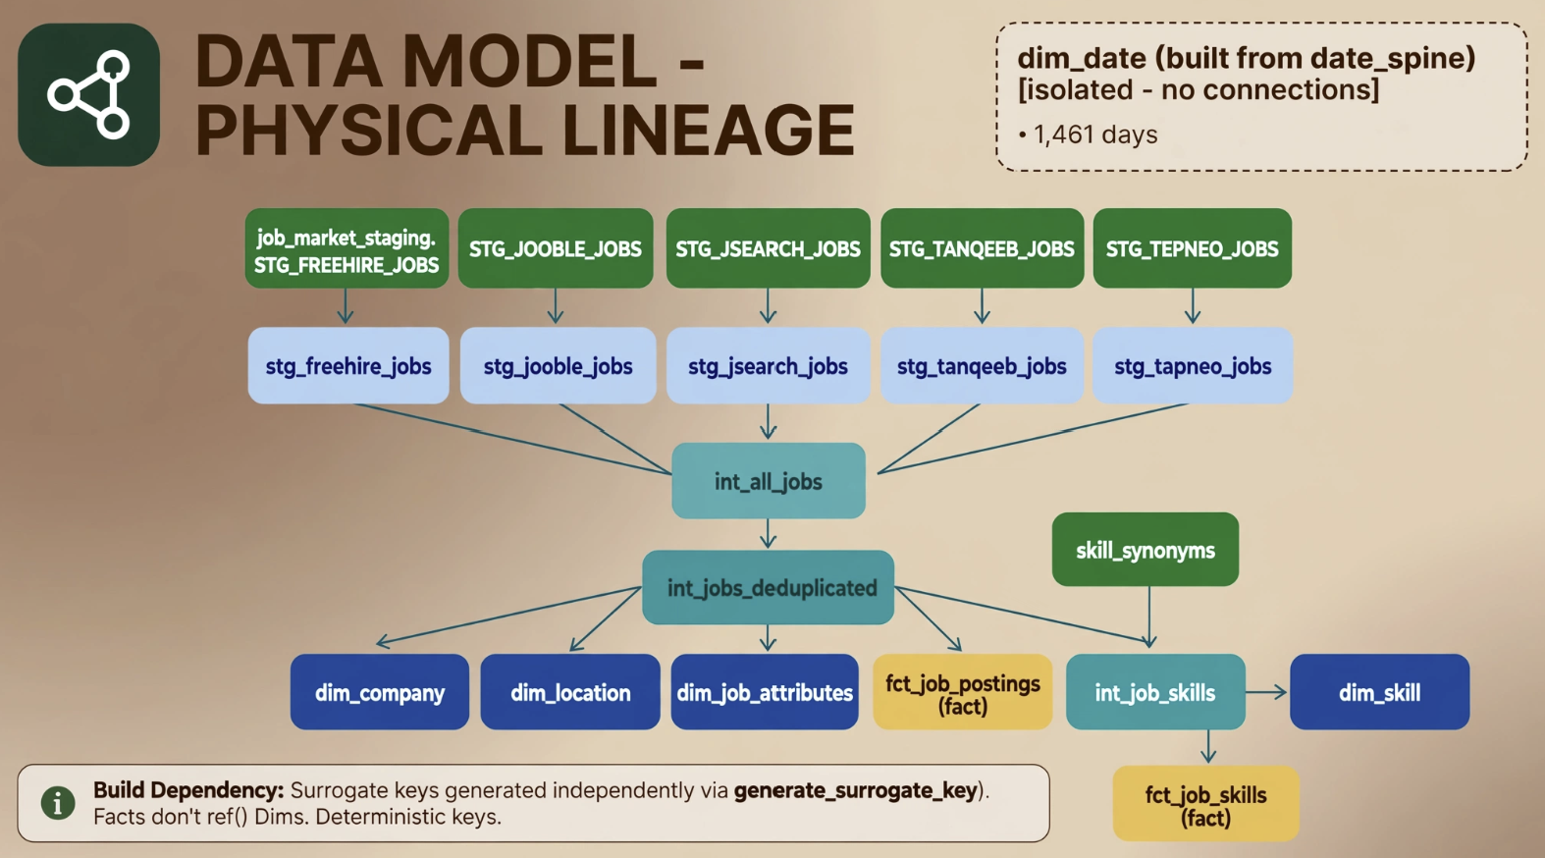

Slide 22
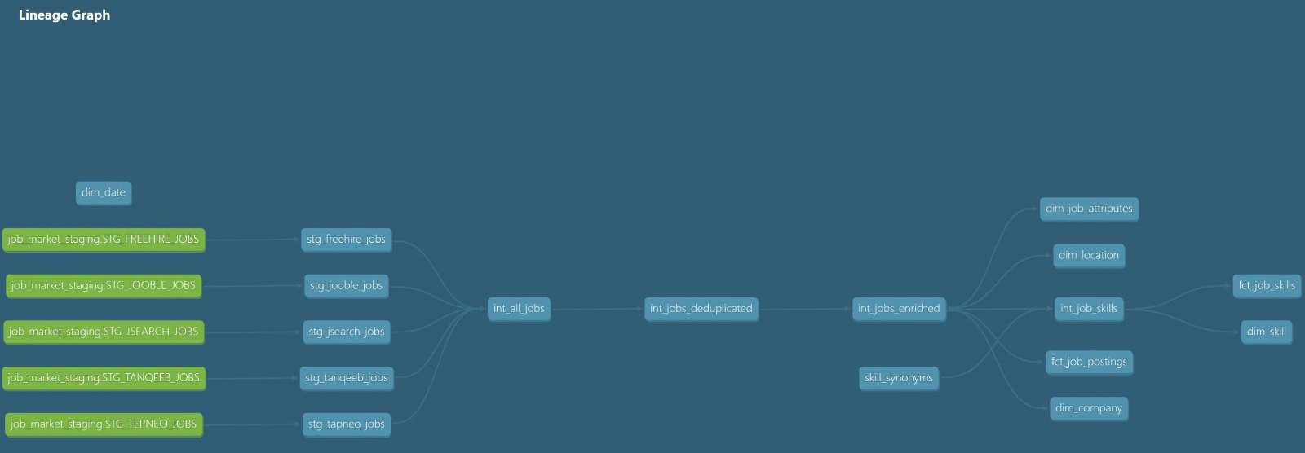
Data Lineage – End-to-End Data Flow

Slide 23
09
Final
Dataset

Slide 24
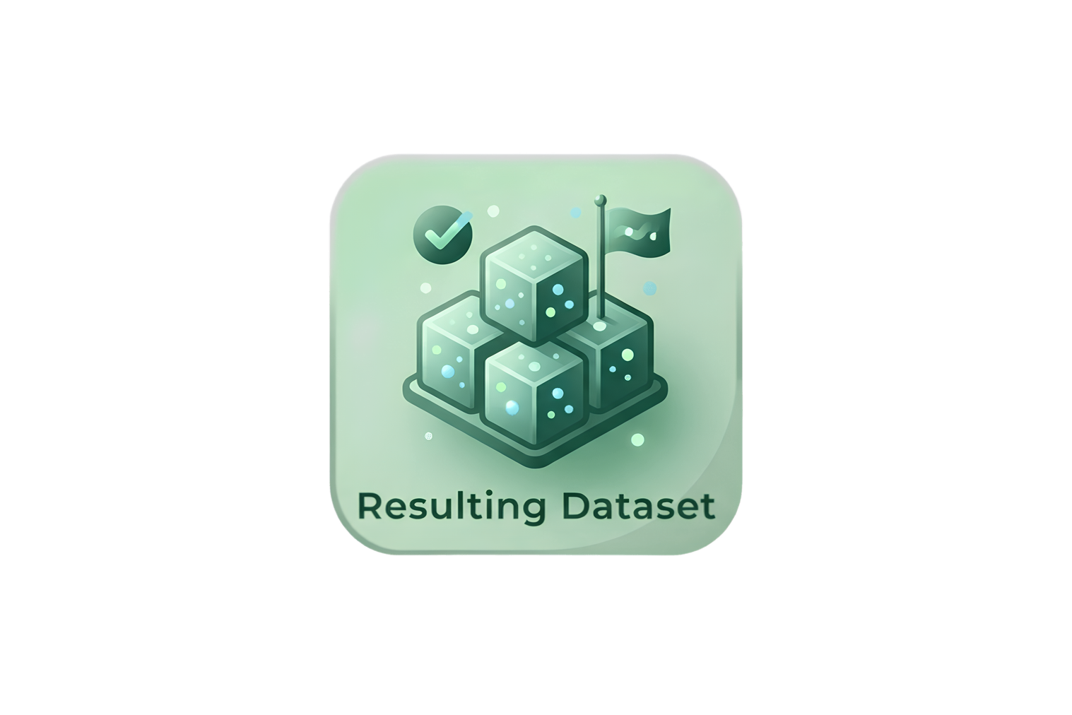
Final Dataset
1,331
723
UNIQUE JOB POSTINGS
TECHNICAL
SKILLS
707
15
COMPANIES
CITIES
7 Curated Mart Tables | Ready for Analytics & Visualization

Slide 25
10
Downstream Applications

Slide 26
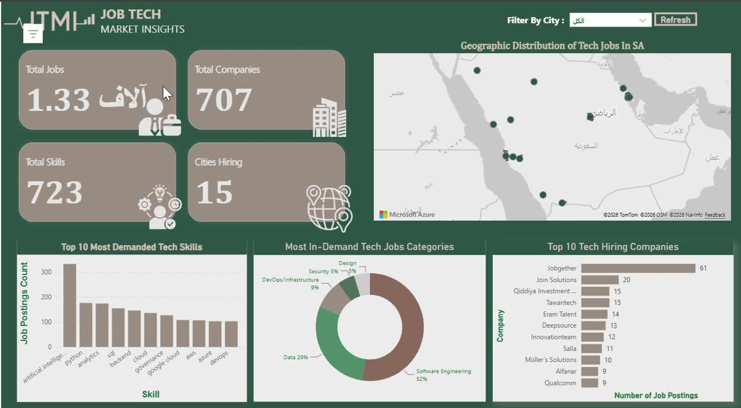
Downstream Application Interactive Dashboard

Slide 27

Job Recommendations
Job Market Analytics
AI-Powered Applications
Job Search
Potential Downstream Applications

Slide 28




Thank You
Saudi Tech Job Market Insights
Our Team
Ghala Alsalem
Muradi Almutairi
Mohammed Alharbi
Lamia Alsuhibani

