Slide 1
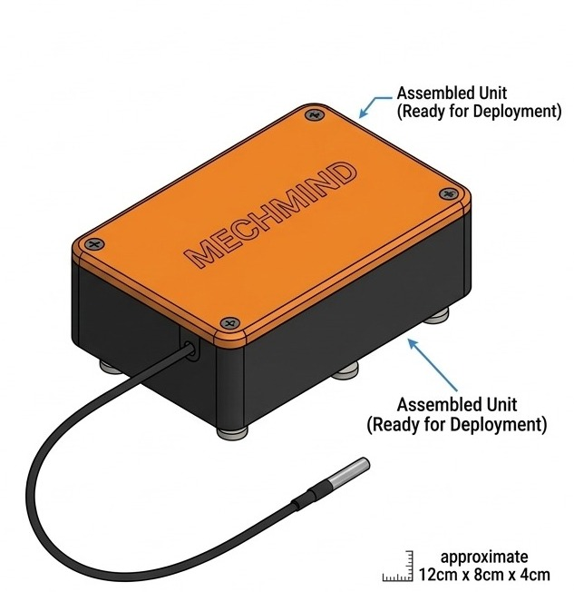
MLH HACK DAY 2026
MechMind AI
Powered by Google Gemma 4
On DigitalOcean
An edge-first Gemma 4 copilot, fed by a $25 magnetic sensor node, that diagnoses heavy machinery over WhatsApp: offline in the field, scaled in the cloud.
Oni Mujeeb Ramadan · Mubarak Raji Babatunde · Olawale Oladele
Lagos State University
github.com/DevMubarak1/mechmind-ai · MIT License
Notes:
0:00–0:15 (Ramadan). Hold up the physical ESP32 node. “This little $25 box stops multi-million naira tractors and excavators from dying on African farms, and the brain behind it is Google Gemma 4.”

Slide 2
THE PROBLEM
One breakdown can strand a machine for weeks
$1.2B
$15,000
2–3 weeks
lost every year to heavy machinery downtime across Africa
for an OEM diagnostic tool such as Cat ET
is the whole planting or harvest window
Rural mechanics have no scan tools, so minor sensor faults get misdiagnosed as engine replacements.
Caterpillar, John Deere and Komatsu lock diagnostics behind proprietary hardware.
One failed hydraulic pump or bearing can spoil a harvest. Farm sites often have only 2G/3G, or nothing.
MechMind AI · Powered by Google Gemma 4 · github.com/DevMubarak1/mechmind-ai
2
Notes:
0:15–0:35 (Ramadan). “Heavy machinery downtime costs Africa over $1.2 billion a year. When an excavator breaks down in rural Nigeria, the OEM diagnostic tool costs $15,000, the nearest technician is hours away, and the harvest window is only two to three weeks.” Hand over to Olawale; Ramadan moves to the laptop.

Slide 3
HOW MECHMIND WORKS
Gemma 4 is the brain of the system
FASTAPI BACKEND · DEPLOYS TO DIGITALOCEAN
ESP32 NODE-001
ChromaDB RAG
WhatsApp copilot
Vibration, temperature and sound features every 2 s
1,200+ pages of Cat, Komatsu, Perkins and XCMG manuals
Cause, tools and repair steps in about 3 s
Safety code pinning
Critical SAE J1939 codes get verified shutdown steps
Mechanic on WhatsApp
Fleet dashboard
Symptoms in their own words, or a photo of the damage
Live gauges, SSE alerts and copilot chat
Google Gemma 4
Edge: gemma4:e2b on Ollama · Cloud: Gemini API
MechMind AI · Powered by Google Gemma 4 · github.com/DevMubarak1/mechmind-ai
3
Notes:
0:35–0:55 (Olawale). “Gemma 4 is the brain. Sensor readings, mechanics’ questions and photos come in. We pull the matching pages from OEM service manuals, pin safety checklists for anything critical, and Gemma 4 writes the answer: on the device with gemma4:e2b, or through the Gemini API across a fleet. Here’s the hardware that feeds it.”

Slide 4
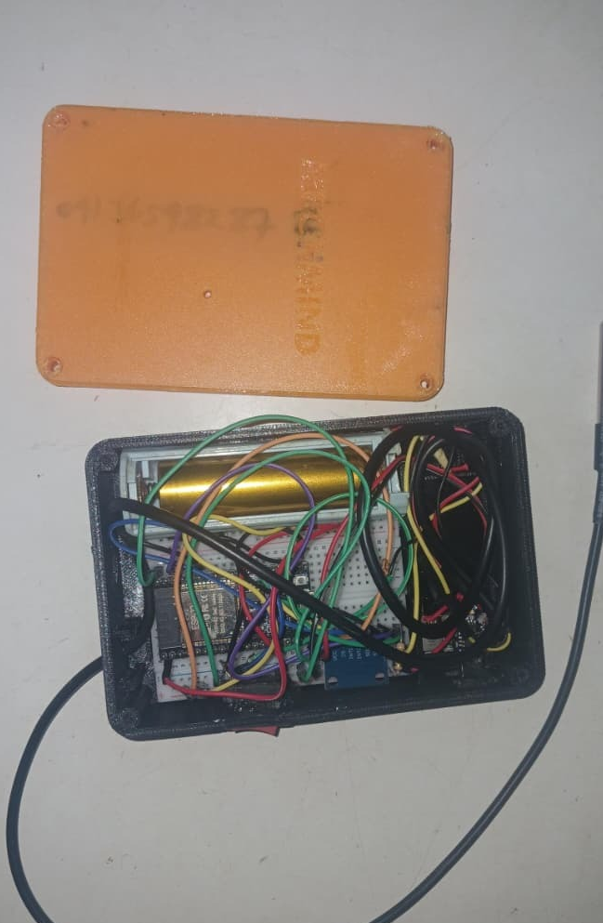
THE SENSOR NODE
Gemma’s eyes and ears
ESP32-WROOM-32
Dual-core 240 MHz MCU with Wi-Fi/BLE. Runs the edge signal processing.
ADXL345 accelerometer
3-axis vibration at 800 Hz: RMS and peak-to-peak for unbalance and bearing wear.
DS18B20 temperature probe
Waterproof, ±0.5 °C. Tracks rate of rise to catch overheating before seizure.
INMP441 mic + 18650 cell
Acoustic cavitation detection. 2600 mAh Li-ion with TP4056 charging, 48+ hours in the field.
Neodymium magnet mount · 25 kg pull · attaches in 30 s
Notes:
0:55–1:10 (Olawale). Show the magnet base on the real node. “An ESP32, a 3-axis accelerometer, a temperature probe and a microphone, on a magnet. It goes on any engine block in 30 seconds with no wiring into the CAN bus, so the warranty is untouched.”

Slide 5
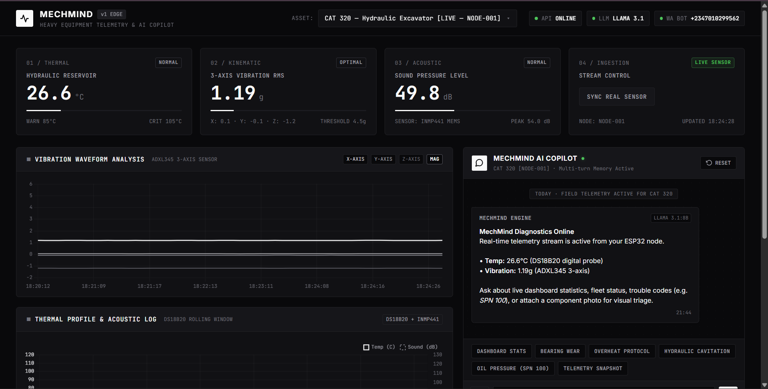
LIVE DEMO 1
Live telemetry gives Gemma 4 real context
2 s
between readings, so Gemma always answers from the machine’s current state
99.88%
less cellular data: 1.6 MB/min of raw samples becomes 3.6 KB/min
< 1 s
to push critical alerts to the screen over Server-Sent Events
MechMind AI · Powered by Google Gemma 4 · github.com/DevMubarak1/mechmind-ai
5
Notes:
1:10–1:40 (Olawale; Ramadan runs the laptop). LIVE DEMO: Ramadan switches to the dashboard on http://localhost:8080. “This is live. The charts refresh every two seconds.” Shake the node so the audience sees the vibration spike. “The ESP32 does the maths on the chip, so we send 3.6 KB a minute instead of 1.6 MB, and that summary is exactly what Gemma 4 reads. Here’s what Gemma does with it.” Ramadan switches back to the slides.

Slide 6
GROUNDED AND SAFE
Gemma 4 answers only from OEM manuals
Alert or question
Retrieve
Pin safety
Gemma 4
A telemetry anomaly fires, or a mechanic texts a symptom or photo.
ChromaDB searches 1,200+ manual pages, split into 500-token chunks.
Critical SAE J1939 codes (e.g. SPN 100 FMI 1, low oil pressure) put shutdown steps first.
Writes the plain-language answer, grounded only in what was retrieved.
75.0%
0.0%
1,200+
benchmark diagnostic accuracy
safety hallucination rate
pages of OEM service manuals
MechMind AI · Powered by Google Gemma 4 · github.com/DevMubarak1/mechmind-ai
6
Notes:
1:40–1:55 (Olawale). “Gemma 4 doesn’t guess. We use retrieval, not fine-tuning: it gets the matching excerpts from 1,200+ pages of Caterpillar, Komatsu, Perkins and XCMG manuals, and critical fault codes are pinned to verified shutdown steps at the top of its prompt. In our 56-case benchmark: 75% accuracy and zero safety hallucinations.”

Slide 7
GEMINI API + DIGITALOCEAN
Edge, cloud and DigitalOcean: one Gemma 4 engine
EDGE · IN THE FIELD
CLOUD · ACROSS THE FLEET
DEPLOY · DIGITALOCEAN
gemma4:e2b
Gemini API
App Platform
Runs on Ollama, offline
Fleet-wide batch processing
digitalocean-app.yaml
No recurring API charges
High-throughput workloads
setup_droplet.sh: live in < 2 min
Answers the mechanic on site
Same grounded prompts
Hermes + GPU Droplets
Under $2/month
per machine to monitor a fleet on DigitalOcean.
MechMind AI · Powered by Google Gemma 4 · github.com/DevMubarak1/mechmind-ai
7
Notes:
1:55–2:10 (Olawale). “In the field, gemma4:e2b runs offline on Ollama, with no API bill. Across a fleet, the backend calls the Google Gemini API for batch work. And the whole stack deploys to DigitalOcean: an App Platform spec and a Droplet script that pulls Gemma 4 and goes live in under 2 minutes, for under $2 a month per machine.”

Slide 8
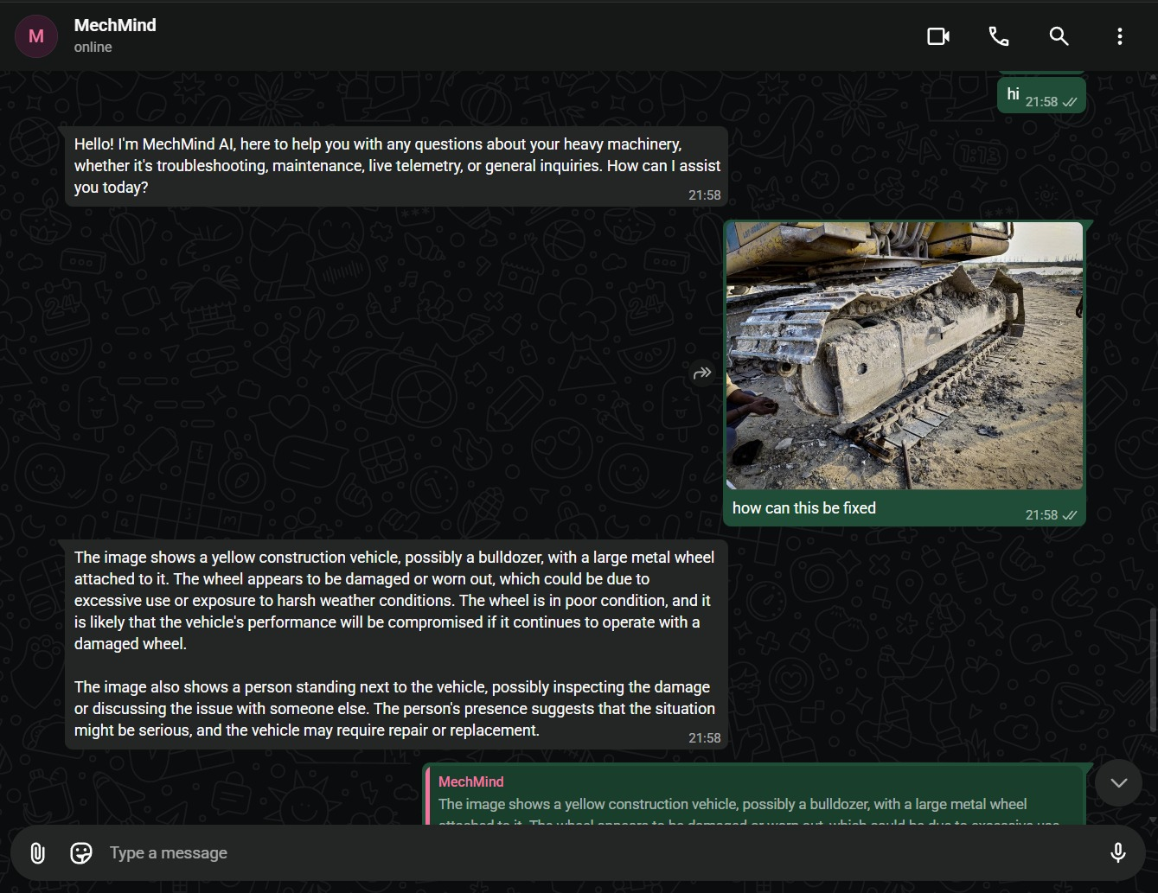
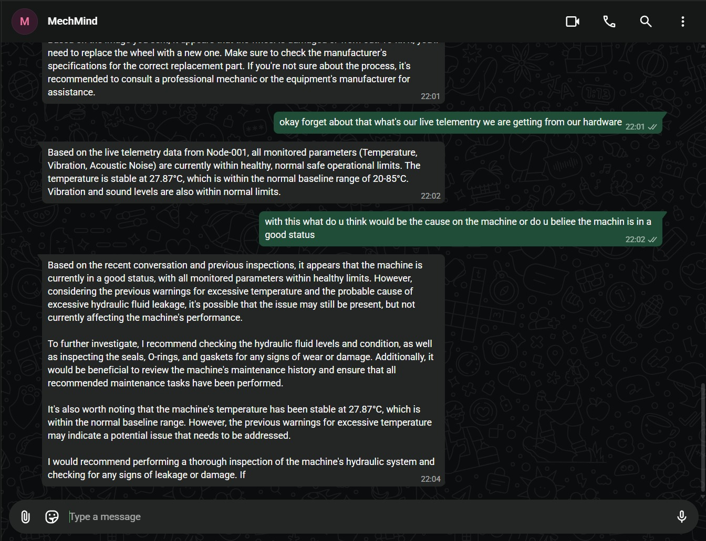
LIVE DEMO 2 · FIELD DELIVERY
Gemma 4 answers right inside WhatsApp
95%
of African mechanics already use WhatsApp daily. No app, no login.
Text a symptom
“Hydraulic pump makes a high-pitched whine and temp is 88 °C”: cause, wrench sizes and steps in about 3 s, using NODE-001’s live readings.
Send a photo
Gemma 4 reads images too: snap the damaged part and get a diagnosis and next steps.
MechMind AI · Powered by Google Gemma 4 · github.com/DevMubarak1/mechmind-ai
8
Notes:
2:10–2:45 (Olawale narrates, Ramadan sends from the phone). LIVE DEMO: Ramadan sends “Hydraulic pump vibrating heavily with temperature at 85C”; Olawale reads the first lines of the reply. If time allows, Ramadan sends a photo of a damaged part. “This is Google Gemma 4 running locally and on DigitalOcean: zero cloud lock-in, zero safety hallucinations.” Hand over to Ramadan.

Slide 9
Gemma 4 puts a diagnostic expert in every mechanic’s pocket
Oni Mujeeb Ramadan
Mubarak Raji Babatunde
Olawale Oladele
Civil Engineering, LASU
Civil Engineering, LASU
Mechanical Engineering, LASU
Product operations, outreach and field validation
AI lead: Gemma 4 RAG, FastAPI, DigitalOcean
Hardware lead: ESP32 firmware, sensors, CAD
OPEN SOURCE · MIT LICENSE
Gemma 4 · ChromaDB · Baileys WhatsApp gateway · ESP32 firmware · Next.js + FastAPI · DigitalOcean deploy
Competing for: Leverage Gemma 4 through Google Gemini APIs · DigitalOcean Open-Source AI · Best Open-Source AI Project
github.com/DevMubarak1/mechmind-ai · mechmind-ng.vercel.app
Thank you
Notes:
2:45–3:00 (Ramadan). “Everything is open source under MIT. MechMind AI democratizes industrial diagnostics for every African mechanic and farmer. We are competing for Leverage Gemma 4, DigitalOcean Open-Source AI, and Best Open-Source Project. Thank you!”

