Slide 1
Numba & Numpy
AmirReza Alasti
Saleh Ebrahimian
Mobin Tasnimi

Slide 2
What is Numba?
Numba is an open-source just-in-time (JIT) compiler for Python that allows for fast execution of numerical algorithms on CPUs and GPUs. It is designed to compile Python code to machine code at runtime, which can significantly improve performance compared to pure Python implementations.
Numba works by analyzing the data types used in a Python program and generating optimized machine code that can be executed directly on the CPU or GPU. This makes it particularly well-suited for numerical computations and data science applications that involve large arrays of data.
Numba supports a wide range of numerical operations, including mathematical functions, linear algebra, and random number generation. It also includes support for CUDA, allowing it to generate code that can be executed on NVIDIA GPUs.
Overall, Numba is a powerful tool for accelerating Python code and improving performance in numerical applications.

Slide 3
How to install Numba?
Open a terminal or command prompt.
Type pip install numba and press Enter.
Wait for the installation to complete.

Slide 4
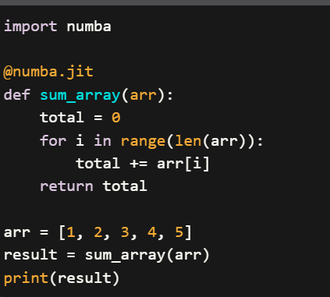
Sample code

Slide 5
Backend of Numba
The backend of Numba is built on top of LLVM (Low-Level Virtual Machine), a collection of modular and reusable compiler and toolchain technologies that can be used to develop a wide range of programming languages and applications. LLVM provides a framework for optimizing code at various levels, including instruction selection, instruction scheduling, register allocation, and code generation.
When Numba compiles Python code using LLVM, it performs a number of optimizations to improve the performance of the resulting machine code. For example, Numba can inline functions, eliminate unnecessary memory allocations, and use SIMD instructions to perform parallel computations on vectorized data.
Overall, the backend of Numba plays a critical role in enabling the library to achieve its goal of accelerating numerical and scientific computations in Python. By leveraging the power of LLVM and other low-level optimization techniques, Numba is able to generate highly optimized machine code that can run much faster than equivalent Python code running in pure interpreted mode.

Slide 6
What is Numpy?

