Slide 1
Numba & Numpy
AmirReza Alasti
Saleh Ebrahimian
Mobin Tasnimi

Slide 2
What is Numba?
Numba is an open-source just-in-time (JIT) compiler for Python that allows for fast execution of numerical algorithms on CPUs and GPUs. It is designed to compile Python code to machine code at runtime, which can significantly improve performance compared to pure Python implementations.
Numba works by analyzing the data types used in a Python program and generating optimized machine code that can be executed directly on the CPU or GPU. This makes it particularly well-suited for numerical computations and data science applications that involve large arrays of data.
Numba supports a wide range of numerical operations, including mathematical functions, linear algebra, and random number generation. It also includes support for CUDA, allowing it to generate code that can be executed on NVIDIA GPUs.
Overall, Numba is a powerful tool for accelerating Python code and improving performance in numerical applications.

Slide 3
How to install Numba?
Open a terminal or command prompt.
Type pip install numba and press Enter.
Wait for the installation to complete.

Slide 4
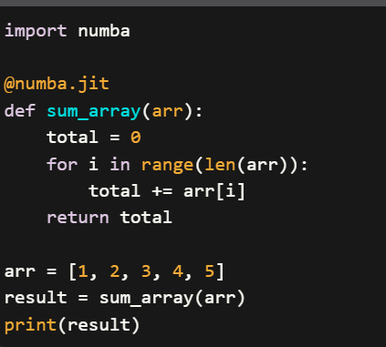
Sample code

Slide 5
Backend of Numba
The backend of Numba is built on top of LLVM (Low-Level Virtual Machine), a collection of modular and reusable compiler and toolchain technologies that can be used to develop a wide range of programming languages and applications. LLVM provides a framework for optimizing code at various levels, including instruction selection, instruction scheduling, register allocation, and code generation.
When Numba compiles Python code using LLVM, it performs a number of optimizations to improve the performance of the resulting machine code. For example, Numba can inline functions, eliminate unnecessary memory allocations, and use SIMD instructions to perform parallel computations on vectorized data.
Overall, the backend of Numba plays a critical role in enabling the library to achieve its goal of accelerating numerical and scientific computations in Python. By leveraging the power of LLVM and other low-level optimization techniques, Numba is able to generate highly optimized machine code that can run much faster than equivalent Python code running in pure interpreted mode.

Slide 6
What is Numpy?
NumPy is a library for the Python programming language that provides support for large, multi-dimensional arrays and matrices, along with a large collection of high-level mathematical functions to operate on these arrays.
NumPy is widely used in scientific computing, data analysis, and machine learning applications. It is an essential tool for numerical computing in Python, providing efficient and optimized operations on arrays and matrices, and is designed to work seamlessly with other scientific computing libraries such as SciPy, pandas, and scikit-learn.
NumPy also provides powerful tools for working with data, including tools for indexing, slicing, and reshaping arrays, as well as functions for linear algebra, Fourier analysis, and random number generation. Its performance, flexibility, and ease of use have made it an essential tool for data scientists, researchers, and developers working with numerical data in Python.

Slide 7
Numpy useful functions
np.array(): Creates a NumPy array from a Python list or tuple.
np.zeros(): Creates an array filled with zeros of a specified shape.
np.ones(): Creates an array filled with ones of a specified shape.
np.arange(): Creates an array of numbers with a specified range and step size.
np.linspace(): Creates an array of numbers with a specified range and number of evenly spaced points.

Slide 8
np.random.rand(): Generates an array of random numbers from a uniform distribution between 0 and 1.
np.random.randn(): Generates an array of random numbers from a standard normal distribution.
np.dot(): Computes the dot product of two arrays.
np.transpose(): Transposes an array (rows become columns and vice versa).
np.reshape(): Reshapes an array to a specified shape.

Slide 9
np.vstack(): Stacks arrays vertically (along the rows).
np.hstack(): Stacks arrays horizontally (along the columns).
np.mean(): Computes the mean of an array.
np.median(): Computes the median of an array.
np.std(): Computes the standard deviation of an array.

Slide 10
np.sum(): Computes the sum of an array.
np.max(): Computes the maximum value of an array.
np.min(): Computes the minimum value of an array.
np.argmax(): Returns the index of the maximum value in an array.
np.argmin(): Returns the index of the minimum value in an array.

Slide 11
np.where(): Returns the indices of elements in an array that meet a specified condition.
np.unique(): Returns the unique elements in an array.
np.linalg.inv(): Computes the inverse of a matrix.
np.linalg.eig(): Computes the eigenvalues and eigenvectors of a matrix.
np.fft.fft(): Computes the one-dimensional discrete Fourier Transform of an array.

