Slide 1


Git - Worktree
command
Presented By: Rahul Soni
Notes:
Note: First “Right Click” on the Gradient background, go to “Order” option and “Send it to Back”, then insert your picture into “Image Placeholder”, “Right Click” on the picture and again go to “Order” option and “Send it to Back” to get the “Gradient” effect.

Slide 2

Our Agenda
Git worktree command
01
Introduction to Worktree
02
Need of git worktree
03
Problem & Solutions
04
More into git worktree
05
Git refs in worktree
knólder

Slide 3
Introduction to Worktree
Let’s meet git worktree
What is Worktree?
How it works?
A Git worktree is a linked copy of your Git repository, allowing you to have multiple branches checked out at a time. A worktree has a separate path from your main working copy, but it can be in a different state and on a different branch.
A git repository can support multiple working trees, allowing you to check out more than one branch at a time. With git worktree add command a new working tree is associated with the repository. This new working tree is called a "linked working tree" as opposed to the "main working tree"
knólder

Slide 4


Introduction to Worktree
How does it look like?
HEAD
master
A
B
C
D
E
Worktree
../
knólder

Slide 5
Need of git worktree
Problem Statement
Suppose,
Problem with git stash
You are working on a feature where you have made bunch of changes to files that are not yet commited, and suddenly you need to work on a hot fix or a more priority feature.
There are two ways you can tackle this:
Using git stash
Using git worktree
Git stash may solve your this kind of situation but if you are juggling more than 2 branches at a time, git stash would be irritating.
knólder

Slide 6
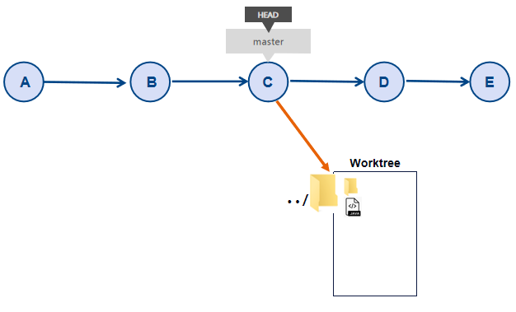
Need of git worktree
Worktree to the rescue
Workflow
create an replica of your project and switch to a new branch
create a new feature
push it
back to previous working directory
Git worktree helps you manage multiple working trees attached to the same repository. you can check out multiple branches at the same time by maintaining multiple clones of the same repository.
knólder

Slide 7

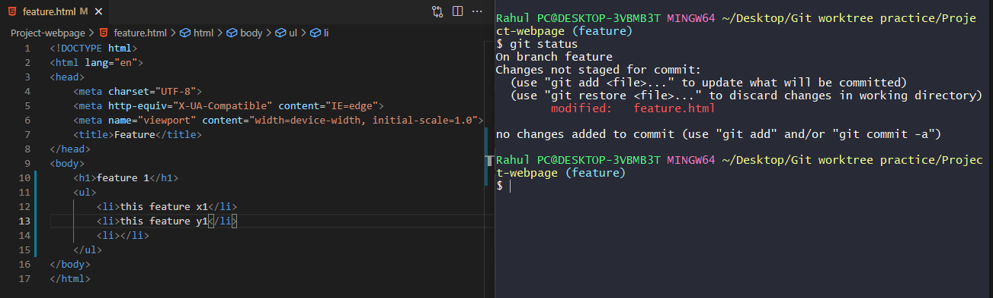
Actual git worktree
How actual worktree looks
Suppose, you are working on a feature where you have made bunch of changes to files that are not yet commited, and suddenly you need to work on a hot fix or a more priority feature.
knólder

Slide 8
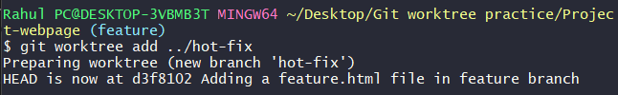
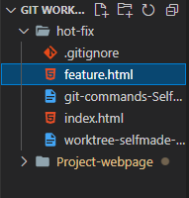
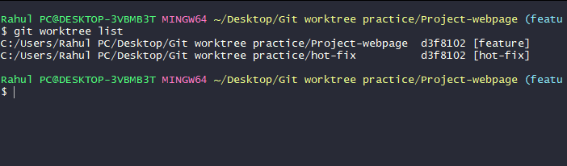
Actual git worktree
How actual worktree looks
1
$ git worktree add <path>
new worktree (hot-fix)
3
$ git worktree list
2
git worktree list command lists all working trees.
Here we can see our newly created worktree.
we can see a new worktree is created with name hot-fix
knólder

Slide 9
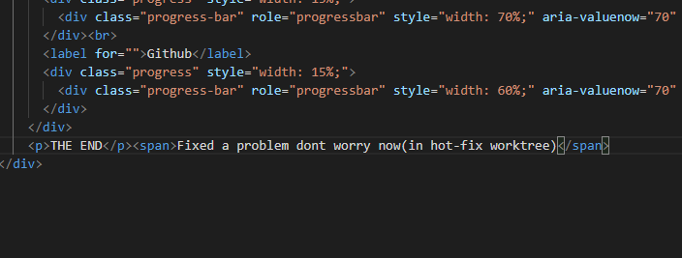
Actual git worktree
How actual worktree looks
In hot-fix worktree we made our changes and fixes. And commit it with a message.
knólder

Slide 10
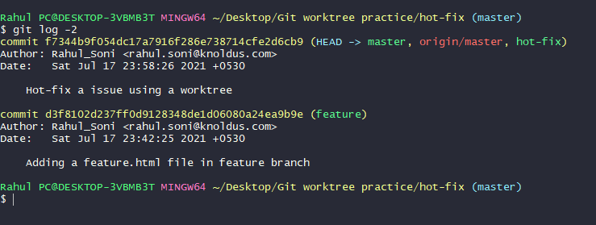
Actual git worktree
How actual worktree looks
In the working tree hot-fix, we made our changes and fixes.
And last we commited it with a message “Hot-fix a issue using worktree”
knólder

Slide 11
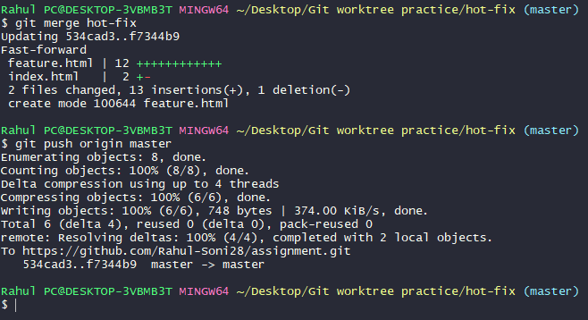
Actual git worktree
How actual worktree looks
It’s time to push the fixes we have made.
we merged the hot-fix branch with master then we pushed it into our remote tracking repository.
$ git merge hot-fix
$ git push origin master
knólder

Slide 12

Actual git worktree
How actual worktree looks
We can see our remote repository got updated and commit is also updated
knólder

Slide 13
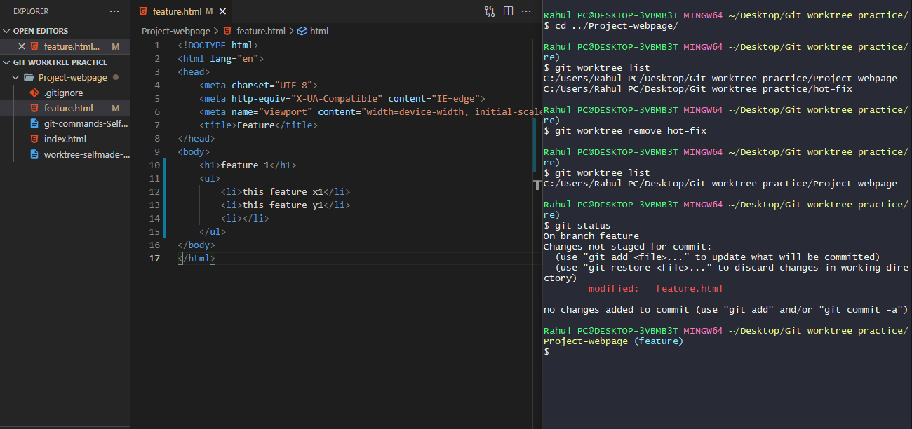
Actual git worktree
How actual worktree looks
Back to our previous working directory to continue our work on feature branch
knólder

Slide 14
More into git worktree
git worktree commands
Synopsis
git worktree add [-f] [--detach] [--checkout] [--lock] [-b <new-branch>] <path> [<commit-ish>]
git worktree list [--porcelain]
git worktree lock [--reason <string>] <worktree>
git worktree move <worktree> <new-path>
git worktree prune [-n] [-v] [--expire <expire-time>]
git worktree remove [--force] <worktree>
git worktree unlock <worktree>
[-options] : These are optional commands only used for specific demands.
<arguement> : These are arguements passed in form of name of worktree or a branch or path-name.
knólder

Slide 15
More into git worktree
git worktree add commands
Add command
$ git worktree add <path> <branch>
To instead work on an existing branch in a new working tree, use git worktree add <path> <branch>
Add command
$ git worktree add <path>
For instance, git worktree add ../hotfix creates new branch hotfix and checks it out at path ../hotfix.
Add command
$ git worktree add -d <path>
If you just plan to make some experimental changes or do testing without disturbing existing development, it is often convenient to create a throwaway working tree not associated with any branch.
knólder

Slide 16
More into git worktree
git worktree add commands
Add command
If <commit-ish> is a branch name (call it <branch>) and is not found, and neither -b nor -B nor --detach are used, but there does exist a tracking branch in exactly one remote (call it <remote>) with a matching name, treat as equivalent to:
$ git worktree add <path> [<commit-ish>]
Create <path> and checkout <commit-ish> into it. The new working directory is linked to the current repository, sharing everything except working directory specific files such as HEAD, index, etc.
$ git worktree add --track -b <branch> <path> <remote>/<branch>
knólder

Slide 17

More into git worktree
More git worktree commands
$ git worktree prune -n
List command
Prune command
Do not remove anything; just report what it would remove.
$ git worktree list
$ git worktree prune
List details of each working tree. The main working tree is listed first, followed by each of the linked working trees. The output details include whether the working tree is bare.
git worktree prune removes information about (non-locked) worktrees which no longer exist. git worktree prune in the main or any linked working tree to clean up any stale administrative files.
$ git worktree prune -v
With prune, report all removals. With list, output additional information about worktrees.
$git worktree prune --expire <time>
With prune, only expire unused working trees older than <time>.
knólder

Slide 18
More into git worktree
More git worktree commands
Lock command
Move command
$ git worktree lock <worktree>
$ git worktree move <worktree> <new-path>
If a working tree is on a portable device or network share which is not always mounted, lock it to prevent its administrative files from being pruned automatically.
Specify a reason for the lock with --reason.
Move a working tree to a new location. Note that the main working tree or linked working trees containing submodules cannot be moved with this command. (The git worktree repair command, however, can reestablish the connection with linked working trees if you move the main working tree manually.)
knólder

Slide 19
More into git worktree
More git worktree commands
Unlock command
Remove command
$ git worktree unlock <worktree>
$ git worktree remove <worktree>
$ git worktree remove [-f] <worktree>
Unlock a working tree, allowing it to be pruned, moved or deleted.
Remove a working tree. Only clean working trees (no untracked files and no modification in tracked files) can be removed. Unclean working trees or ones with submodules can be removed with --force. The main working tree cannot be removed.
knólder

Slide 20
Git Refs
What are refs in git.
What is refs?
Refs in worktree.
A ref is an indirect way of referring to a commit. You can think of it as a user-friendly alias for a commit hash. This is Git’s internal mechanism of representing branches and tags.
In multiple working trees, some refs may be shared between all working trees and some refs are local. One example is HEAD which is different for each working tree.
knólder

Slide 21
Git Refs
This section is about the sharing rules and how to access refs of one working tree from another.
Sharing of refs
Accesing refs.
In general, all pseudo refs are per working tree and all refs starting with refs/ are shared. Pseudo refs are ones like HEAD which are directly under $GIT_DIR instead of inside $GIT_DIR/refs. There are exceptions, however: refs inside refs/bisect and refs/worktree are not shared.
Refs that are per working tree can still be accessed from another working tree via two special paths, main-worktree and worktrees. The former gives access to per-working tree refs of the main working tree, while the latter to all linked working trees.
For example, main-worktree/HEAD or main-worktree/refs/bisect/good resolve to the same value as the main working tree’s HEAD and refs/bisect/good respectively.
Similarly, worktrees/foo/HEAD or worktrees/bar/refs/bisect/bad are the same as $GIT_COMMON_DIR/worktrees/foo/HEAD and $GIT_COMMON_DIR/worktrees/bar/refs/bisect/bad.
knólder

Slide 22
Worktree directories
Each linked worktree has private sub-directory
Directories
Details
Each linked working tree has a private sub-directory in the repository’s $GIT_DIR/worktrees directory. The private sub-directory’s name is usually the base name of the linked working tree’s path, possibly appended with a number to make it unique.
Within a linked working tree, $GIT_DIR is set to point to this private directory (e.g. /path/main/.git/worktrees/test-next in the example) and $GIT_COMMON_DIR is set to point back to the main working tree’s $GIT_DIR
For example, when $GIT_DIR=/path/main/.git the command git worktree add /path/other/test-next next creates the linked working tree in /path/other/test-next and also creates a $GIT_DIR/worktrees/test-next directory (or $GIT_DIR/worktrees/test-next1 if test-next is already taken).
knólder

Slide 23
Conclusion
Why worktree is handy feature.
Handy feature
Parallel worktrees
A Git worktree is a linked copy of your Git repository, allowing you to have multiple branches checked out at a time. A worktree has a separate path from your main working copy
You can make multiple worktree and checkout at same time without disturbing your main directory.
knólder

Slide 24



References
Links to the materials
For documentation - Git
My repository on github.
For unknown errors
knólder

Slide 25



Thank You !
Get in touch with us:
Rahul Soni
knóldus
LinkedIn
Github
Gmail
LinkedIn
visit website
Gmail
knólder

