Slide 1

ANNUAL PEDAGOGICAL PLAN FOR LEADING THE TEACHING –LEARNING PROCESS
SCHOOL NAME: SHRI SHIKSHAYATAN SCHOOL
11 LORD SINHA ROAD,
KOLKATA- 700071
AFFILIATION NUMBER 2430151 School code:15707
ACADEMIC SESSION: 2026-2027
PRINCIPAL’S NAME: Mrs. SANGEETA TANDON
ANNUAL PEDAGOGICAL PLAN FOR DEVELOPING A LEARNING CULTURE
Slide :1

Slide 2
VISION To impart value based education to students so that they are competent to handle global challenges
SCHOOL MISSION
In the next three years( 2024-2027) the school will:
Motivate students to evolve as life long learners through innovative learning practices, fostering communicative and application skills to achieve intellectual and personal excellence
Inculcate values to be aware of social and environmental challenges through active participation in collaborative projects and international exchanges striving towards borderless education
Provide a diverse and inclusive culture promoting universal acceptance to become empathetic, adaptable change makers of the evolving global community
slide 2

Slide 3
Descriptor 4:Developing a Learning Culture
Actionable: Develop policies and systems that support a culture of learning by including all stakeholders
SUB ACTIONABLES : KEY WORDS
Transparent communication amongst stakeholders
Formulate policies on child protection, health and safety
Establish mechanism and procedures for effectively implementing the policies
Invite stakeholders to support learning and areas of academic concern, if any
Analyze and interpret data to identify learning gaps
Monitor and assess progress; Reflect and refine practices
slide 3

Slide 4
Descriptor 4 Develop policies and systems that support a culture of learning by including all stakeholders
Transparent communication amongst stakeholders Define shared beliefs Establish an open-door policy and transparent communication system |  |  | 3
Formulate policies On child protection and safeguarding health and safety, cyber safety, behaviour management On inclusion ;aligning with statutory laws |  |  | 3
Establish mechanism and procedures for effectively implementing the policies Set up committees with defined roles and responsibilities Have SOPs for effective implementation and standardization |  |  | 3
Invite stakeholders to support learning and areas of academic concern, if any Discussions with students, teachers, parents, SMC members Creating opportunities for learning by inviting alumni, parents and community members to serve as resource persons |  |  | 3
Refine instructional practices based on data and analysis Adjust pedagogy, pacing and strategies |  |  | 3

Slide 5
DESCRIPTOR 4: Develop policies and systems that support a culture of learning by including all stakeholders
STEP 1 | STEP 2 | STEP 3 | STEP 4 | STEP 5 | STEP 6
WHERE ARE WE AS A SCHOOL? | WHAT DO WE NEED TO DO IN THE COMING YEAR | HOW WILL WE ACHIEVE WHAT WE WANT TO DO? | WHO IS RESPONSIBLE ? | WHAT IS THE TIMELINE FOR IMPLEMENTATION? | WHAT WILL THE IMPACT LOOK LIKE ?
We are at 3 | Self Improvement Plan will be made and gaps identified Stakeholders Committees will be established and required policies formulated Effective implementation will be planned Systems for Continuous monitoring , reflection and improvement will be in place | Completion of SQAAF, identification of gaps SOPs, policies and parental calendar will be used to strengthen the process Regular meetings with stakeholders to identify gaps and to support learning Action research again to assess the entire procedure | Principal Head-mistress Academic Coordinators Heads of the departments All subject teachers , admin and security , counsellors and special educators | By May 10, 2026, brainstorming sessions on data analyses will take place. Twice in a year, committees will meet Periodic review ,along with final review in March 2027 will help | The school will achieve the rating of 4 Greater interaction and support from stakeholders An inclusive culture of learning will be created slide 5 Slide :6

Slide 6
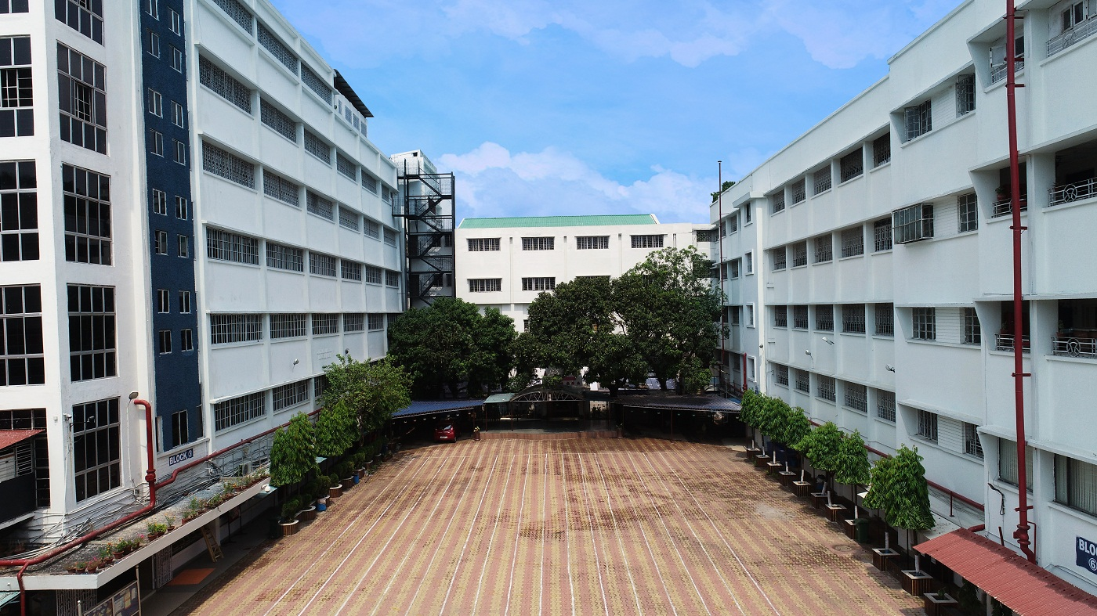
Shri Shikshayatan school 11, Lord Sinha Road
SHRI SHIKSHAYATAN SCHOOL
Thank you
Slide 11

