Slide 1





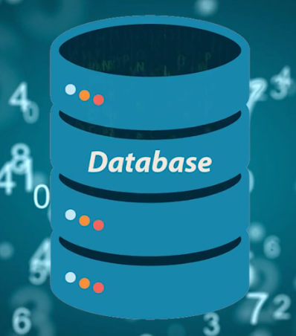
Presentation tier
Microservice UI layer
Internet gateway
Availability zone 1
Application load
balancer
Availability zone 2
Business logic tier
Frontend auto-scaling
eg:
Java
JavaScript
ActiveMQ
Kafka
Maven
Jenkins
Ansible
Jenkins
Or
Ansible CI/CD
Internal load
balancer
Microservices
Backend auto-scaling
Database tier
Master DB
Failover DB
eg:
SQL server
MongoDB
High availability
Backend auto-scaling
Active / Active resiliency

