Slide 1


Devops Workshop
Notes:
Resting slide on screen before you begin presenting.

Slide 2
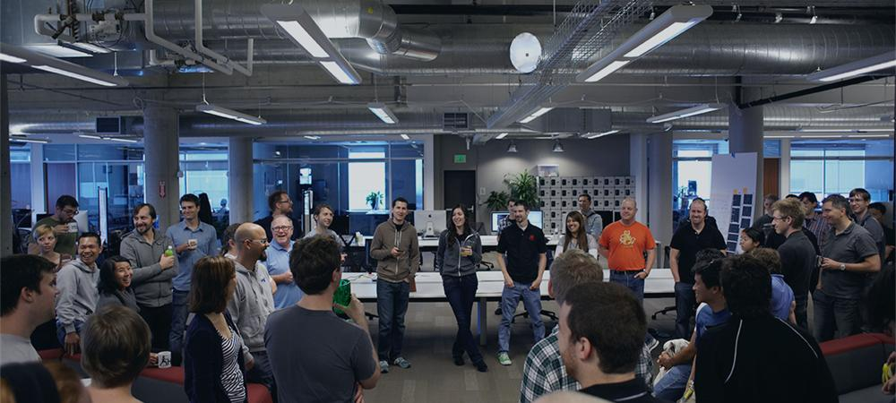

Introductions
Name, Team, Apps

Slide 3
Workshop Agenda – Day 1
Time | Activity/Discussion
8:00 – 8:30 | Breakfast
8:30 – 9:00 | Introductions
100 – Pivotal Cloud Foundry Background
9:00 - 10:00 | PCF Value Proposition
10:00 – 10:10 | Break
10:10 – 11:00 | Intro to PCF
11:00 – 11:10 | Break
11:00 – 11:45 | CF Push (Lab)
11:45 – 12:30 | Lunch

Slide 4
Workshop Agenda – Day 1 (continued)
Time | Activity/Discussion
101 – Cloud Native Concepts
12:30 – 1:30 | Cloud Native Concepts
1:30 – 2:30 | Strategies for breaking down Monoliths (or Getting to "Cloud Friendly”)
2:30 – 2:40 | Break
102 – Intro to Spring Boot
2:40 - 3:30 | Intro to Spring Boot (Lab)
3:30 – 4:15 | Intro to Spring Data (Lab)
4:15 – 5:00 | Production Ready Features (or diagnostics, logging and metrics for my app)
5:00 – 5:15 | Retrospective

Slide 5
Workshop Agenda – Day 2
Time | Activity/Discussion
8:00 – 8:30 | Breakfast
103 – Introduction to Spring Cloud Services
8:30 – 9:00 | Intro to Spring Cloud
9:00 – 9:50 | Configuration Server (Demo)
9:50 – 10:00 | Break
10:00 – 10:50 | Service Registry and Circuit Breaker (Demo)
10:50 – 11:00 | Break
104 – CI/CD Practices
11:00 – 11:30 | CI/CD Concepts

Slide 6
Workshop Agenda – Day 2 (continued)
Time | Activity/Discussion
11:30 – 12:15 | Practical discussion on pipeline automation (exploration of sample implementations on Jenkins and Concourse employing Spring Cloud Pipelines)
12:15 – 12:30 | Restrospective

Slide 7
Important Links
Workshop Git Repo
https://github.com/Pivotal-Field-Engineering/CN-Workshop-Boeing
Cloud Foundry API
https://api.run.pivotal.io
Cloud Foundry Apps Manager
https://console.run.pivotal.io
Notes:
// TODO To be updated with links to Boeing repo?

Slide 8

Be Interactive!

