Slide 1
Hackathon 2017 Alexa for coffee
Abderraouf Gharbi, Valeria Kinitzki, Faiez Mastouri
12.12.17

Slide 2

Alexa for coffee
Value Proposition Canvas
Minimal Viable Product
Alexa skill
IoT Architecture
Demonstration

Slide 3
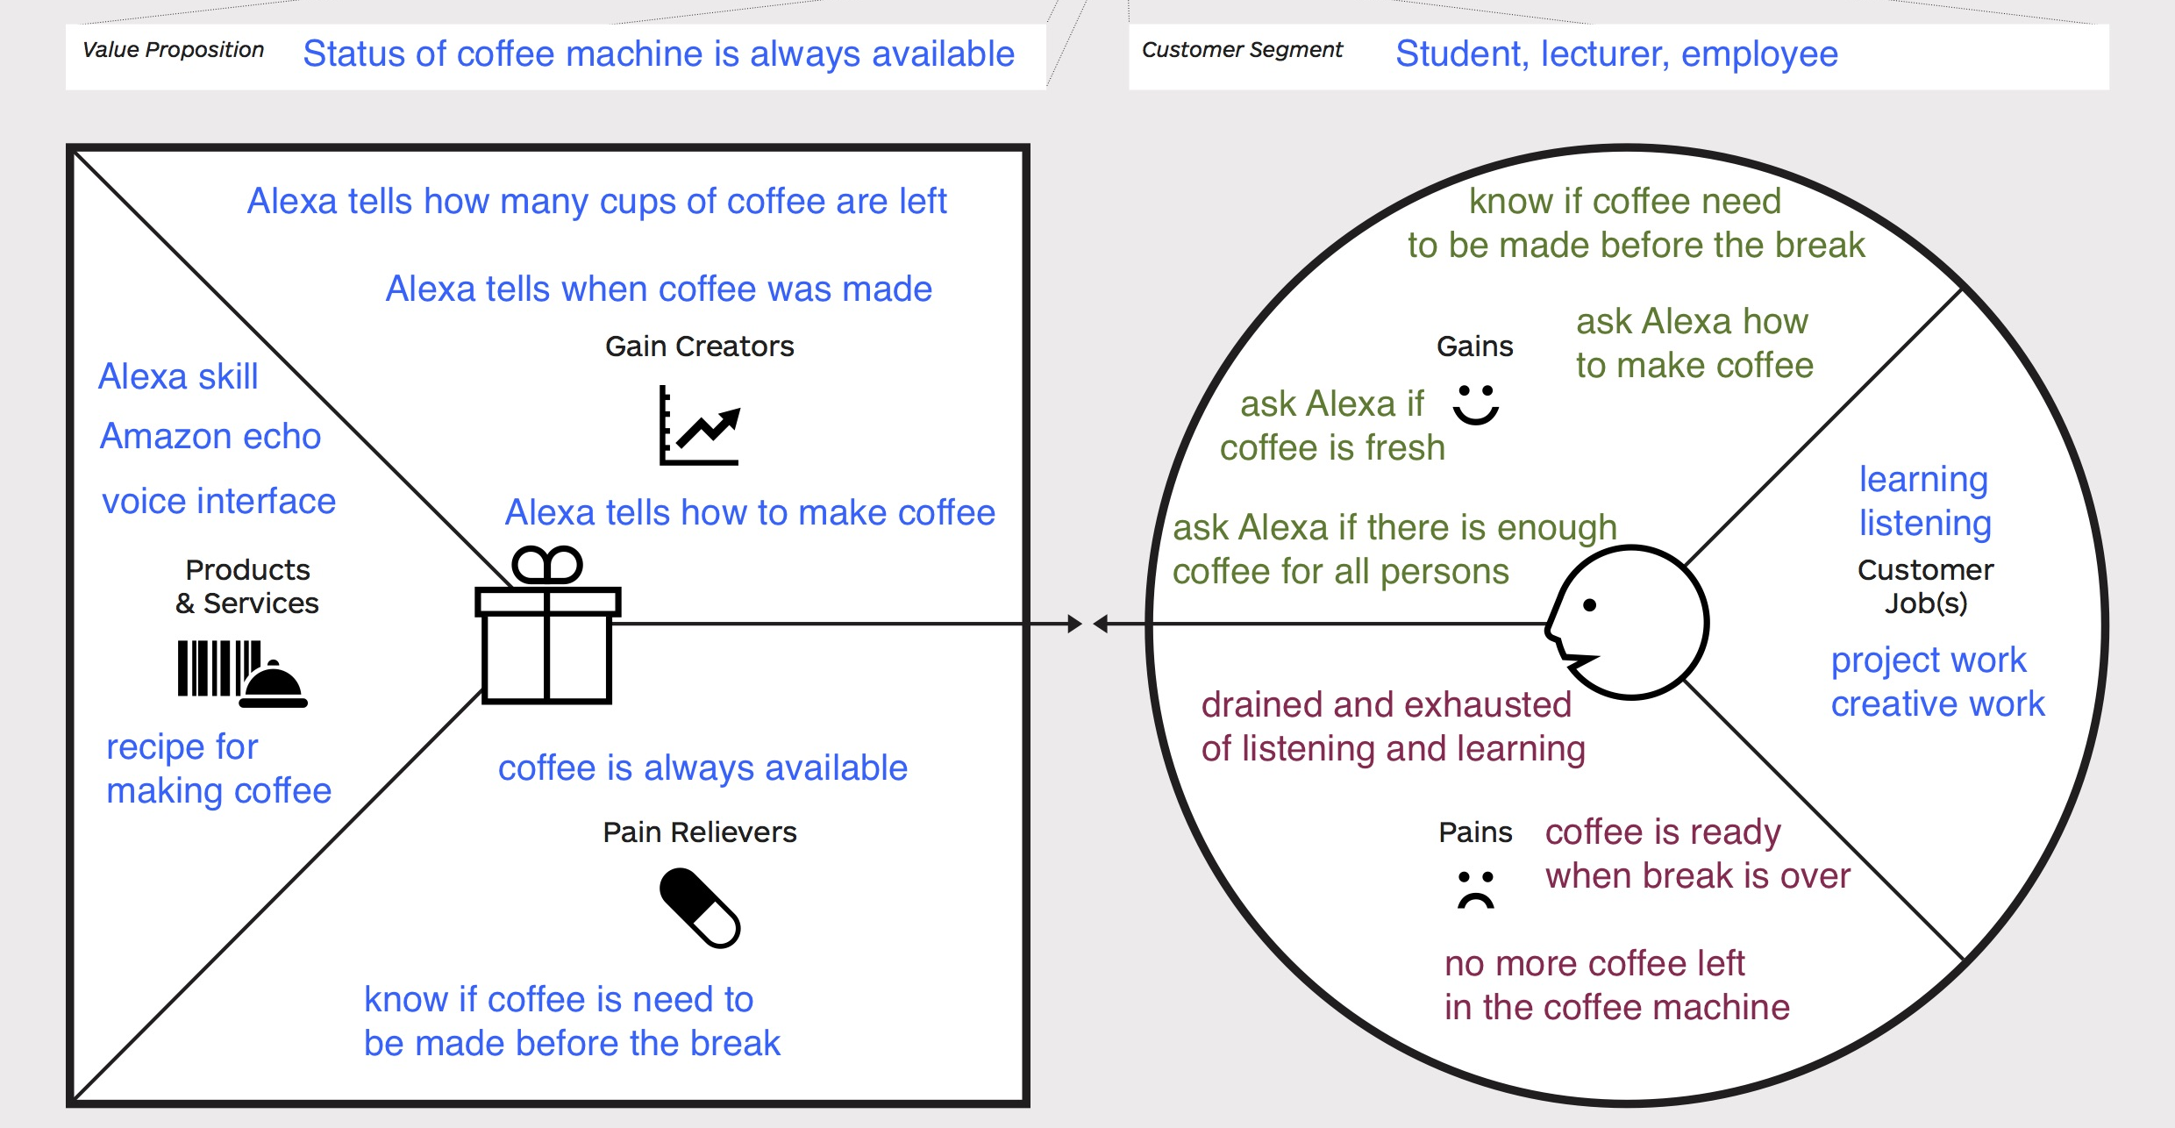
Value Proposition Canvas

Slide 4
Minimal Viable Product
Three Alexa Services for coffee:
When was coffee made?
Alexa tells you how fresh the coffee is
Timestamp from database
How much coffee is left?
Alexa tells you how many cups of coffee can be drunk
Latest amount of coffee used to compute amount of cups
How to make coffee?
Alexa tells you the instruction

Slide 5
Alexa skill
‚invocation name‘ Kaffeemaschine for starting the skill
‚intent‘ to separate different request types
‚Utterances‘ to recognize the questions
‘functions‘ within Lambda code

Slide 6
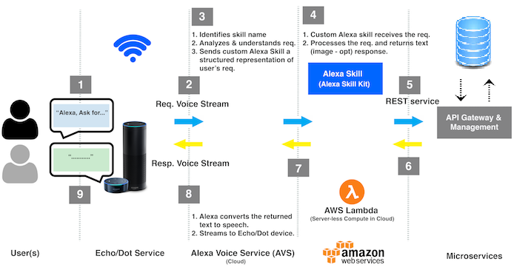
IoT Architecture
https://image.slidesharecdn.com/amazonalexa-buildingcustomskills-170209195616/
95/amazon-alexa-building-custom-skills-32-638.jpg?cb=1486670198

Slide 7
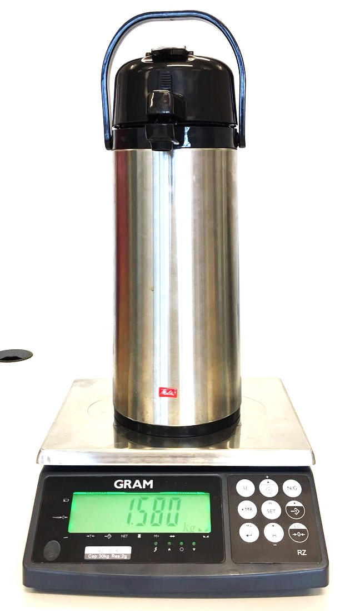
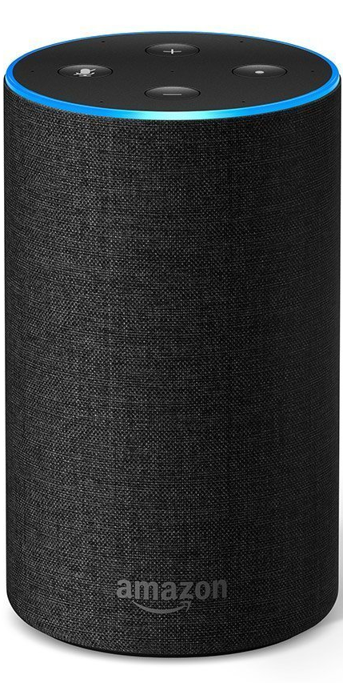

Demonstration
https://images-na.ssl-images-amazon.com/images/I/418mxTrvgUL._AC_UL246_SR190,246_.jpg

