Slide 1

HashiCorp
Introduction To
Terraform

Slide 2
HashiCorp
Terraform
Provisioning Declarative tool that is based on Infrastructure as A Code
Uses its own syntax – HCL (Hashicorp configuration language)
Terraform is written in Golang
Helps to evolve your infrastructure safely and predictably
A plugin-based architecture model
Open-source IAC tool.

Slide 3
Benefits of Infrastructure as Code (IAC)
01
02
03
04
Improved system performance with assured risk prevention
Safer and efficient change management
Scalability and software delivery at high velocity
Improvement of Customer Satisfaction.

Slide 4



Environment Parity
DEV
Same Terraform Code
Replace dedicated staging
Speedup infra Provisioning
STAGE
PROD
DEV
OPS

Slide 5
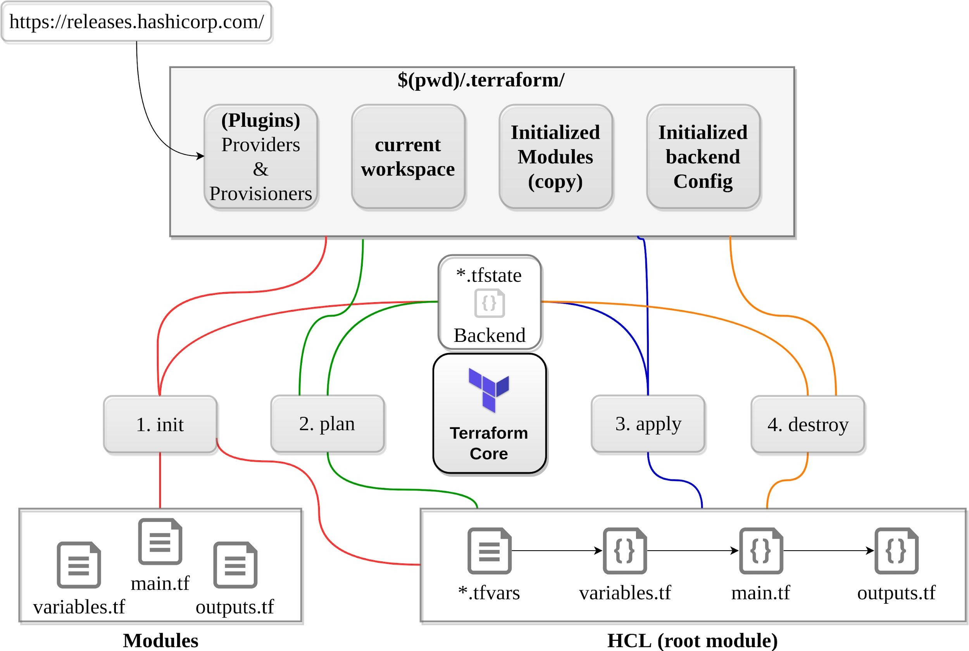
Simple Workflow

Slide 6
Terraform – Common Workflow Issues
01
02
03
04
Hard-Coded Values
Not following naming convention (tags)
Deleting a statelock file
Mess up with the Workspaces
05
06
07
08
Renaming modules, resources
Double references
Syntax problems
Permissions

Slide 8
THANK YOU

