Slide 1


Kubernetes
25-05-2024
Notes:
https://www.freepik.com/

Slide 2
Table Of Contents
Kubernetes Overview
01
Kubernetes Use Case
02
Kubernetes Pros & Cons
03
Conclusion
04

Slide 3
Kubernetes Overview
Notes:
https://www.freepik.com/

Slide 4
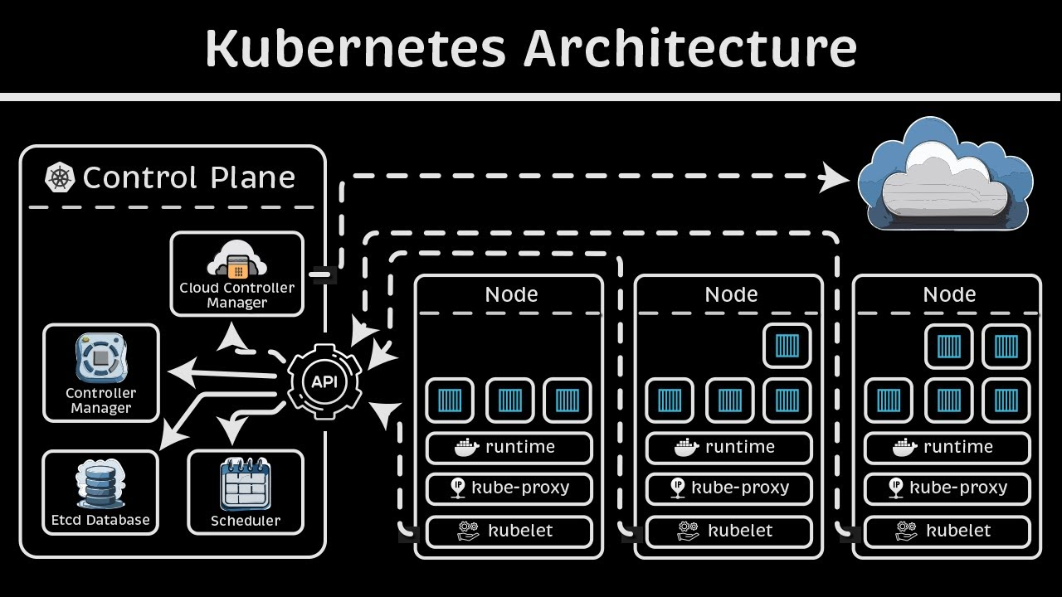

Slide 5
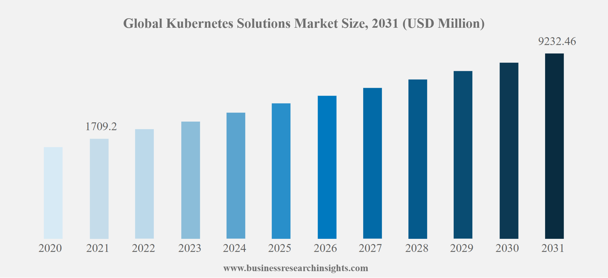

Slide 6

Kubernetes
Use Case
Notes:
https://get.pxhere.com/photo/job-office-collaboration-design-interior-design-white-collar-worker-conversation-learning-employment-hand-desk-furniture-interview-building-team-gesture-management-1535603.jpg
https://pixnio.com/free-images/2017/08/29/2017-08-29-16-04-13-1000x667.jpg
https://pixnio.com/free-images/2020/09/01/2020-09-01-09-33-31-1200x800.jpg
https://live.staticflickr.com/65535/50938102118_144ee02523_b.jpg

Slide 7








Use Case
IBM
Amazon
Technology
E-Commerce
Red Hat
eBay
Kubernetes
JPMorgan Chase
Philips
Finance
Healthcare
Goldman Sachs
J&J

Slide 8




Kubernetes
PROS & CONS
Notes:
https://unsplash.com/photos/5QgIuuBxKwM
<a href='https://www.freepik.com/photos/asian-guy'>Asian guy photo created by benzoix - www.freepik.com</a>

Slide 9




Pros
Scalability
High Availability
Flexibility
Automated Operations
Resource Optimization
Complexity
Resource Intensive
Learning Curve
Integration Efforts
Cons

Slide 10
Conclusion
Kubernetes is a powerful tool for managing containerized applications, offering significant benefits in scalability, flexibility, and automation. Its ability to orchestrate complex, distributed systems makes it invaluable for modern application deployment and management.
Despite its complexity and the challenges associated with its implementation, Kubernetes provides a robust framework for achieving high availability and efficiency in diverse industry applications.
By leveraging Kubernetes, organizations can enhance their operational capabilities and accelerate innovation.

Slide 11
THANK
YOU.
Notes:
https://www.freepik.com/

