Slide 1


CI/CD with
Jenkin
Build
Commit
Test
Deploy
Notes:
https://www.freepik.com/

Slide 2

Table Of Contents
What is CI/CD
01
Why use Jenkins?
02
How Jenkins Works
03
Jenkins Architecture
04
Pros And Cons
05
Conclusion
06

Slide 3
What is CI/CD?
Notes:
https://www.freepik.com/

Slide 4
Continuous Integration(CI) : Automates the build and testing process after every code change.
Continuous Delivery (CD) : Automates the deployment process.
Benefits:
Faster feedback on code changes
Improved software quality and stability
Reduced time to market for new features
More reliable and consistent deployments
Notes:
https://www.freepik.com/

Slide 5
Why Jenkins for CI/CD.?
Notes:
https://www.freepik.com/

Slide 6
Open-Source and Free: No licencing costs large and active community
User-friendly Interface: Easy to configure jobs and workflows with drag and drop functionality
Highly extensible: Vast Library of plugins for various tool, languages and testing frameworks.
Platform – independent: Supports builds and tests across different operating systems and programming languages.
Supports CI/CD Pipeline: Integrates seamlessly with various DevOps tools for a complete CI/CD pipeline.
Notes:
https://www.freepik.com/

Slide 7
How Jenkins works
Notes:
https://www.freepik.com/

Slide 8
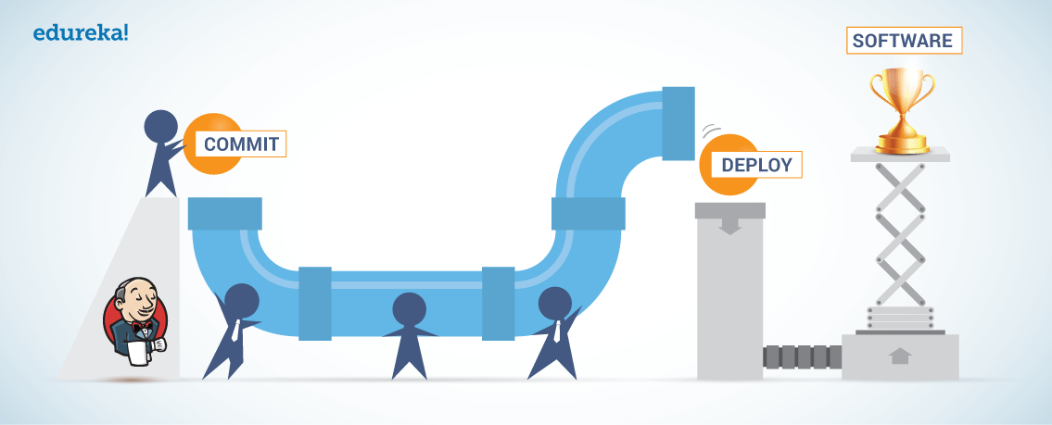
Code changes in version control system (VCS) trigger a build.
Jenkins fetches the code from VCS.
Builds and runs automated tests on the code.
If successful, deploys the code to the environment. (optional manual approval stage)
Provides notifications and reports throughout the pipeline.
Notes:
https://www.freepik.com/

Slide 9


Jenkins Master-Slave Architecture
Jenkins master pulls the code every time there is a commit
Jenkins Server (Master)
Remote source code repository
TCP/IP
TCP/IP
TCP/IP
Jenkins Master distributes its workload to all the salves
On request from Jenkins Master the slaves carry out builds and tests and produce test reports
Jenkins Slave 1
Jenkins Slave 2
Jenkins Slave 3

Slide 10




Jenkins
PROS & CONS
Notes:
https://unsplash.com/photos/5QgIuuBxKwM
<a href='https://www.freepik.com/photos/asian-guy'>Asian guy photo created by benzoix - www.freepik.com</a>

Slide 11




Pros
Open Source
Extensible
Platform independent
Scalability
Free to use with a large community
Over 1800 plugins available for integration
Runs on Windows macOS and Linux
Supports distributed builds across multiple notes
Complex setup
Maintenance
User interface
Security risks
Requires ongoing updates and plug in management
Interface can be outdated and less user-friendly
Potential vulnerabilities with plugins and configurations
Can be difficult to set up and configure
Cons

Slide 12
THANK
YOU.
Notes:
https://www.freepik.com/

