Slide 1

Introduction To Ansible

Slide 2




What is Ansible ?
01
02
03
04
It’s very simple to setup yet powerful.(Agentless Design)
Uses a human-readable language called YAML for playbooks, making it easy to learn and use
It performs
Configuration management (Task automation)
Application Deployment
Ansible is an Open-Source Automation tool

Slide 3
Why is Ansible
It is a free open-source automation tool and simple
Agent Less - No need to install any agent on Ansible Client/Nodes
Reduces errors and Improves efficiency : Automates repetitive task minimising human error and saves time and effort by automating routine configurations.
Python/YAML based highly flexible and configuration management tool.
Large number of ready to use modules and custom modules can be added if needed for system management.

Slide 4
Key Concepts of Ansible
Inventory: A list of systems Ansible manages, defined in a simple text file.
Playbooks: YAML scripts that define the tasks Ansible executes on managed systems.
Modules: Reusable code units that perform specific tasks, like installing software or copying files.

Slide 5
Simple Task
Assume we have 100 servers and need to instal vim and wget packages on all servers
First, we will go with one server
Step 1: Login to each server
Step 2: Check vim and wget packages installed or not
Step 3: If not installed then instal using the yum commands
Assume that this process took 6 minutes. Now for 100 servers it takes 600 minutes which is almost equal to 10 hours
Assuming that shell script is taking 3 minutes to complete our tasks per server Then for hundred servers it takes 300 minutes which is approximately 5 hours

Slide 6
Ansible vs Shell Scrips
If we go with automation tools like Ansible then we can complete the simple task in three minutes for all the 100 servers.
Ansible will execute a task on all servers parallel. So, it will take only 3 minutes of time on any number of servers for our requirements.
Generally writing a shell script is complex compared to playbooks
Playbooks are very short in code and in human readable format

Slide 7
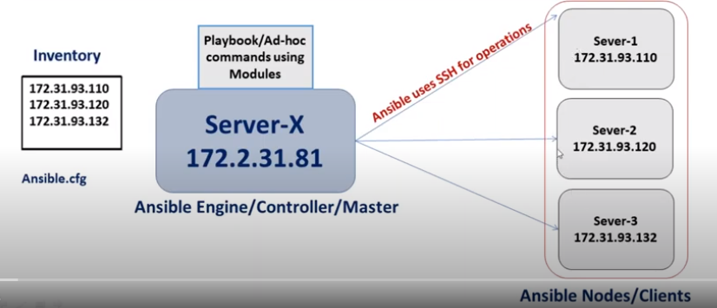
Simple Ansible architecture

Slide 8
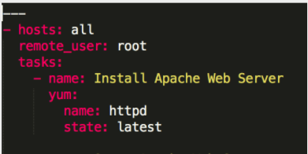
Working with Nodes
There are two ways to work with nodes - AdHoc Commands and Playbooks
AdHoc command is the one-line ansible command that performs 1 task on all the target hosts or group at a time
e.g., ansible all -m shell -a "uptime" #shell is module
A PlayBook is a single yaml file that defines a set of activities to be run on the hosts.

Slide 10
THANK YOU

