Slide 1

GitHub Actions
14-05-2024
Notes:
https://www.freepik.com/

Slide 2

GitHub Actions at a Glance
Globally available since November 13, 2019
Based on Azure Pipelines
YAML-based configuration
Native integration with GitHub API
Modular architecture & community-driven
Runners on Windows, Linux, macOS, or self-hosted
Available with Free, Pro, Team, Enterprise Cloud, One
GitHub Actions make it easy to automate all your software workflows.
GitHub Actions let you build, test, and deploy your code right from GitHub.
The easiest way is to think of GitHub Actions as their own continuous integration system.

Slide 3
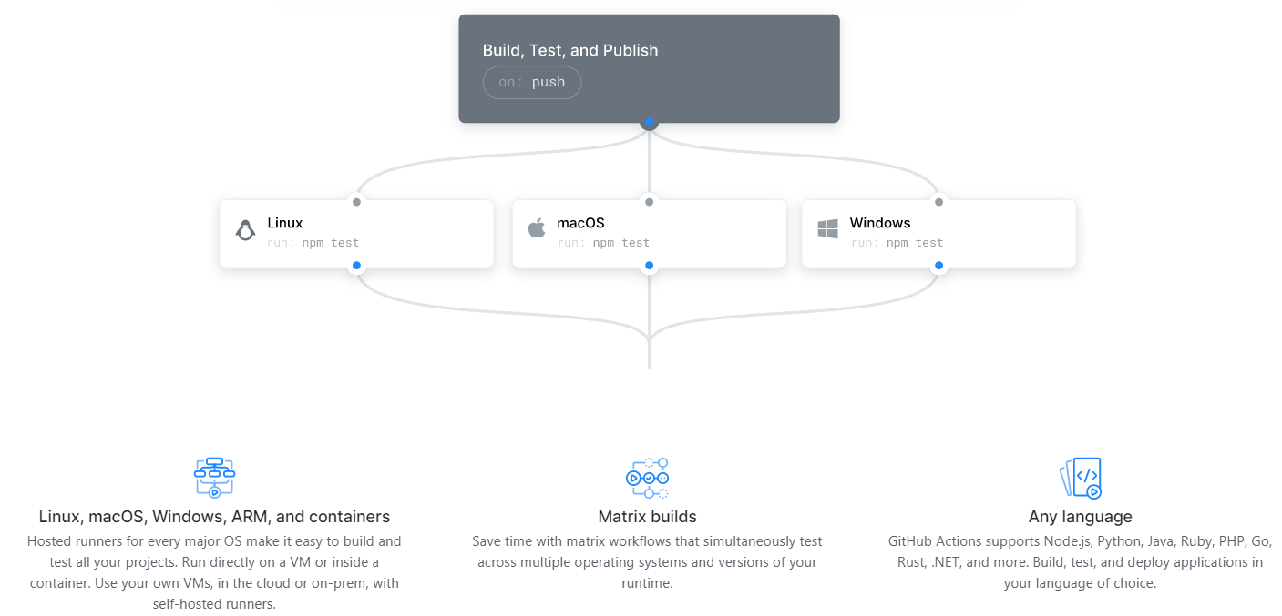
GitHub Actions

Slide 4
Why Github Actions?
Why GitHub Actions?
Less Overhead then other CI/CD Tools
More Collaborations
Test On the Go
Secure Deployments
Easy Code Maintainability
Unlimited Possibilities

Slide 5
GitHub Actions Workflow
Notes:
https://www.freepik.com/

Slide 6
GitHub WorkFlows
Action : Individual tasks that you combine as steps to create a job
Artifact : Artifacts are the files created when you build and test your code.
Event : A specific activity that triggers a workflow run.(Push,Pull) Job : A set of steps that execute on the same runner.
Runner : Any machine with the GitHub Actions runner application installed
Step : A step is an individual task that can run commands or actions.
Workflow : A configurable automated process that you can set up in your repository to build, test, package, release, or deploy any project on GitHub.

Slide 7
Things we can do with GitHub Actions
Run
Run tests on every commit
Publish
Publish Docker image when a tag is pushed
Label
Label an issue by content when it’s created
Run
Run nightly E2E tests
Close
Automatically close stale issues every week
Invite
Invite new contributors to sign the CLA when a PR is opened
Format
Automatically format code on push

Slide 8
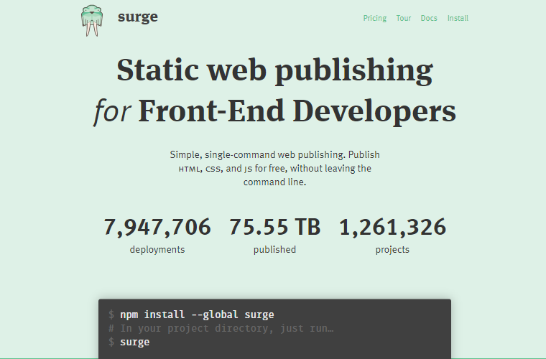
Surge

Slide 9
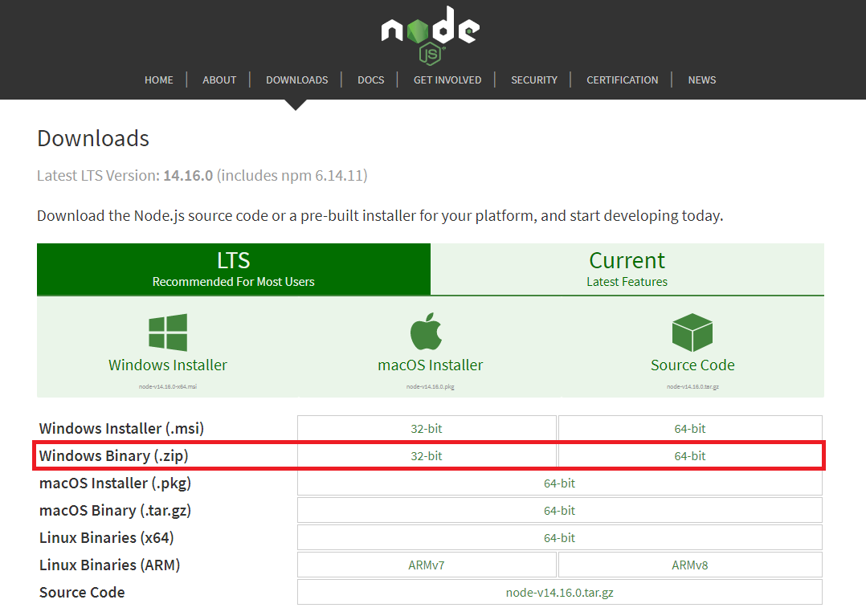
To install Surge we must have Node.js Installed

Slide 10
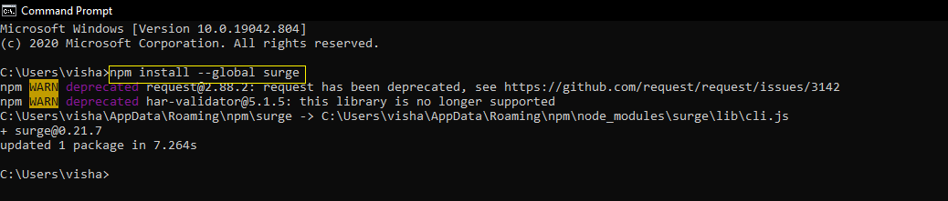
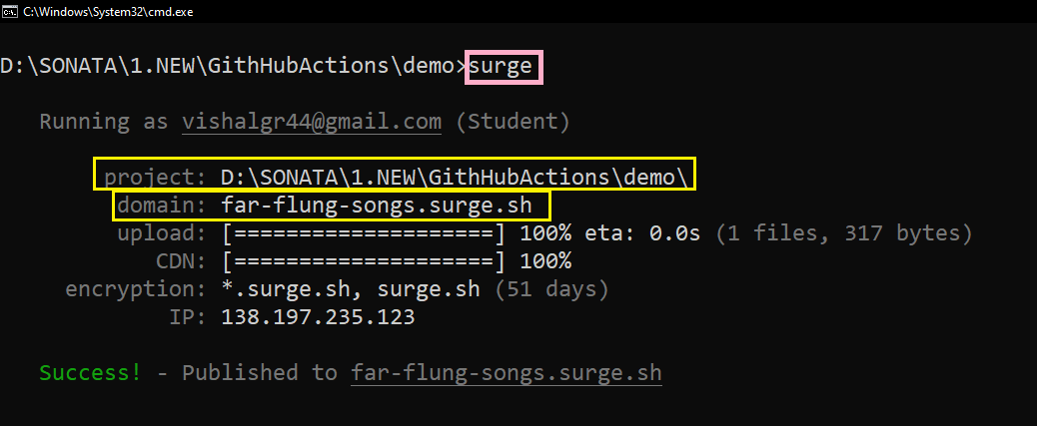
Install Surge
Just Type “SURGE”
To deploy your file

Slide 11
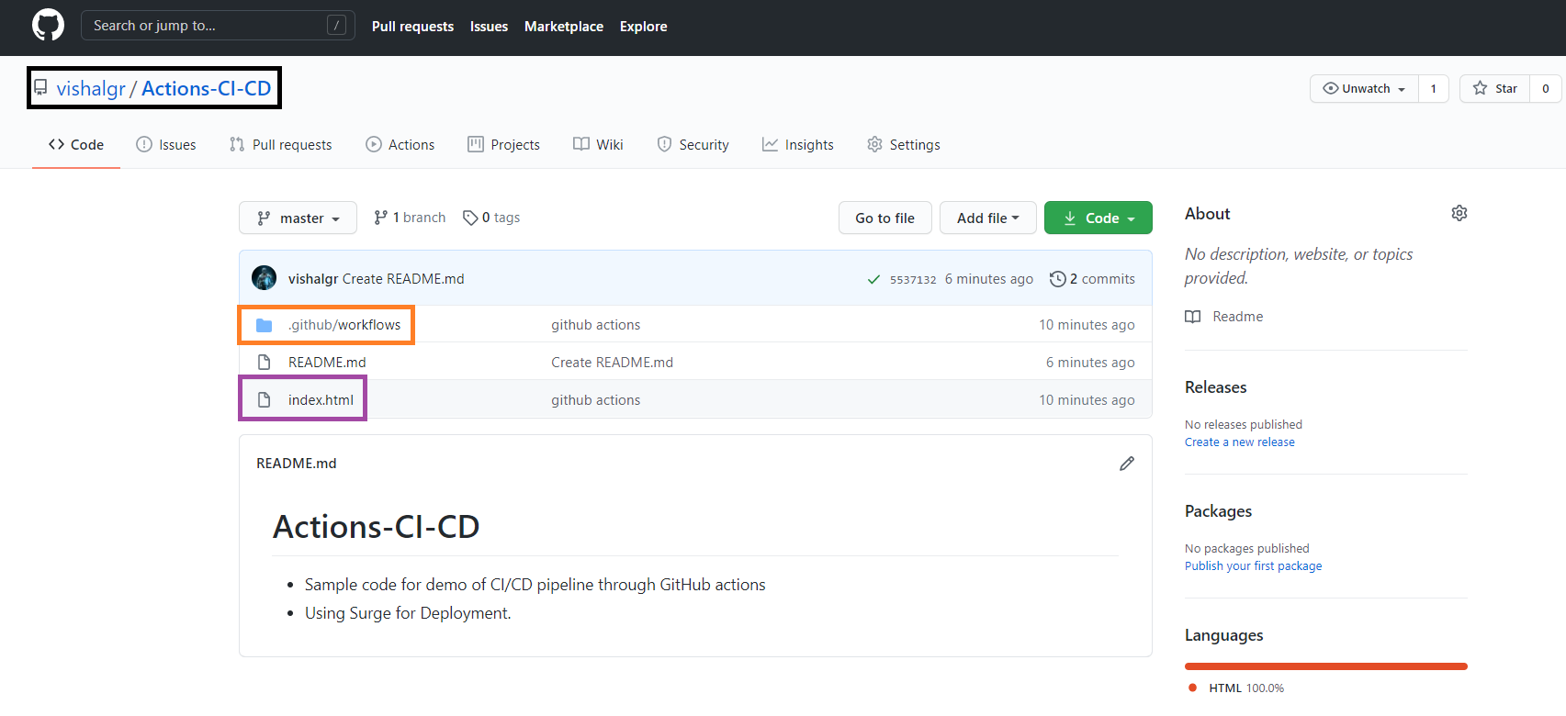
workflows
.github
Main.yml

Slide 12
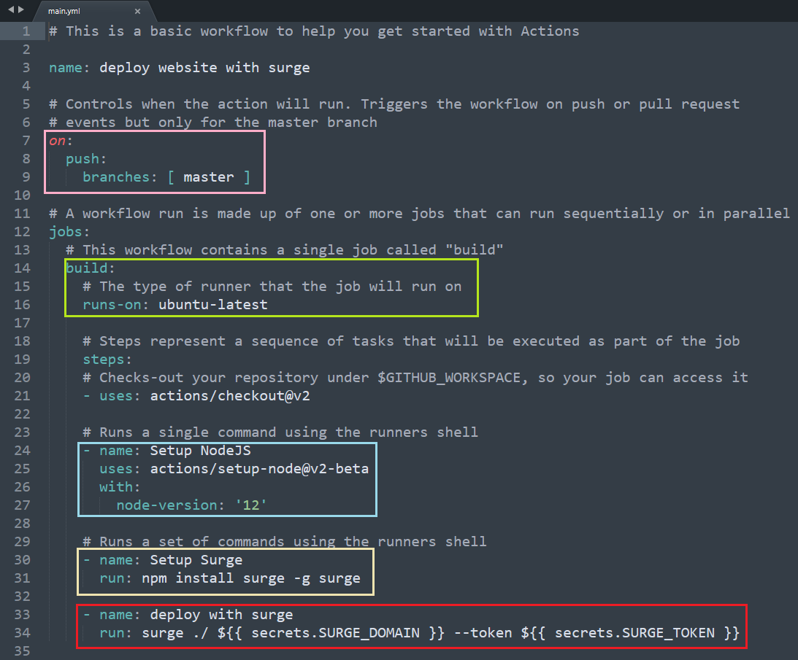
What does Main.yml Contains ?
Tells When the action should trigger
Selects the type of OS to Build
Downloads Node.js
Deploys to Surge
using the Surge domain and surge token stored in Secrets
Downloads Surge

Slide 13
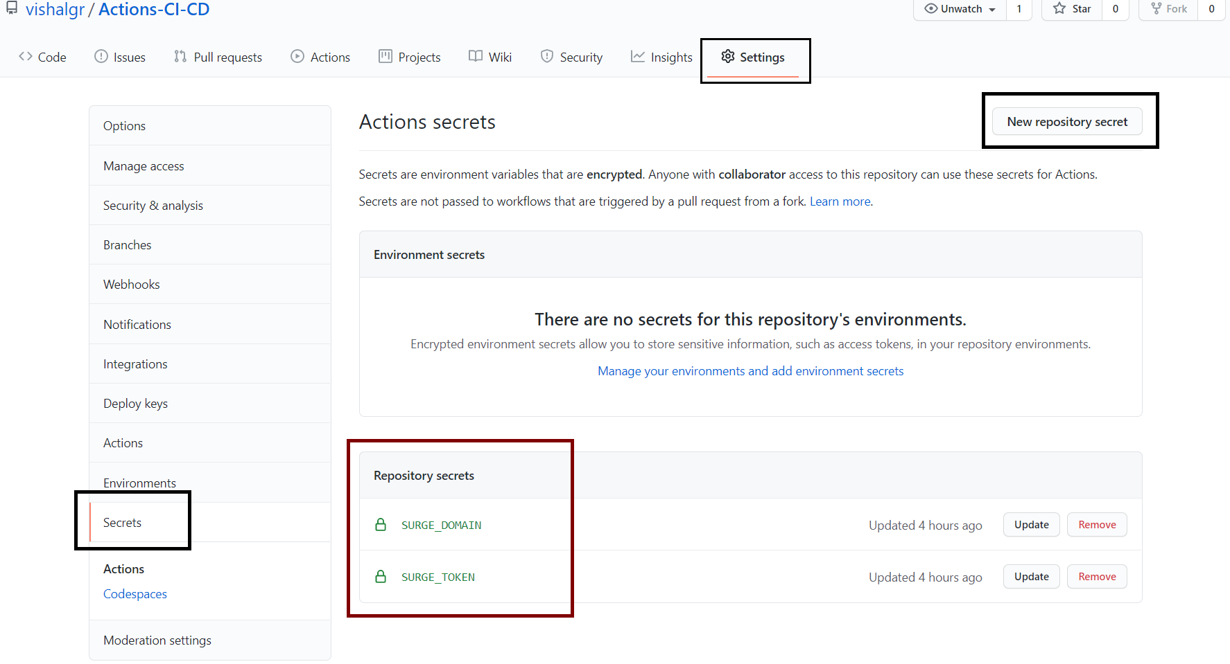
Where are Secrets ?

Slide 14
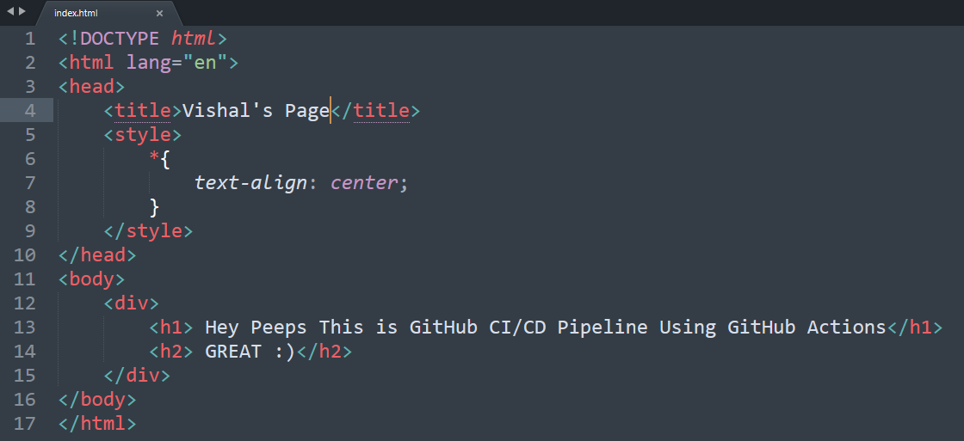
Sample HTML file

Slide 15
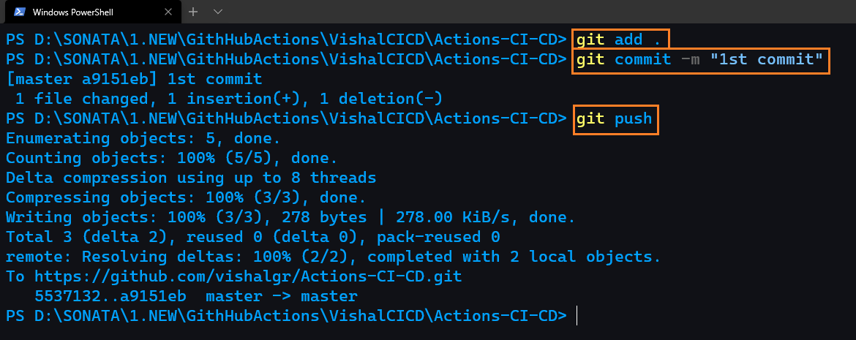
Committing Changes to GitHub

Slide 16
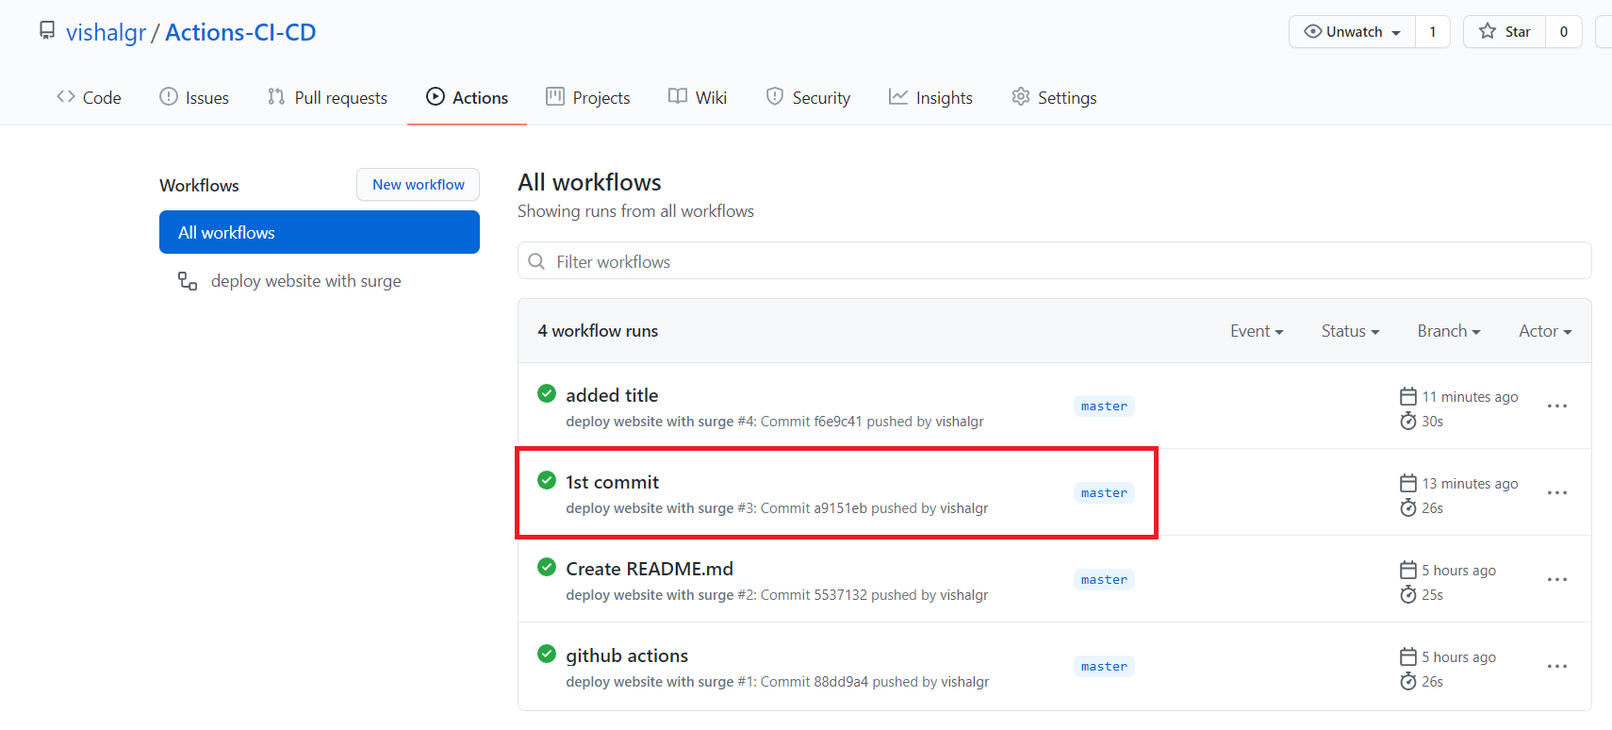
Action’s Triggered

Slide 17
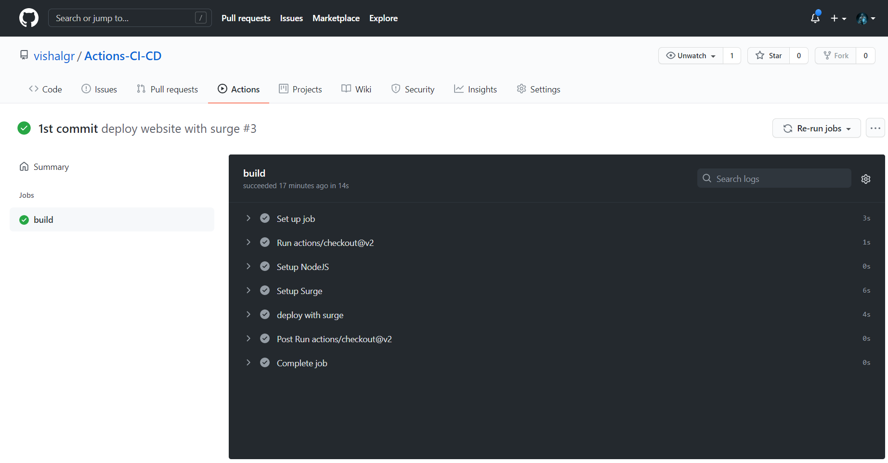

Slide 18
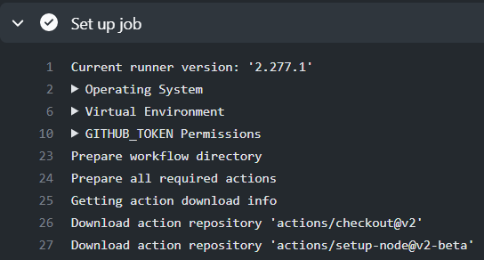
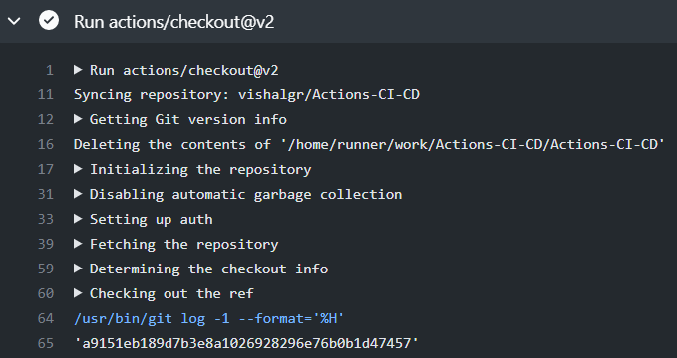
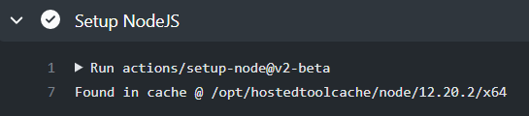

Slide 19
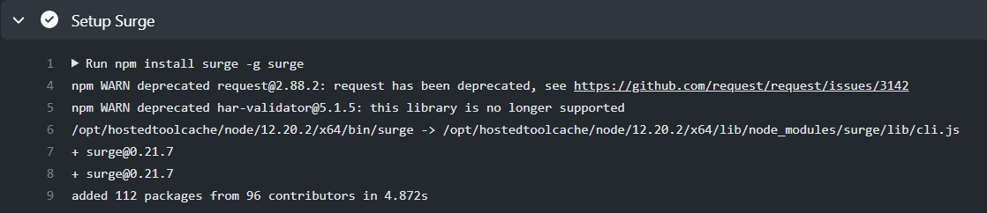
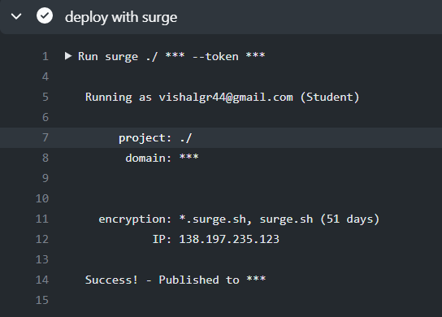

Slide 20
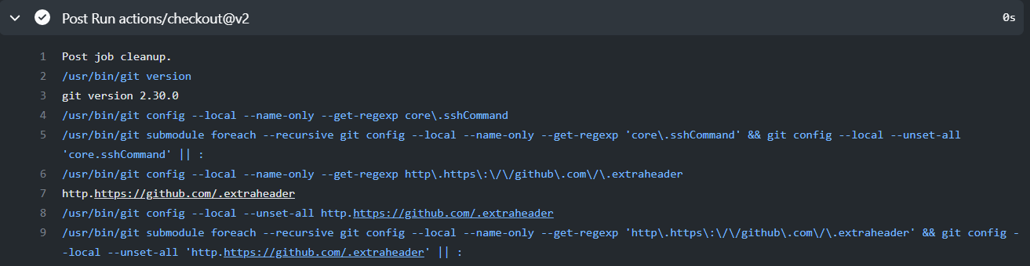

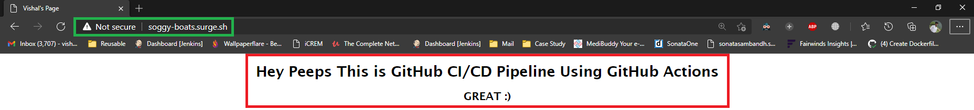

Slide 21
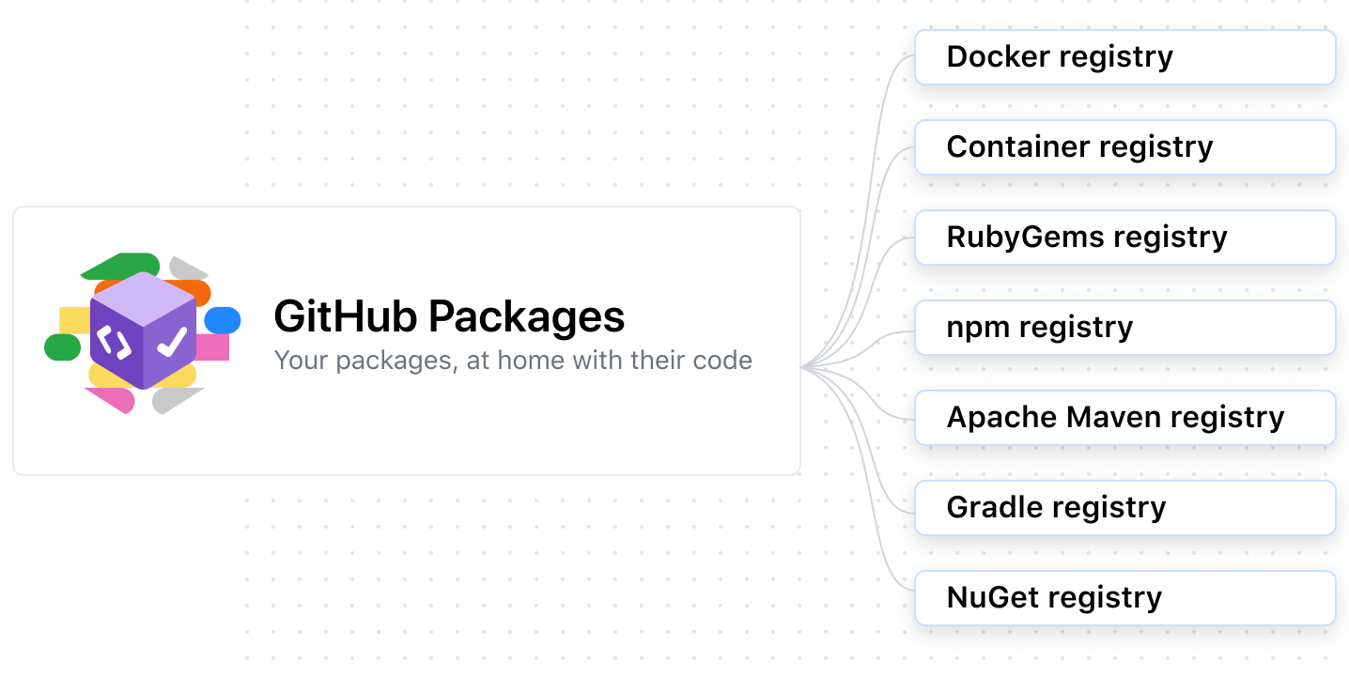
GitHub Packages
With GitHub Packages, you can safely publish and consume packages within your organization or with the entire world.
GitHub Packages is a platform for hosting and managing packages, including containers and other dependencies.
GitHub Packages is a platform for hosting and managing packages, including containers and other dependencies.
You can integrate GitHub Packages with GitHub APIs, GitHub Actions, and webhooks to create an end-to-end DevOps workflow that includes your code, CI, and deployment solutions.

Slide 22
THANK
YOU.
Notes:
https://www.freepik.com/

Slide 23
Table Of Contents
DevOps Overview
01
Conclusion
04
DevOps Use Case
02
Demo
05
DevOps Pros & Cons
03

