Slide 1
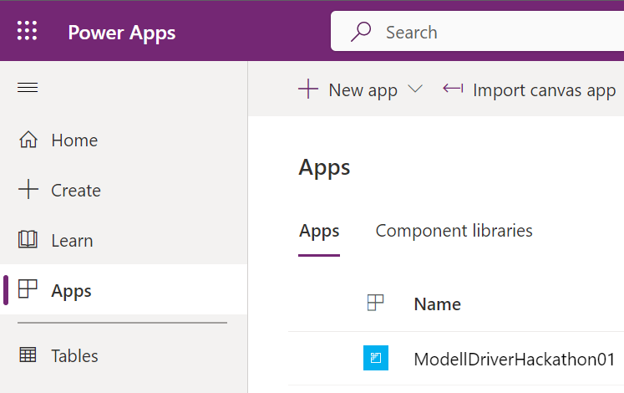
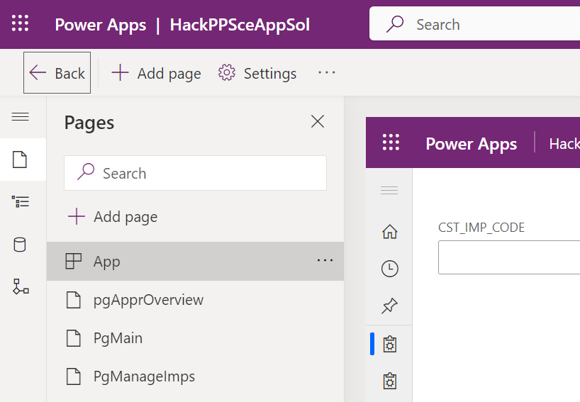
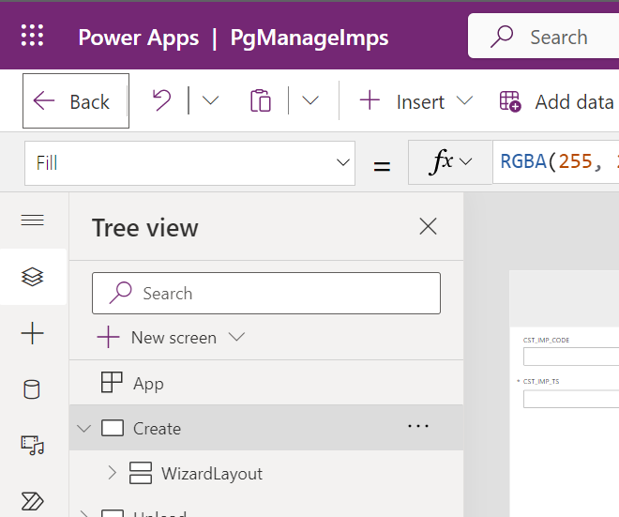
Entry Web Portal
Model driven app (Level: all pages)
Model driven app (Level: Concrete page)

Slide 2
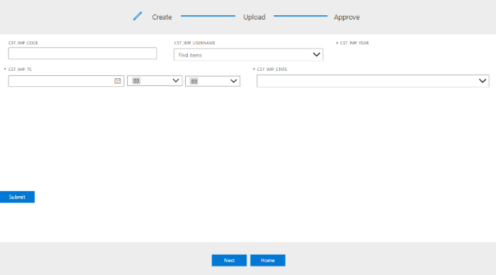
Main content to implement
Navigation to complete

Slide 3
IMP_STATE
IMP_RAW_HDR
USERS
1:N
N:2
1:N
N:1
IMP_DRIVER_TYPE
IMP_RAW
DEPS
1:N
N:1
IMP_ACC
1:N

