Slide 1
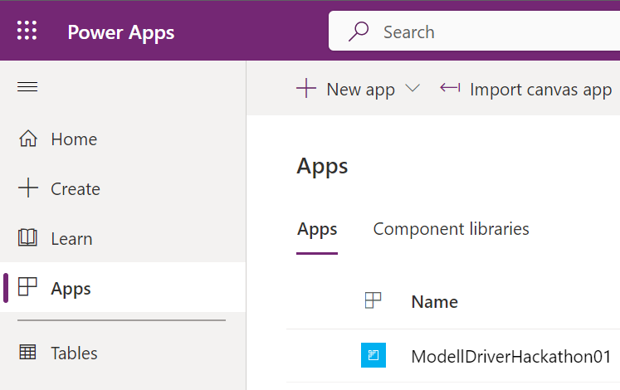
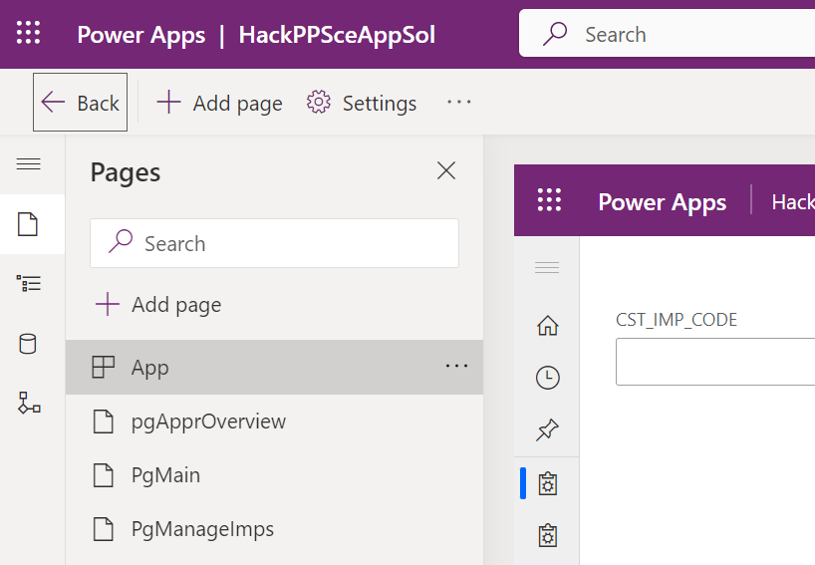
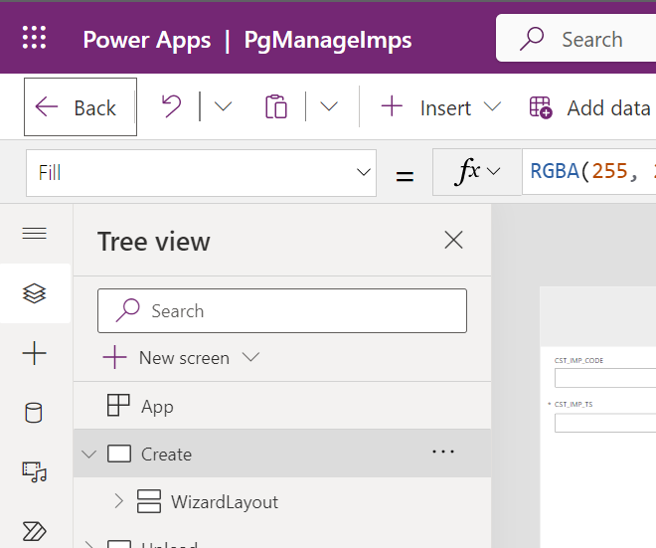
Entry Web Portal
Model driven app (Level: all pages)
Model driven app (Level: Concrete page)

Slide 2
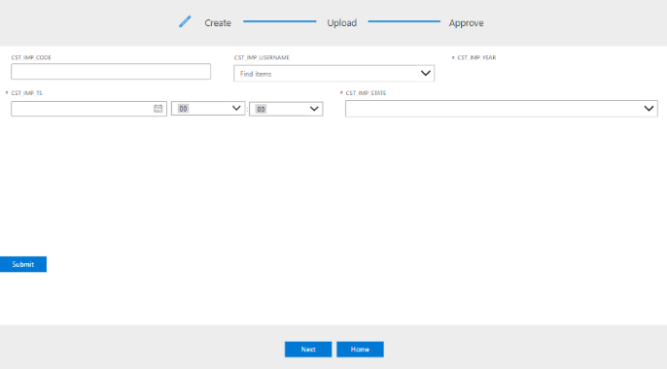
Main Content to imlement
Navigation to complete

