Slide 1
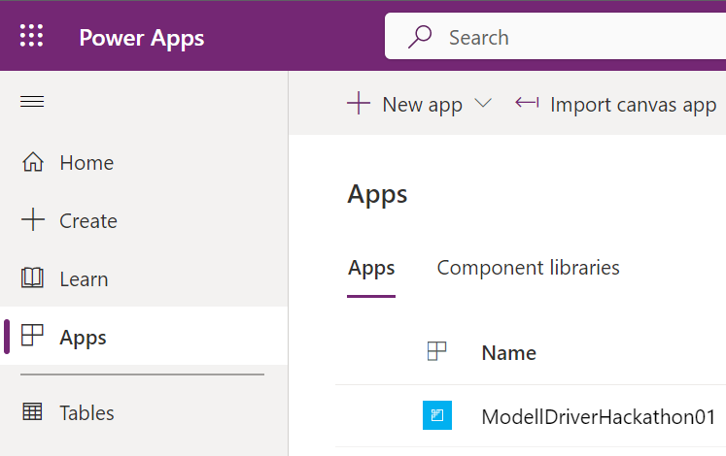
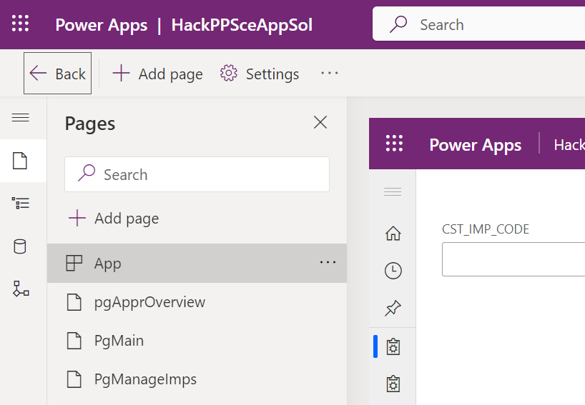
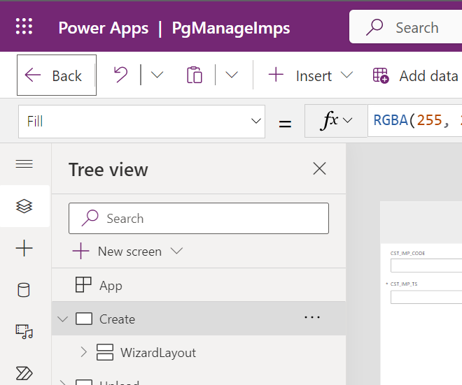
Entry Web Portal
Model driven app (Level: all pages)
Model driven app (Level: Concrete page)

Slide 2
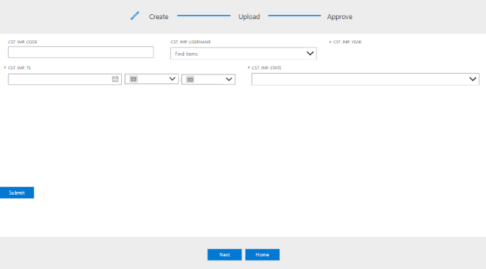
Main content to implement
Navigation to complete

