Slide 1
Zero to Hero
DevOps Malayalam
Azure Kubernetes Service
RAHUL RAJ V V
CLOUD & DEVOPS ARCHITECT

Slide 2
Contents
AKS Introduction
Working of AKS
AKS DEMO & Walkthrough
Deploying an Application
AKS networking
AKS storage
AKS security
AKS and Azure Active Directory

Slide 3
What is Kubernetes?
1. AKS Introduction
Opensource Platform
Orchestration tool
Used for managing and deploying a group of containers
What is AKS ?
AKS is a managed Kubernetes Cluster in Azure by offloading the operational overhead to Microsoft Azure
As a hosted Kubernetes service, Azure handles critical tasks, like health monitoring and maintenance

Slide 4
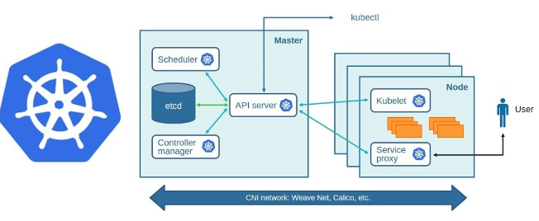
2. Working of AKS
Why AKS ?
Simple to deployment and manage
Identity And Management (IAM)
Logging and Monitoring
Cluster node Scales
Cluster node update
Master node is fully manage by Azure
Azure manages heath monitoring and maintenance
You have to manage only the agent node
Master node are free, pay only for agent node
Features

Slide 5
Create an AKS using Azure Portal
Create a simple docker image and Push to ACR
Walkthrough in AKS using CLI and UI (LENS)
AKS Demo & Walkthrough

Slide 6
Deploying an Application : Basics to know
Container
Container: Instance of an application
Pod: One or more containers
Node: Individual VM
Manifest: Yaml format file contains specifications
Deployment: one or more identical pod managed by Kubernetes
Pools: Group of Nodes
Pod1
Pod2
Deployment
Node1
Node2
Node3
Node4
Pool

Slide 7
AKS - Components
Pods
Deployments
Services
Ingress
Config Maps
Secrets
Storage Classes

Slide 8
Understanding AKS Workloads and Networks
Each pod is given a unique IP address
Pods consist of one or more containers that are always scheduled together
Deployments will fetch the image and communicate with rest of services
Deployments allow you to easily scale and perform rolling upgrades
Containers in a pod can speak to each other via localhost

Slide 9

AKS Networking
Services: Used to refer to a group of pods. types:, cluster IP, node Port, load balancer
Load Balancer : Type of extension of Node port type. It has a cluster Ip and one or more node port values
Ingress: Define how traffic outside the cluster is routed to inside the cluster. Usually implemented by a load balancer.
Node port: An open port on every node of your cluster. Creates a port mapping directly with the node, IP address and port
Cluster IP: Internal Traffic
Services

Slide 10
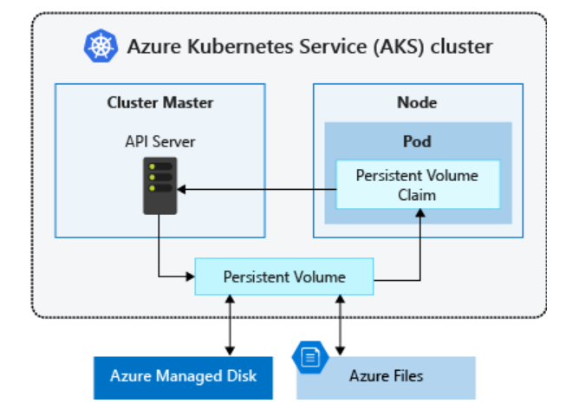
AKS Storage
Data stored in a pod is volatile.
Multiple pods share same data volume.
Storage Class — allows for dynamic provisioning of Persistent Volumes
Persistent Volume — representation of a storage volume ( Default namespace)
Persistent Volume Claim – Claims a PV with Satisfying condition ( Individual namespace)
Abstraction is for ease of use.
First the StorageClass is created, then the PersistentVolume and finally the PVC link to Pod

Slide 11
AKS Security
Master cluster is fully managed by Azure
Node are automatic security patches (when deployed/scaled).
Secrets and credential keys are stored in Kube secrets
Configurations are stored in Config maps
Private network will handle the network security.

Slide 12
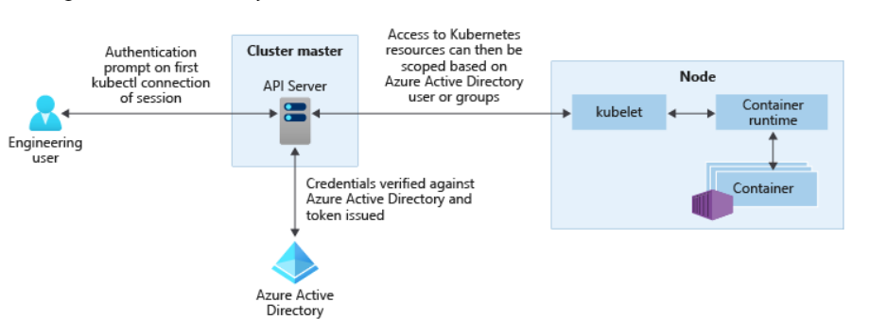
AKS and Azure Active Directory
AD as integrated identity solution for accessing AKS
Use service account, user account and RBAC.
Configure cluster roles and Role binding

Slide 13

Questions ?
Thank You!!

