Slide 1

우렁이 - 나동민

Slide 2
Docker Engine
Docker Engine
Host OS
Host OS
Server
Server

Slide 3
Control Plane(Master)
Docker Engine
Docker Engine
Host OS
Host OS
Server
Server
Worker Node
Worker Node

Slide 4
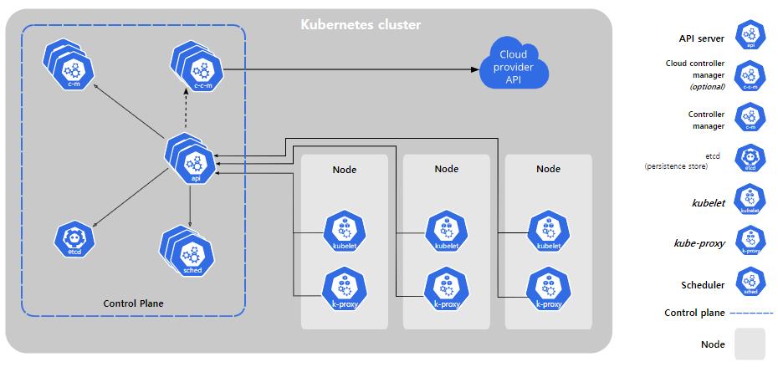

Slide 5
