Slide 1

Databricks and Azure with Datadog Integration
Enhanced Observability for Databricks and Azure platform

Slide 2




Implementation Overview
Objective
Comprehensive monitoring for Databricks and Azure using Datadog
Why
Improve visibility, troubleshooting speed, performance analysis
Components
Agents, Log Collection, Custom Metrics, Azure Integration

Slide 3
Cluster Metrics and Logs
Agent Installation
Metrics Collected
Logs Collected
All-purpose clusters
CPU Usage
Spark execution logs
Job compute clusters
Memory Utilization
Application logs
Auto-collection on start
Network Throughput
Detailed traces

Slide 4
Custom Metrics
System Tables
Workspace APIs
Benefits
Model Serving Endpoints Usage
Notebook execution times
Custom dashboards
Cost Monitoring
Job completion rates
Tailored alerts
Runtime metrics
User activity patterns
Precise monitoring

Slide 5
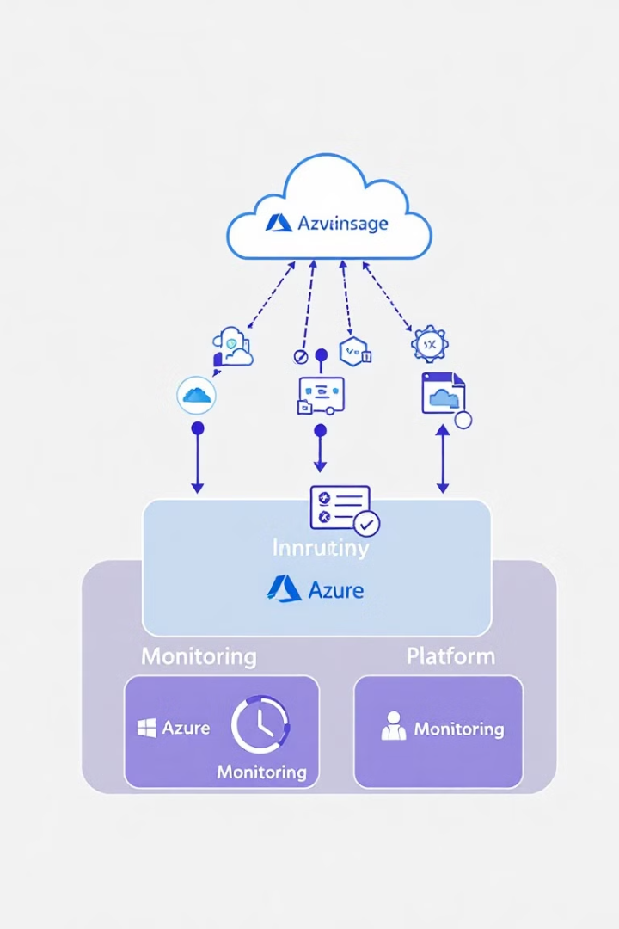



Azure & Datadog Integration
Azure Plugin Configuration
Out-of-box Monitoring
Direct connection between Azure and Datadog
Keyvault storage accounts, resource health and etc.
Unified Visibility
Azure resources alongside Databricks metrics

Slide 6








Forwarding Azure Resource Logs
Log Generation
Event Hub
Databricks workspace
Log collection point
Datadog API
Azure Function
Monitor and alert
Process and transform

Slide 7






Benefits Achieved
Improved Collaboration
Dev and Ops unified view
Reduced Downtime
Faster issue resolution
Enhanced Visibility
Quick issue detection

Slide 8
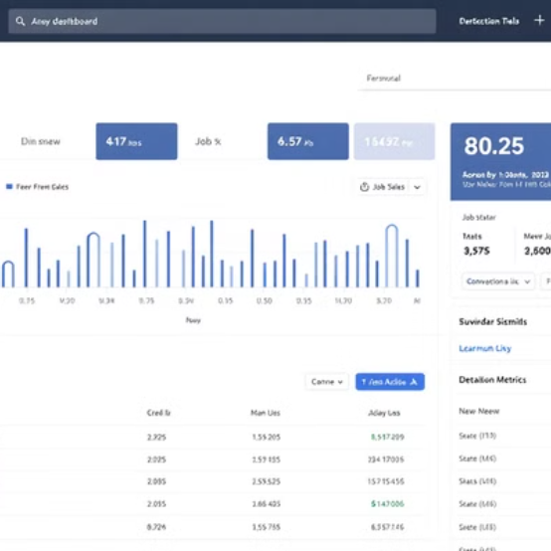
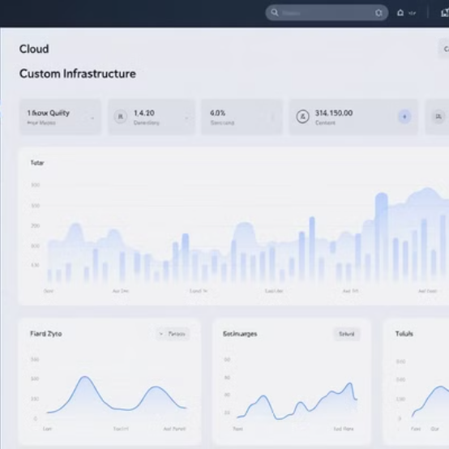
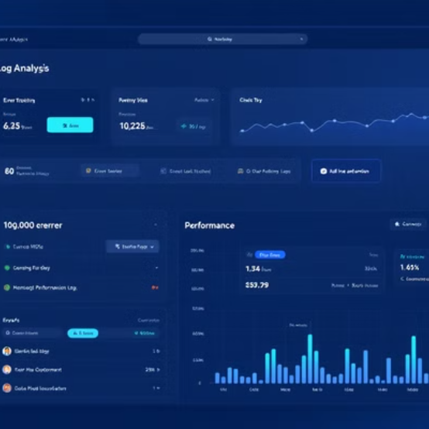
Dashboard Preview
Real-time metrics, logs, and alerts in action
Questions? We welcome your feedback!

