Slide 1
ANSIBLE
Introducton

Slide 2
INTRO TO ANSABLE
What is Ansible?
Why do we need Ansible?
Advantages of using Ansible
What Ansible can do?
Ansible Architecture
Ansible in DevOps
Real-Life usage of Ansible by NASA
Some Ansible terms, to help you understand Ansible better.

Slide 3
Ansible is an open source IT Configuration Management, Deployment & Orchestration tool. It aims to provide large productivity gains to a wide variety of automation challenges. This tool is very simple to use yet powerful enough to automate complex multi-tier IT application environments.

Slide 4
Why Do We Need Ansible?
beginning of networked computing when deploying and managing servers reliably and efficiently has been a challenge. Previously, system administrators managed servers by hand, installing software, changing configurations, and administering services on individual servers.
As data centers grew, and hosted applications became more complex
administrators realized they couldn’t scale their manual systems management as fast as the applications they were enabling.

Slide 5
Why Do We Need Ansible?
since the development team was agile and releasing software frequently, but IT operations were spending more time configuring the systems. That’s why server provisioning and configuration management tools came to flourish.
Consider the tedious routine of administering a server fleet. We always need to keep updating, pushing changes, copying files on them etc. These tasks make things very complicated and time consuming.

Slide 6
The solution is – Ansible.
familiarized with few Ansible terminologies:

Slide 7
Ansible Terms:
Controller Machine: The machine where Ansible is installed, responsible for running the provisioning on the servers you are managing.
Inventory: An initialization file that contains information about the servers you are managing.
Playbook: The entry point for Ansible provisioning, where the automation is defined through tasks using YAML format.
Task: A block that defines a single procedure to be executed, e.g. Install a package.

Slide 8
Module: A module typically abstracts a system task, like dealing with packages or creating and changing files. Ansible has a multitude of built-in modules, but you can also create custom ones.
Role: A pre-defined way for organizing playbooks and other files in order to facilitate sharing and reusing portions of a provisioning.
Play: A provisioning executed from start to finish is called a play. In simple words, execution of a playbook is called a play.
Facts: Global variables containing information about the system, like network interfaces or operating system.
Handlers: Used to trigger service status changes, like restarting or stopping a service.

Slide 9
Ansible is a helpful tool that allows you to create groups of machines, describe how these machines should be configured or what actions should be taken on them. Ansible issues all commands from a central location to perform these tasks.
No other client software is installed on the node machines. It uses SSH to connect to the nodes. Ansible only needs to be installed on the control machine (the machine from which you will be running commands) which can even be your laptop. It is a simple solution to a complicated problem.

Slide 10
Advantages Of Using Ansible
Simple: Ansible uses a simple syntax written in YAML called playbooks.
YAML is a human-readable data serialization language. It is extraordinarily simple.
So, no special coding skills are required and even people in your IT organization, who do not know what is Ansible can likely read a playbook and understand what is happening. Ansible always executes tasks in order. It is simple to install too (Don’t believe me? Check out my Ansible Installation blog). Altogether the simplicity ensures that you can get started quickly.

Slide 11

Advantages Of Using Ansible
Agentless: Finally, Ansible is completely agentless. There are no agents/software or additional firewall ports that you need to install on the client systems or hosts which you want to automate. You do not have to separately set up a management infrastructure which includes managing your entire systems, network and storage. Ansible further reduces the effort required for your team to start automating right away.

Slide 12

Advantages Of Using Ansible
Powerful & Flexible: Ansible has powerful features that can enable you to model even the most complex IT workflows.
In this aspect, Ansible’s batteries included approach (This philosophy means that something is self-sufficient, comes out-of-the-box ready to use, with everything that is needed) can manage the infrastructure, networks, operating systems and services that you are already using, as Ansible provides you with hundreds of modules to manage them.
Together Ansible’s capabilities allow you to orchestrate the entire application environment regardless of where it is deployed.

Slide 13

Advantages Of Using Ansible
Efficient: No extra software on your servers means more resources for your applications. Also, since Ansible modules work via JSON, Ansible is extensible with modules written in a programming language you already know. Ansible introduces modules as basic building blocks for your software. So, you can even customize it as per your needs. For e.g. If you have an existing message sending module which sends messages in plain-text, and you want to send images too, you can add image sending features on top of it.

Slide 14
What Ansible Can Do?
Ansible is usually grouped along with other Configuration Management tools like Puppet, Chef, SaltStack etc. Well, let me tell you, Ansible is not just limited to Configuration Management. It can be used in many different ways too. I have mentioned some of them below:

Slide 15
What Ansible Can Do?
Provisioning
Configuration Management
Application Deployment
Security and Compliance
Orchestration

Slide 16
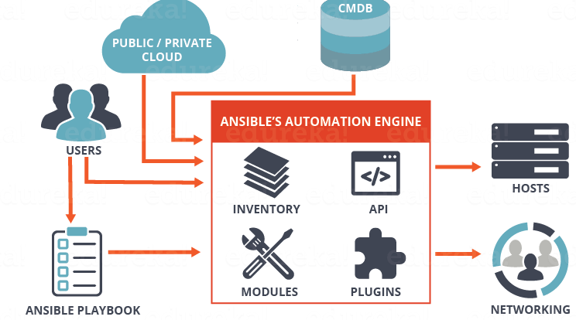
What is Ansible & its Architecture?

Slide 17
The Ansible Automation engine consists of:
Inventories: Ansible inventories are lists of hosts (nodes) along with their IP addresses, servers, databases etc. which needs to be managed. Ansible then takes action via a transport – SSH for UNIX, Linux or Networking devices and WinRM for Windows system.
APIs: APIs in Ansible are used as transport for Cloud services, public or private.
Modules: Modules are executed directly on remote hosts through playbooks. The modules can control system resources, like services, packages, or files (anything really), or execute system commands. Modules do it by acting on system files, installing packages or making API calls to the service network. There are over 450 Ansible-provided modules that automate nearly every part of your environment. For e.g.
Cloud Modules like cloudformation which creates or deletes an AWS cloud formation stack;
Database modules like mssql_db which removes MYSQL databases from remote hosts.
Plugins: Plugins allows to execute Ansible tasks as a job build step. Plugins are pieces of code that augment Ansible’s core functionality. Ansible ships with a number of handy plugins, and you can easily write your own. For example,
Action plugins are front ends to modules and can execute tasks on the controller before calling the modules themselves.
Cache plugins are used to keep a cache of ‘facts’ to avoid costly fact-gathering operations.
Callback plugins enable you to hook into Ansible events for display or logging purposes

Slide 18
The Ansible Automation engine consists of:
Networking: Ansible can also be used to automate different networks. Ansible uses the same simple, powerful, and the agentless automation framework IT operations and development are already using. It uses a data model (a playbook or role) that is separate from the Ansible automation engine that easily spans different network hardware.
Hosts: The hosts in the Ansible architecture are just node systems which are getting automated by Ansible. It can be any kind of machine – Windows, Linux, RedHat etc.
Playbooks: Playbooks are simple files written in YAML format which describes the tasks to be executed by Ansible. Playbooks can declare configurations, but they can also orchestrate the steps of any manual ordered process, even if it contains jump statements. They can launch tasks synchronously or asynchronously.

Slide 19
The Ansible Automation engine consists of:
CMDB : It is a repository that acts as a data warehouse for IT installations. It holds data relating to a collection of IT assets (commonly referred to as configuration items (CI)), as well as to describe relationships between such assets.
Cloud: It is a network of remote servers hosted on the Internet to store, manage, and process data, rather than a local server. You can launch your resources and instances on cloud and connect to your servers.

Slide 20
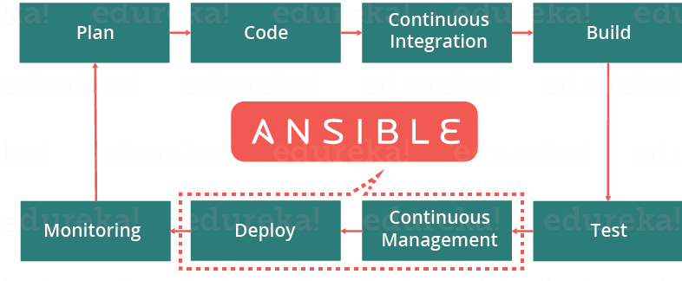
What is Ansible in DevOps

Slide 21
INSTALLATION OF ANSIBLE

Slide 22
Virtualization technology for Labs
VirtualBox
VMWare Workstation
Cloud – AWS
Cloud – GCP
Cloud - Azure

Slide 23
Programming Languages for Demonstrations
Python
Ruby
NodeJS
Go
Java
C
.Net
Shell Scripting
Powershell
Python
Ruby
NodeJS
Go
Java
C
.Net
Shell Scripting
Powershell
Python
Java
C
.net etc

Slide 24
How to install ansible on AWS ec2 instances
to install ansible on Amazon Linux or to setup ansible lab in aws we need two or three ec2 instances. one is ansible master ec2 instance remaining ec2 instances are clients. in the master ec2 instance only we will install ansible.

Slide 25
Launch three or two ubuntu 16.04 instances
give Name one ubuntu ec2 instances as ansible-master
give remaining ec2 instances names as client1, clinet2
in both ansible master and clients security groups
open ssh port no 22 from anywhere

Slide 26
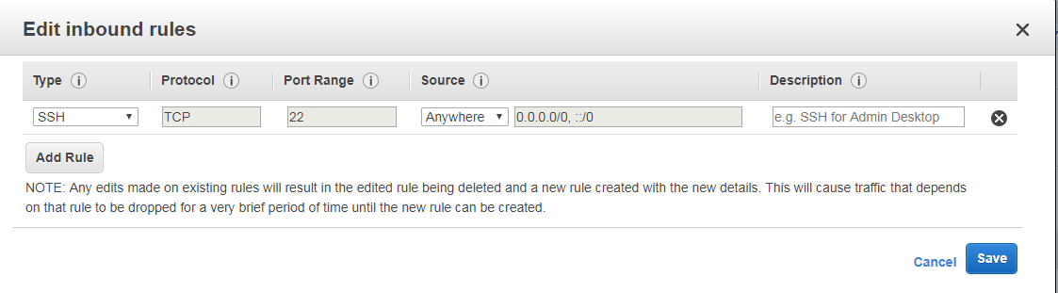
install python in ansible master and clients instances

Slide 27
install python in ansible master and clients instances
ansible and its modules are built on python, so we have to install python in all master and client machines.
to install python execute below commands as root user

Slide 28
How to Install Ansible on AWS EC2 Instance RHEL 8
Go to your AWS management console and launch an RHEL instance. Use Putty/MobaXterm to SSH into the instances once they start running.
Step 2:
Next, we will be installing Python3 in our RHEL 8 EC2 instances. If you have a special requirement of Python2, mention Python2 in the command, otherwise use the command below as is.
#yum install python3 -y

Slide 29
How to Install Ansible on AWS EC2 Instance RHEL 8
#alternatives — set python /usr/bin/python3
Step 3:
Now, you must install Python3-pip on the instance. Pip is a package manager for Python that allows you to install and manage additional Python packages which are not part of the standard python library.
#yum -y install python3-pip

Slide 30
How to Install Ansible on AWS EC2 Instance RHEL 8
Step 4:
We wouldn’t be able to install Ansible as a root user here, because in RHEL 8, this operation is not allowed. So, we are going to create a new user and setup a password for it.
#useradd ansiblecontrol

Slide 31
How to Install Ansible on AWS EC2 Instance RHEL 8
#passwd ansiblecontrol
For the second instance, create a user named, “managedhost” and setup a password for it as well.
Once completed, we should add the user ‘ansiblecontrol’ to sudoers file for sudo access. Use the command below to do that.
#echo “ansiblecontrol ALL=(ALL) NOPASSWD: ALL” >> /etc/sudoers
Similarly, repeat the above with the user “managedhost” in the second instance.

Slide 32
How to Install Ansible on AWS EC2 Instance RHEL 8
Step 5:The control node, also referred to as Ansible Master, connects to the managed host using SSH. Though using key-based authentication is recommended, when you are at a learning stage, use password-based authentication.
#vi /etc/ssh/sshd_config

