Slide 1
Bimodal IT
And other snakeoil
Notes:
Hi everyone, this is my talk on Bimodal IT.

Slide 2
Me:
@KrisSaxton
Recovering systems engineer
Founding partner of Automation Logic
Notes:
Career spanning 15 years in IT, 10 in Datacentre automation, the last 5 as a founder and consultant with my company Automation Logic.

Slide 3
Automation Logic
UK’s leading independant enterprise automation company
Early years building private clouds
Cloud adoption/migration
Bimodal here ^
Notes:
We've built up loads of experience in enterprise cloud adoption & migration - and we've realised that they're aren't many people out there than can do it, and even fewer who want to. Today's that's where we focus and have built up a team of guys with both old school and leading edge skills to achieve it..
And it’s as part of those adventures around cloud adoption that I first learned about Bimodal IT.

Slide 4
What is Bimodal IT?
“Bimodal IT is the practise of managing two separate, coherent modes of IT delivery, one focused on stability and the other on agility.
Mode 1 is traditional and sequential, emphasizing safety and accuracy.
Mode 2 is exploratory and nonlinear, emphasizing agility and speed”
Gartner 2014
Notes:
From Gartner 2014

Slide 5
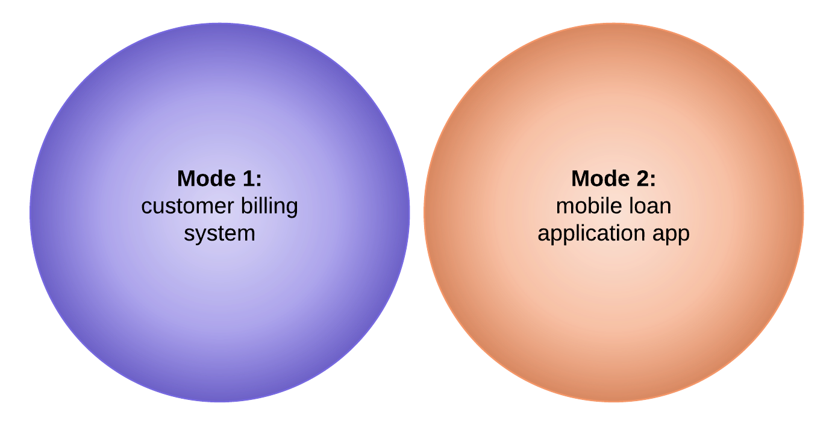
Example:
Notes:
Mode 1 service: central customer register
Been around a while,
It’s stable although there’s still change (maintenance, updates)
The availability of the service is critical
There’s a well establish incident & change process based around ITIL principles
Mode 2 service: mobile app for loan applications
New
It’s in a high state of flux
The availability of the service important, but it’s in beta
It’s developed in an agile way by a dedicated product team

Slide 6

eh?
Notes:
I was at a public cloud conference when I first heard about Bimodal IT, and well I just didn’t get it. I was then (and still am) engaged in several cloud migration projects and my experiences on those engagements just didn’t tally up with what Bimodal IT seemed to be advocating. So, in that conference in fact, I penned a synopsis for this talk to Barry and DevOpsDays team and now here I am.

Slide 7
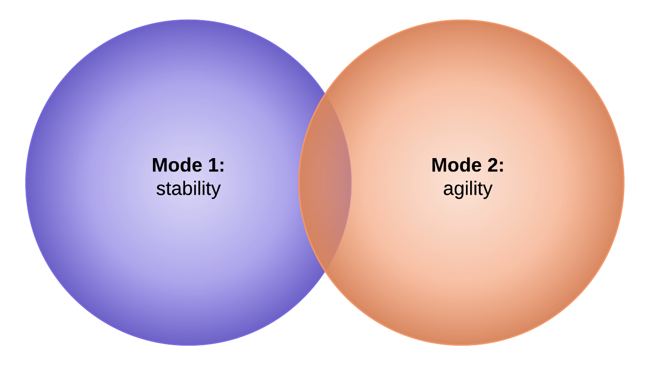
Why is Bimodal IT Problematic?
Seems sane, but..
oversimplification
counterproductive
Notes:
Now slightly less glib and in greater detail, why is this such a problem? The detail of how to innovate within a large enterprise is broadly sensible.
There are indeed many systems with different risk & maturity profiles and which experience different rates of change. But Bimodal’s broad brush approach to classification is an oversimplification for me, and as vision which communicates the intent of the CIO to everyone in the organisation it’s even more problematic.

Slide 8
Specifically
Innovation
Risk vs Agility
Culture
Notes:
What I’m going to argue in this talk It’s problematic from the perspective of its ability to foster long term innovation, and it’s wrong in its assumptions around agility vs risk and it’s problematic in that is works against a culture of collaboration.

Slide 9

Innovation
The illusion of innovation,
then death
Notes:
Bimodal IT is supposed to protect innovation in our Mode 2 world, but I think it only allows the illusion of innovation, and that illusion is short lived.
Innovation within a Bimodal model is like fresh cut flowers. You get an initial blooming and then death, why? Because the organism isn’t connected to an ecosystem that allows it to take root.
What do I mean by ecosystem? Well, how many services within a large enterprise such as within finance operate in complete isolation? I would hazzard, none. And where are the related services and data that these new services need to get access to? More often than not they’re on the other side of the fence (the fence we just built for ourselves to protect our innovation). So we can build services in our fenced off Mode 2 world., but they aren’t going to be able to connect to anything that will allow them to become genuine innovations in the market. By dependant services I mean Mode 1 services that I gave in the example; your subscriber databases, your active directories, your systems of record.

Slide 10

Innovation
Coupled systems move at the pace of the slowest
Notes:
To be fair to Gartner, their Bimodal approach does allow for some limited data exchange between the two modes, but if we’ve decided that we aren’t going to tackle modernising these mode 1 services (because we’re focused on stability) but we are going to hook them up to our new digital services, then we have to follow that to its logical conclusion which is that the evolution of everything along the value chain will slow down to the pace that can be supported by the slowest component, the system of record. So we just hitched up our supercar to a supertanker. Innovation is dead,
Either we can’t get to the data to make our new services relevant or if we can, we’ve coupled ourselves to a system which kills our ability to move fast.

Slide 11
Risk vs Agility
“Gartner’s model rests on a false assumption that is still pervasive in our industry:
that we must trade off responsiveness against reliability….
...This assumption is wrong.”
Jez Humble
Notes:
The other big internal inconsistency with Bimodal it is around risk.
The conventional wisdom is that if we make changes to our products and services faster and more frequently, we will reduce their stability, increase our costs, and compromise on quality.
This is one of the areas of Bimodal IT which is least internally consistent. On data, there’s scope within the detail of Bimodal IT for data exchange. On culture I think that’s a case of unforeseen consequences, but on the splitting the org into one area focused on stability and the other on agility, Bimodal IT just has it flat out wrong.

Slide 12
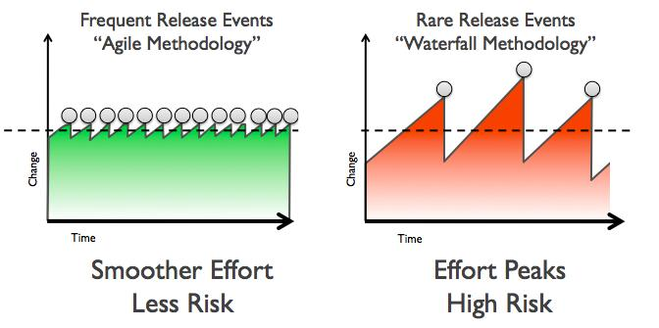
Risk vs Agility
Frequent change
Low risk
Short MTTR
Notes:
The error at the heart of it is thinking that risk and agility are in some way mutually exclusive, whereas in fact they are the happiest of bed fellows. Errors may be more frequent with an agile approach, because we’re making more changes, but regular, small changes means each change has a much smaller potential blast radius and crucially, the MTTR (x168) for each change is proportionally smaller. I’m preaching to the choir here I know.
For a given set of changes, agile can and does deliver those changes with lower risk. For evidence of this, again check out Jez Humbles blog.
So with Bimodal advocating not pushing for things like continuous delivery we’re stuck with either large changes or no change, and that’s just a recipe for disaster.

Slide 13


Risk vs Agility
vs
Notes:
I’ll use an analogy of when I was working in ISPs and responsible for some fairly traditional but large IT services, email, DNS that type of thing.
My anxiety levels as the engineer responsible for those services actually rose the longer the service had been without a change, which might seem counterintuitive.
It was only immediately after an upgrade or some kind of intervention that I had confidence that the service was actually working well.
Agile gives you that feeling at much more regular intervals. You’re still defusing, but your handling matches, not 1000lbs bombs.

Slide 14
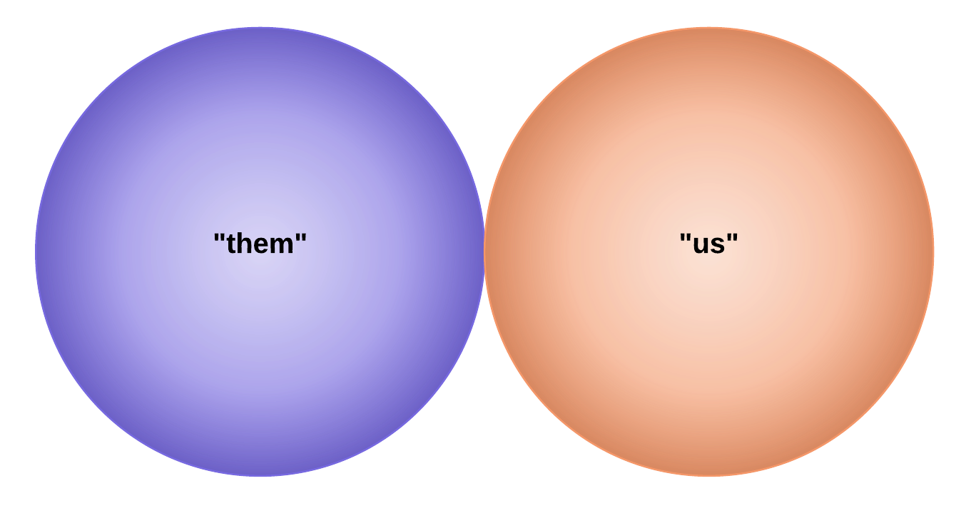
Culture
Notes:
But as someone who’s actively engaged in transformation projects bringing these two modes together, the biggest problem for me with Bimodal IT is it’s cultural impact.
The cultural impact that’s the result of us drawing a boundary around a particular set of technologies or practices (Mode 1 and Mode 2 for shorthand) and, in doing so, not being aware that we’re also creating an organisational or a cultural boundary. We’re creating a them and us.

Slide 15
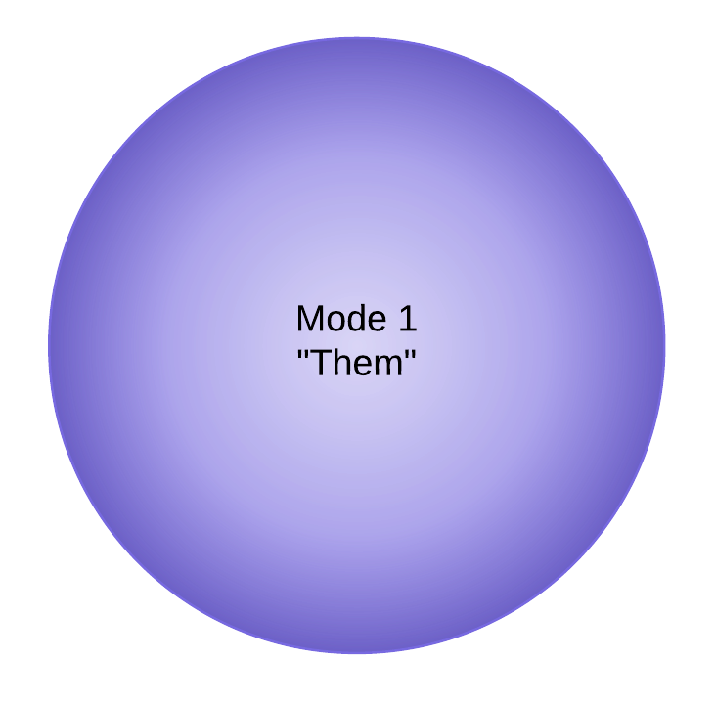
Them?
Reactionary
Outdated
Blockers
Notes:
Typical pejorative comments I hear when working with digital service teams, of course they are always making these comments when they need something from a team on the other side of the fence.

Slide 16
Them?
Domain knowledge
Organisational experience
Skilled IT practitioners
Notes:
People with enormous amounts of domain knowledge about the business we’re trying to transform and the IT services we’re trying to replace or renew.
People with lots of experience about the internal structure of your organisation and how to get things done.
People with IT skills, OK maybe not with the types of tools and techniques we like to use in our innovation bubble but IT none the less and many are really up for the challenge of learning something new.

Slide 17
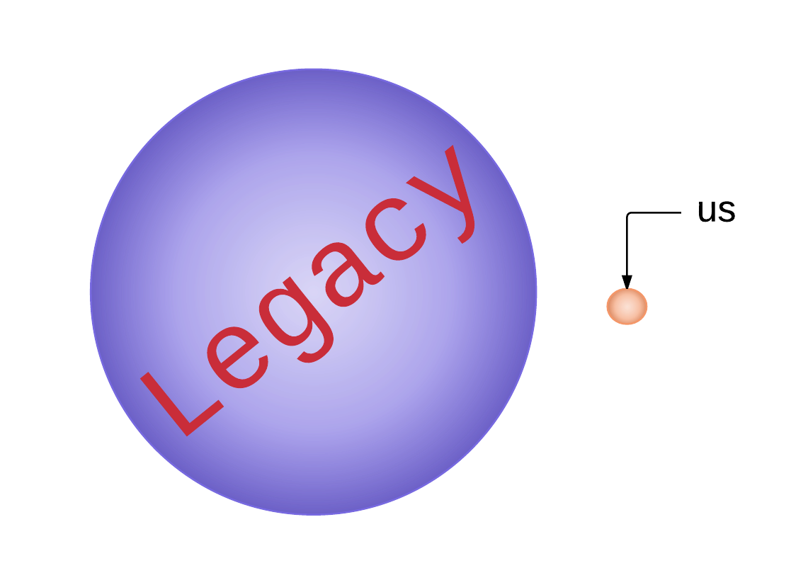
Culture
Notes:
And I’ve chosen to give you a feel of the relative scale of these two modes, Staff, number of services, relevance to today’s business and budget. 5:1 -> 100:1 £10m vs £1billion
So how does relate to Bimodal IT?
Well, even if we go with the Bimodal approach and stick to some kind of minimal interaction between new and old worlds, just enough to get at the data we need to make our new services viable. We still need to engage with the teams in the existing environment as part of putting in place the mechanisms to access the data therein.
So what kind of reaction do we think we’re going to get when we draw a big circle around everything that our colleagues have built and stand-for and call it ‘legacy’ (a common synonym for Mode 1 IT) not worthy of anything other than risk mitigation while we work on innovating it into irrelevance.

Slide 18
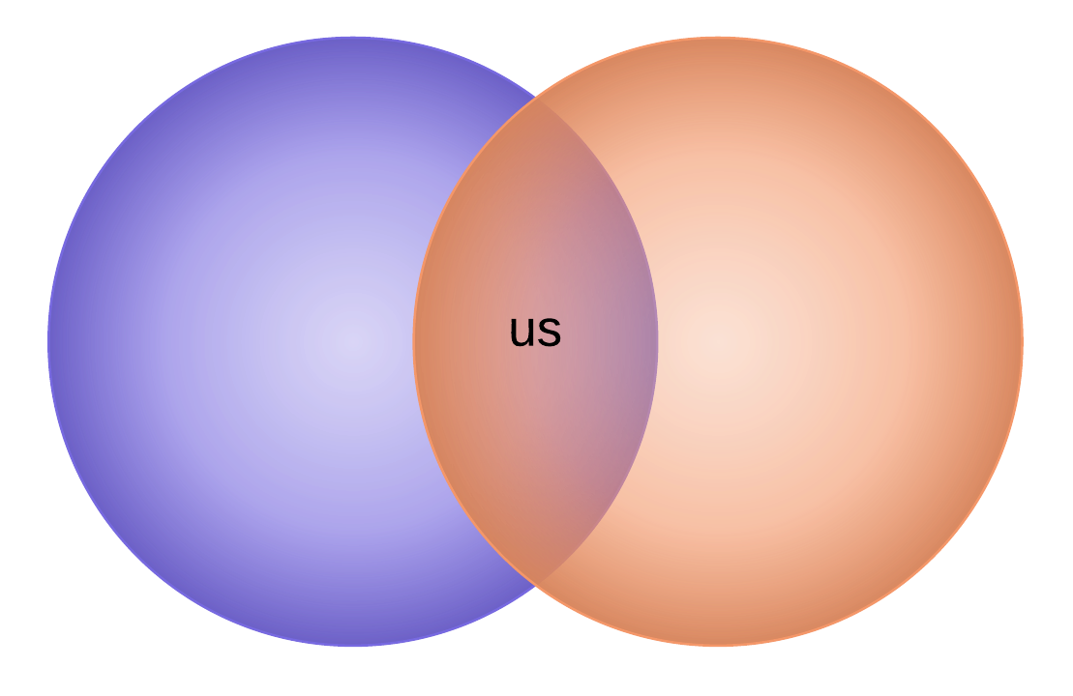
Culture
Notes:
So, when there’s a general recognition amongst technologists that the cultural aspects of transformation are typically harder than the technology ones (or at least harder for us), we need to be not just cognisant but actively focused on getting the conditions for successful collaboration right and Bimodal sends out a message which makes all that harder?

Slide 19
Current State?
Stalled transformation?
from ‘is’ to ‘aught’?
Notes:
So what is it about Bimodal IT that seems to compelling? It’s simplicity for one, but really for what Bimodal IT is a description of the state we’re currently in, not as a result of deliberate strategy but due to the fact that transforming how people work together and delivery IT is a difficult thing to do. I think many of these initial efforts at transformation have or are stalling and Bimodal is where you end up when you don’t keep going, keep trying.
Bimodal IT is an attempt to go from an ‘is’ to an ‘aught’ when actually what we need to be doing as an industry is pushing on, and moving beyond Bimodal as fast as we possibly can.

Slide 20

Alternatives?
Notes:
OK, so that’s probably something like 15 mins of solid negativity.
Time to get positive.
What’s an alternative strategy to Bimodal IT?
That’s a tough one as I don’t really see Bimodal IT as a strategy, it’s just an method of classification that I don’t find particularly useful or helpful.
So my alternative would be to simply avoid framing things in a Bimodal IT way, and keep working within strategies that are transformative and bring together existing and new IT practices.
Technology Strategies that I think really help that are microservices, shift left and cloud adoption (private if you have to, public if you can),. Shift left being from Mode 1, microservices from Mode 2 and cloud adoption prevalent in both.

Slide 21
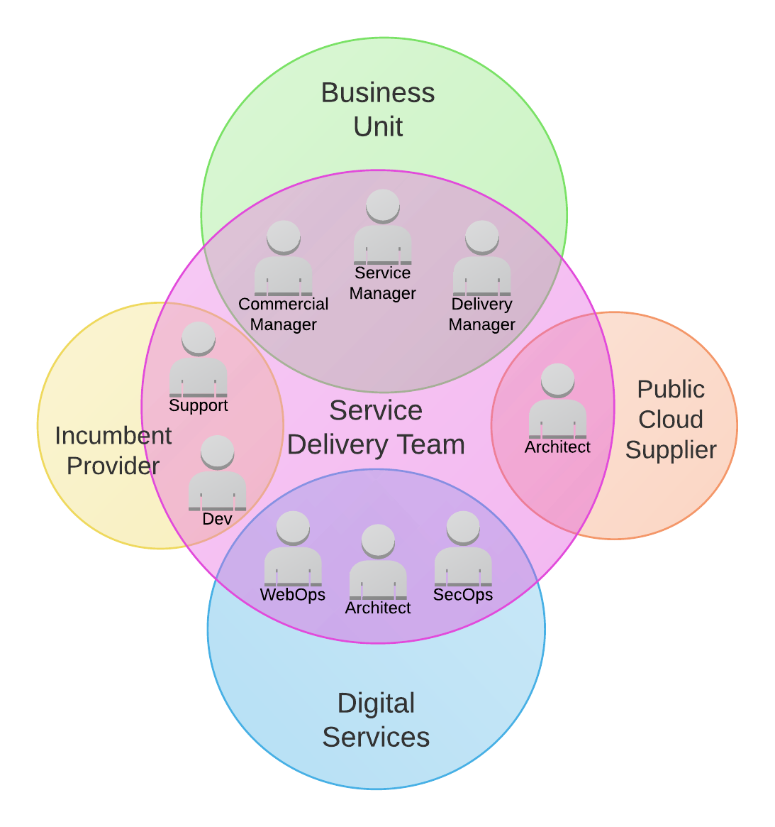
Alternatives?
Multi-disciplinary teams
People-focused (culture)
Relatively cheap
Small scope, scalable
Notes:
But if there’s one thing that I would say is an opposite to Bimodal IT it’s actually an organisational strategy rather than an IT delivery one and that’s working in small, multidisciplinary, teams oriented around a service or product. The types of teams pioneered by the likes of Netflix and AWS
It’s a solution which gets right to the heart of the cultural challenges of IT transformation because it’s focused on people and getting them working together.
It’s low cost, small in scope and allows you to experiment with new and existing ways of working. When you hit success, it’s easy enough to scale.
And although these teams don’t prescribe any particular processes or techniques as part of getting the job done (I’ve done it with ITIL and agile alike), the reason this should feel comfortable with much of the audience is that it’s straight out of the agile manifesto in that it focuses on individuals and interactions over people and processes.

Slide 22
Conclusion
“That whole movement around two-phase IT, we are not subscribing to that. You bring everybody along with you, you make sure the whole team is on that journey.”
Finbarr Joy (CTO) William Hill
Bimodal IT is snakeoil & counterproductive
Keep transforming
Focus on people
Notes:
To recap Bimodal IT fails as a strategy: It fails to nurture long term innovation, it actively erodes collaboration within an organisation and it doesn’t necessarily bring about one of its main aims which is to mitigate risk.
Instead focus on people, empowering service delivery teams and trusting them with the autonomy to get the job done. They won’t disappoint.

Slide 23
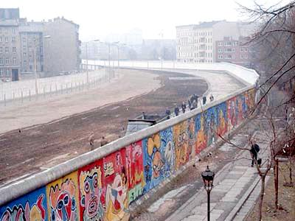
Sorry about that ->

Slide 24
Further reading
Jez Humble:
http://continuousdelivery.com/2016/04/the-flaw-at-the-heart-of-bimodal-it/
Rob England:
http://www.itskeptic.org/content/multi-speed-it
Simon Wardley:
http://blog.gardeviance.org/2014/11/how-we-used-to-organise-stuff.html

Slide 25
Thank You:
Questions?
@KrisSaxton
www.automationlogic.com/blog

