Slide 1

aol

Slide 2
Logistics
WiFi – SSID: Public
Restrooms
Exits
Live Stream
#devopsdays
devopsdaysdc.org

Slide 3
Schedule at a Glance
9:00 – Keynotes
10:35 – Morning Break
12:05 – Ignite Talks
12:20 – Open Space Agenda
1:00 – Lunch
2:00 – Ignite Talks
2:20 – Open Spaces
3:30 – Afternoon Break
4:50 – Evening News
6:00 – Happy Hour at the Carlyle Club

Slide 4


Staff & Volunteers

Slide 5
Etherpad
e.devopsdaysdc.org
We Are Hiring
Looking for Work
Reading List
Social Media
Feedback on DevOpsDays DC

Slide 6


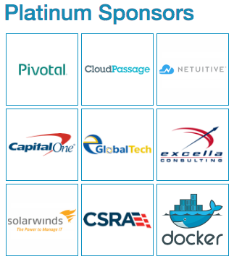
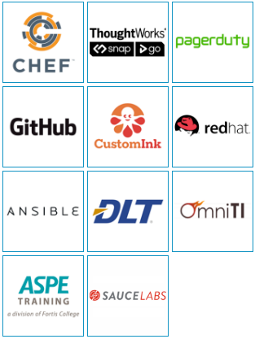
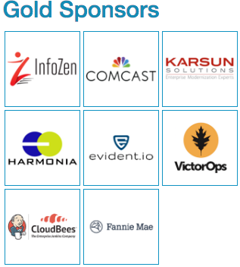

Sponsors

Slide 7
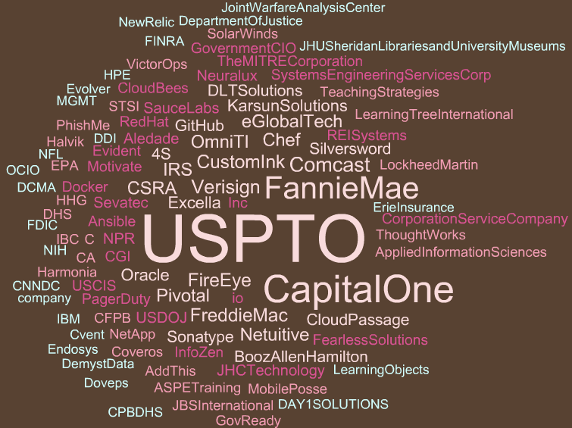

Slide 8
aol

Slide 9
Open Spaces
Initial Conditions
Expected Outcomes
Principles
Law of Mobility
Frien-DA
Building the Schedule
Facilitators
Scribes
Participants
The spaces

Slide 10
aol

Slide 11
Logistics
WiFi – SSID: Public
Restrooms
Exits
Live Stream
#devopsdays
devopsdaysdc.org

Slide 12
Schedule at a Glance
9:00 – Keynotes
10:25 – Morning Break
11:55 – Ignite Talks
12:25 – Open Space Agenda
1:00 – Lunch
2:00 – Open Spaces
4:15 – DevOpsDays Podcast

Slide 13
Staff & Volunteers

Slide 14
Etherpad
e.devopsdaysdc.org
We Are Hiring
Looking for Work
Reading List
Social Media
Feedback on DevOpsDays DC

Slide 15
Sponsors

Slide 16
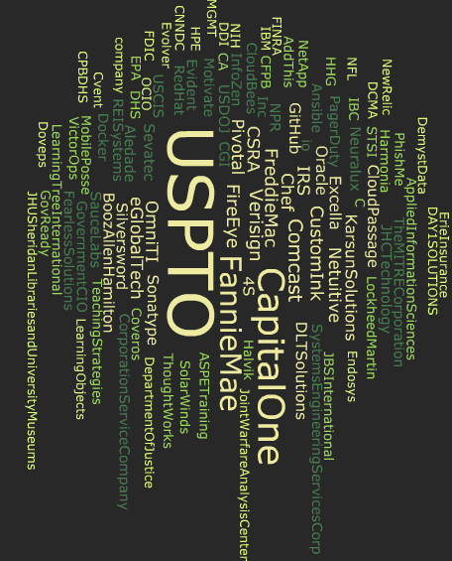

Slide 17
aol

Slide 18
Open Spaces
Initial Conditions
Expected Outcomes
Principles
Law of Mobility
Frien-DA
Building the Schedule
Facilitators
Scribes
Participants
The spaces

