Slide 1

aol
Logo Designed by
Terry Watkins

Slide 2

Event Massages provided by…
http://www.massagewithbecki.com

Slide 3

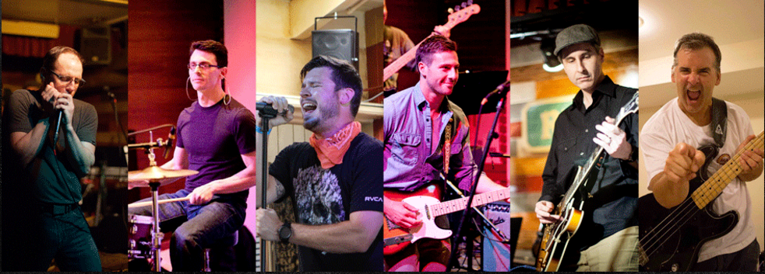

Slide 4

Happy Hour Sponsor
@aol_inc

Slide 5

Platinum & Venue Sponsor
@uspto

Slide 6
Happy Hour Schedule 6:00 PM – 9:00 PM
6:00 PM –
Networking, Drinks and Food
7:00 PM –
Detached Retina (Band)
9:00 PM – Happy Hour Ends
9:01 PM –
Be safe! See you tomorrow

Slide 7

Happy Hour Sponsor
@opsgenie

Slide 8
aol
Logo Designed by
Terry Watkins

Slide 9
Thursday Schedule at a Glance
9:00 – Keynotes
10:25 – Morning Break
11:55 – Ignite Talks
12:25 – Open Space Agenda
1:00 – Lunch
2:00 – Open Spaces
4:15 – DevOpsDays Podcast

Slide 10
Happy Hour Sponsor
@aol_inc

Slide 12

Our gracious Happy Hour hosts

Slide 13

Happy Hour Massages
http://www.massagewithbecki.com

Slide 14
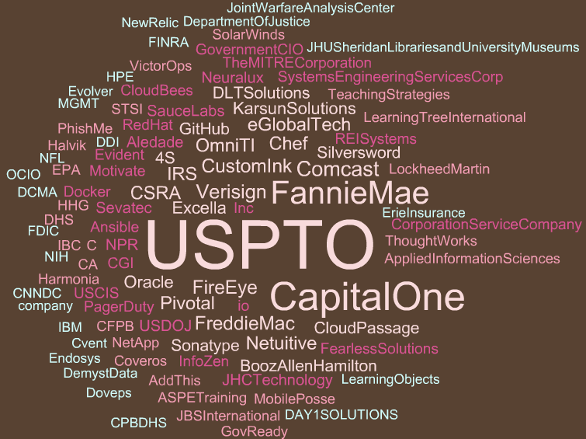

Slide 15
aol
Logo Designed by
Terry Watkins

Slide 16
Happy Hour Sponsor
@opsgenie

Slide 17
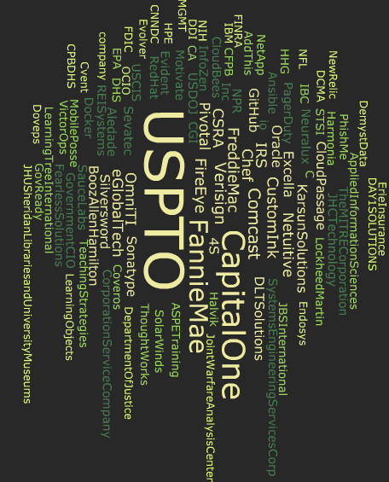

Slide 18
aol
Logo Designed by
Terry Watkins

Slide 19
Happy Hour Sponsor
@aol_inc

Slide 20
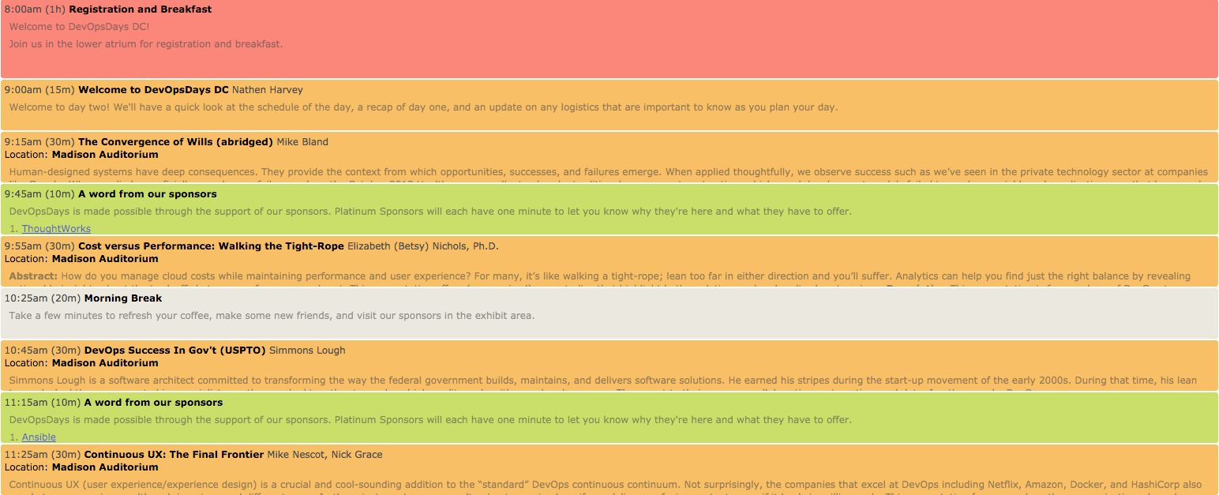
Thursday Morning

Slide 21
Happy Hour Sponsor
@opsgenie

Slide 22
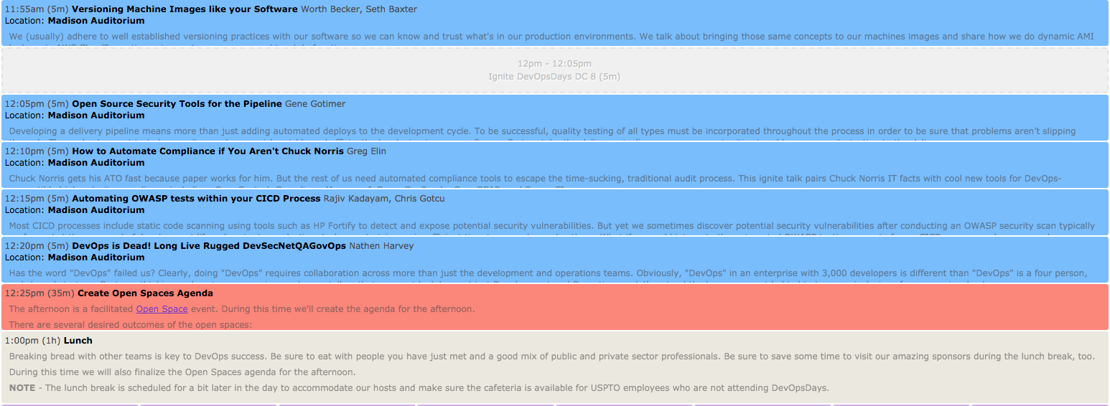
Thursday Afternoon

Slide 23
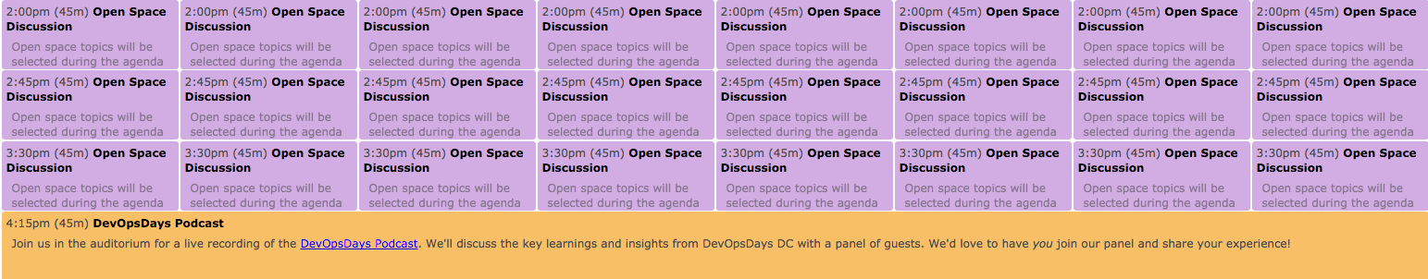
Thursday Afternoon Cont.

Slide 24

August 16-17

Slide 25
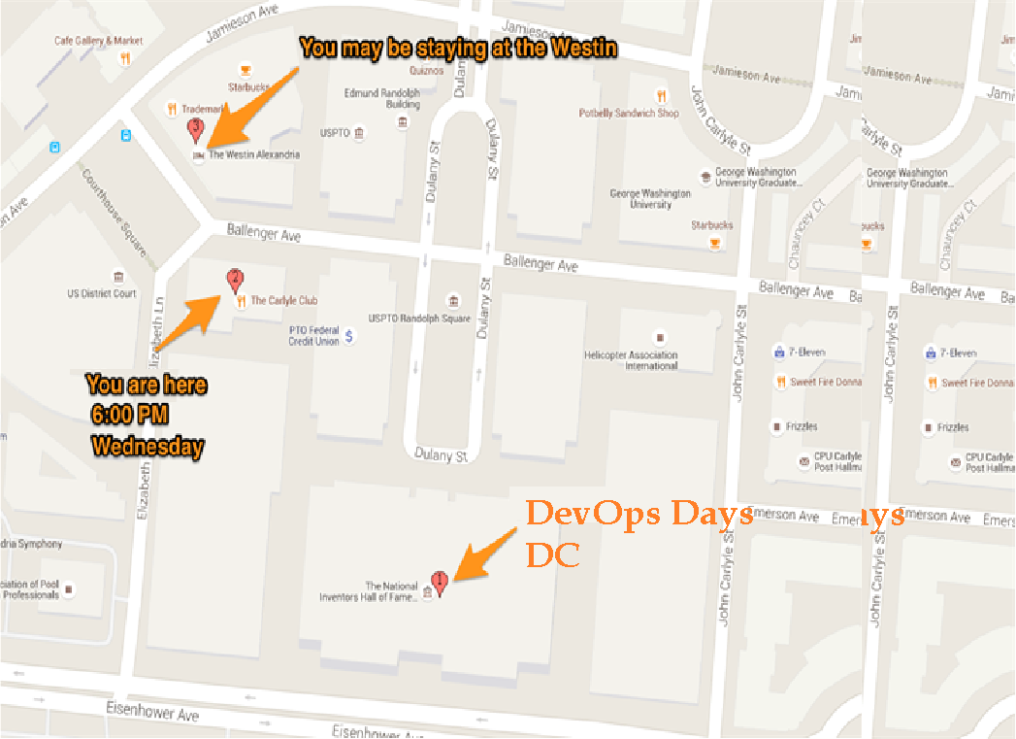

Slide 26
Please be safe this evening. Don’t drink and drive. If you find yourself needing assistance please let one of the organizers, hosts, or volunteers know so that we can help you.

