Slide 1
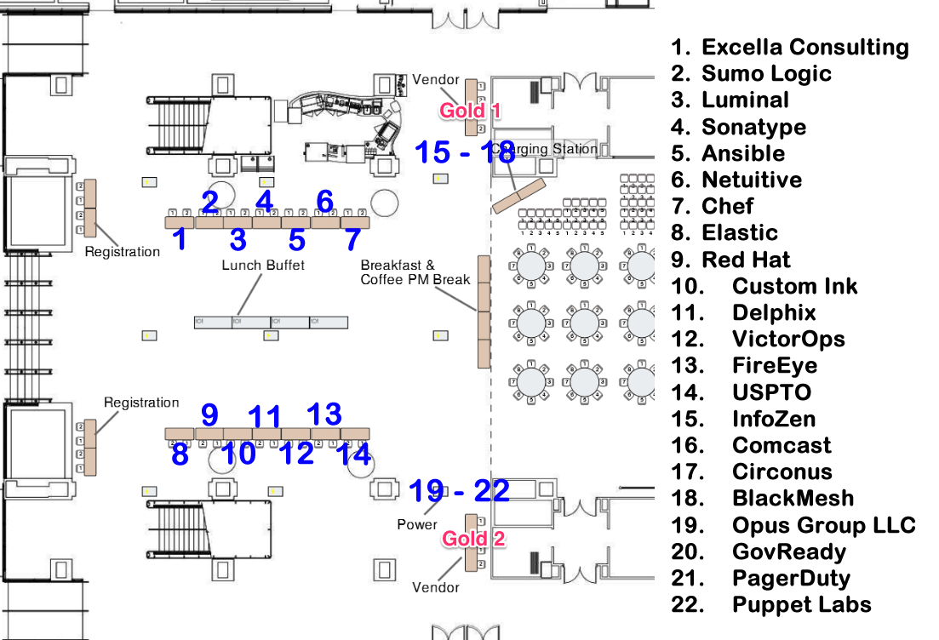

Slide 2

Platinum & Location Sponsor
Table 14
@uspto

Slide 3

Platinum Sponsor
Table 1
@excellaco

Slide 4

Platinum Sponsor
Table 2
@sumologic

Slide 5

Platinum Sponsor
Table 3
@FugueHQ

Slide 6

Platinum Sponsor
Table 4
@sonatype

Slide 7

Platinum Sponsor
Table 5
@ansible

Slide 8

Platinum Sponsor
Table 6
@netuitive

Slide 9

Platinum Sponsor
Table 7
@chef

Slide 10

Platinum Sponsor
Table 8
@elastic

Slide 11

Platinum Sponsor
Table 9
@redhadsoftware

Slide 12

Platinum Sponsor & T-Shirt Sponsor
Table 10
@customink

Slide 13

Platinum Sponsor
Table 11
@delphix

Slide 14

Platinum Sponsor
Table 12
@VictorOps

Slide 15

Platinum Sponsor
Table 13
@FireEye

Slide 16

Gold Sponsor
Gold 1
@InfoZenCorp

Slide 17

Gold Sponsor
Gold 1
@comcast

Slide 18

Gold Sponsor
Gold 1
@circonus

Slide 19

Gold Sponsor
Gold 1
@BlackMesh

Slide 20

Gold Sponsor
Gold 2
@OpusGroupLLC

Slide 21

Gold Sponsor
Gold 2
@gitmachines

Slide 22

Gold Sponsor
Gold 2
@pagerduty

Slide 23

Silver Sponsor
@puppetlabs

Slide 24
Platinum & Location Sponsor
@uspto

Slide 25
Platinum Sponsor
@excellaco

Slide 26
Platinum Sponsor
@sumologic

Slide 27
Platinum Sponsor
@FugueHQ

Slide 28
Platinum Sponsor
@sonatype

Slide 29
Platinum Sponsor
@ansible

Slide 30
Platinum Sponsor
@netuitive

Slide 31
Platinum Sponsor
@chef

Slide 32
Platinum Sponsor
@elastic

Slide 33
Platinum Sponsor
@redhadsoftware

Slide 34
Platinum Sponsor & T-Shirt Sponsor
@customink

Slide 35
Platinum Sponsor
@delphix

Slide 36
Platinum Sponsor
@VictorOps

Slide 37
Platinum Sponsor
@FireEye

Slide 38
Gold Sponsor
@InfoZenCorp

Slide 39
Gold Sponsor
@comcast

Slide 40
Gold Sponsor
@circonus

Slide 41
Gold Sponsor
@BlackMesh

Slide 42
Gold Sponsor
@OpusGroupLLC

Slide 43
Gold Sponsor
@gitmachines

Slide 44
Gold Sponsor
@pagerduty

Slide 45
Silver Sponsor
@puppetlabs

