Slide 1
Configuration Management - Ansible

Slide 2
Introduction
Ansible is a configuration Management tool intended towards managing large scale infrastructure and configuration changes. It can configure systems, deploy software, and orchestrate more advanced IT tasks such as continuous deployments or zero downtime rolling updates.
Ansible was released in 2012 by Michael DeHaan.

Slide 3
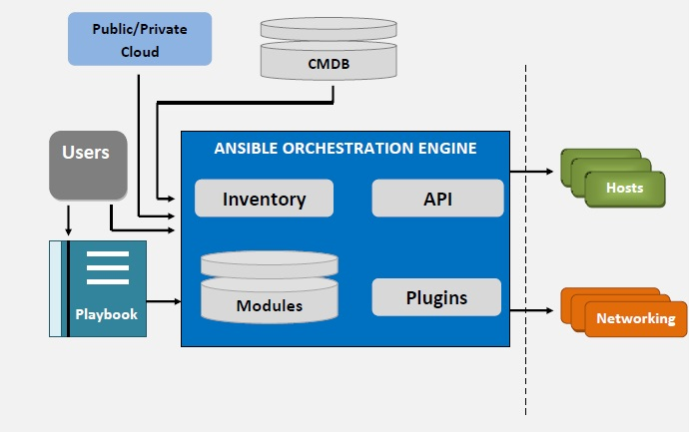
Architecture

Slide 4
Advantages
Clear - Ansible uses a simple syntax (YAML) and is easy for anyone (developers, sysadmins, managers) to understand.
Fast - Fast to learn, fast to set up—especially considering you don’t need to install extra agents or daemons on all your servers!
Efficient - No extra software on your servers means more resources for your applications. Also, since Ansible modules work via JSON, you can easily extend Ansible with modules in a programming language you already know.
Secure - Ansible uses SSH, and requires no extra open ports or potentially-vulnerable daemons on your servers.

Slide 5
Installation
EPEL :
rpm -ivh http://dl.fedoraproject.org/pub/epel/6/x86_64/epel-release-6-8.noarch.rpm
http://dl.fedoraproject.org/pub/epel/7/x86_64/Packages/e/epel-release-7-11.noarch.rpm
yum install ansible
pip install ansible (on ec2)
ansible –version
ssh-keygen
ssh-copy-id -i ~/.ssh/id_rsa.pub root@host

Slide 6
Inventory
Hosts and Groups
/etc/ansible/hosts : Contains the host/Ips
[webservers]
foo.example.com
[dbservers]
one.example.com
two.example.com

Slide 7
Continued…
Host Variables
We can assign variables to hosts that will be used later in playbooks:
[atlanta]
host1 http_port=80
host2 mysql_port=3306
Group Variables
Variables can also be applied to an entire group at once:
[atlanta]
host1
host2
[atlanta:vars]
ntp_server=ntp.atlanta.example.com
proxy=proxy.atlanta.example.com

Slide 8
Continued…
Splitting Out Host and Group Specific Data
The preferred practice in Ansible is actually not to store variables in the main inventory file.
mkdir /etc/ansible/group_vars
vi /etc/ansible/group_vars/webservers
http_port : 8080
ssl_port: 443
http_user: apache

Slide 9
Ad-Hoc Commands
Shell Commands:
ansible example -m setup
ansible example -m copy -a "src=/etc/hosts dest=/tmp/hosts“
ansible example -m yum -a "name=httpd state=installed“
ansible example -m yum -a "name=httpd state=removed“
ansible example -m user -a "name=foo password=foo@123“
ansible example -m user -a "name=foo state=absent“
ansible example -m service -a "name=httpd state=started“
ansible example -m service -a "name=httpd state=stopped“
ansible example -a "/sbin/reboot“

Slide 10
Ansible Playbook
Playbooks in ansible is another way to use ansible than in adhoc task execution mode, and are particularly powerful.
It uses YAML to represent the tasks and actions.
The goal of a play is to map a group of hosts to some well defined roles, represented by things ansible calls tasks. At a basic level,
A task is nothing more than a call to an ansible module.

Slide 11
Ansible Playbook
- hosts: example
tasks:
- name: Ensure NTP (for time synchronization) is installed.
yum: name=ntp state=installed
- name: Ensure NTP is running.
service: name=ntpd state=started enabled=yes
Run Playbook
# ansible-playbook -i "hosts" ntp.yml

Slide 12
---
hosts: webservers
vars:
http_port: 80
max_clients: 200
remote_user: root
tasks:
- name: ensure apache is at the latest version
yum: name=httpd state=latest
name: write the apache config file
template: src=/srv/httpd.j2 dest=/etc/httpd.conf
notify: restart apache
- name: ensure apache is running (and enable it at boot) service: name=httpd state=started enabled=yes handlers:
- name: restart apache
service: name=httpd state=restarted

Slide 13
Conditoionals
When Statement
Sometimes you will want to skip a particular step on a particular host. This could be something as simple as not installing a certain package if the operating system is a particular version, or it could be something like performing some cleanup steps if a filesystem is getting full.
tasks:
- name: "shutdown Debian flavored systems"
command: /sbin/shutdown -t now
when: ansible_os_family == "Debian"

Slide 14
Loops
Loop Statement
Often you’ll want to do many things in one task, such as create a lot of users, install a lot of packages, or repeat a polling step until a certain result is reached.
name: add several users
user: name={{ item }} state=present groups=wheel
with_items: - testuser1 - testuser2
name: add several users
user: name={{ item.name }} state=present groups={{ item.groups }}
with_items: - { name: 'testuser1', groups: 'wheel' } - { name: 'testuser2', groups: 'root' }

Slide 15
Thank You
??Queries??

