Slide 1
DevOps

Slide 2
Objectives
At the end of this session, you will be able to:
    What is DevOps
    Importance of DevOps
    Difference between DevOps and Agile, Waterfall Model

Slide 3
Agenda
Different SDLC models
Difference between DevOps and Agile
How we can implement DevOps

Slide 4
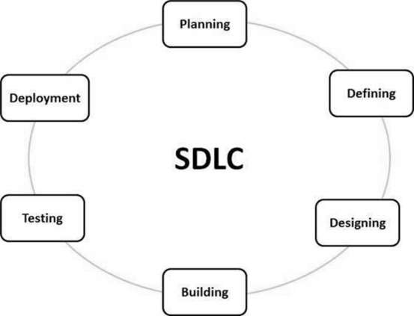
What is SDLC
SDLC is a process followed for a software project, within a software organization.
It consists of a detailed plan describing how to develop, maintain, replace and alter or enhance specific software.
The life cycle defines a methodology for improving the quality of software and the overall development process.

Slide 5
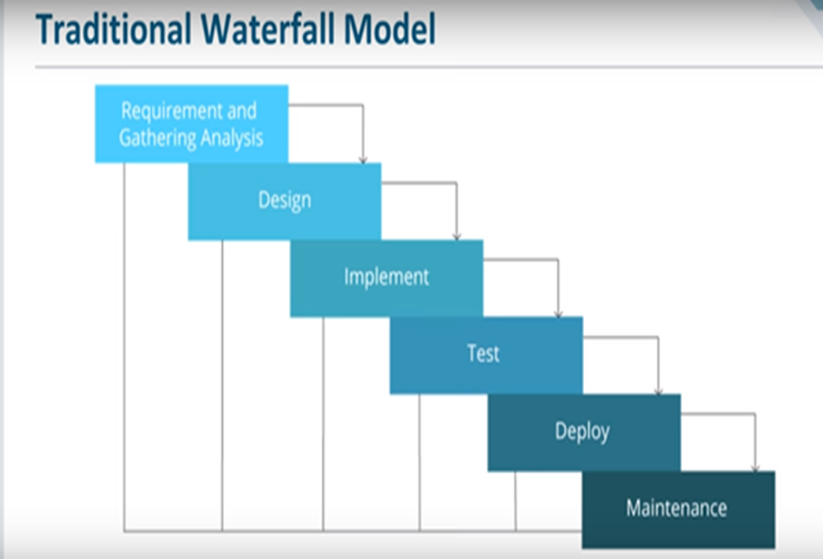
Water Fall Model
Waterfall approach was first SDLC Model to be used widely in Software Engineering to ensure success of the project.
`In "The Waterfall" approach, the whole process of software development is divided into separate phases.
In this Waterfall model, typically, the outcome of one phase acts as the input for the next phase sequentially.

Slide 6
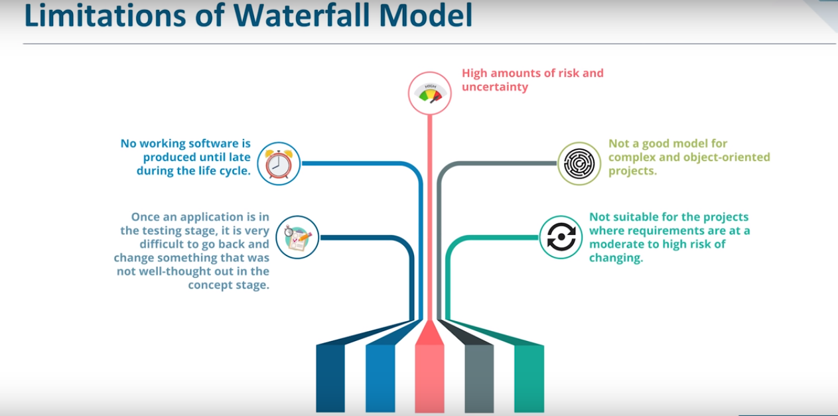

Slide 7
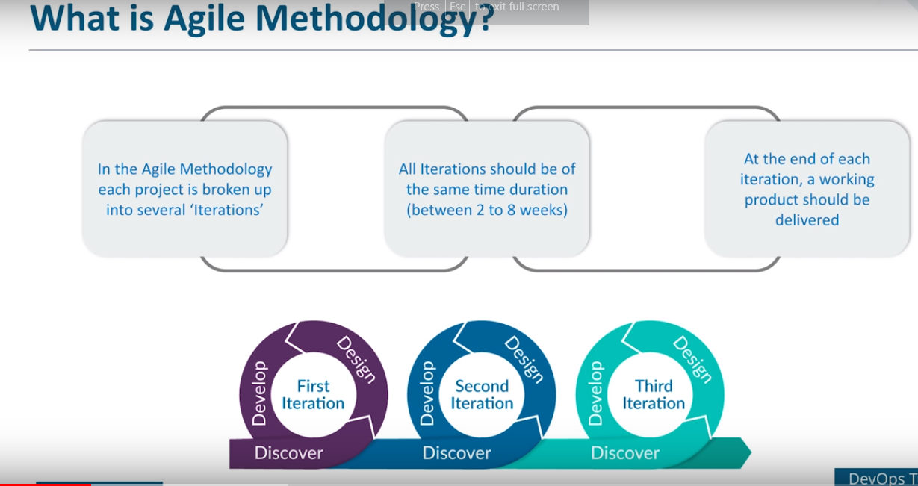

Slide 8
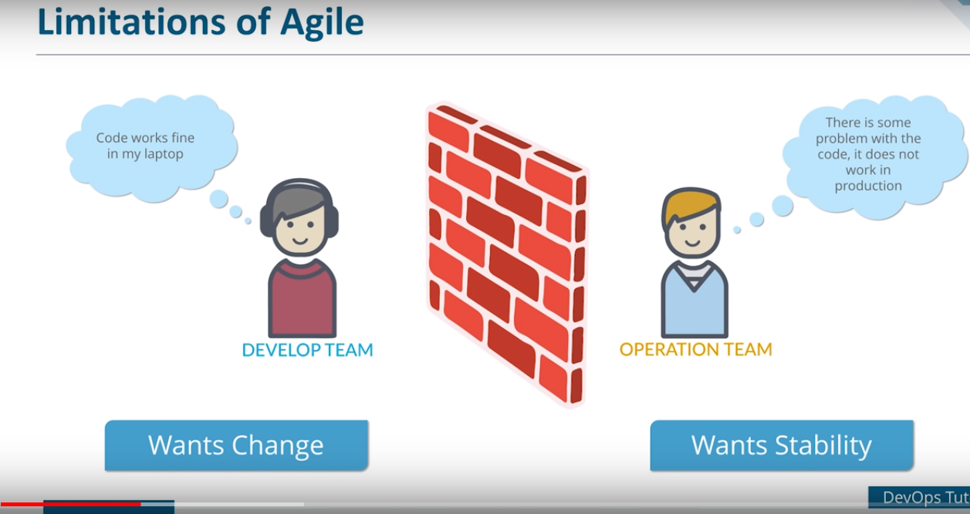

Slide 9
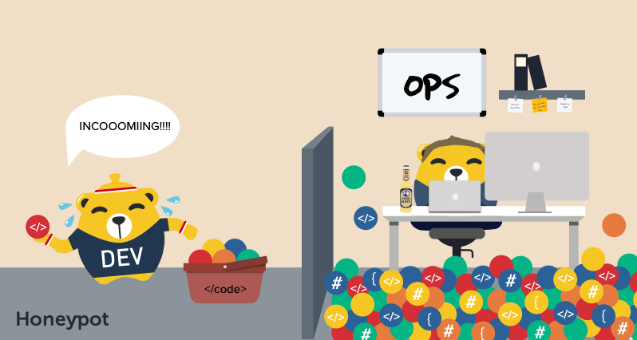
Challenges in Agile

Slide 10
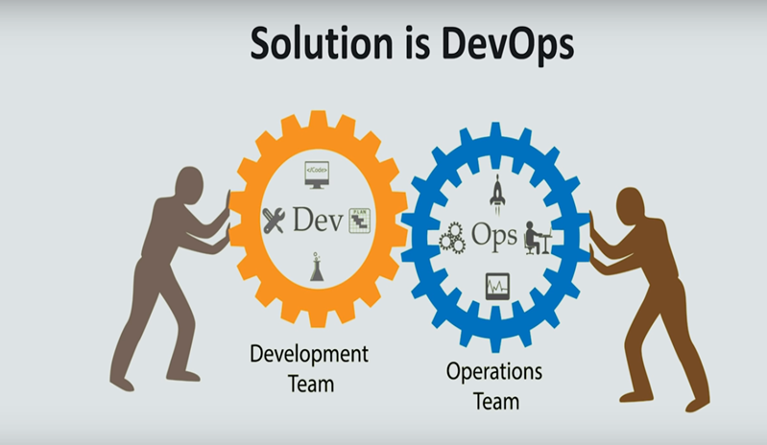

Slide 11
DevOps
DevOps is a culture which promotes collaboration between Development and Operations Team to deploy code to production faster in an automated & repeatable way
Before DevOps operation and Development team working in completed isolation.
Manual code deployment leads to human errors in production
In the Old process, Operations team has no clue on the progress of the Development team. So, operations team developed a IT infrastructure purchase and monitoring plan as per their understanding.
In the DevOps process operation team fully aware of the progress of developer. The purchase and monitoring planning is accurate.
DevOps offers Maintainability, Predictability, Greater quality cost efficiency and time to market.

Slide 12
DevOps ----Continued
Agile process focuses on functional and non-functional readiness while DevOps focuses on that IT infrastructure aspects.
DevOps life cycle includes Development, Testing, Integration, Deployment, and Monitoring.
DevOps lifecycle must be automated to satisfy CI/CD concept .
DevOps helps organizations in shifting their code deployment cycles to weeks and months instead of years.

Slide 13
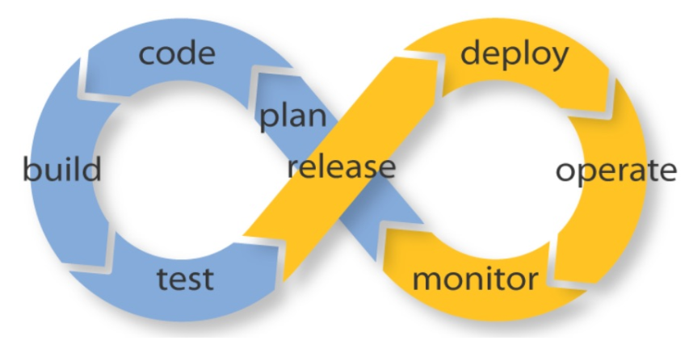
DevOps Expectation

Slide 14
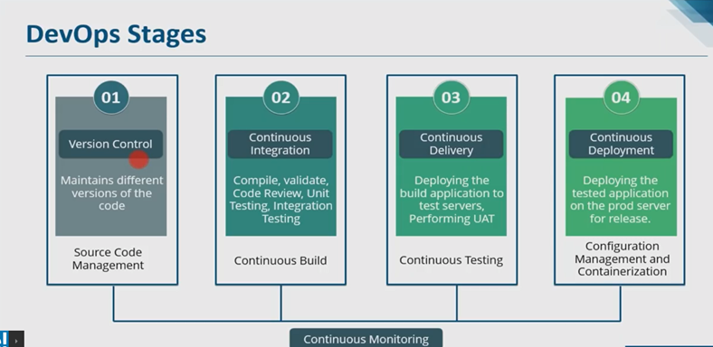
DevOps Stages

Slide 15
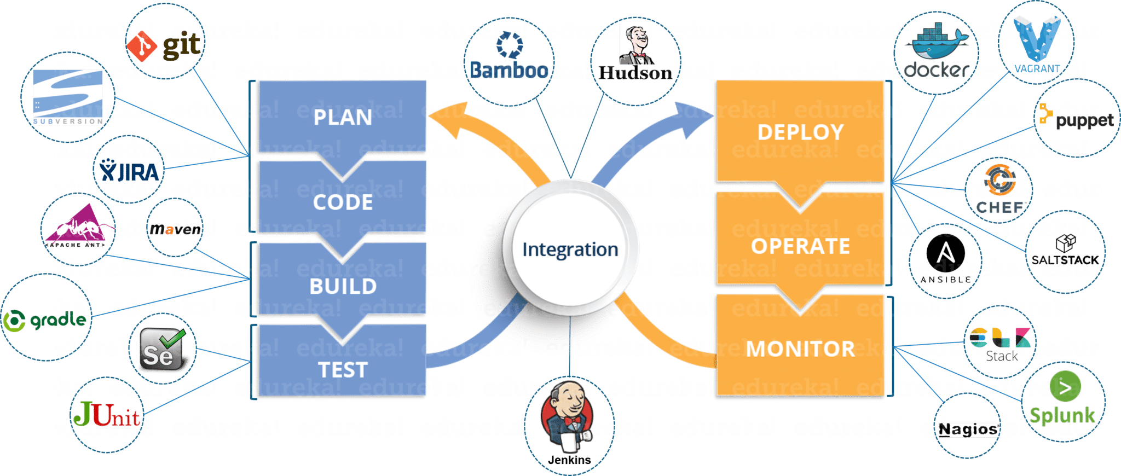
DevOps Tools and its integration

Slide 16
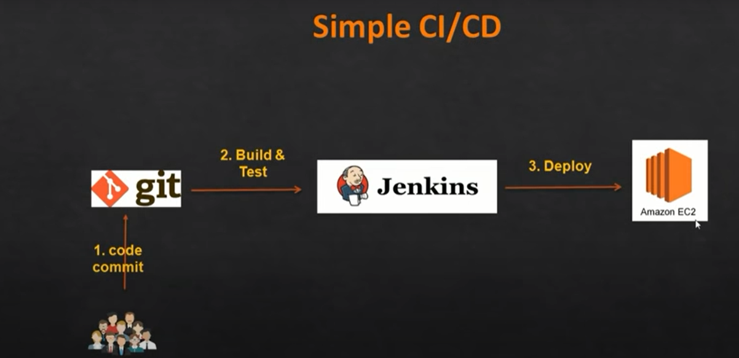
Demo of small DevOps Project

Slide 17
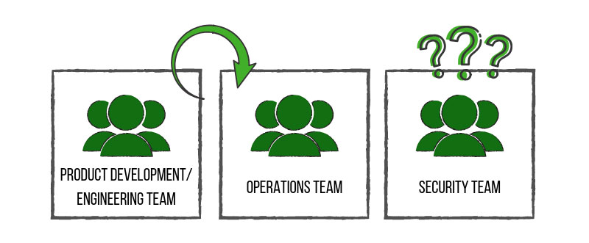
Challenges in DevOps
DevOps Teams Neglect Security.
The security team was often clued in at the end of the project, much like an afterthought. Security Teams Struggle to Keep Up With the Pace of DevOps.
This lack of communication caused confusion and conflict between teams, slowed down production time and introduced more vulnerable products to the consumer. This, of course, consequently affected the path of value for companies.

Slide 18
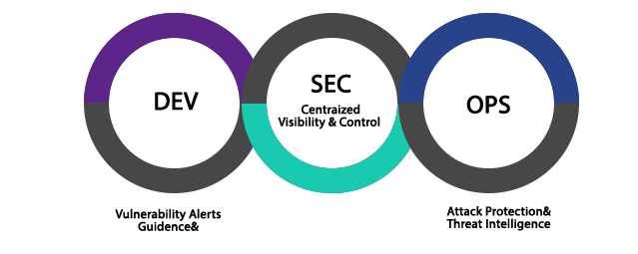
What is DevSecOps?
DevSecOps is the evolution of the DevOps philosophy.
The advent of DevSecOps placed security into the big picture and allowed all involved teams to work together from development to end product – a stronger, more efficient and more resilient end product.
It is a concept that injects security into the software development lifecycle. If DevOps is about increasing the level of communication between development and operations, then DevSecOps is about inviting security into the conversation
Now with DevSecOps concept of CI/CD/CS come into picture .

Slide 19
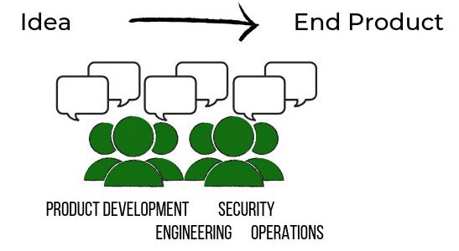
What we want to achieve through DevSecOps?

Slide 20
What are the benefits of DevSecOps?
Costs are reduced by uncovering and fixing security issues further left in the development lifecycle versus in production environments.
Speed of product delivery is increased by incorporating automated security tests versus adding security testing at the end of lifecycle.
Increased transparency and team collaboration leads to faster detection and recovery of threats.
Implementing immutable infrastructure improves overall security by reducing vulnerabilities, increasing automation, and encourages organizations to move to the cloud.

Slide 21
Summary
In this session, we have covered,
    How the DevOps evolved
    DevOps is about CI/CD.
    What is DevSecOps
    .

Slide 22
Thank you

