Slide 1
GIT & GITHUB

Slide 2
Objectives
At the end of this session, you will be able to:
  Understand distributed version control system and its features
  Set-up Git in your system
  List the three-stage workflow in Git
  Create branches and track files
  Create a repository in Git and GitHub
  Describe merging, cloning, rebasing, among others

Slide 3
What is “version control”, and why should you care?
Version control is a system that records changes to a file or set of files over time so that you can recall specific versions later.
If you are a graphic or web designer and want to keep every version of an image or layout (which you would most certainly want to), a Version Control System (VCS) is a very wise thing to use. It allows you to revert selected files back to a previous state, revert the entire project back to a previous state, compare changes over time, see who last modified something that might be causing a problem, who introduced an issue and when, and more. Using a VCS also generally means that if you screw things up or lose files, you can easily recover. In addition, you get all this for very little overhead.

Slide 4
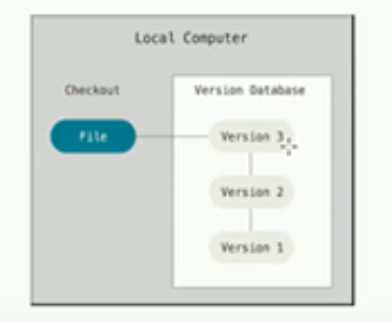
Centralized VCS have a single server that contains all the versioned files, and a number of clients that check out files from that central place. For many years, this has been the standard for version control.
Local Version Control Systems

Slide 5
Challenges in Agile
Development and operations team work in isolations
In Agile, Operations team has no clue on the progress of the Development team. So, operations team develops an IT infrastructure deployment and monitoring plan as per their understanding.
Manual code deployment leads to human errors in production
organizations would divide work and communicate internally, but hardly ever between teams. When one team completed their tasks, they would pass it to the next team, throwing it over the proverbial “wall”, assuming that their job was done and they had nothing else to do with the project.

Slide 6
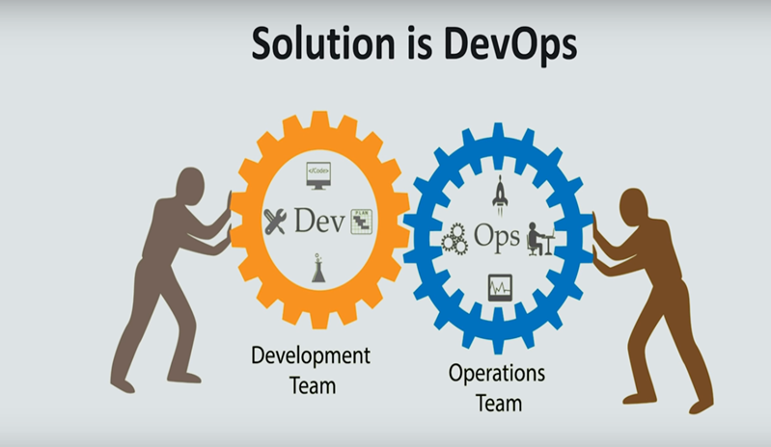

Slide 7
DevOps
DevOps is a culture which promotes collaboration between Development and Operations Team to deploy code to production faster in an automated & repeatable way.
In the DevOps process operation team fully aware of the progress of developer. The deployment and monitoring planning is accurate.
DevOps offers Maintainability, Predictability, Greater quality cost efficiency and time to market.

Slide 8
DevOps ----Continued
Agile process focuses on functional and non-functional readiness while DevOps focuses on that IT infrastructure aspects.
DevOps life cycle includes Development, Testing, Integration, Deployment, and Monitoring.
DevOps lifecycle must be automated to satisfy CI/CD concept .
DevOps helps organizations in shifting their code deployment cycles to weeks and months instead of years.

Slide 9
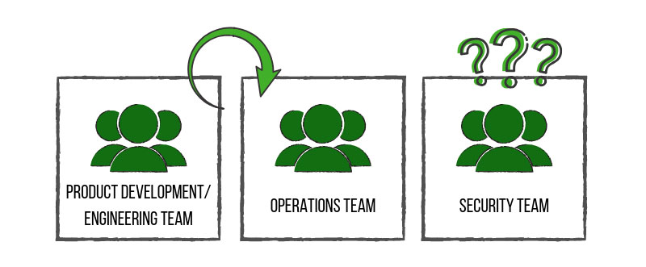
Challenges in DevOps
The security team was often clued in at the end of the project, much like an afterthought. Security Teams Struggle to Keep Up With the Pace of DevOps.
DevOps Teams Neglect Security.
This lack of communication caused confusion and conflict between teams, slowed down production time and introduced more vulnerable products to the consumer. This, of course, consequently affected the path of value for companies.

Slide 10
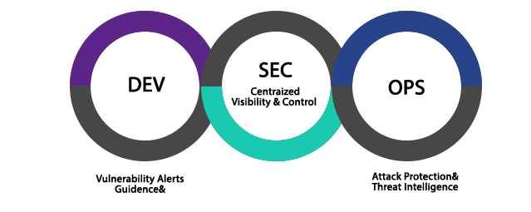
What is DevSecOps?
DevSecOps is the evolution of the DevOps philosophy.
The advent of DevSecOps placed security into the big picture and allowed all involved teams to work together from development to end product – a stronger, more efficient and more resilient end product.
It is a concept that injects security into the software development lifecycle. If DevOps is about increasing the level of communication between development and operations, then DevSecOps is about inviting security into the conversation
Now with DevSecOps concept of CI/CD/CS come into picture .

Slide 11
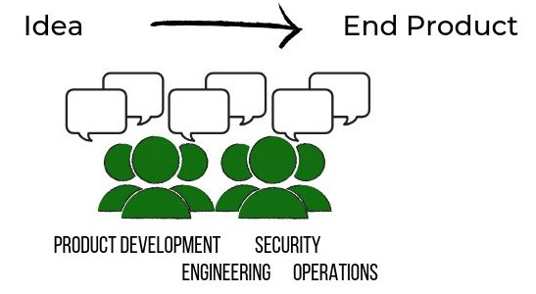
What we want to achieve through DevSecOps?

Slide 12
What are the benefits of DevSecOps?
Costs are reduced by uncovering and fixing security issues further left in the development lifecycle versus in production environments.
Speed of product delivery is increased by incorporating automated security tests versus adding security testing at the end of lifecycle.
Increased transparency and team collaboration leads to faster detection and recovery of threats.
Implementing immutable infrastructure improves overall security by reducing vulnerabilities, increasing automation, and encourages organizations to move to the cloud.

Slide 13
Key Performance Indicators (KPIs) of DevSecOps
Release Cycle Time-Code deployments should happen more often, and complete in less time. Shorter cycle times are a sign of optimized processes, while longer times could be a sign that you need to reexamine your coding best practices and/or tools. Start tracking your cycle times to get a baseline in place, and then begin measuring variations in that baseline to see how things change.
Code Quality and Risk-Keep a close eye on customer-initiated contacts, bug reports, and code coverage percentage. The risks of low-quality code include performance and security risks, which can be costly to both the company and the consumer. Good quality code is consistent, well documented, and able to be tested.
Development Time-to-Market (TTM)-Code should make its way through development faster, from ideation to deployment push. Review your process and see if there are any unnecessary meetings or duplication of efforts that could free up more time for innovation and testing. Ensure communication between teams is streamlined, and remember to automate whenever possible. A faster time-to-market means greater competitive advantage for your company.

Slide 14
Summary
In this session, we have covered,
    How the DevOps and DevSecOps evolved
    DevSecOps is about CI/CD/CS.
    App Security is the responsibility of every one .

Slide 15
Thank you

