Slide 1
SonarQube

Slide 2
Objectives
At the end of this session, you will be able to:
    What is SonarQube
    Advantages of SonarQube
    Installation of SonarQube including port numbers etc
    Quality Profiles
    Quality gates
    Architecture of SonarQube
    SonarQube Scanner
    Maven commands to evaluate Project source

Slide 3
What is SonarQube
SonarQube is an open-source platform developed by SonarSource for continuous inspection of code quality to perform automatic reviews with static analysis of code to detect bugs, code smells, and security vulnerabilities .
It supports on 20+ programming languages.
It gives you a moment-in-time snapshot of your code quality today, as well as trending of lagging (what’s already gone wrong) and leading (what’s likely to go wrong in the future) quality indicators.

Slide 4
Advantages of SonarQube
It detects bugs in the code automatically and alerts developers to fix them before rolling it out for production.
SonarQube platform significantly increases the lifetime of applications by reducing complexities, duplications and potential bugs in the code, by keeping neat and clean code architecture and increased unit tests.
SonarQube increases productivity by enabling development teams to detect and muzzle duplication and redundancy of code.
SonarQube help in monitoring the code quality and also keep track issues. It helps in on time delivery of the quality product.

Slide 5
How to install SonarQube
Download SonarQube from : https://www.sonarqube.org/downloads/
I have downloaded community edition for training
Unzip the folder
Go to D:\SonarQube\sonarqube-7.9.4\conf file and set the java 11 path.
Start the SonarStart.bat file (D:\SonarQube\sonarqube-7.9.4\bin\windows-x86-64)
When server is up go to http://localhost:9000 to access
Default username and password is admin/admin

Slide 6
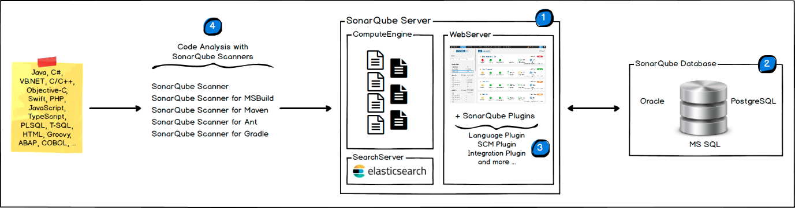
Architecture

Slide 7
What is Sonar Profiles
The Quality Profiles service is central to SonarQube since this is where you define your requirements by defining sets of rules (ex: Methods should not have a Cognitive Complexity greater than 15).
Default Sonar Profile is ‘Sonar way’.
Ideally, all projects will be measured with the same profile for any given language, but that’s not always practical.
You can define your own customized profiles and assign to projects and also make as default profiles.

Slide 8
Quality Gate
A Quality Gate is a set of conditions the project must meet before it can qualify for production release. It answers one question: can I push my code to production in its current state or not?
Ensuring code quality of “new” code while fixing existing ones is one good way to maintain a good codebase over time. The Quality Gate facilitates setting up rules for validating every new code added to the codebase on subsequent analysis.
The conditions set in the Quality Gate still affect unmodified code segments. If we can prevent new issues arising, over time, we'll eliminate all issues.

Slide 9
Maven settings
Prerequisites
Maven 3.x
At least the minimal version of Java supported by your SonarQube server is in use
Global Settings
Edit the settings.xml file, located in $MAVEN_HOME/conf or ~/.m2, to set the plugin prefix and optionally the SonarQube server URL.
Example:
<settings> <pluginGroups> <pluginGroup>org.sonarsource.scanner.maven</pluginGroup> </pluginGroups>
<profiles> <profile> <id>sonar</id> <activation> <activeByDefault>true</activeByDefault> </activation>
<properties>
<sonar.host.url> http://myserver:9000 </sonar.host.url>
</properties>
</profile> </profiles> </settings>
Analyzing
Analyzing a Maven project consists of running a Maven goal: sonar:sonar from the directory that holds the main project pom.xml.
mvn clean verify sonar:sonar
In some situations you may want to run the sonar:sonar goal as a dedicated step. Be sure to use install as first step for multi-module projects
mvn clean install mvn sonar:sonar

Slide 10
Sonar scanner Setting
Got to D:\SonarQube\sonar-scanner-cli-4.5.0.2216-windows\sonar-scanner-4.5.0.2216-windows\conf\sonar-scanner file and make following changes
sonar.projectKey=SonarTest
sonar.projectName=SonarTest
sonar.version=1.0
sonar.projectBaseDir=D:/workspace/SonarTest/src/com/test/main
sonar.sources=D:/workspace/SonarTest/src/com/test/main

Slide 11
Thank you

