Slide 1
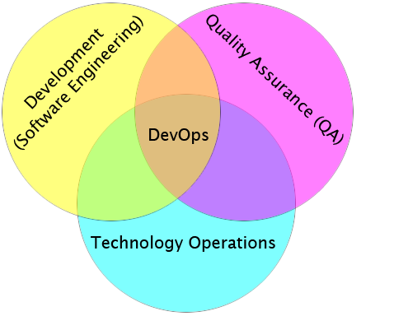
MCDevOps
Infrastructure In One Hour

Slide 2
Sponsors
Improving Enterprises http://www.improvingenterprises.com
Software Development and Training Services

Slide 3
Speaker
Alex Soncodi
Software Engineer for Brokerloop.com
Twitter: @soncodi
GitHub: http://github.com/ruff

Slide 4
Toolset on localhost
git / msysGit
TortoiseGit
PuTTY
Perforce p4Merge

Slide 5
Setting up VM
Login to EC2 Dashboard
Create VM – Ubuntu Stable 11.10 AMI
http://cloud-images.ubuntu.com/releases/11.10/release/
Associate IP and Security group

Slide 6
Configure LAMP
Install required packages
sudo apt-get install php5 mysql-server php5-mysql git unzip
sudo apt-get install htop byobu
Cleanup Apache config file
Prod settings: Hide Apache Version, PHP header
Enable Site, test in browser

Slide 7
Create Git Repo
Basic file structure
Push to hosted service, like GitHub
Add SSH keys where applicable

Slide 8
Update Script
Create site directory structure
Run update script, pull current version
View in browser

Slide 9
Future Changesets
Commit to Git Repo
Pull from VM with update script
.. profit?

Slide 10
Overview
What have we done?
Other alternatives
Microsoft stack
Other Amazon Services
Other cloud platforms

