Slide 1
Service Oriented Architecture In the Real World

Slide 2


Does Service Oriented Architecture make things Simple?

Slide 3
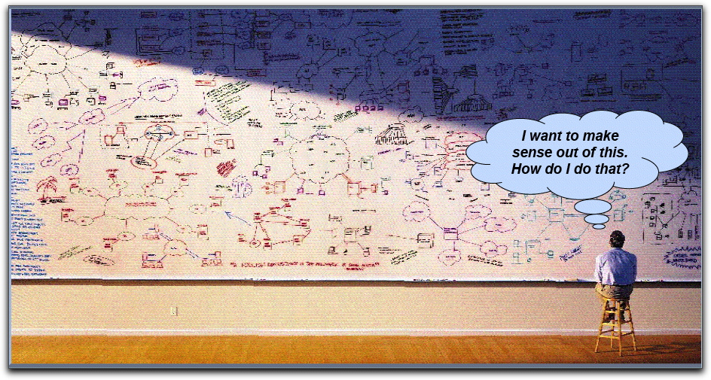
Problems Addressed by a SOA
Notes:
Why do we need an architecture?

Slide 4
Purpose of Architecture: To Manage Interdependencies
Notes:
Let me show you the some of the statistics

Slide 5
Directions of System Architecture
1960 - 1980
1990 - 2000
2010 - 2050
Organization Focus
Mainframe Centric
Internal Use
Unique Data
Process Focus
Client Server
Partial Connectivity
EDI File Transfer
Distributed Functions
Data Centric
Universal Interoperability
Real-time Connectivity

Slide 6
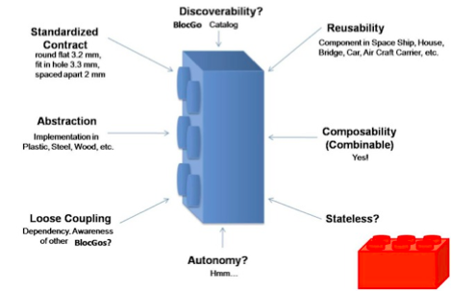
What is a Service Oriented Architecture
A method of design, deployment, and management of both applications and the software infrastructure where:
All software is organized into business services that are network accessible and executable
Service interfaces are based on public standards for interoperability.

Slide 7
What is a “Service”?
A Service is a reusable component.
A Service changes business data from one state to another.
A Service is the only way how data is accessed.
If you can describe a component in WSDL, it is a Service.

Slide 8
SOA Basics – What SOA Means
SOA attempts to solve problems OO and CO could not solve by raising the level of abstraction
Architecture composed of services
Efficient for:
large systems
distributed systems
systems of systems
Inefficient for:
Small – medium sized systems
Non-distributed systems
So what’s a service ?
Notes:
1 min

Slide 9
Key Characteristics of SOA
Quality of service, security and performance are specified.
Software infrastructure is responsible for managing.
Services are cataloged and discoverable.
Data are cataloged and discoverable.
Protocols use only industry standards.

Slide 10
A Few Key SOA Protocols
Universal Description, Discovery, and Integration, UDDI. Defines the publication and discovery of web service implementations.
The Web Services Description Language, WSDL, is an XML-based language that defines Web Services.
SOAP is the Service Oriented Architecture Protocol. It is a key SOA in which a network node (the client) sends a request to another node (the server).
The Lightweight Directory Access Protocol, or LDAP is protocol for querying and modifying directory services.
Extract, Transform, and Load, ETL, is a process of moving data from a legacy system and loading it into a SOA application.

Slide 11
Why SOA Saves Code
Provides a standard way of interacting with shared software.
Enables software to become building blocks for reuse.
Shifts focus to application assembly rather than design.
Creates new applications out of existing components.
Integrates with applications in other enterprises.
Notes:
40 Million lines of code in Windows XP is unknowable.
Testing application (3 Million lines) requires >10¹⁵ tests.
Probability correct data entry for a supply item is <65%.
There are >100 formats that identify a person in DoD.
Output / Office Worker: >30 e-messages /day.

Slide 12
How to View Organizing for SOA
P
E
R
S
O
N
A
L
L
E
V
E
P
L
r
i
v
a
t
e
A
p
p
l
i
c
a
t
i
o
n
s
a
n
d
F
i
l
e
s
P
r
i
v
a
c
y
a
n
I
d
VARIETY HERE
n
d
i
v
i
d
u
a
S
l
e
c
u
r
i
t
y
B
a
r
r
i
e
r
G
r
a
p
h
i
c
I
n
f
o
W
i
n
d
o
w
,
P
e
r
s
o
n
a
l
T
o
o
l
s
,
I
n
q
u
i
r
y
L
a
n
g
u
a
g
e
s
C
u
s
t
o
m
i
z
e
d
A
p
p
l
i
c
a
t
i
o
n
s
,
P
r
o
t
o
t
y
p
i
n
g
T
o
o
l
s
,
L
o
c
a
l
L
O
C
A
L
L
E
V
E
A
L
p
p
l
i
c
a
t
i
o
n
s
a
n
d
F
i
l
e
s
A
p
p
l
i
c
a
t
i
o
n
S
s
e
c
u
r
i
t
y
B
a
r
r
i
e
r
A
p
p
l
i
c
a
t
i
o
n
s
D
e
v
e
l
o
p
m
e
n
t
&
M
a
i
n
t
e
n
a
n
c
e
A
P
P
L
I
C
A
T
I
O
N
L
E
V
E
L
B
u
s
i
n
e
s
S
s
e
c
u
r
i
t
y
B
a
r
r
i
e
r
Service A
Service B
OSD
B
U
S
I
N
E
S
S
L
E
V
E
L
P
r
o
c
e
s
S
s
e
c
u
r
i
t
y
B
a
r
r
i
e
r
F
u
n
c
t
i
o
n
a
l
P
r
o
c
e
s
s
A
F
u
n
c
t
i
o
n
a
l
P
r
o
c
e
s
s
B
P
R
O
C
E
S
S
L
E
V
E
F
L
u
n
c
t
i
o
n
a
l
P
r
o
c
e
s
s
C
F
u
n
c
t
i
o
n
a
l
P
r
o
c
e
s
s
D
C
o
r
p
o
r
a
t
e
P
o
l
i
c
y
,
C
o
r
p
o
r
a
t
e
S
t
a
n
d
a
r
d
s
,
R
e
f
e
r
e
n
c
e
M
o
d
e
l
s
,
D
a
t
a
M
a
n
a
g
e
m
e
n
t
a
n
d
T
o
o
l
s
,
I
n
t
e
g
r
a
t
e
d
S
y
s
t
e
m
s
E
N
T
E
R
P
R
I
S
E
L
E
V
E
C
L
o
n
f
i
g
u
r
a
t
i
o
n
D
a
t
a
B
a
s
e
,
S
h
a
r
e
d
C
o
m
p
u
t
i
n
g
a
n
d
T
e
l
e
c
o
m
m
u
n
i
c
a
t
i
o
n
s
STABILITY HERE
I
n
d
u
s
t
r
y
S
t
a
n
d
a
r
d
s
,
C
o
m
m
e
r
c
i
a
l
O
f
f
-
t
h
e
-
S
h
e
l
f
G
L
O
B
A
L
L
E
V
E
P
L
r
o
d
u
c
t
s
a
n
d
S
e
r
v
i
c
e
s

Slide 13
SOA Must Reflect Timing
Private Applications and Files
PERSONAL
Graphic InfoWindow, Personal Tools, Inquiry Languages
SHORT TERM
Customized Applications, Prototyping Tools, Local
LOCAL
Applications and Files
ADAPTABILITY &
TECHNOLOGY
Applications Development & Maintenance
APPLICATION
SIMPLICITY
Business A
Business B
Infrastructure
Support
BUSINESS
Functional Process A
Functional Process B
Functional Process C
PROCESS
LONG TERM
Functional Process D
STABILITY &
Corporate Policy, Corporate Standards, Reference Models,
TECHNOLOGY
Data Management and Tools, Integrated Systems
ENTERPRISE
Configuration Data Base, Shared Computing and
COMPLEXITY
Telecommunications, Security and Survivability
Industry Standards, Commercial Off-the-Shelf
Products and Services
GLOBAL

Slide 14
Data Interoperability Policies
Data are an enterprise resource.
Single-point entry of unique data.
Enterprise certification of all data definitions.
Data stewardship defines data custodians.
Zero defects at point of entry.
De-conflict data at source, not at higher levels.
Data aggregations from sources data, not from reports.

Slide 15
Organization of Infrastructure Services
Infrastructure
Services
(Enterprise Information)
Data
Services
Security
Services
Computing
Services
Communication
Services
Application
Services

Slide 16
SOA Clients – Architecture
Use synchronization domains here
Interactive Thread
Presentation Thread
Logic Thread
Communication Thread
Data Access Thread
Presentation Services
Logic Services
Communications Services
Data Access Services
Presentation Queue
Logic Queue
Communications Queue
Data Access Queue
Yellow lines are for DeQueue operations, Red are for EnQueue operations, White are for direct calls. Small circles represent in memory objects.
DB
Notes:
5 min

Slide 17
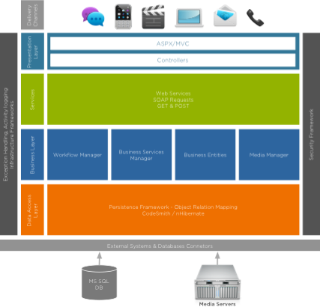
Component/Layered Architecture

Slide 18
SOA Basics – 4 Tenets of SOA
A service is autonomous
A service has explicit boundaries
A service exposes schema & contract, not class or type
A service allows or denies use based on policy
Notes:
Here are the 4 principles of SOA.
I will discuss with some examples later in this presentation

