Slide 1
Wifi
SSID :HMT Guest
Password : INN3R-bauble*shipment
Notes:
First of all thanks to everyone for joining us for this DevOps Playground Meetup at ECS Digital.
Before we begin the session, has anyone not been able to access the Wifi?

Slide 2
Continuous Testing with Jenkins and Zalenium #DevOpsPlayground
Ali Hill, Hammad Chandio, Farhan Shaikh
Notes:
Tonight’s Playground session will involve setting up a continuous testing pipeline in Jenkins. We will be using a set of JavaScript tests written using Selenium WebDriver.io and running these through Zalenium. At the end of the test run we will be generating test reports using Allure.

Slide 3


https://www.devopsdays.org/events/2018-edinburgh/welcome/
1st-2nd November 2018
@devopsdaysedi
Notes:
ECS Digital are gold sponsors for this year’s Edinburgh DevOpsDays which takes place on the 1st and 2nd November.
The speaker lineup details are announced, full details can be found on the DevOpsDays website or Twitter account.

Slide 4
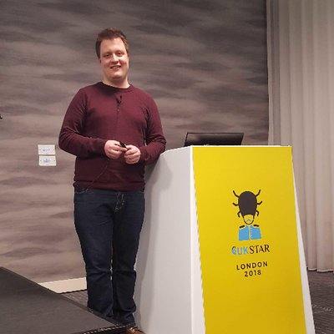


About Us
Ali Hill
QA and Continuous Delivery Consultant (Edinburgh)
Twitter: @ali_hill91
Hammad Chandio
QA and Continuous Delivery Consultant (London)
Farhan Shaikh
QA and Continuous Delivery Consultant (London)
Notes:
I thought I’d begin by introducing your 3 presenters for this evening. Hammad, Farhan and myself are all QA and Continuous Delivery Consultants at ECS Digital. I’m based up here in Edinburgh and Hammad and Farhan have joined us tonight from our London offices.
You can also find me on Twitter, my handle is on the slide.
All 3 of us were involved in setting up this Playground, so feel free to give one of us a shout during the presentation if you have any questions.
If you find this Playground interesting and are interested in doing more like this then feel free to speak to any of us or Connor about potential opportunities.

Slide 5
Agenda
Quick re-cap of Zalenium.
Overview of Jenkins Pipeline.
Why use Jenkins Pipeline?
Overview of our test structure.
Playground – Jenkins, Zalenium, Allure.
Notes:
I’ll run through the agenda for the evening so that you know what to expect.

Slide 6
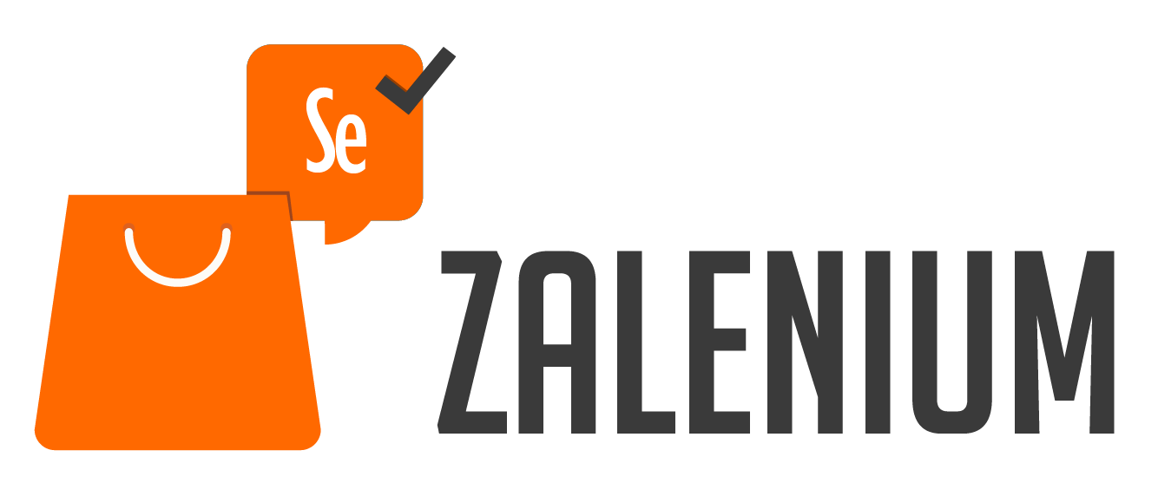
Zalenium Re-Cap
Open-source tool created by Zalando in 2017.
Can be run out of the box using Docker and Kubernetes.
Removes pain points of maintaining your own Selenium Grid.
Allows anyone in your team to have flexible and disposable Selenium Grid infrastructure created within seconds.
Auto-scales during and after tests are run.
Notes:
*CLICK* Zalenium is an open-source tool created by Zalando, a German ecommerce company with a huge tech department, in 2017. It has over 11,000 users in more than 80 countries. 500 people use it daily and has executed over 4.5 million tests since 2017.
*CLICK* It can be run out of the box using Docker and Kubernetes. This means it can also be run on most cloud providers.
*CLICK* A lot of time is invested in setting up and maintaining your own Selenium Grid. Having all browser versions updated and in line with the Selenium WebDriver browser drivers is often a frustrating process.
Zalenium manages this for you, removing this frustration.
*CLICK* Zalenium allows anyone to have flexible and disposable Selenium Grid infrastructure created within seconds. It means that functional testing can take place easily at any point in the development cycle as the infrastructure is available to all.
*CLICK* The number of docker-selenium instances scales during run time of the tests. Once the requests to run the tests are received the tool creates new containers. Once the tests are finished it auto-deletes the containers meaning resource is not wasted.

Slide 7
Test Code

Slide 8
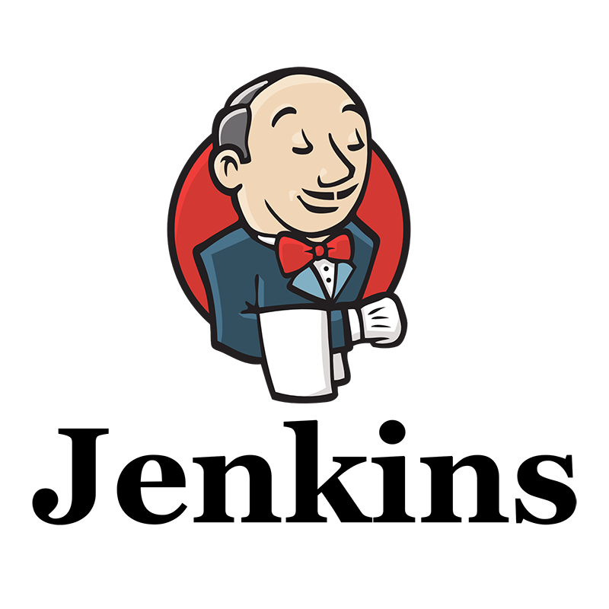
Jenkins Pipeline
Jenkins Pipeline is a plugin which allows us to implement a continuous delivery (CD) pipeline.
Pipeline provides us with a set of tools to write CD pipelines as code using a Pipeline syntax.
Pipeline script can be put into version control by using a ‘Jenkinsfile’ – better practice.
Allows for code review for Pipeline process.
Provides an audit trail.
All branches/pull requests have a Pipeline build process.
Notes:
Jenkins is an open-source tool which offers a simple way to set up a continuous integration environment for almost any combination of languages and source code repositories. Activities can be triggered by pull requests being completed into a code repository, for example.
*CLICK* Jenkins Pipeline is a suite of plugins which supports implementing and integrating continuous delivery pipelines into Jenkins.
It allows us to implement a repeatable process for getting code from version control right through to our users or customers. It allows us to implement a reliable process of moving software through different stages of testing and deployment.
*CLICK* Pipeline provides an extensible set of tools for modeling simple-to-complex delivery pipelines "as code" via the Pipeline syntax, which is built on Groovy.
*CLICK* The Pipeline script that you create can be put into source control in the format of a Jenkinsfile. For the purposes of this evening’s Playground we will not be using a Jenkinsfile but editing directly in the Jenkins UI.
This is not best practice. It’s highly advised to have your Pipeline script in version control as it:
*CLICK* means all changes can go through code review.
*CLICK* there is an audit trail for the Pipeline script. This is not available when editing directly in Jenkins UI.
*CLICK* All branches and pull requests will follow a Pipeline build process.

Slide 9
Why Pipeline?
Pipeline adds a set of automation tools into Jenkins to execute powerful CI/CD pipelines.
Implemented in Code.
Durable.
Pausable.
Versatile.
Extensible.
Notes:
Given all of that information about Jenkins Pipeline, why would you want to use?
*CLICK* It adds access to a lot of powerful automation tools into Jenkins, ranging from Continuous Integration to Continuous Delivery activities.
*CLICK* Pipelines are implemented in code and typically checked into source control, giving teams the ability to edit, review, and iterate upon their delivery pipeline.
*CLICK* Pipelines can survive both planned and unplanned restarts of the Jenkins master.
*CLICK* It may not be better practice but Pipelines can optionally stop and wait for human input or approval before continuing the Pipeline run.
*CLICK* Pipelines support complex real-world CD requirements, including the ability to fork, loop, and perform work in parallel.
*CLICK* The Pipeline plugin supports custom extensions to its DSL and multiple options for integration with other plugins.

Slide 10
Playground
Access the Playground ReadMe and GitHub repo here: https://bit.ly/2R6v6F4
We’re going to create a Jenkins Pipeline in multiple stages:
Checking out test code from Git.
Installing Dependencies.
Starting Zalenium.
Running tests.
Generating reports using Allure.
Stopping Zalenium.
Notes:
Tonight’s Playground can be accessed using the link on this slide *make sure people have accessed it fine*.

Slide 11
How have we set up this Playground?
On a Linux (Ubuntu 16.04) VM hosted in Azure.
Java and Jenkins installed using instructions in ReadMe.
Set-up Jenkins using the suggested plugins upon first run-time.
Custom plugins installed: Blue Ocean, NodeJS and Allure.
Global Tool Configuration for NodeJS and Allure.
Cloned the initial VM’s VHD.
Created multiple VMs using the clones of the disk.
Notes:
*Have users follow ‘Accessing Your Jenkins Instance’ and log into their Jenkins instance – make sure all is ok*
I’ll cover briefly what infrastructure your Jenkins instance is installed on and how we set it up.
*CLICK* We first of all set up a Linux VM in a new resource group. We used Ubuntu 16.04 as our OS and created the VM through Azure Portal.
*CLICK* On the first VM we created, we installed Java and Jenkins using the instructions linked in the ReadMe file.
*CLICK* After starting Jenkins for the first-time we installed the suggested plugins and set up the ‘DevOps’ username and password.
*CLICK* We then installed Blue Ocean, NodeJS and Allure - we’ll go into more details about these plugins later.
*CLICK* We then set up the Global Tool Configuration to specify Allure and NodeJS names and versions for the Pipeline to use.
*CLICK* At this point we stopped the VM and created multiple clones of the disk using Azure CLI. The instructions are included in the ReadMe.
*CLICK* Finally, we created multiple VMs using our cloned disks by using Azure CLI.

Slide 12
Pipeline Syntax
Declarative pipeline.
All Declarative pipelines must be enclosed in a pipeline {} block.
agent – specifies where the pipeline will be run.
tools – declares any tools required to be used in the pipeline.
stage – declares the different stages of your pipeline.
steps – defines what is happening during this stage.
Notes:
*Have users edit a Jenkins pipeline – show this slide after running*
Whilst the first run is taking place I thought I would explain a bit more about the Pipeline code we are using.
*CLICK* Our pipeline is a Declarative pipeline. Declarative Pipelines are relatively new to the Pipeline plugin and provides a relatively simple syntax to follow.
Previously Pipelines were only written in a Scripted Pipeline syntax, which meant there was a bit of a learning curve for teams as it was written in pure Groovy. Scripted syntax may be more desirable for more experienced users as the only limitations on syntax come from Groovy itself.
*CLICK* All declarative pipelines must be enclosed in a pipeline block.
*CLICK* The agent property is required at the top level of the pipeline block, but you can declare optional agents at different stages of your pipeline. Our pipeline is not run on any specific agents so we use the value ‘any’, but if you would like your pipeline to run in Docker, for example, you can declare this here.
*CLICK* The next sections we have is the tools section. It declares one or more tools to be installed and put on the PATH. In our case we installed NodeJS as we require it to install dependencies.
*CLICK* The stage section is pretty self-explanatory in that it defines the different stages or sections of your pipeline.
*CLICK* The steps section, within each stage, defines what happens within the different declared stages. You might notice in our Pipeline that we are running the first two stages in parallel.
Now that I’ve covered the basic structure of our pipeline I’ll go into the specifics of our pipeline.

Slide 13
What is Allure?
Open-source test reporter.
Generates clear reports which are readable by all members of the team.
HTML reports.
Notes:
*Have users complete up to Reporting Using Allure*
Before we add in the reporting capabilities I thought I’d cover what Allure reporter is.
*CLICK* It’s an open-source test reporter created by the Yandex testing team.
*CLICK* It generates clear test reports which are readable by all members of your delivery team.
*CLICK* The reports it generates are in HTML. They can be accessed through the Jenkins UI and a new report is generated each time the tests are run, meaning the results of each Pipeline can be investigated.

Slide 14

Thank You
Ali Hill, Hammad Chandio, Farhan Shaikh

