Slide 1
Wifi
SSID :HMT Guest
Password : INN3R-bauble*shipment
Notes:
First of all thanks to everyone for joining us for this DevOps Playground Meetup at ECS Digital.
Before we begin the session, has anyone not been able to access the Wifi?

Slide 2
Continuous Testing with Jenkins and Zalenium #DevOpsPlayground
Ali Hill, Hammad Chandio, Farhan Shaikh
Notes:
Tonight’s Playground session will involve setting up a Continuous Testing pipeline in Jenkins. We will be using a set of JavaScript tests written using Selenium WebDriver.io and running these through Zalenium. At the end of the test run we will be generating test reports using Allure.
Last month we ran a a session on Zalenium which seemed to generate a lot of interest and great discussion. We wanted to build on that and show how you can extend that Zalenium knowledge to include it in a continuous testing pipeline.

Slide 3


https://www.devopsdays.org/events/2018-edinburgh/welcome/
1st-2nd November 2018
@devopsdaysedi
Notes:
ECS Digital are gold sponsors for this year’s Edinburgh DevOpsDays which takes place on Thursday and Friday this week.
The speaker lineup details are announced, full details can be found on the DevOpsDays website or Twitter account. There are still a limited number of tickets on sale if you are free on Thursday and Friday.

Slide 4
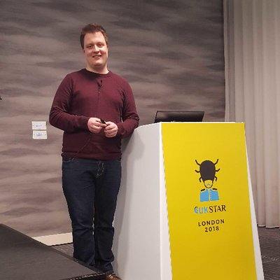


About Us
Ali Hill
QA and Continuous Delivery Consultant (Edinburgh)
Twitter: @ali_hill91
Hammad Chandio
QA and Continuous Delivery Consultant (London)
Farhan Shaikh
QA and Continuous Delivery Consultant (London)
Notes:
I thought I’d begin by introducing your 3 presenters for this evening. Hammad, Farhan and myself are all QA and Continuous Delivery Consultants at ECS Digital. I’m based up here in Edinburgh and Hammad and Farhan have joined us tonight from our London offices.
You can also find me on Twitter, my handle is on the slide.
All 3 of us were involved in setting up this Playground, so feel free to give one of us a shout during the presentation if you have any questions or technical issues.
If you find this Playground interesting and are interested in doing more like this then feel free to speak to any of us or Connor about potential opportunities.

Slide 5
Agenda
Quick re-cap of Zalenium.
What is Continuous Testing and what are its benefits?
Overview of Jenkins Pipeline.
Why use Jenkins Pipeline?
Playground – Jenkins, Zalenium, Allure.
Overview of pipeline syntax.
Overview of our test structure.
Overview and benefits of using Allure reporter.
Notes:
I’ll run through the agenda for the evening so that you know what to expect.

Slide 6
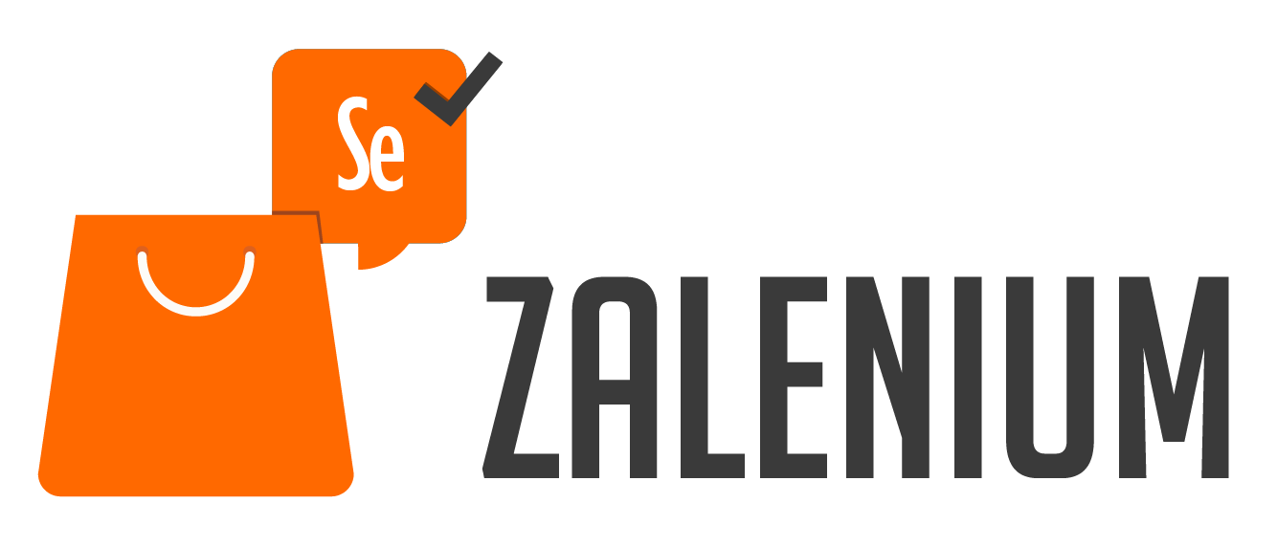
Zalenium Re-Cap
Open-source tool created by Zalando in 2017.
Can be run out of the box using Docker and Kubernetes.
Removes pain points of maintaining your own Selenium Grid.
Allows anyone in your team to have flexible and disposable Selenium Grid infrastructure created within seconds.
Auto-scales during and after tests are run.
Notes:
*CLICK* Zalenium is an open-source tool created by Zalando, a German ecommerce company with a huge tech department, in 2017. It has over 11,000 users in more than 80 countries. 500 people use it daily and has executed over 4.5 million tests since 2017.
*CLICK* It can be run out of the box using Docker and Kubernetes. This means it can also be run on most cloud providers.
*CLICK* A lot of time is invested in setting up and maintaining your own Selenium Grid. Having all browser versions updated and in line with the Selenium WebDriver drivers is often a frustrating process.
Zalenium manages this for you, removing this frustration.
*CLICK* Zalenium allows anyone to have flexible and disposable Selenium Grid infrastructure created within seconds. It means that functional testing can take place easily at any point in the development cycle as the infrastructure is available to all.
*CLICK* The number of docker-selenium instances scales during run time of the tests. Once the requests to run the tests are received the tool creates new containers. Once the tests are finished it auto-deletes the containers meaning resource is not wasted.

Slide 7
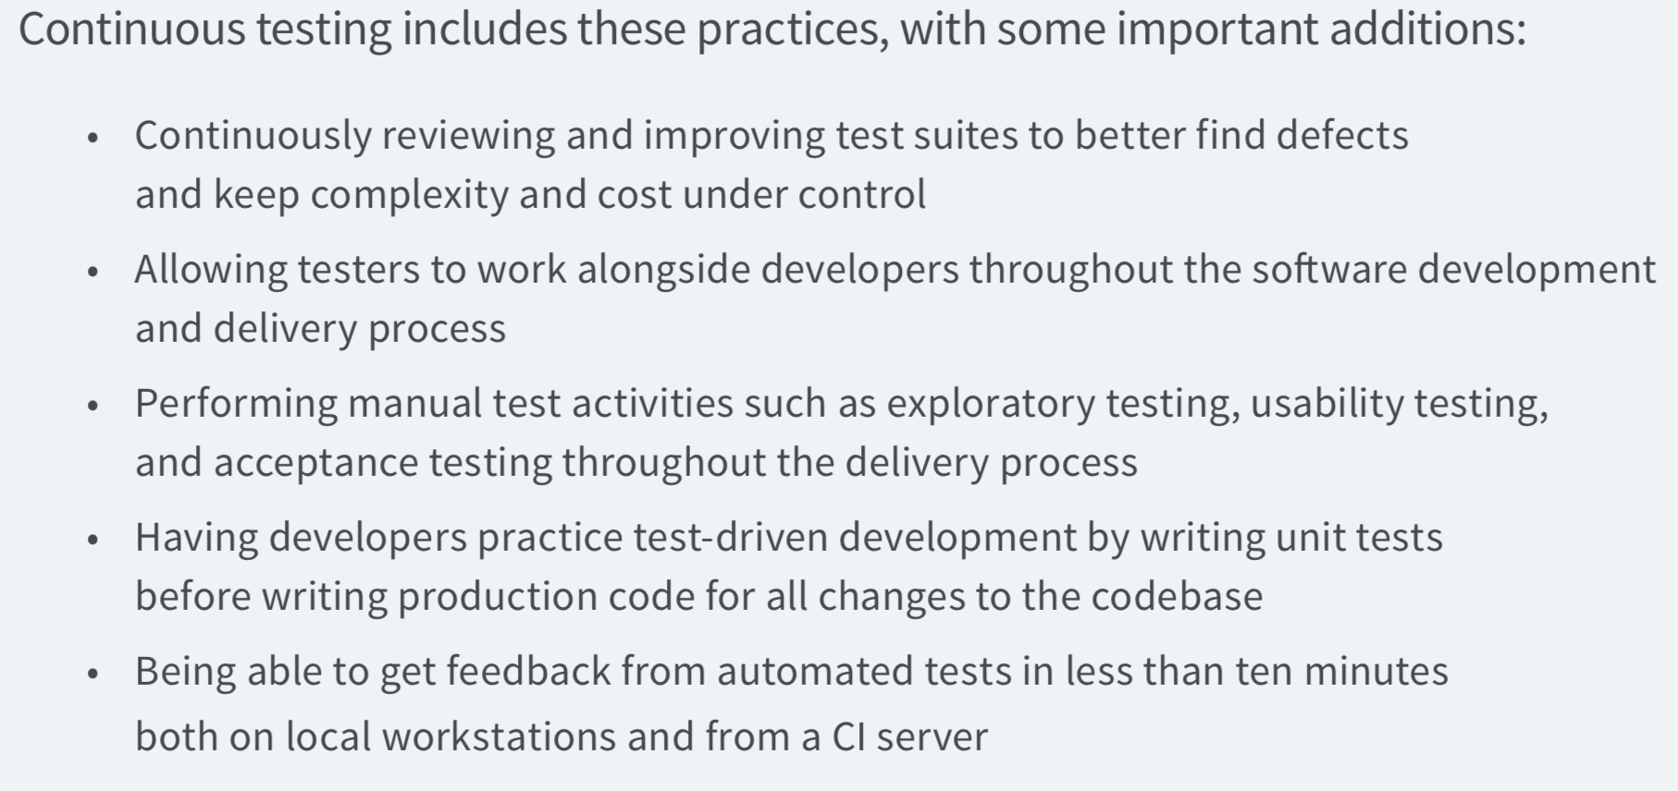
How do we define Continuous Testing?
DORA State of DevOps report 2018:
Notes:
The DORA State of DevOps report is published every year and aims to evaluate software delivery performance from technology companies across the world. It allows teams to benchmark themselves against industry standards.
The section on Continuous Testing is quite short, but it does highlight that automated testing is an important part of software delivery. Alongside automated testing, which is what this Playground will focus on, the State of DevOps report suggests that the following are important in being able to continuously delivery software to a high standard:
- Continuously reviewing test suites to improve our tests.
Working alongside developers throughout the SDLC lifecycle. I don’t believe the term Continuous Testing differs from Agile Testing in this sense.
Performing exploratory testing throughout the delivery process.
Having teams practice TDD.
Being able to get fast feedback from our test runs.

Slide 8
Continuous Testing – Automation - Benefits
Provides us with fast feedback on code changes.
Provides us with a certain level of confidence after every build.
Functional and non-functional tests can be run in a scheduled way.
Testing becomes more transparent.
Notes:
The automation side of Continuous Testing offers us the following advantages:
*CLICK* We get fast feedback on any code changes made to builds. This is important as historically developers would have to wait a long time to know if their build was stable.
*CLICK* As long as we are writing the correct tests, and we pair this with exploratory testing, we can have a certain amount of confidence that our build is stable and there are no major defects.
*CLICK* As well as having functional tests running after each build, as we are tonight using WebDriver and Zalenium, you can set up non-functional tests, such as performance tests, to run in a scheduled manner.
*CLICK* In my opinion, one of the main benefits of implementing automation into a CI process is that testing becomes transparent. Reports can be generated, viewed and actioned by all members of the team.

Slide 9
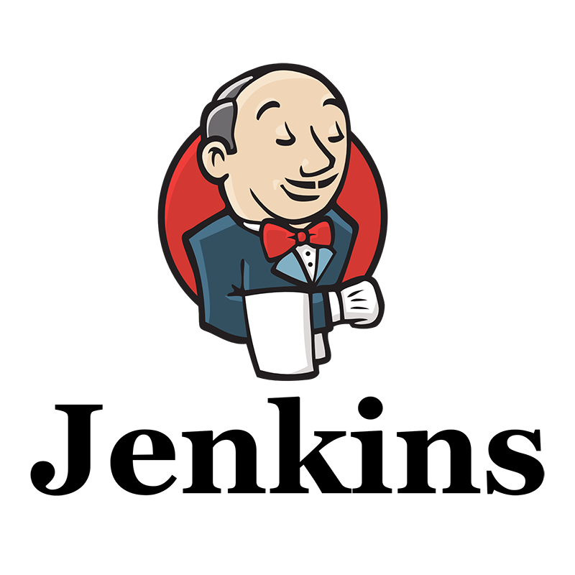
Jenkins Pipeline
Jenkins Pipeline is a plugin which allows us to implement a continuous delivery (CD) pipeline.
Pipeline provides us with a set of tools to write CD pipelines as code using a Pipeline syntax.
Pipeline script can be put into version control by using a ‘Jenkinsfile’ – better practice.
Allows for code review for Pipeline process.
Provides an audit trail.
All branches/pull requests have a Pipeline build process.
Notes:
Jenkins is an open-source tool which offers a simple way to set up a continuous integration environment for almost any combination of languages and source code repositories. Activities can be triggered by pull requests being completed into a code repository, as an example.
*CLICK* Jenkins Pipeline is a suite of plugins which supports implementing and integrating continuous delivery pipelines into Jenkins.
It allows us to implement a repeatable process for getting code from version control right through to our users or customers. It allows us to implement a reliable process of moving software through different stages of testing and deployment.
*CLICK* Pipeline provides an extensible set of tools for modeling simple-to-complex delivery pipelines "as code" via the Pipeline syntax, which is built on Groovy.
*CLICK* The Pipeline script that you create can be put into source control in the format of a Jenkinsfile. For the purposes of this evening’s Playground we will not be using a Jenkinsfile but editing directly in the Jenkins UI.
This is not best practice. It’s highly advised to have your Pipeline script in version control as it:
*CLICK* means all changes can go through code review.
*CLICK* there is an audit trail for the Pipeline script. This is not available when editing directly in Jenkins UI.
*CLICK* All branches and pull requests will follow a Pipeline build process.

Slide 10
Why Pipeline?
Pipeline adds a set of automation tools into Jenkins to execute powerful CI/CD pipelines.
Implemented in Code.
Durable.
Pausable.
Versatile.
Extensible.
Notes:
Given all of that information about Jenkins Pipeline, why would you want to use?
*CLICK* It adds access to a lot of powerful automation tools into Jenkins, ranging from Continuous Integration to Continuous Delivery activities.
*CLICK* Pipelines are implemented in code and typically checked into source control, giving teams the ability to edit, review, and iterate upon their delivery pipeline.
*CLICK* Pipelines can survive both planned and unplanned restarts of the Jenkins master.
*CLICK* It may not be better practice but Pipelines can optionally stop and wait for human input or approval before continuing the Pipeline run.
*CLICK* Pipelines support complex real-world CD requirements, including the ability to fork, loop, and perform work in parallel.
*CLICK* The Pipeline plugin supports custom extensions to its DSL and multiple options for integration with other plugins.

Slide 11
Playground
Access the Playground ReadMe and GitHub repo here: https://bit.ly/2R6v6F4
We’re going to create a Jenkins Pipeline in multiple stages:
Checking out test code from Git.
Installing Dependencies.
Starting Zalenium.
Running tests.
Generating reports using Allure.
Stopping Zalenium.
Notes:
Tonight’s Playground can be accessed using the link on this slide *make sure people have accessed it fine*.
Tonight’s Pipeline will involve the following steps *read from slide*
I think it would be good to highlight that we’re only implementing the testing aspect of a Jenkins Pipeline this evening. You would normally start a pipeline with your production or application code building and then being deployed to a test environment and then have your tests run and if they’re successful, deploy the build to production.
**Have user log into their Jenkins instance**

Slide 12
How have we set up this Playground?
On a Linux (Ubuntu 16.04) VM hosted in Azure.
Java and Jenkins installed using instructions in ReadMe.
Set-up Jenkins using the suggested plugins upon first run-time.
Custom plugins installed: Blue Ocean, NodeJS and Allure.
Global Tool Configuration for NodeJS and Allure.
Cloned the initial VM’s VHD.
Created multiple VMs using the clones of the disk.
Notes:
*Have users follow ‘Accessing Your Jenkins Instance’ and log into their Jenkins instance – make sure all is ok*
I’ll cover briefly what infrastructure your Jenkins instance is installed on and how we set it up.
*CLICK* We first of all set up a Linux VM in a new resource group. We used Ubuntu 16.04 as our OS and created the VM through Azure Portal.
*CLICK* On the first VM we created, we installed Java and Jenkins using the instructions linked in the ReadMe file.
*CLICK* After starting Jenkins for the first-time we installed the suggested plugins and set up the ‘DevOps’ username and password.
*CLICK* We then installed Blue Ocean, NodeJS and Allure - we’ll go into more details about these plugins later.
*CLICK* We then set up the Global Tool Configuration to specify Allure and NodeJS names and versions for the Pipeline to use.
*CLICK* At this point we stopped the VM and created multiple clones of the disk using Azure CLI. The instructions are included in the ReadMe.
*CLICK* Finally, we created multiple VMs using our cloned disks by using Azure CLI.
**Go back to the ReadMe and start the first run of the Pipeline**

Slide 13
Pipeline Syntax
Declarative pipeline.
All Declarative pipelines must be enclosed in a pipeline {} block.
agent – specifies where the pipeline will be run.
tools – declares any tools required to be used in the pipeline.
stage – declares the different stages of your pipeline.
steps – defines what is happening during this stage.
Notes:
**Have users run a Jenkins pipeline – show this slide after running**
Whilst the first run is taking place I thought I would explain a bit more about the Pipeline code we are using as dependencies often take a long time to install on the first run.
*CLICK* Our pipeline is a Declarative pipeline. Declarative Pipelines are relatively new to the Pipeline plugin and provides a relatively simple syntax to follow.
Previously Pipelines were only written in a Scripted Pipeline syntax, which meant there was a bit of a learning curve for teams as it was written in pure Groovy. Scripted syntax may be more desirable for more experienced users as the only limitations on syntax come from Groovy itself.
*CLICK* All declarative pipelines must be enclosed in a pipeline block.
*CLICK* The agent property is required at the top level of the pipeline block, but you can declare optional agents at different stages of your pipeline. Our pipeline is not run on any specific agents so we use the value ‘any’, but if you would like your pipeline to run in Docker, for example, you can declare this here.
*CLICK* The next sections we have is the tools section. It declares one or more tools to be installed and put on the PATH. In our case we installed NodeJS as we require it to install dependencies.
*CLICK* The stage section is pretty self-explanatory in that it defines the different stages or sections of your pipeline.
*CLICK* The steps section, within each stage, defines what happens within the different declared stages. You might notice in our Pipeline that we are running the first two stages in parallel.
Now that I’ve covered the basic structure of our pipeline I’ll go into the specifics of our pipeline.
**Discuss the pipeline specifics and then complete up to Running our tests**

Slide 14
Test Code – WebDriverIO
Javascript - WebDriver IO:
Extendable
Compatible
Feature-Rich
Allows you to write asynchronous commands in a synchronous way.
Notes:
Whilst the tests are running I can cover a bit more detail about how our tests are constructed.
*CLICK* We have written the tests in JavaScript using the WebDriverIO.
*CLICK* WebDriverIO is extendable. Helper functions are easy to add and the command line commands are simple to get to grips with.
**Have people check tests and then run the Allure reporter – come back once allure reports are being run**
*CLICK* WebDriverIO is Compatible with most TDD and BDD JavaScript frameworks.
*CLICK* It is feature-rich and can be used alongside multiple other tools and plugins such as Sauce Labs, Allure and Teamcity.
*CLICK* Parallel or asynchronous tests runs are easy to write. It removes the need to be concerned with race conditions as WebDriverIO handles the parallel running of tests for you.
Our test scenarios will be navigating to Google and then asserting that the title of the Google home page is ‘Google’. A really simple, basic test.

Slide 15
What is Allure and Why Use it?
Open-source test reporter.
Generates clear reports which are readable by all members of the team.
XML reports transformed into HTML.
It is extremely easy to install and set up for running with WebDriver IO test suites.
Notes:
*Have users complete up to Reporting Using Allure*
Before we add in the reporting capabilities I thought I’d cover what Allure reporter is.
*CLICK* It’s an open-source test reporter created by the Yandex testing team.
*CLICK* It generates clear test reports which are readable by all members of your delivery team. It provides sections which provide an Overview of all tests, it also shows Defects,
*CLICK* The reports it generates are in XML and then coverted into an HTML web page. They can be accessed through the Jenkins UI and a new report is generated each time the tests are run, meaning the results of each Pipeline can be investigated.
*CLICK* It is extremely easy to install using an npm command to generate the reports using your WebDriverIO config file.
**Explore UI of Allure a bit and then return to final slide after**

Slide 16
Tonight’s Playground – Review
We created a Jenkins Pipeline in the Jenkins Pipeline Editor UI.
Our pipeline:
Pulled dependencies and checked out code in parallel.
Started Zalenium
Ran our tests.
Generated reports using Allure.
Stopped Zalenium.
Notes:
That’s tonight’s Playground complete. Let’s re-cap on what we covered:
*CLICK* We created a Jenkins Pipeline using the Jenkins UI. As I mentioned before, best practice is to create a Jenkinsfile in your code repository to allow for greater visibility on changes etc.
*CLICK* Our Pipeline did the following: pulled dependencies and checked out code from Git in parallel. Started our Zalenium in Docker. Ran our WebDriver IO tests on our Zalenium VMs in Docker. Generated HTML WebDriverIO reports using Allure. Stopped the Zalenium containers.
Usually these tests would be running as part of a build process. Typical flow may be that a developer checks in code, the latest build is deployed to a test environment and then these tests are run. We’ve decided to highlight the testing part of the pipeline tonight, to further highlight the benefits of Continuous Testing in a CI/CD tool such as Jenkins Pipeline.

Slide 17

Thank You
Ali Hill, Hammad Chandio, Farhan Shaikh
Notes:
Thank you very much for attending tonight’s Playground hosted by ECS Digital.
If you have any questions at all then please feel free to ask. If you don’t want to ask just now then feel free to ask us over pizza! Thank you.

