Slide 1



DevOps Playground 6
Terraform and AWS
Mourad Trabelsi

Slide 2
DevOps Playground
Monthly event
Hands-on session
Interesting use cases or technologies
External speaker accepted ☺

Slide 3
Terraform – Infrastructure as Code
Automate the creation of infrastructures
All in one template
Support all public cloud providers
One-command deploy

Slide 4
AWS – Simplified concept
EC2 : Machines, server
AMI : Machine images
Security Group : AWS-Level firewall
ELB : AWS load balancer

Slide 5
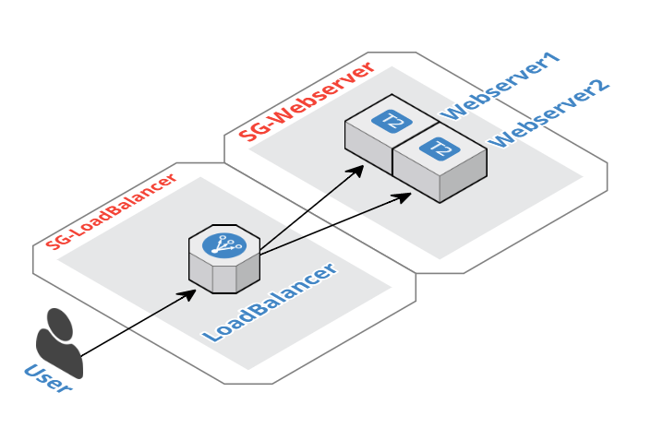
Plan

Slide 6
What we need
Virtual Machine : in the USB key
AWS access keys : Store in the Virtual Machine
Access to our Github : https://github.com/ForestTechnologiesLtd

Slide 7
Hands-on

