Slide 1
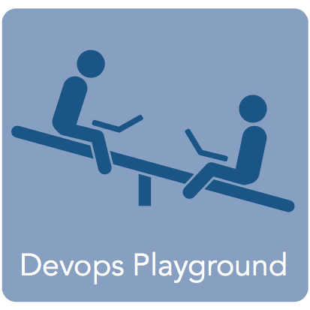
DevOps Playground: Nomad SSID: ECSD-HOTSPOT PW: entry-ind2x&creed=blade
Daniel Monteiro

Slide 2
Content
5 minutes presentation about Nomad + 45 minutes hands-on
Presentation:
What is Nomad?
Why Nomad?
Nomad vs other tools
Cases to use Nomad
Hands-On:
Set up our environment
Web APP Job
Cluster Job
GIT Repo: https://goo.gl/XYMsx8

Slide 3


What is Nomad?
Manage highly available and distributed clusters and applications;
Deploy applications;
Declare and run jobs;
Monitor your jobs and resources allocation.

Slide 4
Why Nomad?
Simple &
Built for scale
One binary to rule them all!
Supports Docker

Slide 5


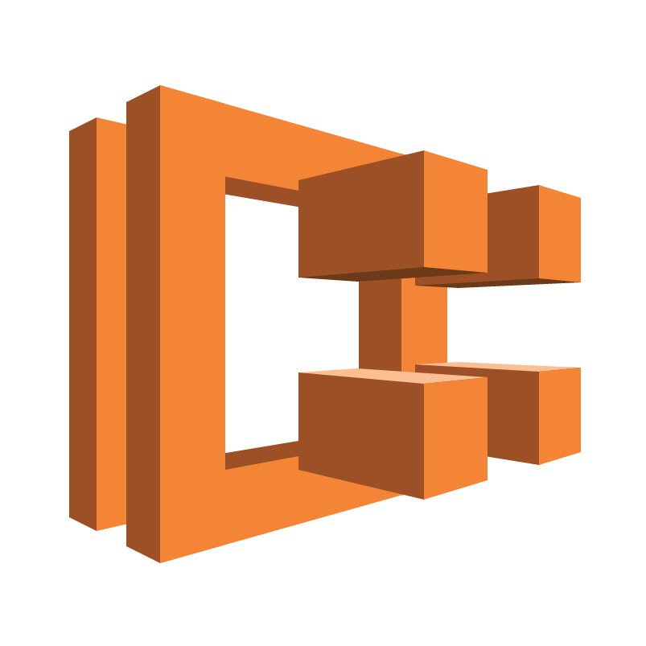
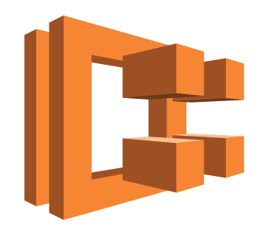
Nomad vs other tools
Kubernetes
Cluster Management
Scheduling
Service discovery
Monitoring
Secrets management
Nomad
Docker Swarm
Docker containers
Other containers/applications
API
AWS ECS
Cluster Management
Cloud internal
Environment agnostic
Support Docker

Slide 6
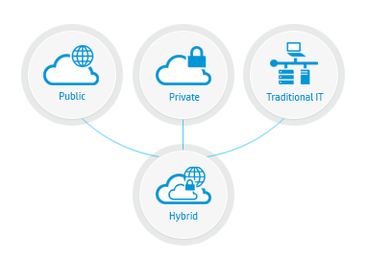


Cases when Nomad would be the best choice
Notes:
MICROSERVICES Nomad provides a platform for managing microservices, making it easier to adopt the paradigm.
HYBRID CLOUD designed to handle multi-datacenter and multi-region deployments and is cloud agnostic
ECOMMERCE load balancer, web frontends, API servers, and OLTP databases. Batch processing using Hadoop or Spark . workloads to share an underlying cluster, increasing utilization, reducing cost, simplifying scaling and providing a clean abstraction for developers.

Slide 7

Q&A

Slide 8
Hands-On
Let’s try now Nomad by performing a hands-on use case!

Slide 9
https://conferences.oreilly.com/velocity/vl-eu
18th of October 2017
Promo code for 25% off: DOPLAY
DevOps Playground – Hands on HashiCorp Consul

Slide 10
Thank you everyone!
It’s pizza and drinks time at 8pm! Enjoy!d

