Slide 1
Wifi
SSID :HMT Guest
Password : INN3R-bauble*shipment

Slide 2
Auto-Scaling Selenium Grid with Docker using Zalenium #DevOpsPlayground
Ali Hill, Hammad Chandio, Farhan Shaikh

Slide 3
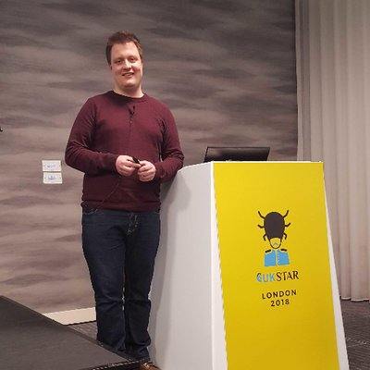


About Us
Ali Hill
QA and Continuous Delivery Consultant (Edinburgh)
Twitter: @ali_hill91
Hammad Chandio
QA and Continuous Delivery Consultant (London)
Farhan Shaikh
QA and Continuous Delivery Consultant (London)

Slide 4


https://www.devopsdays.org/events/2018-edinburgh/welcome/
1st-2nd November 2018

Slide 5
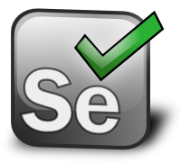
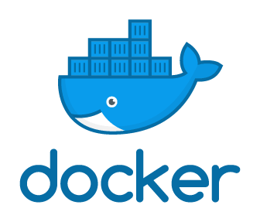
Selenium Overview
WebDriver
Web browser automation library.
Used for automating browser interaction.
Tests can be written in language of choice.
docker-selenium
Docker images for Selenium Grid server.
Contains hub and node configurations for Firefox and Chrome.

Slide 6
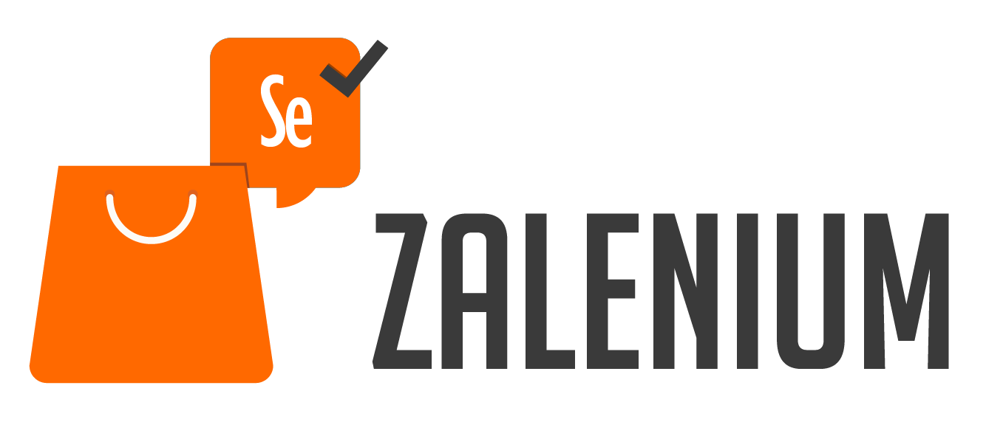
What is Zalenium?
Open-source tool created by Zalando in 2017.
Allows you to create a dynamic, on-demand Selenium Grid within seconds.
Can be run out of the box using Docker and Kubernetes.
Based on ‘docker-selenium’ so tests can be run in Firefox and Chrome.
Auto-scales during run-time and deletes nodes after tests are finished.
Simple to set up and run.
Tests can be run on other cloud testing providers - Sauce Labs, Testing Bot and Browser Stack
Notes:
Zalando = ecommerce company specialising in fashion and beatuy, over 1,000 employees in the tech department. Name is mixture of Zalando and Selenium.
Over 11,000 users in more than 80 countries. 500 people use it daily and has executed over 4.5 million tests since 2017.

Slide 7
Why use Zalenium?
Zalenium auto-scales.
Selenium Grid can consume a lot of resources when scaling.
Difficult to maintain all requirements in Grid (e.g. keeping all browsers up to date, maintaining Selenium drivers).
Allows anyone in your team to have flexible and disposable Selenium Grid infrastructure created within seconds.
Compliments external cloud testing providers which can run tests on browsers other than Firefox and Chrome.
Videos automatically recorderd (can be disabled) in ‘tmp/videos’ folder.
Dashboard available to see test execution history.
Also works with Kubernetes.
Notes:
Selenium Grid maintenance – browser releases, grid releases, driver versions take up a lot of time to maintain.
It’s not meant to replace cloud testing providers but work alongside them as they provide access to more browsers. Zalenium automatically redirects your tests to a cloud testing provider if one is available and docker-selenium cannot run those tests.
Overall Zalenium can increase the speed of your test suite as it runs docker-selenium tests locally, which reduces latency, but also utilizes the cloud testing provider you pay for in a smarter way.

Slide 8
How it works
Upon running the Zalenium start Docker command a Selenium Grid Hub is started.
A docker-selenium Starter Proxy then starts. This handles incoming requests.
A test request is sent to the Hub from the host machine.
docker-selenium proxy analyses the test and creates a new docker-selenium container which registers itself to the Hub.
The Hub then assigns a new test to the container where it is executed.
Once the test is complete, the node shuts down, and saves video files to a temporary location on the users’ machine.

Slide 9
How it works
If the Hub receives a test that docker-selenium is not compatible with (e.g. Safari, IE) then it will check for the availability of a cloud testing provider, where it will run the tests.

Slide 10
How it works

Slide 11
Playground
Everyone should have an IP address to log into over SSH.
Access the Playground ReadMe and GitHub repo here: https://bit.ly/2zrbOED
We’re going to:
Install docker-selenium and Zalenium.
Run Zalenium
Run JavaScript WebDriver.io tests in parallel using Zalenium
View the Zalenium Dashboard

Slide 12
Running tests on Cloud Proxy
As well as running tests on VMs, Zalenium also has support for the following providers:
Sauce Labs
TestingBot
Browser Stack
An example of this, to access Sauce Labs, add the following to your startup command:
export SAUCE_USERNAME=<your Sauce Labs username> export SAUCE_ACCESS_KEY=<your Sauce Labs access key> export SAUCE_LABS_URL=<your Sauce Labs url:port number>
--sauceLabsEnabled true

Slide 13
What else can be customised?
Basic auth grid protection can be implemented for deploying Zalenium in the cloud.
Zalenium start/stop can be streamlined into one curl command
curl -sSL https://raw.githubusercontent.com/dosel/t/i/p | bash -s start
curl -sSL https://raw.githubusercontent.com/dosel/t/i/p | bash -s stop
Set CPU/memory limits, output logs to JSON, set browser screen width/height, time zones and much more…

Slide 14

Thank You
Ali Hill, Hammad Chandio, Farhan Shaikh

