Slide 1
Wifi
SSID :HMT Guest
Password : INN3R-bauble*shipment
Notes:
First of all thanks to everyone for joining us for this DevOps Playground Meetup at ECS Digital.
Before we start the session, has everyone managed to connect to the WiFi?

Slide 2
Auto-Scaling Selenium Grid with Docker using Zalenium #DevOpsPlayground
Ali Hill, Hammad Chandio, Farhan Shaikh
Notes:
This evening’s session will involve getting hands-on with an open source tool called Zalenium, which allows you to create a scalable Selenium Grid infrastructure using Docker.
You can use the #DevOpsPlayground on Twitter/LinkedIn to find our social media posts about our Meetups. All updates are also posted on the Meetup.com website.

Slide 3


https://www.devopsdays.org/events/2018-edinburgh/welcome/
1st-2nd November 2018
@devopsdaysedi
Notes:
ECS Digital are gold sponsors for this year’s Edinburgh DevOpsDays which takes place on the 1st and 2nd November.
The speaker lineup details should be getting announced soon, and you can follow them on Twitter @devopsdaysedi for further updates.

Slide 4
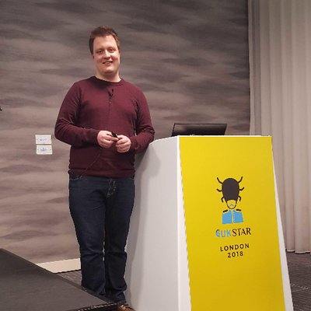


About Us
Ali Hill
QA and Continuous Delivery Consultant (Edinburgh)
Twitter: @ali_hill91
Hammad Chandio
QA and Continuous Delivery Consultant (London)
Farhan Shaikh
QA and Continuous Delivery Consultant (London)
Notes:
I thought I’d begin by introducing your 3 presenters for this evening. Hammad, Farhan and myself are all QA and Continuous Delivery Consultants at ECS Digital. I’m based up here in Edinburgh and Hammad and Farhan have joined us tonight from our London offices.
You can also find me on Twitter, my handle is on the slide.
All 3 of us were involved in setting up this Playground, so feel free to give one of us a shout during the presentation if you have any questions.

Slide 5
Agenda
Overview of Selenium WebDriver and docker-selenium
What is Zalenium?
How does Zalenium work?
Why use Zalenium?
Hands-on session with Zalenium.
How to run Zalenium using a cloud testing provider.
Further features of Zalenium.
Notes:
I’ll run through the agenda for the evening so that you know what to expect.

Slide 6
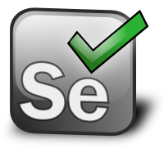
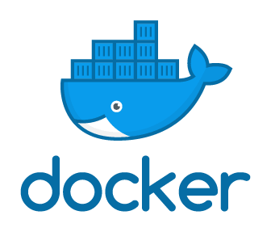
Selenium Overview
WebDriver
Web browser automation library.
Used for automating browser interaction.
Tests can be written in language of choice.
docker-selenium
Docker images for Selenium Grid server.
Contains hub and node configurations for Firefox and Chrome.
Notes:
First of all I’ll give a high-level overview of what Selenium WebDriver is.
Who has used Selenium?
Who has used Selenium Grid?
*CLICK* WebDriver is an open source web automation framework that allows you to automate tests against different web browsers.
It interacts with page elements and allows you to assert that certain elements are displayed on the page, can be interacted with and text can be input as just a few examples. It allows us to add browser testing to our continuous testing solution.
You can write your tests in your language of choice. I know there’s support for C#, Java, JavaScript, Python and many more.
For tonight’s hands-on example we have created a small suite of simple JavaScript tests which run in parallel. We won’t be delving into the Javascript code itself, but feel free to see how it has been created in our GitHub repo after tonight’s session.
*CLICK* docker-selenium is a Docker image for Selenium Grid. Selenium Grid allows us to run distributed test cases across multiple machines. Selenium for docker allows us to create pre-made Docker containers which include Selenium Grid, making running tests created in WebDriver easy.
It contains configurations for Firefox and Chrome.

Slide 7
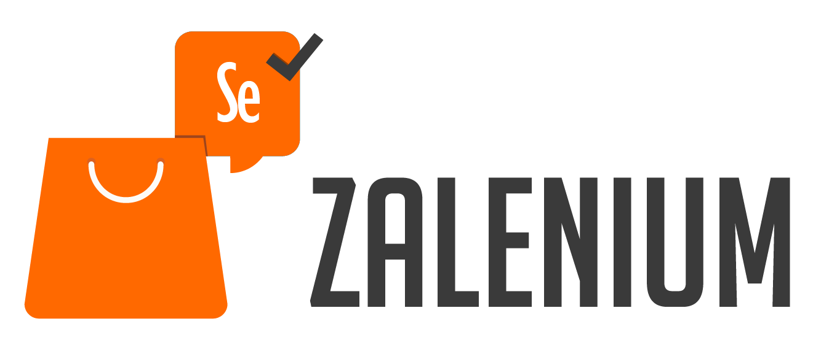
What is Zalenium?
Open-source tool created by Zalando in 2017.
Allows you to create a dynamic, on-demand docker-selenium instances within seconds.
Can be run out of the box using Docker and Kubernetes. It can be run on most cloud providers.
Based on ‘docker-selenium’ so tests can be run in Firefox and Chrome.
Auto-scales during run-time and deletes nodes after tests are finished.
Simple to set up and run.
Tests can be run on other cloud testing platforms.
Notes:
*CLICK* Zalenium is an open-source tool created by a company called Zalando. Zalando are an ecommerce company based in Germany specialising in fashion and beauty with over 1,000 employees in the tech department. Then Name of Zalenium tool is mixture of Zalando and Selenium.
*CLICK* The main purpose of the tool is to allow you to create dynamic and on-demand docker-selenium instances within seconds.
*CLICK* It can be run out of the box using Docker and Kubernetes. It is is the only open source tool which provides complete functionality with both of these. It can also be run on most cloud providers e.g. AWS, Azure, Google Cloud Engine etc.
*CLICK* As it is based on docker-selenium, tests can be run on Firefox and Chrome. I’ll discuss a bit later about how it is possible to run tests on other browsers using Zalenium.
*CLICK* The number of docker-selenium instances scales during run time of the tests. Once the requests to run the tests are received the tool creates new containers. Once the tests are finished it auto-deletes the containers meaning resource is not wasted.
*CLICK* It’s really simple to set up and get started with.
*CLICK* It can work in collaboration with cloud testing providers, such as Sauce Labs, TestingBot and Browser Stack, meaning that tests can be run on other platforms.
Over 11,000 users in more than 80 countries. 500 people use it daily and has executed over 4.5 million tests since 2017.

Slide 8
How it works
Upon running the Zalenium start Docker command a Selenium Grid Hub is started.
A docker-selenium starter proxy then starts. This handles incoming requests.
A test request is sent to the Hub from the host machine.
docker-selenium proxy analyses the test and creates a new docker-selenium container which registers itself to the Hub.
The Hub then assigns a new test to the container where it is executed.
Once the test is complete, the node shuts down, and saves video files to a temporary location on the host machine.
Notes:
I’ll now go into a bit more detail about how Zalenium works behind the scenes.
*CLICK* Upon entering the run command, which we’ll show later, a Selenium Grid Hub is started by Zalenium.
*CLICK* A docker-selenium starter proxy is then started. This Is used to handle incoming requests.
*CLICK* When a test request is triggered by the host machine, a request is sent to the Grid Hub.
*CLICK* The Hub then sends the request to the docker-selenium proxy, which creates a new container, which will register itself to the Grid Hub.
*CLICK* The Hub then assigns a new test to the container where it is executed.
*CLICK* Once the test is complete, the node is shut down and a video file is saved to a temporary location on the host machine.

Slide 9
How it works
If the Hub receives a test that docker-selenium is not compatible with (e.g. Safari, IE) then it will check for the availability of a cloud testing provider, where it will run the tests.
Notes:
That’s an overview of how the main functionality of Zalenium is performed and the process it goes through, but there is also an additional scenario.
*CLICK* If the Grid Hub receives a test that docker-selenium cannot run (i.e. one in a browser other than Chrome or Firefox), then it will check for the availability of a cloud testing provider, such as Sauce Labs, which is where it will run those tests.
I’ll cover how to specify the availability of a cloud testing provider later on.

Slide 10
How it works
Notes:
Zalando have provided a nice image of both of those scenarios play out.

Slide 11
Why use Zalenium?
Zalenium auto-scales.
Difficult to maintain all requirements in Grid (e.g. keeping all browsers up to date, maintaining Selenium drivers).
Allows anyone in your team to have flexible and disposable Selenium Grid infrastructure created within seconds.
Compliments external cloud testing providers which can run tests on browsers other than Firefox and Chrome.
Videos recorded (can be disabled) in ‘tmp/videos’ folder.
Dashboard available to see test execution history.
Also works with Kubernetes.
Notes:
So, why would you decide to use Zalenium?
*CLICK* First of all, it auto-scales by creating more docker containers as and when they are needed. It also scales back down as tests finish.
*CLICK* A lot of time is invested in setting up and maintaining your own Selenium Grid. Having all browser versions updated and in line with the Selenium WebDriver browser drivers is often a frustrating process.
Zalenium manages this for you, removing this frustration.
*CLICK* Zalenium allows anyone to have flexible and disposable Selenium Grid infrastructure created within seconds. It means that functional testing can take place easily at any point in the development cycle as the infrastructure is available to all.
*CLICK* It compliments your existing cloud testing providers. If you already use providers such as Sauce Labs and Testing Bot then Zalenium can work alongside those. Have the Chrome and Firefox tests run on host machines for faster feedback, but tests in other browsers can be directed to your provider.
*CLICK* Videos are automatically recorded, if required into a temporary location. These videos are automatically saved in a temporary location on the host machine.
*CLICK* The dashboard feature or live preview can show you exactly what is happening in your tests. It also displays both Selenium logs and browser logs (which can be saved in JSON format onto the host machine).
*CLICK* It also has Kubernetes support. We won’t be covering this in this session, but we may do a part 2 of the Playground exploring how to run Zalenium as part of CI using Kubernetes.
Overall, Zalenium can increase the speed of your continuous testing process as it manages them in a smarter way by providing more containers when required and allowing anyone to have flexible and disposable Selenium Grid infrastructure.

Slide 12
Cons
Performance
High spec machine
Video recording slows down tests a lot. Can be disabled.
Notes:
So, why would you decide to use Zalenium?
*CLICK* First of all, it auto-scales by creating more docker containers as and when they are needed. It also scales back down as tests finish.
*CLICK* A lot of time is invested in setting up and maintaining your own Selenium Grid. Having all browser versions updated and in line with the Selenium WebDriver browser drivers is often a frustrating process.
Zalenium manages this for you, removing this frustration.
*CLICK* Zalenium allows anyone to have flexible and disposable Selenium Grid infrastructure created within seconds. It means that functional testing can take place easily at any point in the development cycle as the infrastructure is available to all.
*CLICK* It compliments your existing cloud testing providers. If you already use providers such as Sauce Labs and Testing Bot then Zalenium can work alongside those. Have the Chrome and Firefox tests run on host machines for faster feedback, but tests in other browsers can be directed to your provider.
*CLICK* Videos are automatically recorded, if required into a temporary location. These videos are automatically saved in a temporary location on the host machine.
*CLICK* The dashboard feature or live preview can show you exactly what is happening in your tests. It also displays both Selenium logs and browser logs (which can be saved in JSON format onto the host machine).
*CLICK* It also has Kubernetes support. We won’t be covering this in this session, but we may do a part 2 of the Playground exploring Kubernetes.
Overall, Zalenium can increase the speed of your continuous testing process as it manages them in a smarter way by providing more containers when required and allowing anyone to have flexible and disposable Selenium Grid infrastructure.

Slide 13
Playground
Everyone should have an IP address to log into over SSH.
Access the Playground ReadMe and GitHub repo here: https://bit.ly/2zrbOED
We’re going to:
Install docker-selenium and Zalenium.
Run Zalenium
Run JavaScript WebDriver.io tests in parallel using Zalenium
View the Zalenium Dashboard

Slide 14
Running tests on Cloud Proxy
As well as running tests on VMs, Zalenium also has support for the following providers:
Sauce Labs
TestingBot
Browser Stack
An example of this, to access Sauce Labs, add the following to your startup command:
export SAUCE_USERNAME=<your Sauce Labs username> export SAUCE_ACCESS_KEY=<your Sauce Labs access key> export SAUCE_LABS_URL=<your Sauce Labs url:port number>
--sauceLabsEnabled true
Notes:
*CLICK* So as well as the scenario we’ve just show, we can also run these tests on cloud providers. Just now there is support for Sauce Labs, TestingBot and Browser Stack.
*CLICK* It’s pretty simple to register these providers to Zalenium. An example of how to do this is shown below. You simply add these arguments to the Zalenium run command which we executed earlier.

Slide 15
What else can be customised?
Basic auth grid protection can be implemented for deploying Zalenium in the cloud.
Zalenium start/stop can be streamlined into one curl command
curl -sSL https://raw.githubusercontent.com/dosel/t/i/p | bash -s start
curl -sSL https://raw.githubusercontent.com/dosel/t/i/p | bash -s stop
Set CPU/memory limits, output logs to JSON, set browser screen width/height, time zones and much more…

Slide 16

Thank You
Ali Hill, Hammad Chandio, Farhan Shaikh

