Slide 2




Git History
▪
▪
▪
▪

Slide 3







SCM Terminologies

Slide 4
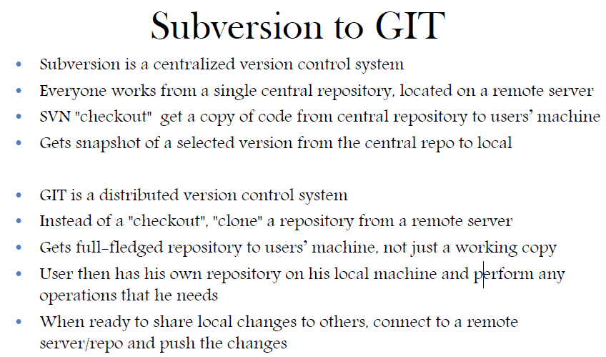

Slide 5

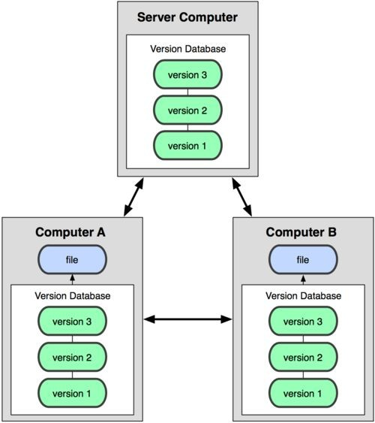
Distributed version control system
Centralized Model
Distributed Model
(CVS, Subversion, Perforce)
(Git, Mercurial)
Result: Many operations are local

Slide 6
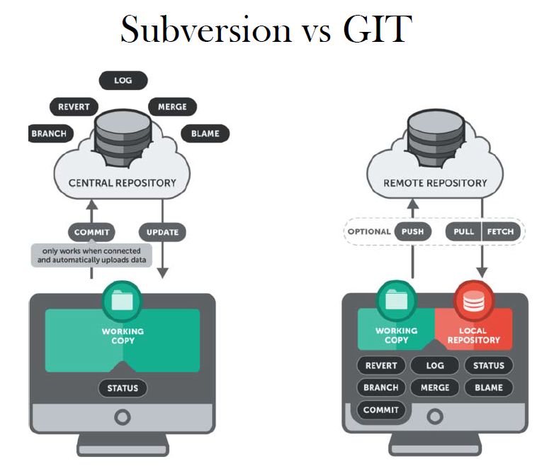

Slide 7
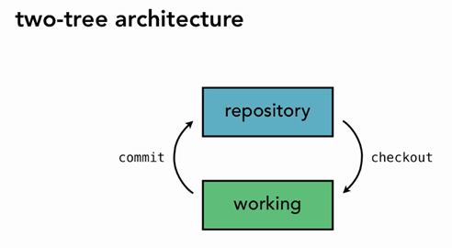
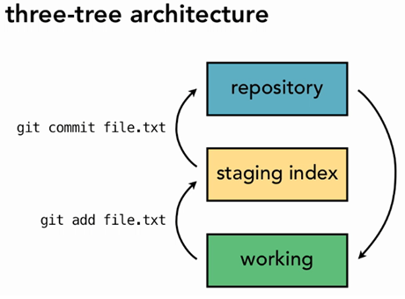
SVN / GIT Process Flow
SVN
GIT

Slide 8
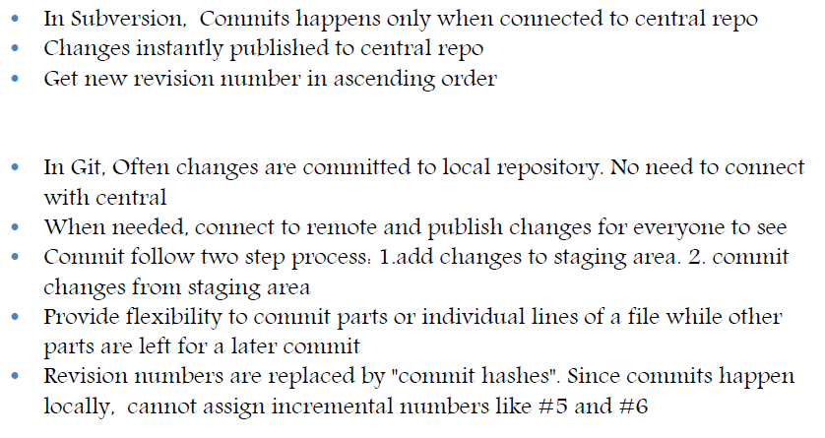
Difference is Commits

Slide 9
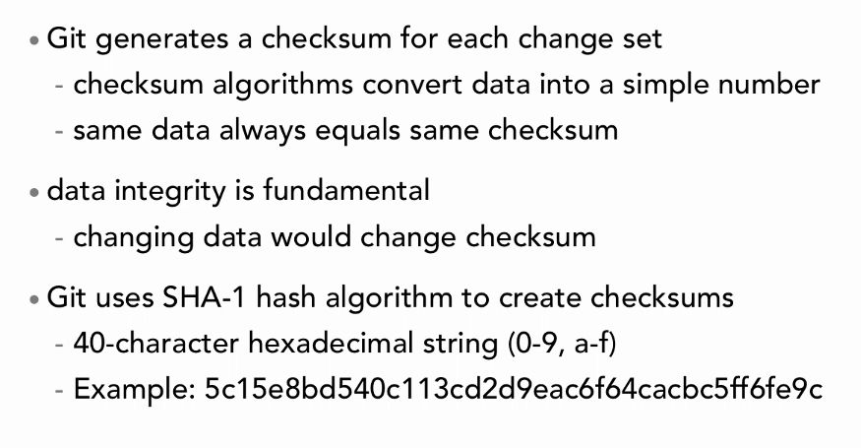
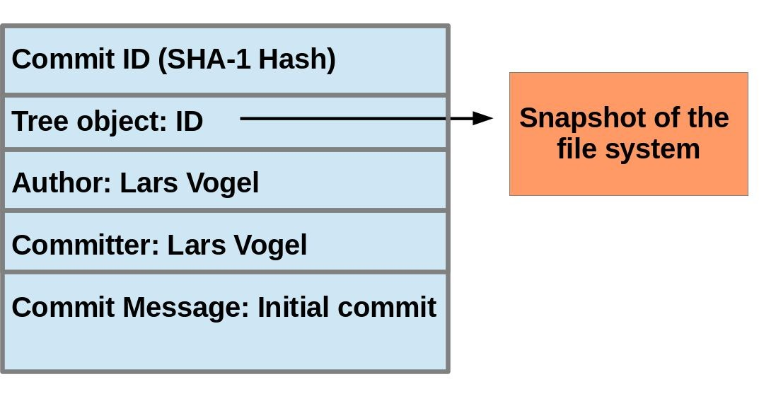
Git uses checksums

Slide 10
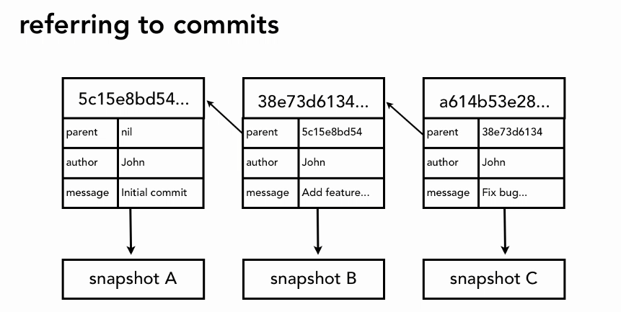
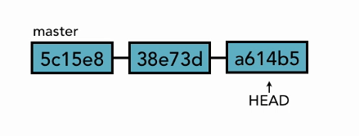
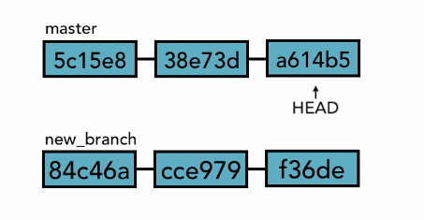
Git Commit Referencing
Head Pointers

Slide 11

A L ocal Git project has three areas
Committed
Files
Unmodified/modifie Stage
d d
Files Files
Note: working directory sometimes called the “working tree”, staging area sometimes called the “index”.

Slide 12
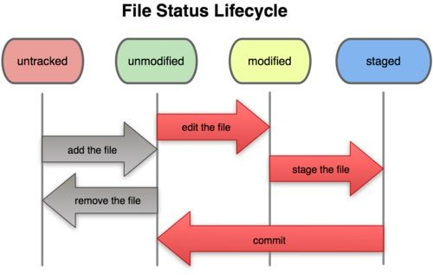
Git file lifecycle

Slide 13
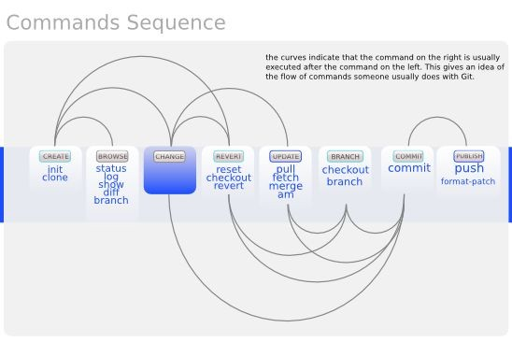
Basic Workflow

Slide 14



Repositories
Bare Repository
▪
▪
Non-bare Repository
▪
Creating Repository from Remote Repository
▪

Slide 15





Get ready to use Git!
1.
$ git config --global user.name “Bugs Bunny”
$ git config --global user.email
$ git config --global push.default simple
git config –list
--global

Slide 16







Git commands
git clone url [dir]
git add files
git commit
git status
git diff
git help [command]
git pull
git push
init, reset, branch, checkout, merge, log, tag

Slide 17


Add, Status and Diff
$ git add <file>
$ git status
$ git status –s (-s
$ git diff

Slide 18



Pulling and Pushing
1.
2.
3.
$ git pull origin master
$ git push origin master
origin master

Slide 19





Ignoring files & Viewing logs

Slide 20
Branching
•$ git branch experimental
•$ git branch
•$ git checkout experimental
•$ git diff master <your_branch>
Merge branches :
•$ git merge <source_branch> <destnation_branch>

Slide 21
Stashing commited changes
•$ git stash
•$ git stash list
•$ git stash pop
•$ git stash apply stash@{num}
Remove stash from repo
•$ git stash clear

Slide 22

Reverting changes
•$ git reset <file>
•$ git reset --soft
•$ git reset --mixed
•$ git reset --hard

Slide 23

Reverting changes …
•$ git revert <commit>
•$ git checkout <commit_id>
•$ git rm <file>
•$ git clean -n (-n is for dry run)
•$ git clean -f (force delete)
Discard changes in working directory
•$ git checkout -- <file>

Slide 24




Tags
•$ git tag –a <pattern> -m ‘comment’ <commitid>
•$ git show <pattern>
•$ git tag

