Slide 1
Workspace

Slide 2

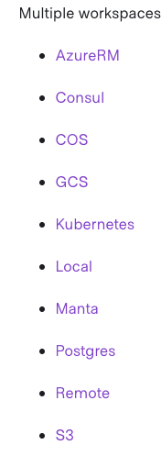
Workspaces are Collections of Infrastructure
Terraform starts with a single workspace named "default". This workspace is special both because it is the default and also because it cannot ever be deleted. If you've never explicitly used workspaces, then you've only ever worked on the "default" workspace.
The persistent data stored in the backend belongs to a workspace. Initially the backend has only one workspace, called "default", and thus there is only one Terraform state associated with that configuration.
Terraform Cloud manages infrastructure collections with workspaces instead of directories. A workspace contains everything Terraform needs to manage a given collection of infrastructure, and separate workspaces function like completely separate working directories.

Slide 3
Workspaces are managed with the terraform workspace set of commands. To create a new workspace and switch to it, you can use terraform workspace new; to switch workspaces you can use terraform workspace select; etc.
$ terraform workspace new bar
Created and switched to workspace "bar"!
You're now on a new, empty workspace. Workspaces isolate their state, so if you run "terraform plan" Terraform will not see any existing state for this configuration.

Slide 4
Why
Named workspaces allow conveniently switching between multiple instances of a single configuration within its single backend. They are convenient in a number of situations, but cannot solve all problems.
A common use for multiple workspaces is to create a parallel, distinct copy of a set of infrastructure in order to test a set of changes before modifying the main production infrastructure. For example, a developer working on a complex set of infrastructure changes might create a new temporary workspace in order to freely experiment with changes without affecting the default workspace.
Non-default workspaces are often related to feature branches in version control. The default workspace might correspond to the "main" or "trunk" branch, which describes the intended state of production infrastructure.
When Terraform is used to manage larger systems, teams should use multiple separate Terraform configurations that correspond with suitable architectural boundaries within the system so that different components can be managed separately and, if appropriate, by distinct teams.

Slide 5
Workspaces are technically equivalent to renaming your state file. They aren't any more complex than that. Terraform wraps this simple notion with a set of protections and support for remote state.
For local state, Terraform stores the workspace states in a directory called terraform.tfstate.d. This directory should be treated similarly to local-only terraform.tfstate
For remote state, the workspaces are stored directly in the configured backend. For example, if you use Consul, the workspaces are stored by appending the workspace name to the state path.

Slide 6
In Terraform CLI, workspaces are separate instances of state data that can be used from the same working directory. You can use workspaces to manage multiple non-overlapping groups of resources with the same configuration.
Every initialized working directory has at least one workspace. (If you haven't created other workspaces, it is a workspace named default.)
For a given working directory, only one workspace can be selected at a time.
Most Terraform commands (including provisioning and state manipulation commands) only interact with the currently selected workspace.
Use the terraform workspace select command to change the currently selected workspace.
Use the terraform workspace list, terraform workspace new, and terraform workspace delete commands to manage the available workspaces in the current working directory.

