Slide 1
Terraform State

Slide 2
State:
Terraform must store state about your managed infrastructure and configuration. This state is used by Terraform to map real world resources to your configuration, keep track of metadata, and to improve performance for large infrastructures.
This state is stored by default in a local file named "terraform.tfstate", but it can also be stored remotely, which works better in a team environment.
Terraform uses this local state to create plans and make changes to your infrastructure. Prior to any operation, Terraform does a refresh to update the state with the real infrastructure.

Slide 3
Purpose
State is a necessary requirement for Terraform to function.
For mapping configuration to resources in the real world, Terraform uses its own state structure
Terraform expects that each remote object is bound to only one resource instance, which is normally guaranteed by Terraform being responsible for creating the objects and recording their identities in the state.

Slide 4
Metadata
Alongside the mappings between resources and remote objects, Terraform must also track metadata such as resource dependencies.
when you delete a resource from a Terraform configuration, Terraform must know how to delete that resource. Terraform can see that a mapping exists for a resource not in your configuration and plan to destroy
To ensure correct operation, Terraform retains a copy of the most recent set of dependencies within the state. Now Terraform can still determine the correct order for destruction from the state when you delete one or more items from the configuration.

Slide 5
Performance
Terraform stores a cache of the attribute values for all resources in the state.
When running a terraform plan, Terraform must know the current state of resources in order to effectively determine the changes that it needs to make to reach your desired configuration
For small infrastructures, Terraform can query your providers and sync the latest attributes from all your resources. This is the default behaviour of Terraform: for every plan and apply, Terraform will sync all resources in your state.
For larger infrastructures, querying every resource is too slow. Many cloud providers do not provide APIs to query multiple resources at once, and the round trip time for each resource is hundreds of milliseconds. On top of this, cloud providers almost always have API rate limiting so Terraform can only request a certain number of resources in a period of time. Larger users of Terraform make heavy use of the -refresh=false flag as well as the -target flag in order to work around this.
By Default Terraform stores the config info in local folder, when Teamwork is needed we go Remote.

Slide 6
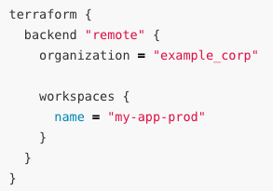
Remote State
By default, Terraform stores state locally in a file named terraform.tfstate. When working with Terraform in a team, use of a local file makes Terraform usage complicated because each user must make sure they always have the latest state data before running Terraform and make sure that nobody else runs Terraform at the same time.
With remote state, Terraform writes the state data to a remote data store, which can then be shared among all members of a team.
Terraform supports storing state in Terraform Cloud, HashiCorp Consul, Amazon S3, Azure Blob Storage, Google Cloud Storage, Alibaba Cloud OSS, and more
Remote state is implemented by a backend, which you can configure in your configuration's root module.
Remote state allows you to share output values with other configurations.
Each Terraform configuration can specify a backend, which defines where and how operations are performed, where state snapshots are stored, etc.
Backend Configuration documents the form of a backend block, which selects and configures a backend for a Terraform configuration.

Slide 7

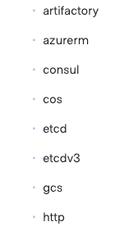
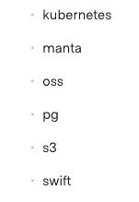
State Locking
If supported by your backend, Terraform will lock your state for all operations that could write state. This prevents others from acquiring the lock and potentially corrupting your state.
State locking happens automatically on all operations that could write state. You won't see any message that it is happening. If state locking fails, Terraform will not continue. You can disable state locking for most commands with the -lock flag but it is not recommended.
Terraform has a force-unlock command to manually unlock the state if unlocking failed.

Slide 8
The terraform state list command shows the resource addresses for every resource Terraform knows about in a configuration, optionally filtered by partial resource address.
The terraform state show command displays detailed state data about one resource.
The terraform refresh command updates state data to match the real-world condition of the managed resources. This is done automatically during plans and applies, but not when interacting with state directly.
The terraform state mv to move the state like re-creation/renaming instead of destroy/apply.
The terraform state pull – download and output from remote
The terraform state push – upload local state to remote

Slide 9
terraform import
Sometimes our friends can create some resource manually
Sometimes you may do manually first and then go for terraform
Terraform is able to import existing infrastructure. This allows you take resources you've created by some other means and bring it under Terraform management.
This is a great way to slowly transition infrastructure to Terraform, or to be able to be confident that you can use Terraform in the future if it potentially doesn't support every feature you need today.
The current implementation of Terraform import can only import resources into the state. It does not generate configuration. A future version of Terraform will also generate configuration.

