Slide 1

Software Development Model Comparison
Waterfall vs Agile
Jessica Johnson
02/21/2025

Slide 2
Objective
Should ChadaTech transition to Agile?
SNHU Travel Software Pilot use of Scrum-Agile
Notes:
AI-generated content may be incorrect. --- In this presentation, we will explore two predominant software development methodologies: Scrum-Agile and Waterfall. We will discuss the principles, roles, phases, and factors influencing the choice between these approaches.

Slide 3
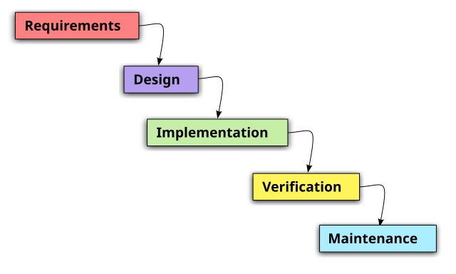
What is Waterfall?
Waterfall Development
Distinct phases that flow into one another.
Each phase must be complete before moving onto the next.
Cannot move backward in the phases, only top to bottom.
Know the majority of details upfront with minimal flexibility.
Rigid, not fluid.
Waterfall suits projects with clear, fixed requirements.
(Declute, 2022)
Notes:
Choosing between Agile and Waterfall depends on project-specific factors. Understanding these factors will help teams select the most appropriate methodology for their needs.

Slide 4
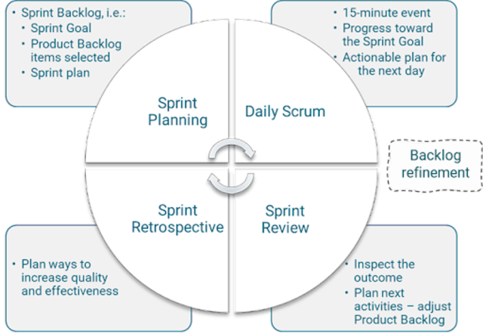
What is Scrum-Agile?
Scrum-Agile Development
Agile principles provide early and continuous delivery of software.
Agile principles prioritize responding to change over following a plan.
Scrum is a framework within the Agile methodology. Scrum, Kanban, Lean, and Extreme Programming are all frameworks that can be used within the Agile methodology. (geeksforgeeks, 2024)
“Scrum lessens the chances of significant mistakes by working in increments and accounting for feedback during the springs” (Martins, 2025).
Constant communication and collaboration amongst members of the team and the client are vital to the success of a scrum team.
Scrum is small increments, constant communication, adaptability, and continuous improvement.
Agile is ideal for complex projects with evolving requirements. (Martins, 2025)
Notes:
Choosing between Agile and Waterfall depends on project-specific factors. Understanding these factors will help teams select the most appropriate methodology for their needs.

Slide 5

Roles in Scrum-Agile Development
Scrum Master
Product Owner
Developers
Testers
Supporting role: Client
Notes:
In Scrum-Agile development, specific roles are crucial for successful implementation. Understanding these roles and their responsibilities is essential for effective teamwork and project success.

Slide 6

Scrum Master
Facilitator
Responsible for holding daily standup scrum meetings, hosting print planning, review, and retrospective meetings.
Removes obstacles and facilitates clarity
Provides an environment that promotes collaboration and continuous improvement.
(Martins, 2025)
Notes:
The Scrum Master acts as a facilitator for the team, ensuring that Scrum practices are followed. Their responsibilities include removing obstacles, coaching team members, and fostering an environment of collaboration and continuous improvement.

Slide 7
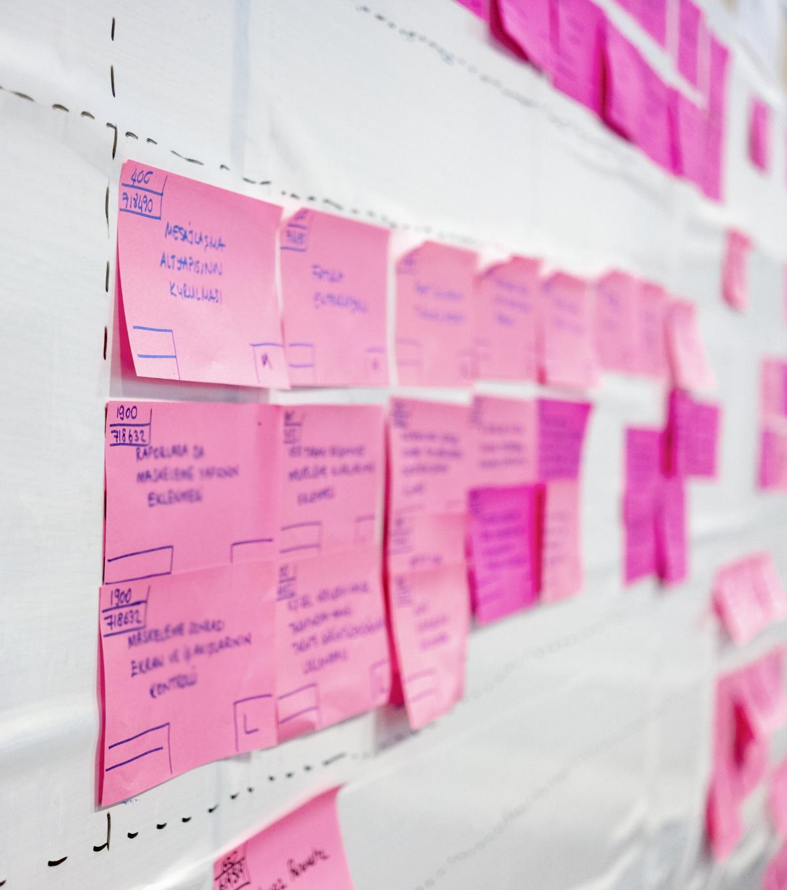
Product Owner
Maintains product backlog
Provides clarity about what's priority and not
Vital to have great communication skills for interactions with the client and scrum team.
(Martins, 2025)
Notes:
The Product Owner is responsible for maximizing the value of the product. This involves managing the product backlog, prioritizing features, and ensuring clear communication of the vision to the development team.

Slide 8

Development Team
Developers and Testers
Diverse group of skilled professionals that provide a product after each sprint.
Collaboration and communication are crucial for success
Participates in daily stand ups, sprint planning, sprint review, and sprint retrospective.
(Talreja, 2023)
Notes:
The Development Team is composed of professionals who work together to deliver a potentially shippable product increment at the end of each sprint. Collaboration is key, as team members must communicate effectively and share knowledge to achieve their goals.

Slide 9
Phases of the Scrum-Agile Process
Ideation
Development
Testing
Deployment
Operations
Notes:
The Scrum-Agile process consists of several key phases that guide the development cycle. Understanding these phases is essential for implementing Scrum practices effectively.

Slide 10

Ideation
It all starts with an idea.
Product Owner pieces together a project vision
Plans the project enough to get started but not to its entirety, that would go against the idea of a flexible agile framework.
Defines purpose and goals of the new software
Business Requirements
Starts prioritizing tasks
(DiCesare, 2025)
Notes:
Sprint planning involves defining the work to be done in the upcoming sprint and refining the product backlog. This phase ensures that the team is aligned on priorities and understands the goals for the sprint.

Slide 11

Development
Sprints are completed by the skilled, collaborative development teams.
Scrum events like, sprint planning, daily scrum meetings, sprint reviews, and sprint retrospectives all include the development team and vital to the development of the sprints. (Martins, 2025)
Notes:
At the end of each sprint, the team conducts a sprint review to demonstrate completed work and gather feedback. This is followed by a sprint retrospective, where the team reflects on their process and identifies areas for improvement.

Slide 12

Testing
After the developers submit their sprint, it is time to test.
Testing identifies issues. With the small iterations of the sprint planning, testing happens often, and issues are identified sooner than later.
Testing ensures the code is clean, free of bugs, and runs as intended.
(DiCesare, 2025)
Notes:
At the end of each sprint, the team conducts a sprint review to demonstrate completed work and gather feedback. This is followed by a sprint retrospective, where the team reflects on their process and identifies areas for improvement.

Slide 13

Deployment
Product is Complete!!!!
The product goes live to the consumer/customer.
(DiCesare, 2025)
Notes:
At the end of each sprint, the team conducts a sprint review to demonstrate completed work and gather feedback. This is followed by a sprint retrospective, where the team reflects on their process and identifies areas for improvement.

Slide 14

Operations
After the product launches there will still need to be background maintenance.
Keeps software relevant, error free, and functioning as intended.
Collect feedback from users to improve future versions.
(DiCesare, 2025)
Notes:
At the end of each sprint, the team conducts a sprint review to demonstrate completed work and gather feedback. This is followed by a sprint retrospective, where the team reflects on their process and identifies areas for improvement.

Slide 15
SNHU Travel Software Pilot
Scrum Events
Sprint planning, Daily scrum meetings, the sprint itself, sprint reviews, and retrospectives. Promotes cross collaboration, great communication, removal of barriers, and high visibility for a fluid ever changing environment.
For the SNHU Travel software, we chose to use Pair Programming as an agile development technique. It helped our developers deliver better results and continually improve from one another.
Scrum-Agile Principles Used and their Benefits
Roles
Defined Roles of Scrum Master, Product Owner, Developers, and Testers helped the team work more efficiently. Each defined, role was defined, and each person knew the others’ roles contributing when applicable. When SNHU Travel asked we keep the same timeline after the transition to detox/wellness, the Scrum Team rallied well because their roles were defined, and they knew how they can work together as a team to accomplish the end goal. The scrum events helped keep the team working together with high communication.
Scrum Artifacts
Product backlog, sprint backlogs, and product increment all facilitate a development environment that is highly adaptable.
When SNHU Travel asked that we change to a detox/wellness centered platform, we were able to facilitate the request and still meet deadlines.
Notes:
The Waterfall model is a linear project management approach where development flows through sequential phases. It is often contrasted with Agile methodologies due to its structured nature.

Slide 16

What if?
What would have been the result of the SNHU Travel project if we would have used our company's traditional development method, Waterfall?
With waterfall you must know most of the details in the beginning.
SNHU Travel gave us most of the information needed in the beginning to create the Software using the waterfall method. They knew exactly what they wanted and how they wanted it to function.
Waterfall is rigid. It can not easily accommodate changes, feedback, or iteration.
When SNHU Travel chose to change their travel booking software to a detox/wellness travel booking software. If we were using the waterfall method, we would have had major time, financial, and design integrity issues. With the use of Scrum-Agile, the team was able to use iterative sprints and all the other scrum events to update/change everything that needed to be within the time frame given.
***If SNHU Travel hadn’t changed their destination platform to detox/wellness, I would say Waterfall would work well for this client. But, because of the big change the client presented at the end, Scrum-Agile and its adaptability proved to be the better development framework for the SNHU Travel project.
Notes:
Waterfall offers clear documentation and structured project management, making it easier to manage expectations. However, its rigidity can be a disadvantage, as it may struggle to accommodate changes once the project is underway.

Slide 17
Factors to Consider When Choosing Between Agile and Waterfall
Project Size and Complexity
Waterfall: Typically, Small and Simple
Agile: Typically, Large and Complex
Flexibility/Adaptability Requirements
Waterfall: Can not be flexible/adaptable
Agile: Can be flexible/adaptable
Client Involvement
Waterfall: Heavy involvement in the beginning and end but not in the middle.
Agile: Consistent involvement through the entirety of the project
(Declute, 2022)
Notes:
Choosing between Agile and Waterfall depends on project-specific factors. Understanding these factors will help teams select the most appropriate methodology for their needs.

Slide 18
Conclusion
In my opinion, Chada Tech should transition all its development teams to an Agile methodology using the Scrum Framework. Its adaptability, defined team roles, collaboration, continuous team development, and improved outcomes are the main reasons why I support Agile over Waterfall.
Our company is taking on larger and more complex projects. With agile, our team can adjust to the growing demand.
Notes:
Both Scrum-Agile and Waterfall have their strengths and weaknesses. Choosing the right software development approach depends on various factors, including project size, complexity, and stakeholder involvement. Understanding these methodologies can greatly enhance project success.

Slide 19
References
DeClute, D. (2022, September 15). Agile vs. Waterfall: What's the difference? TheServerSide. https://www.theserverside.com/tip/Agile-vs-Waterfall-Whats-the-difference
Martins, J. (2025, February 1). Scrum: The most popular Agile framework. Asana. https://asana.com/resources/what-is-scrum
(2024, June 24). What are Agile frameworks? Geeksforgeeks. https://www.geeksforgeeks.org/what-are- agile-frameworks/
Talreja, A. (2023, September 14). Scrum Role: Development Team. Teaching Agile. https://teachingagile.com/scrum/psm-1/scrum-framework/scrum-roles/development-team
DiCesare, M. (2025, January 16). The 5 Stages of the Agile Software Development Lifecycle. Mendix. https://www.mendix.com/blog/agile-software-development-lifecycle-stages/
Notes:
The Waterfall model is a linear project management approach where development flows through sequential phases. It is often contrasted with Agile methodologies due to its structured nature.

