Slide 1
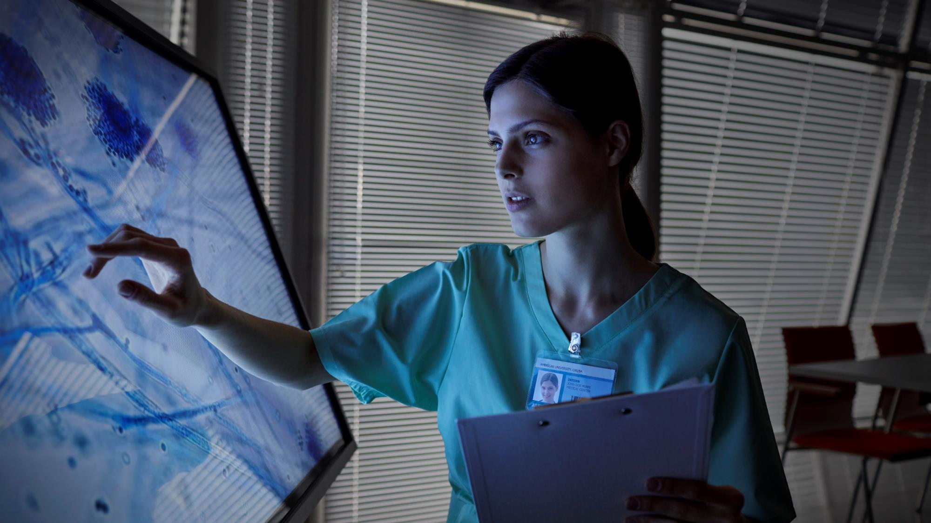
LEVERAGING DEEP LEARNING TECHNIQUES IN SKIN CANCER
HARSAHIB PREET SINGH​
MUNDHIR AL BOHRI​
NOOF AL SHEHHI

Slide 2
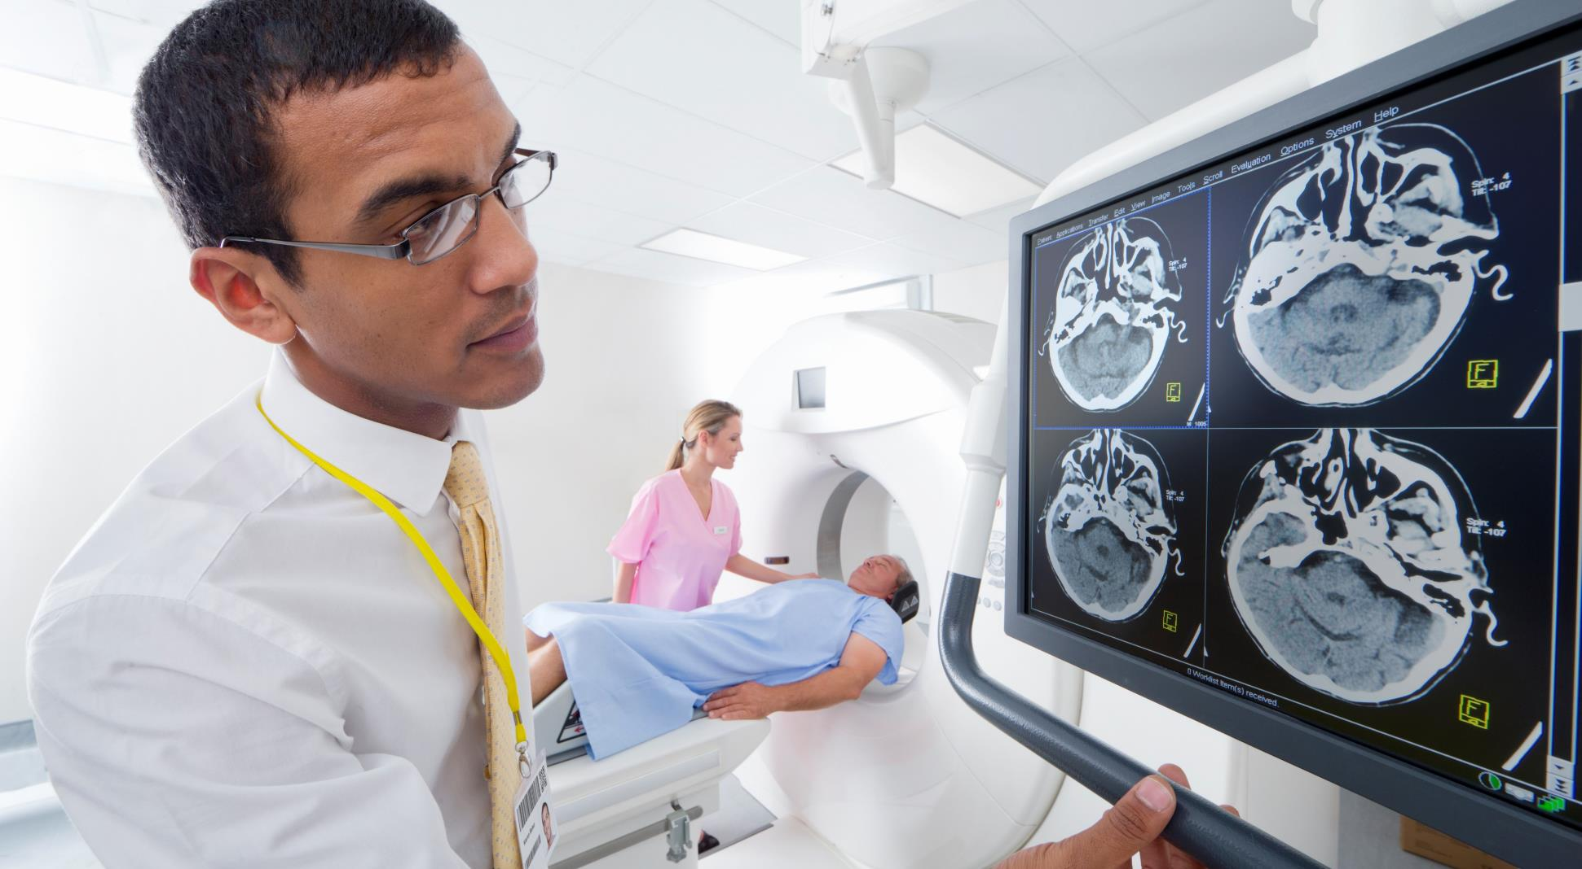




Problem Statement
Lack of a reliable and accurate automated system for classifying different types of skin cancer from images
Difficulties in generalizing model performance to real-world medical settings and practical deployment.
Uncertainty regarding the most effective machine learning models for precise skin cancer detection.
Challenges in ensuring interpretability and gaining trust from medical professionals for AI-based diagnostic systems
Challenges

Slide 3

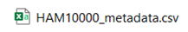
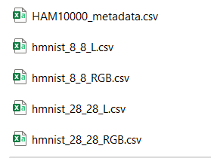
Dataset
Skin Cancer MNIST: HAM10000 https://www.kaggle.com/datasets/kmader/skin-cancer-mnist-ham10000
Original Files
After Organizing Files

Slide 4
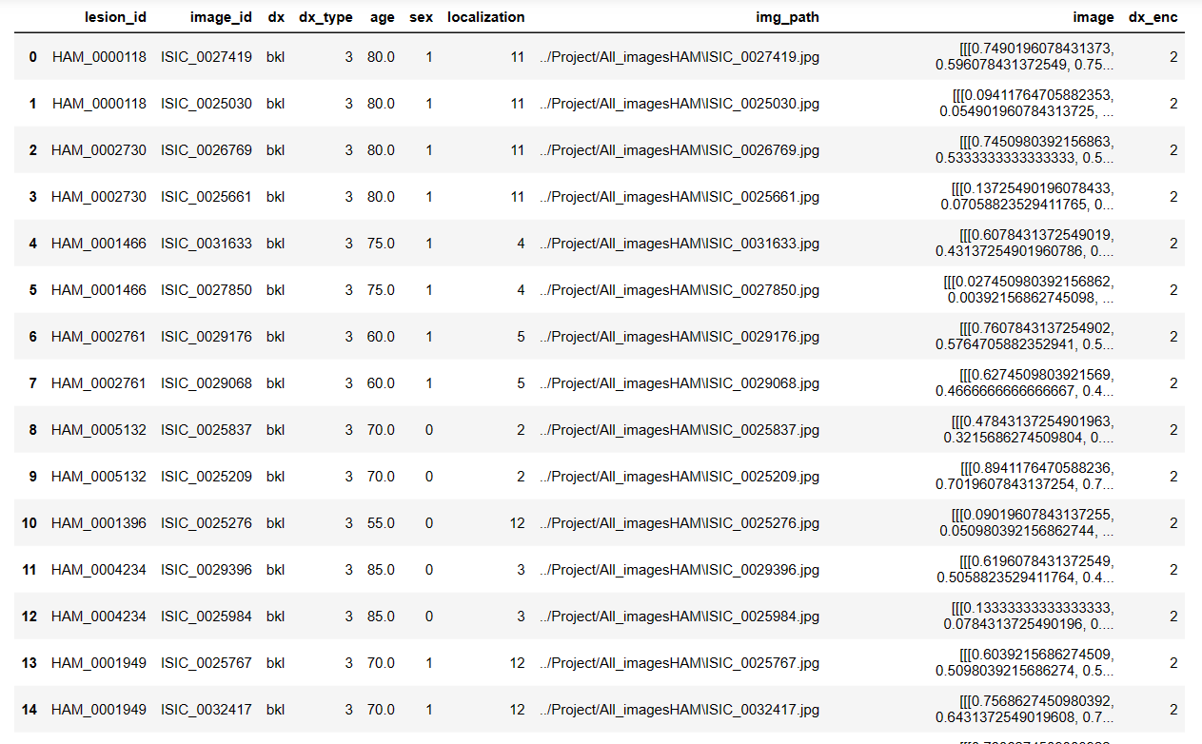
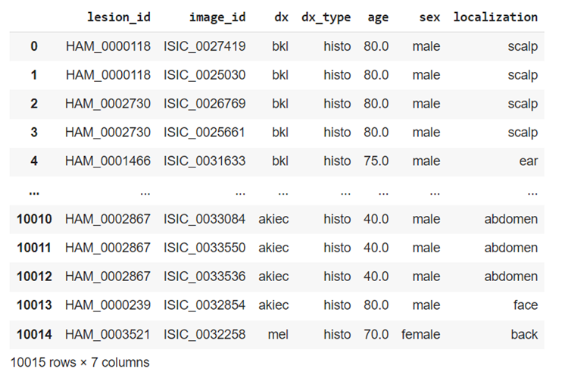
Data Preprocessing
Eploratory Data analysis

Slide 5


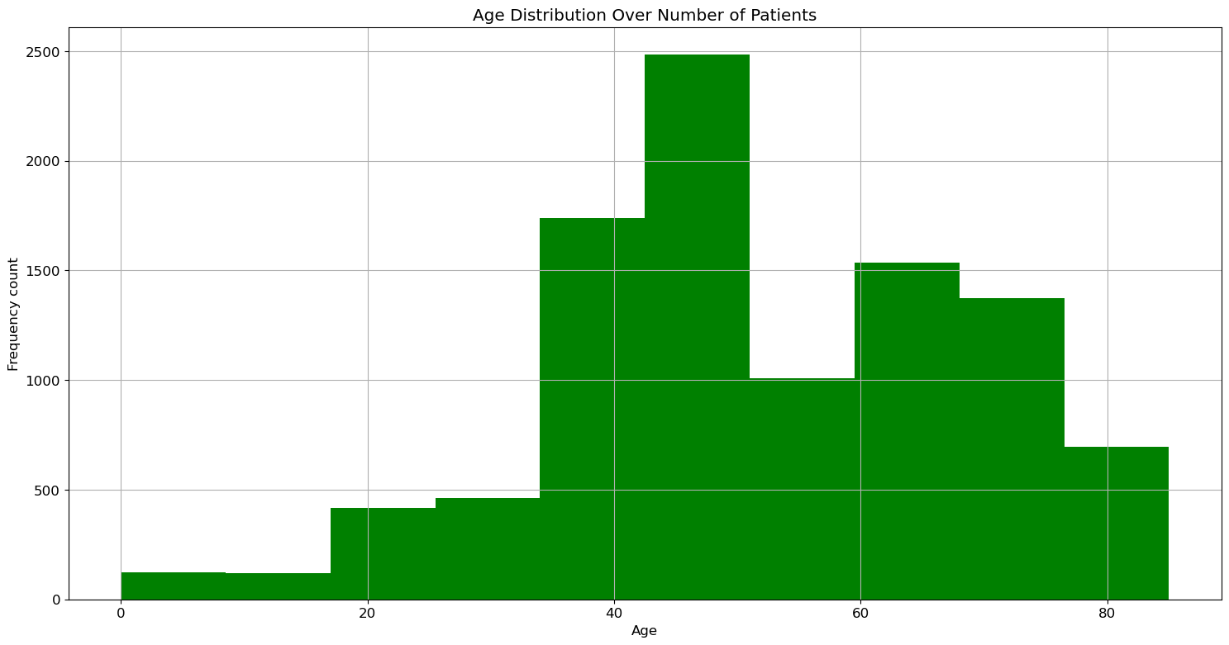
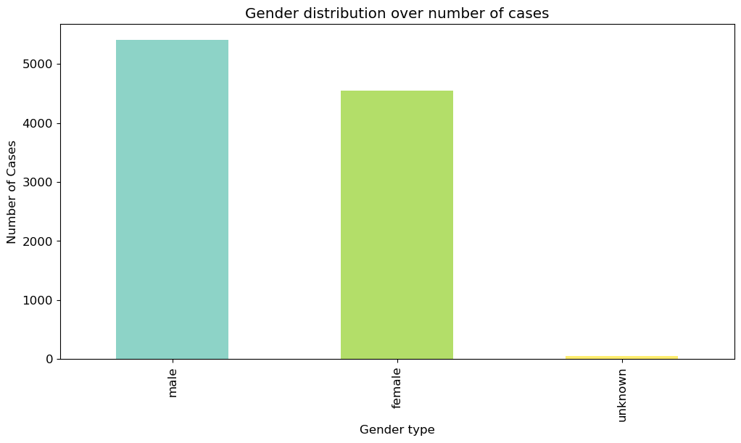
dataset
Dataset
Age
Gender

Slide 6


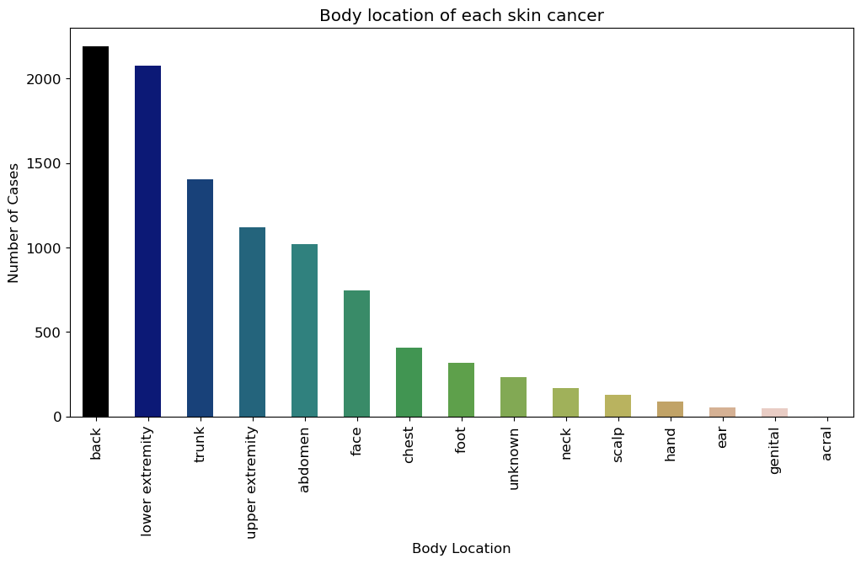
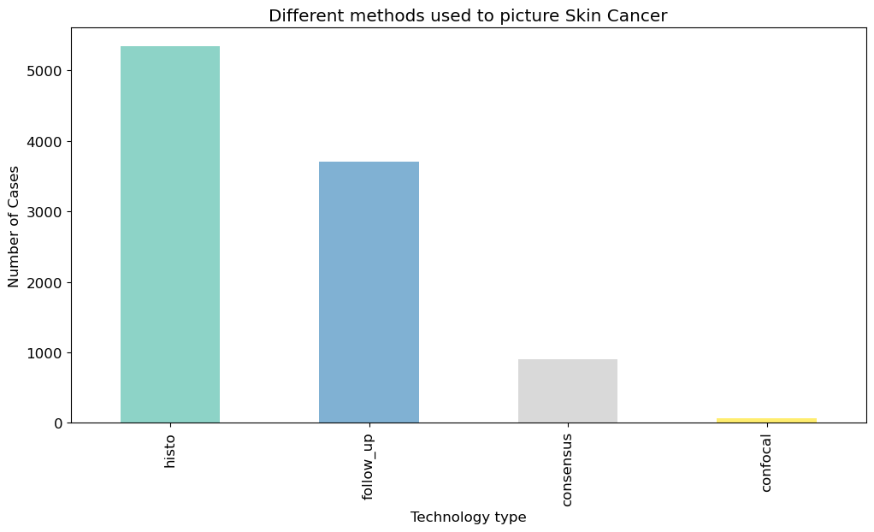
dataset
Dataset
Skin cancer location
Picture methods

Slide 7

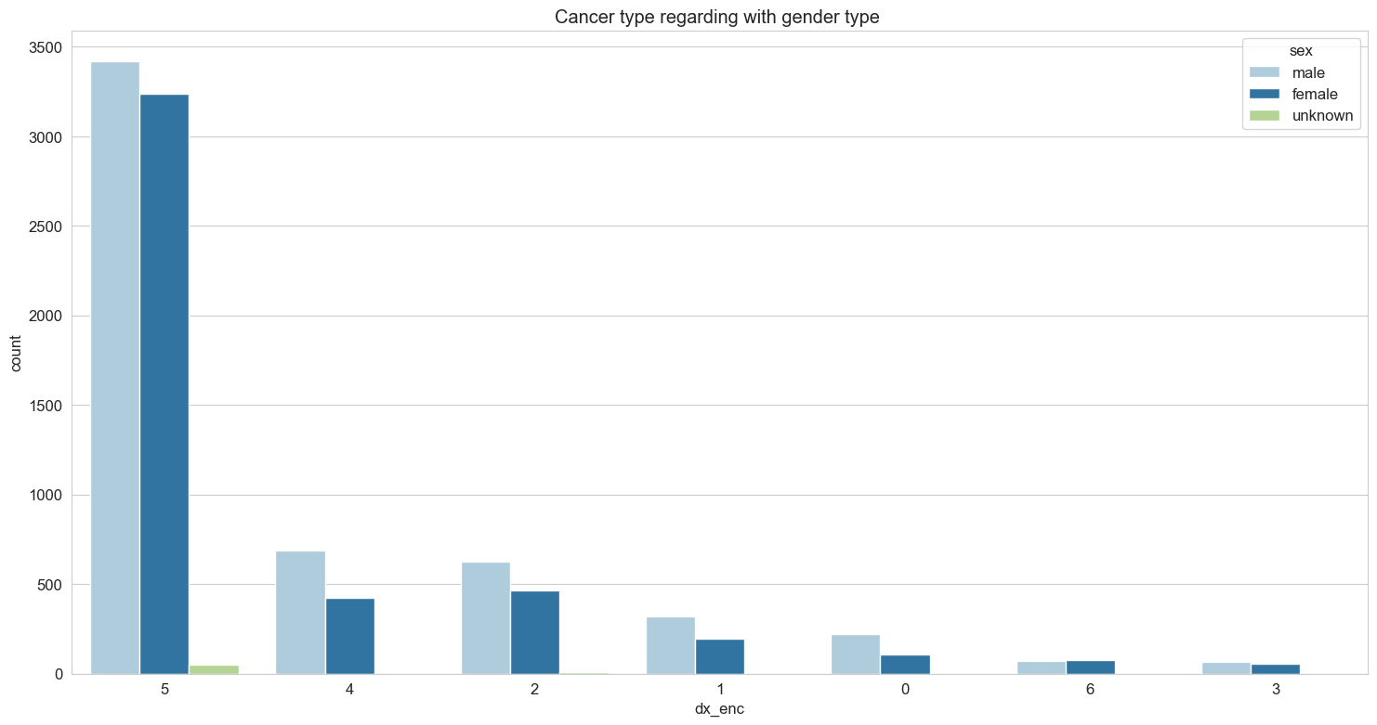
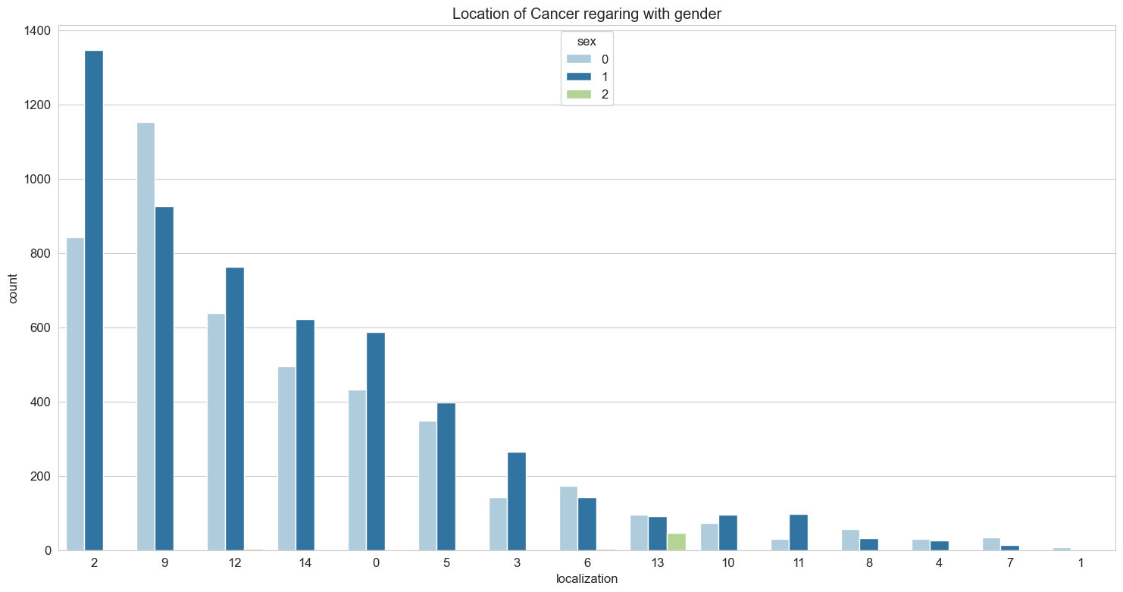
Preprocessing findings:
Relationship between:
Cancer Type and sex features
location and Sex features

Slide 8
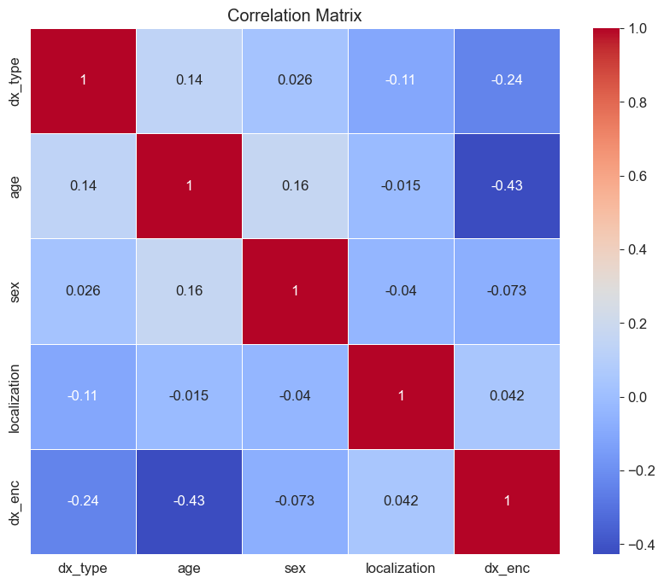
Features Correlation

Slide 9

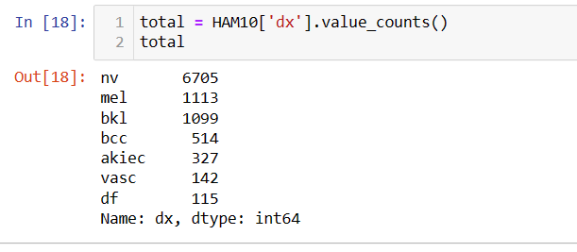
Preprocessing findings:
Unbalanced image data

Slide 10

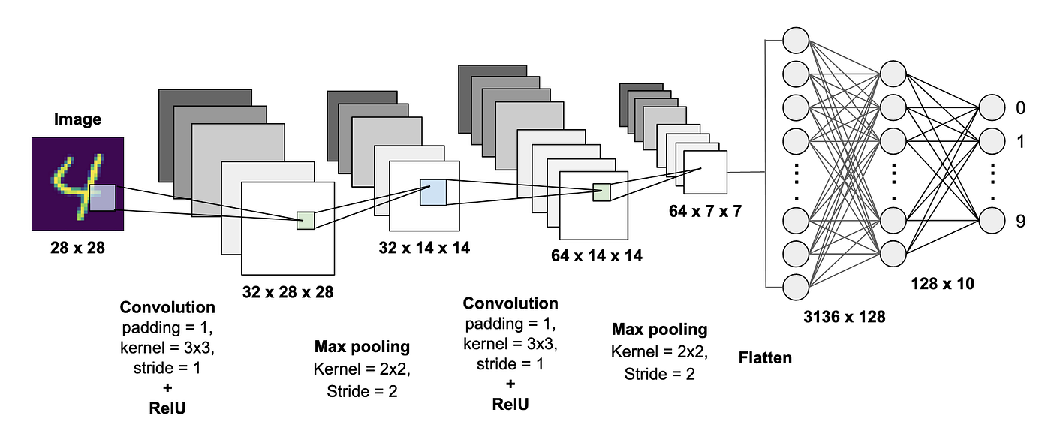
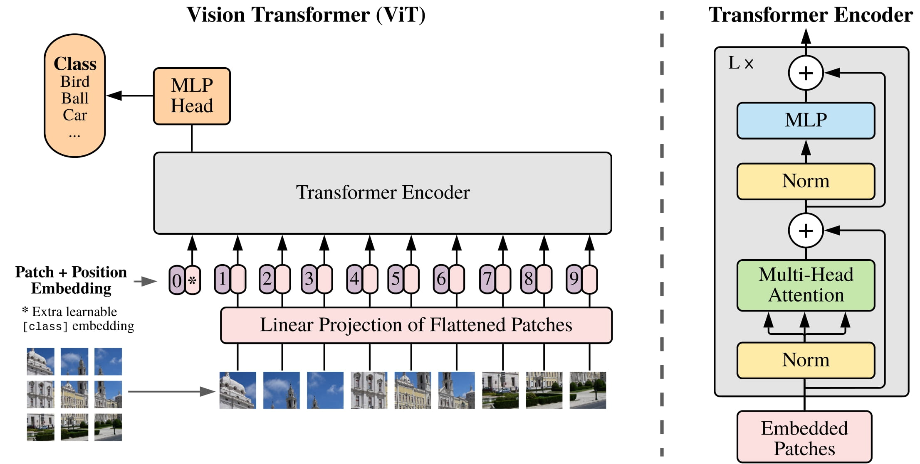
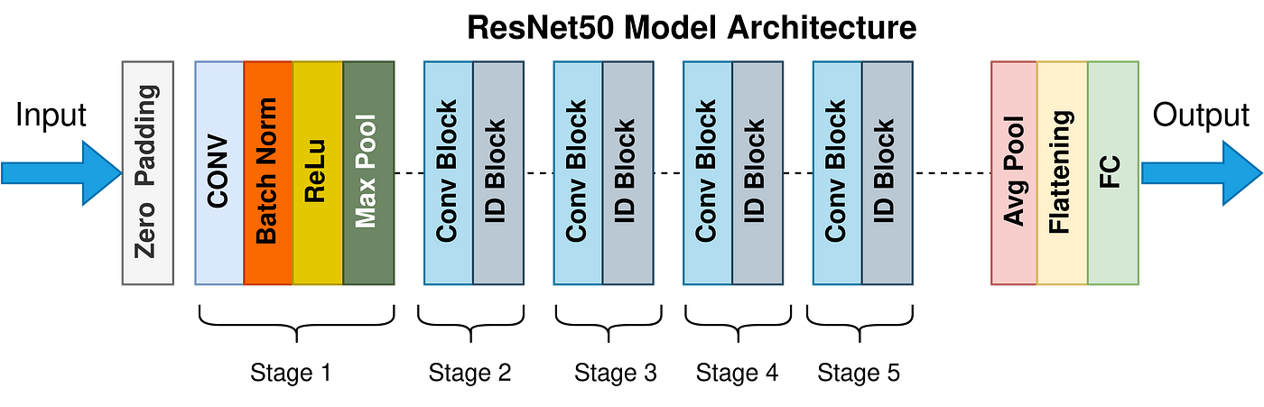
PROPOSED TECHNIQUE

Slide 11



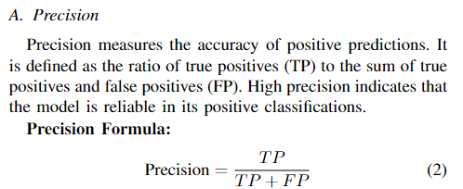
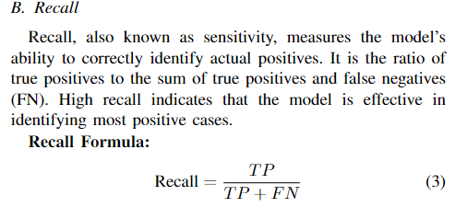
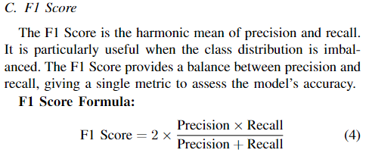
EVALUATION METRICS
Besides accuracy we used

Slide 12
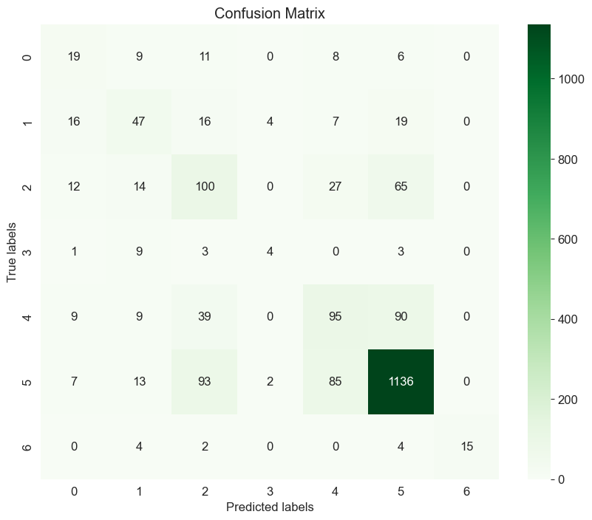
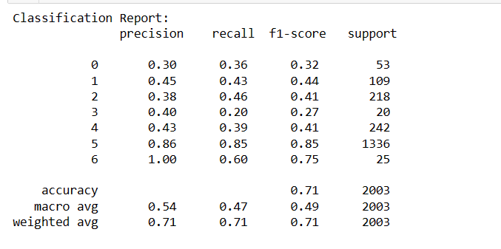
EVALUATION METRICS
Besides accuracy we used
Based CNN

Slide 13
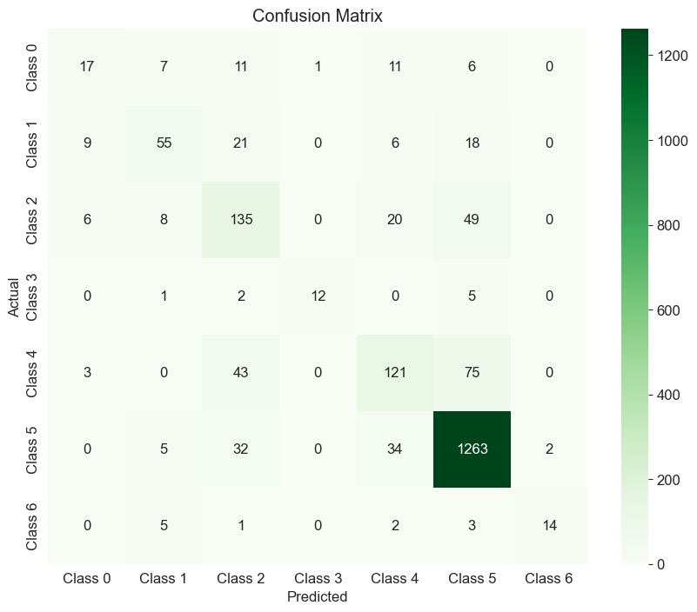
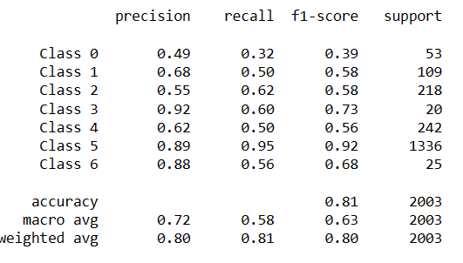
EVALUATION METRICS
Besides accuracy we used
Multi – Input CNN

Slide 14
Results
71%
81%
83%
72%
Base CNN
Complex CNN
ResNet101
VIT
Models | Accuracy
Base model CNN | 66%
Complex CNN | 73%
ResNet101 | 83%
VIT | 72%

Slide 15
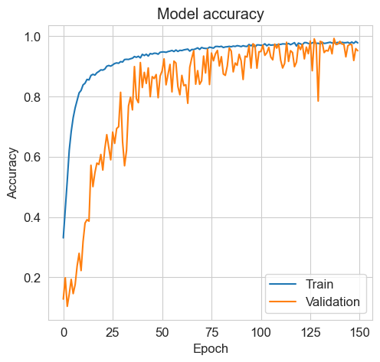
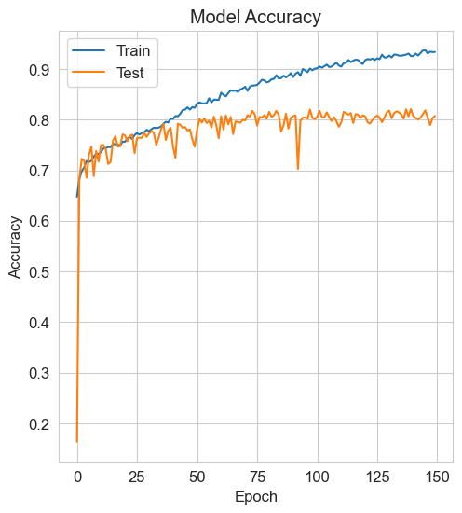
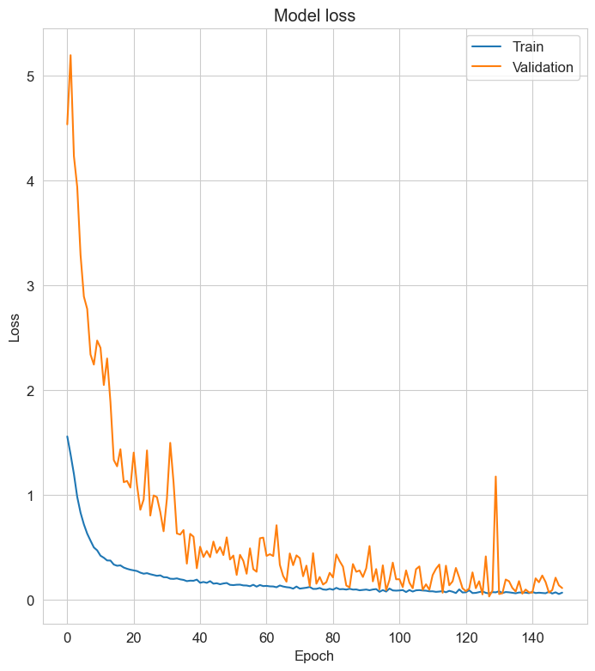
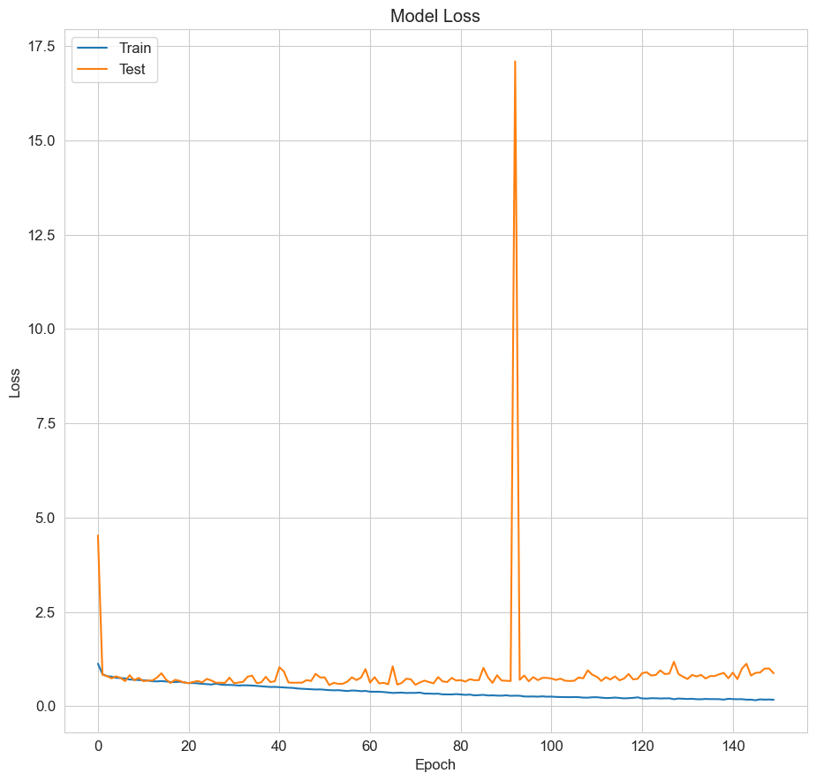
Results
Base CNN
Complex CNN

Slide 16
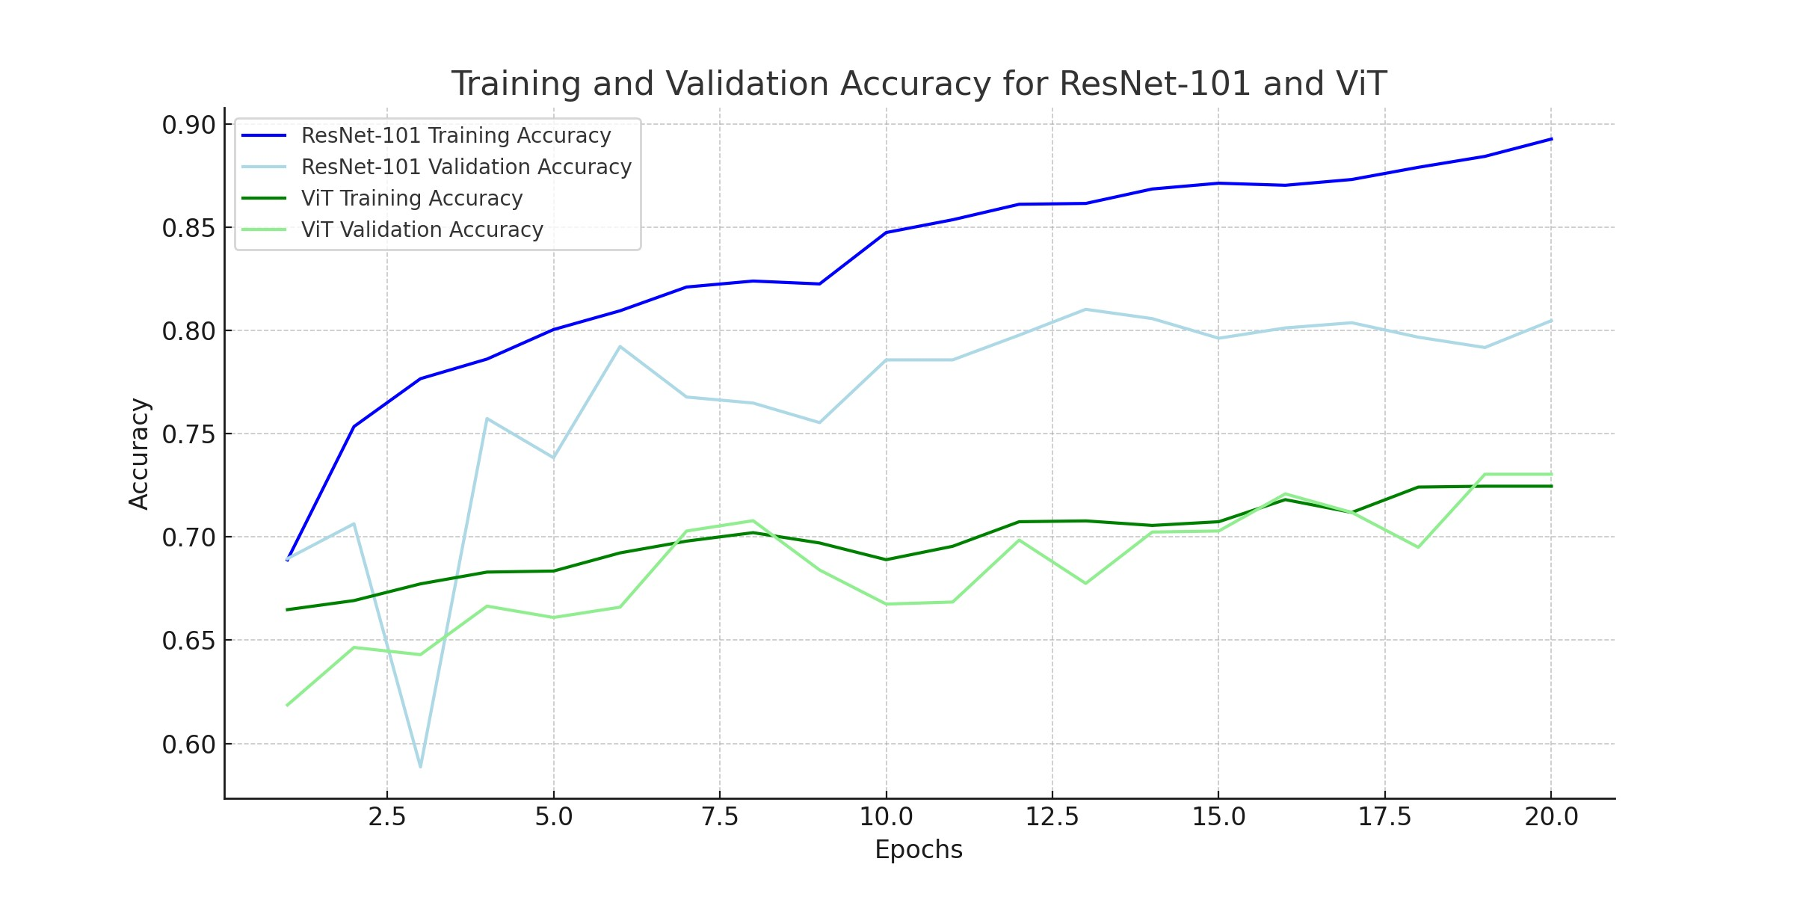
Resnet101 / vit accuracy

Slide 17
Conclusion
Best Model
Multi-input CNN: Enhanced to 81% accuracy by integrating additional label features, showing a commendable improvement from the initial 71% accuracy.
ResNet-101: Significantly outperformed others, progressing steadily from 68.89% to an impressive 89.28% accuracy over 20 epochs, showcasing exceptional learning capabilities.
Vision Transformer (ViT): Showed promise with consistent improvement, achieving a final accuracy of 73.04% despite some fluctuations during training.
Overall, while the multi-input CNN improved after feature enhancement, the ResNet-101 model emerged as the frontrunner, displaying exceptional adaptability and top performance, surpassing other models in final accuracy.

Slide 18



FUTURE SCOPE
Model Fusion and Ensemble Techniques
Transfer Learning and Pre-trained Models:
Real-time Deployment and Clinical Integration
Investigate ensemble methods to combine predictions from multiple models like the multi-input CNN, ResNet-101, and ViT. Fusion techniques could leverage the strengths of each model to create a more robust and accurate classifier.
Explore the use of pre-trained models on larger image datasets (like ImageNet) and fine-tune them for skin cancer classification. Transfer learning could help leverage the knowledge learned from these datasets, potentially boosting performance.
Focus on optimizing models for real-time prediction and integration into clinical workflows. This could involve considerations for computational efficiency without compromising accuracy.

