Slide 1


Project SEM Report

Slide 2

DEAD OF EVIL
LE VAN QUY
VU CONG TUAN

Slide 3

Introduction to Game
Name Game : Dead Of Evil
Category: Platformer 2D, Metroidvania
Framework : Cocos2d-x
Language: C++
Time Complete: 3 months

Slide 4
Game Concept
Camera: 2D , horizontal scroll view
Map: made up of many undulating or hanging patches of land as well as landscapes of rocks, thorns, etc.
Player: can move 2 directions left and right and jump, hit, roll, use the average health ..
Obstacles: there are many types of enemies, moving still, shooting, holding shields and traps
Boss: keep the princess, have high stamina, the boss has 2 sides, the 2nd side will be stronger than the first, the skills to fight and shoot fire bullets
Goal: defeat all monsters along the way, bosses to rescue the locked-up princess

Slide 5
Platform Requirement
Android: 5.0 or high
- RAM: Minimum 2G
OS: Windows 7 and 10
- I3 1.3 GHz Processor
- 2GB RAM
- Direct3D 9.0 support
- 100MB Hard-Drive space available.
- 1.8 GHz Processor
- 512MB RAM

Slide 6
Technique Goal
Handling and building game systems
Use algorithms on games
Create a 2D platform game with pixel graphics as the original goal
Understand and compare advantages and disadvantages with other popular platforms today
Use other supporting software for the game

Slide 7
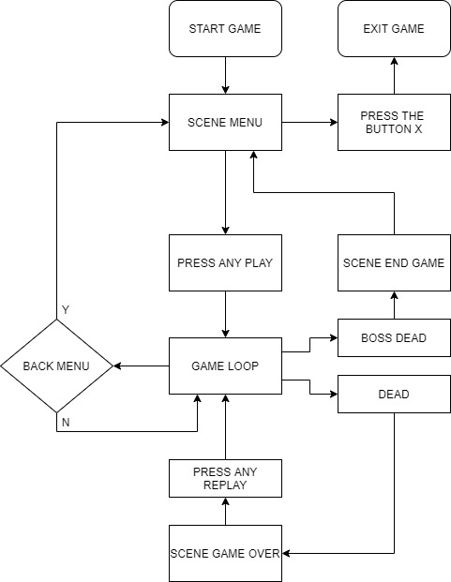
Main Game Loop

Slide 8
Game Object – Player
Deal close range damage
Advantages :
- Can deal great damage every time you level up
- Roll will help the player avoid the attacks of enemies
- Use a health potion to recover
Defect :
- All skills are entirely dependent on MP
- Low MP recovery
Properties: Upgrade after each level
(level <=10)
HP : 100 | + 0
MP : 100 | + 0
Speed : 3.0 | + 0.15
Jump : 4.5 | + 0.1
Attack : 35 | + 9
Time Roll : 4 | + 0.1

Slide 9





Game Object – Enemy
Enemy: Many types of enemies
Soldier
Shoot
Fly
Water
,

Slide 10
Game Object – Enemy
Soldier
,
Skeleton
Lothric Knight
Soldier Guard
Properties:
HP : 100 | :150 | :85
Speed : 1, 1.5 | :1, 1.2 | :0
Vision range : 40 | :50 | :45
Damage : 15 | :15 | :25
Exp : 40 | :50 | :45

Slide 11
Game Object – Enemy
Shoot
,
Dullness
Winzard
Properties:
HP : 70 | :75
Speed : 0 | :0
Vision range : 400 | :400
Damage : 10 | :10
Exp : 35 | :50

Slide 12
Game Object – Enemy
Fly and water
,
Bat
Treehurt
Properties:
HP : 50 | : 60
Speed : 1 | : 0
Vision range : 100 | : 35
Damage : 15 | : 20
Exp : 20 | : 30

Slide 13

Game Object – Boss
Deal melee and ranged damage
Advantages:
- Use skills that can fire bullets
- There are many diverse skills.
- High endurance
- High flexibility
- Can revive after death
Defect
- Easy to dodge skills
Properties:
Face One: HP : 2000
Speed : 1
Vision range : 400
Damage :
+ Skill Attack A : 10
+ Skill Attack B : 15
+ Skill Fire Ball : 10
Face Two:
| + 500
| + 1.5
| + 100
| + 5
| + 5
| + 0

Slide 14




Attack A
Game Object – Boss
Attack B
Faces 2
Revival
Fire Ball

Slide 15


Game Object – Obstancle
Obstacle: Many types of Obstacle
Spikes
Traps
Door lock
Properties:
Speed : 1 | : 0 | : 0
Damage : 20 | : 50 | : 0

Slide 16


Game Object – Items
Items: The HP recovery potions for the player
Item HP:
Chess:
Bonfire:
Use will increase by 50 hp
Attacking it will drop an HP item
Increases HP by 100% when impacted on it

Slide 17
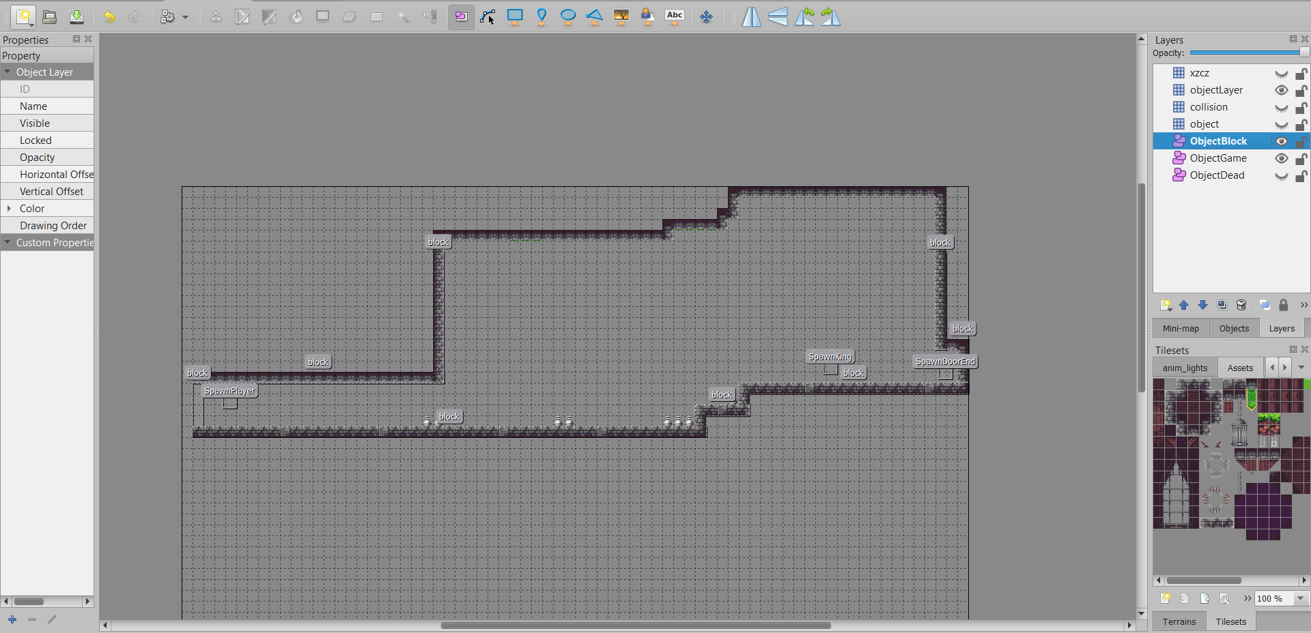
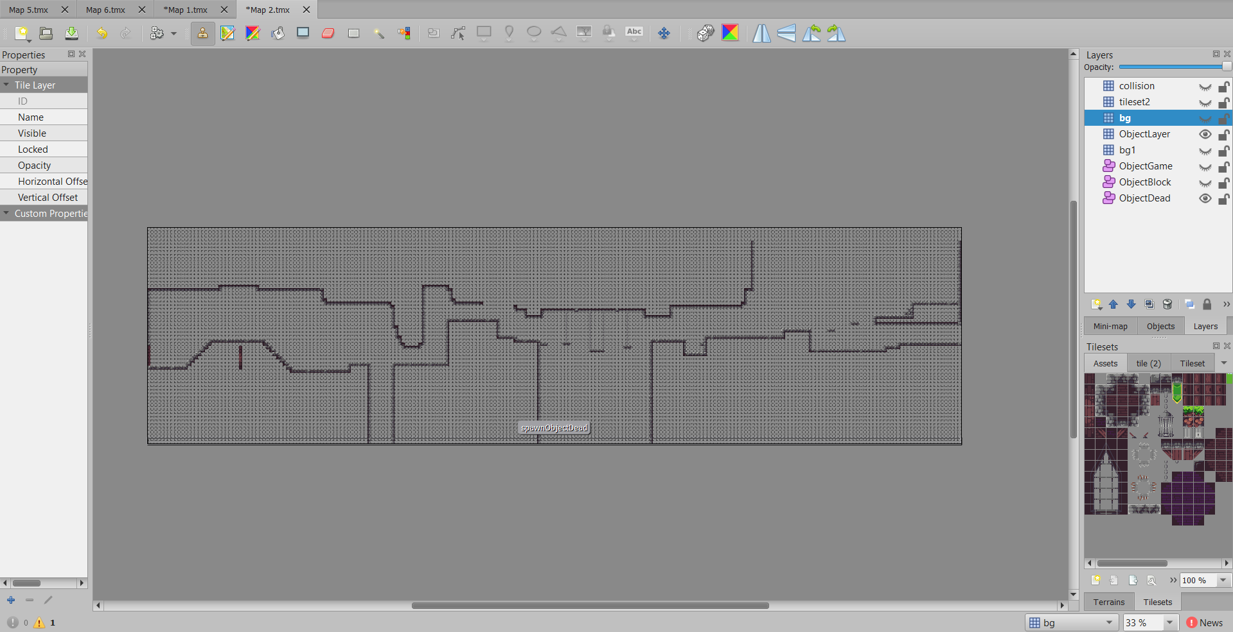
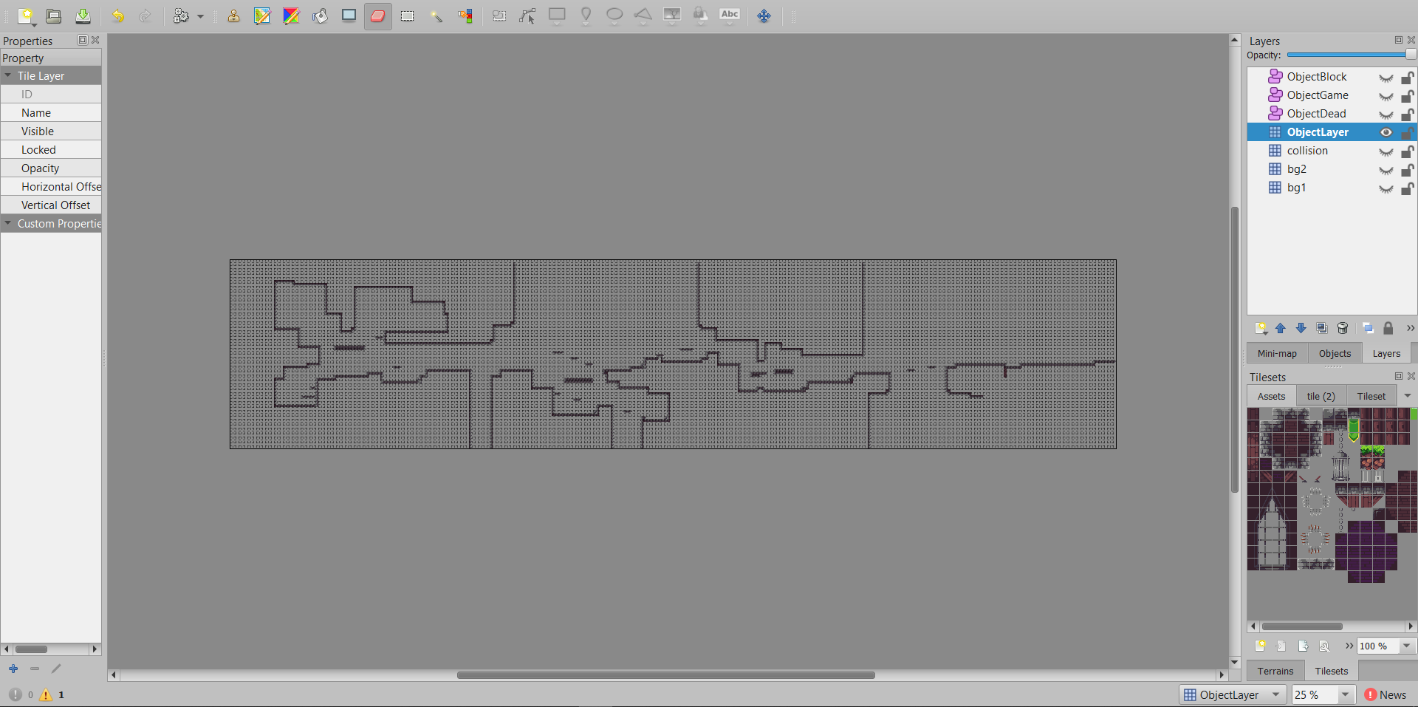
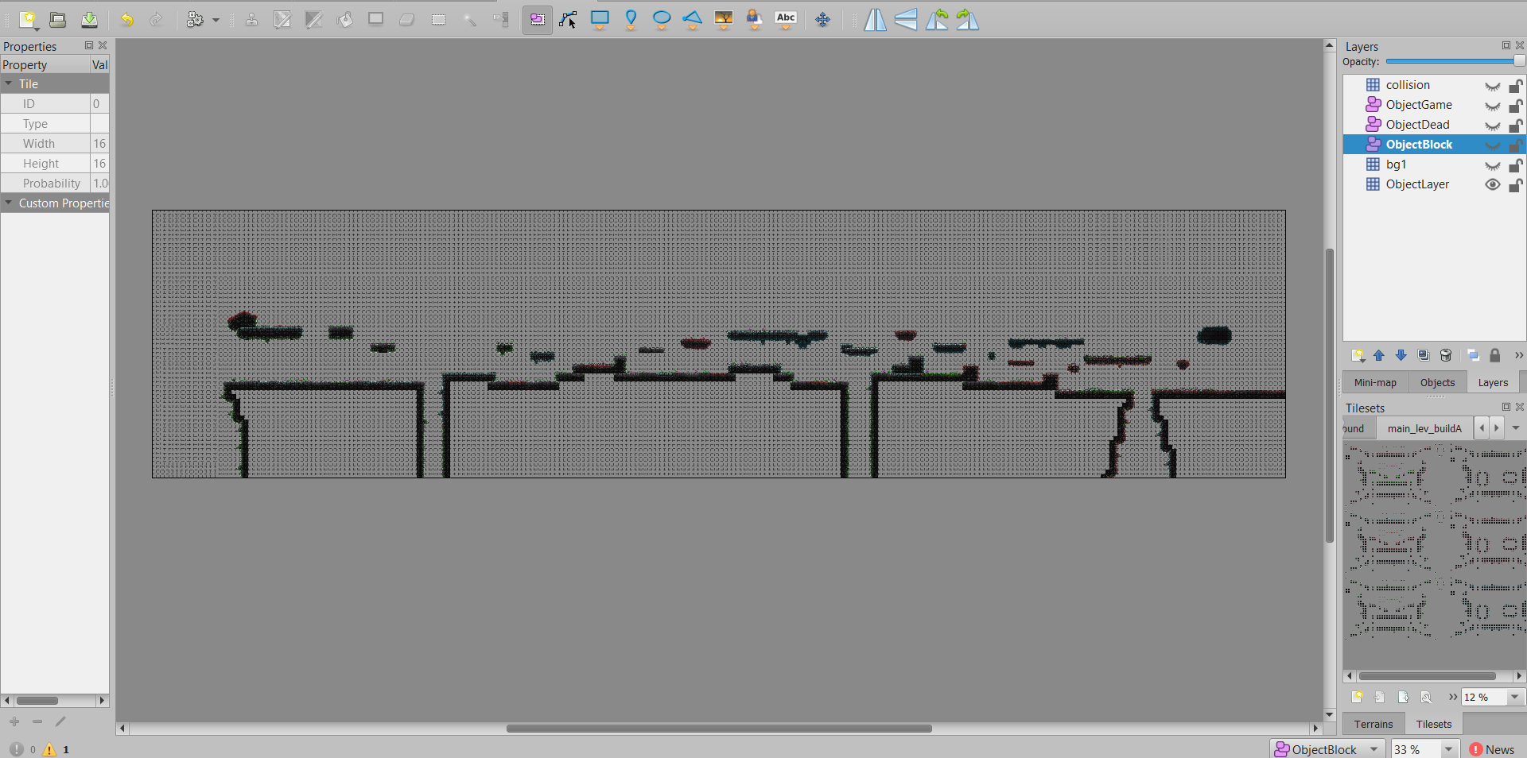
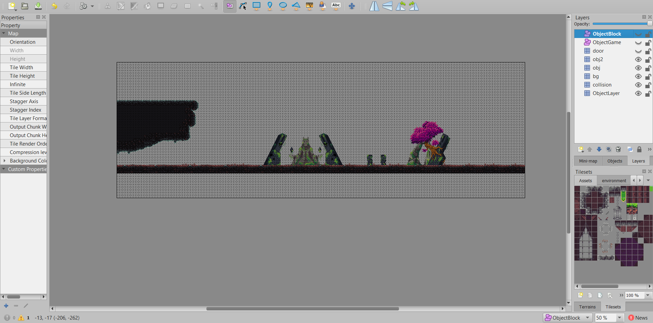
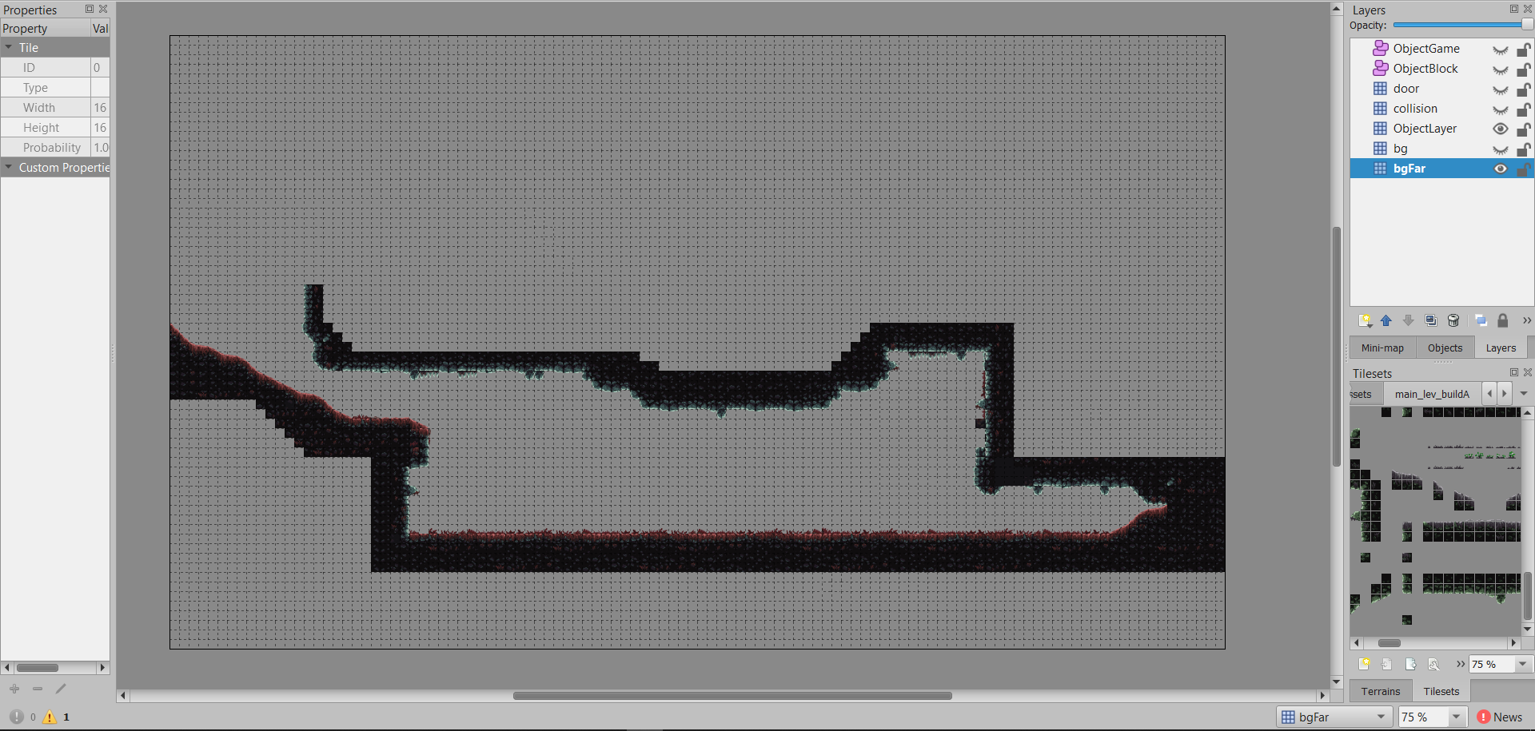
Project Tiles
Use Tiled to design and initialize maps
Different map sizes
Map 1
Map 2
Map 3
Map 4
Map 5
Map 6

Slide 18
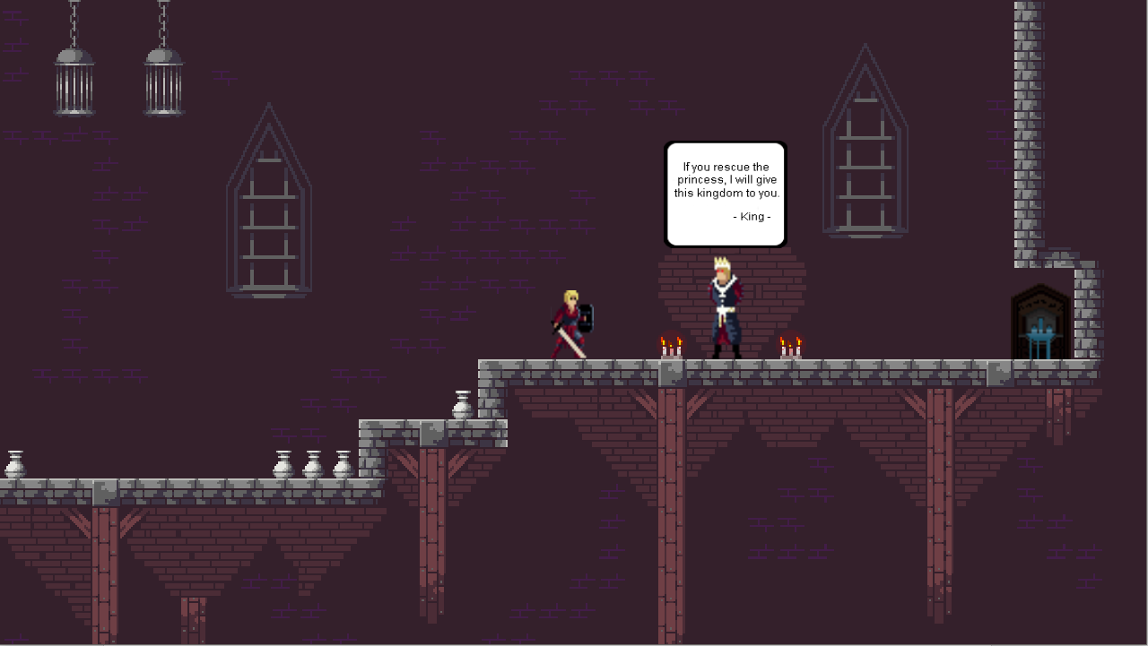
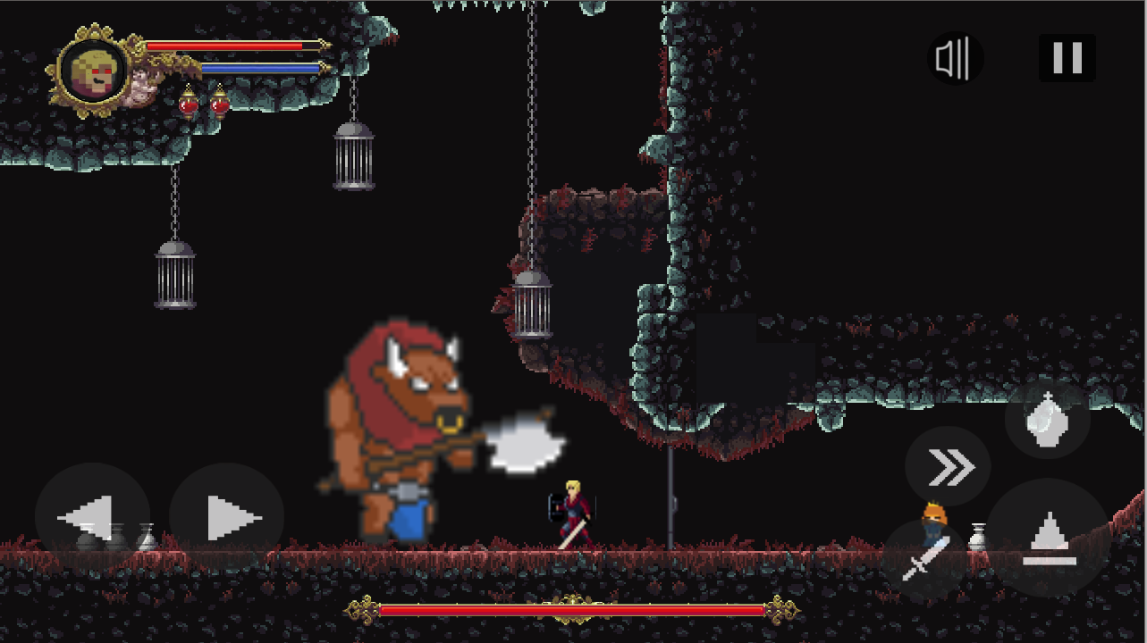
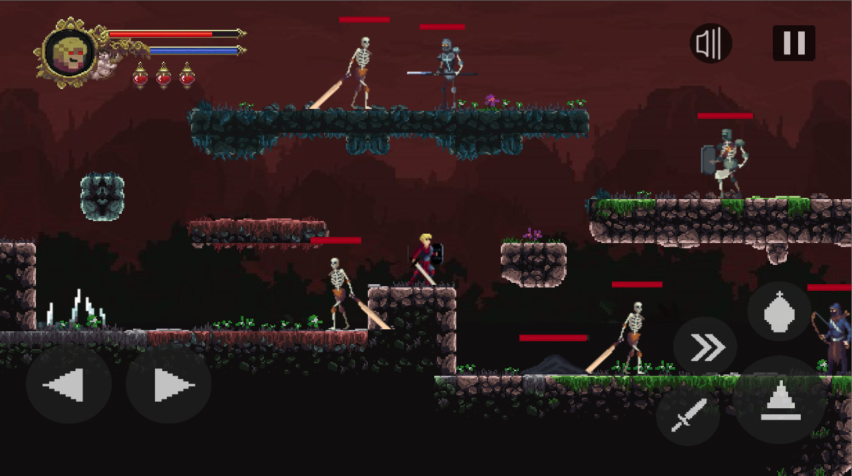
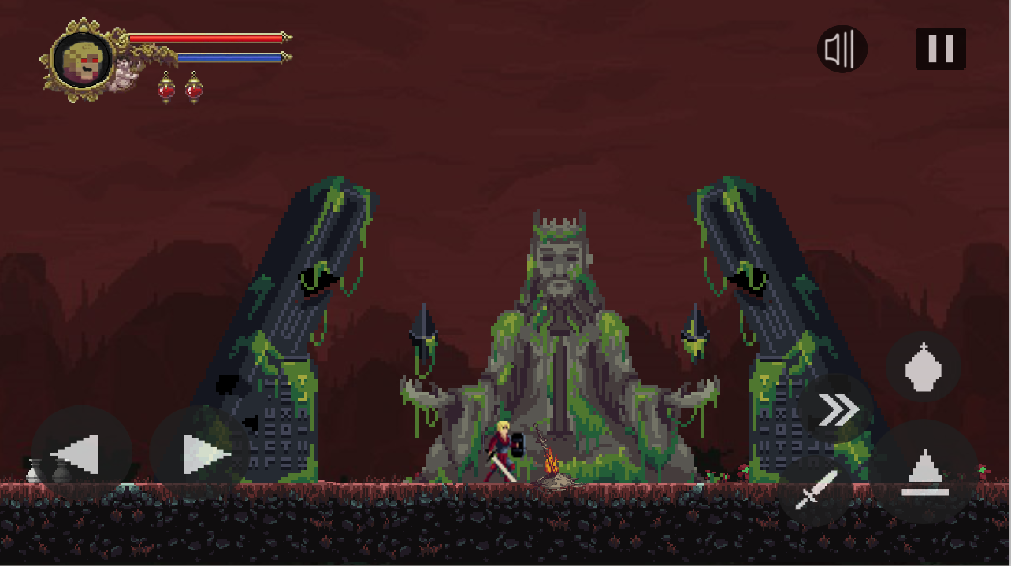
Project Tiles
Images map in the game

Slide 19
Graphic Engine
Render system
- Direct3D 9.0 support.
Animation
- My team uses images for object behavior
- Eg: Player, Enemies, Boss with moving animations moved, hit, died ....
Texture
- Use picture as jpg, png.
- Use texture built-in system cocos2dx
Text
- Font Arial, Marker Felt, Pixel.
- Load text by built-in system cocos2dx
Particles
- Load text by built-in system cocos2dx

Slide 20
Audio
Audio format
- My game use mp3 and wav format for audio
Compression/Decompression
- None
Sound Manager
- I used Simple Audio Engine of Cocos2dx
Special Audio Effects:
- None

Slide 21
Summary
Ability to program games on the cocos2d-x platform
Increased ability to use the C ++ language
Increase teamwork ability
Program / game knowledge
Experience in program / game design
Improve your writing skills

Slide 22
References
https://docs.cocos2d-x.org/api-ref/cplusplus/v3x/ : API of cocos2dx
https://stackoverflow.com/ how-to-shake-screen3 : Command pattern is used.
https://www.stdio.vn/articles/categories/cplusplus-22/ : Document
https://stackoverflow.com/ : fix bug
https://www.youtube.com/watch?v=0zkwbWC65yM : Cut video traller

Slide 23
Q & A

