Slide 1
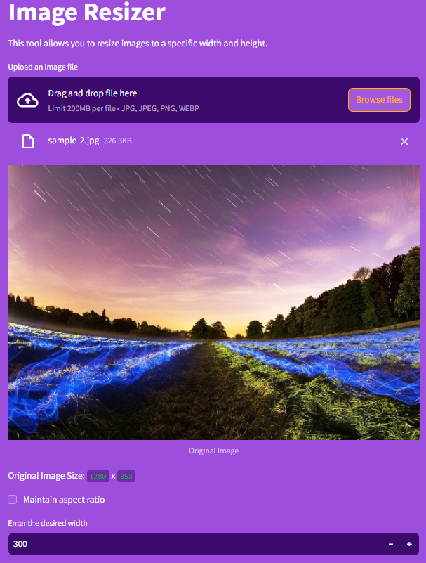

ConvoHub: Your Versatile File and Image Converter
A Streamlit-based application designed for seamless file format conversion and image processing. Simplifying complex tasks with an intuitive, web-based solution.

Slide 2
Introducing ConvoHub
What is ConvoHub?
Why ConvoHub?
Streamlit-powered web application
Simplifies file and image conversions
Converts image formats and data files
Easy-to-use web-based solution
Includes image resizing tool

Slide 3





Key Features
File Conversion
Image Conversion
Excel, CSV, JSON, HTML, PDF
JPG, PNG, WEBP, GIF, TIFF, BMP
Image Resizing
User-Friendly Interface
Adjust dimensions with ease
Drag-and-drop, real-time conversion

Slide 4
ConvoHub: Pros and Cons
Merits
Demerits
Fast and efficient file conversions
Limited advanced image options
Web-based, no install
Requires internet connection
Supports multiple formats
Can process only file size upto 200mb
Simple UI with drag-and-drop

Slide 5

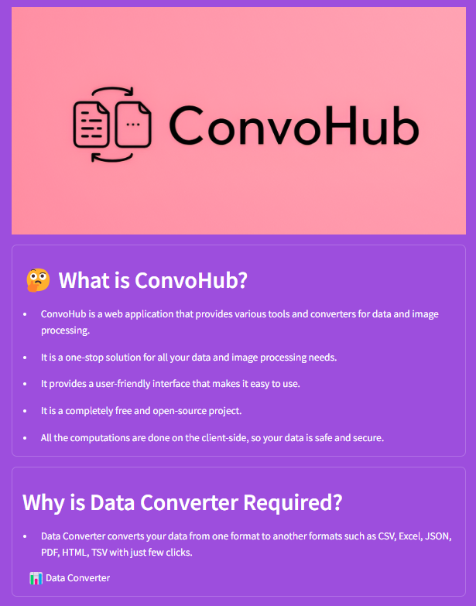




Future Enhancements
Image Processing
Filters, cropping, batch processing
AI-Based OCR
Images to editable text
Cloud Storage
Google Drive, Dropbox
More Formats
XML, Markdown, database exports

Slide 6
Technologies and Conclusion
Technologies Used
Conclusion
Python, Streamlit, Pandas, Pillow (Language & Libraries)
VS Code, GitHub (IDEs & Version Control)
1
Easy Conversion
Streamlit Sharing (Hosting Service)
ConvoHub makes it simple to convert a wide range of file formats, from documents to images. With just a few clicks, users can seamlessly transform their content.
2
For Everyone
Whether you're a professional or a casual user, ConvoHub caters to all. Its intuitive interface and powerful features make file and image conversion accessible to everyone.

