Slide 1




PredictGrad – A Unified Academic Risk Platform
PredictGrad is a smart academic intelligence system built to:
Predict future performance
Analyze attendance-performance patterns
Detect academic risk proactively
It combines:
Predictive Modeling
Analytical Insight
(Semester 3 marks forecasting & risk classification)
(correlation between attendance and performance)
Why It Matters:
Academic declines often go unnoticed. PredictGrad detects subtle warning signs before they become problems — enabling timely intervention, informed support, and data-backed decision-making.

Slide 2


Team Members
PANCHAL DEV SACHINKUMAR 23002170510023 AIDS
4. PANCHAL NITYAKUMAR ALPESHKUMAR 23002170510024 AIDS
2. BHATT MAHARSHI JIGNESHBHAI 23002170110010 CE
5. MISTRY ANJALI KALPESHBHAI 23002170110090 CE
3. BALESANA HASSANBHAI YUNUSBHAI 23002170110003 CE

Slide 3
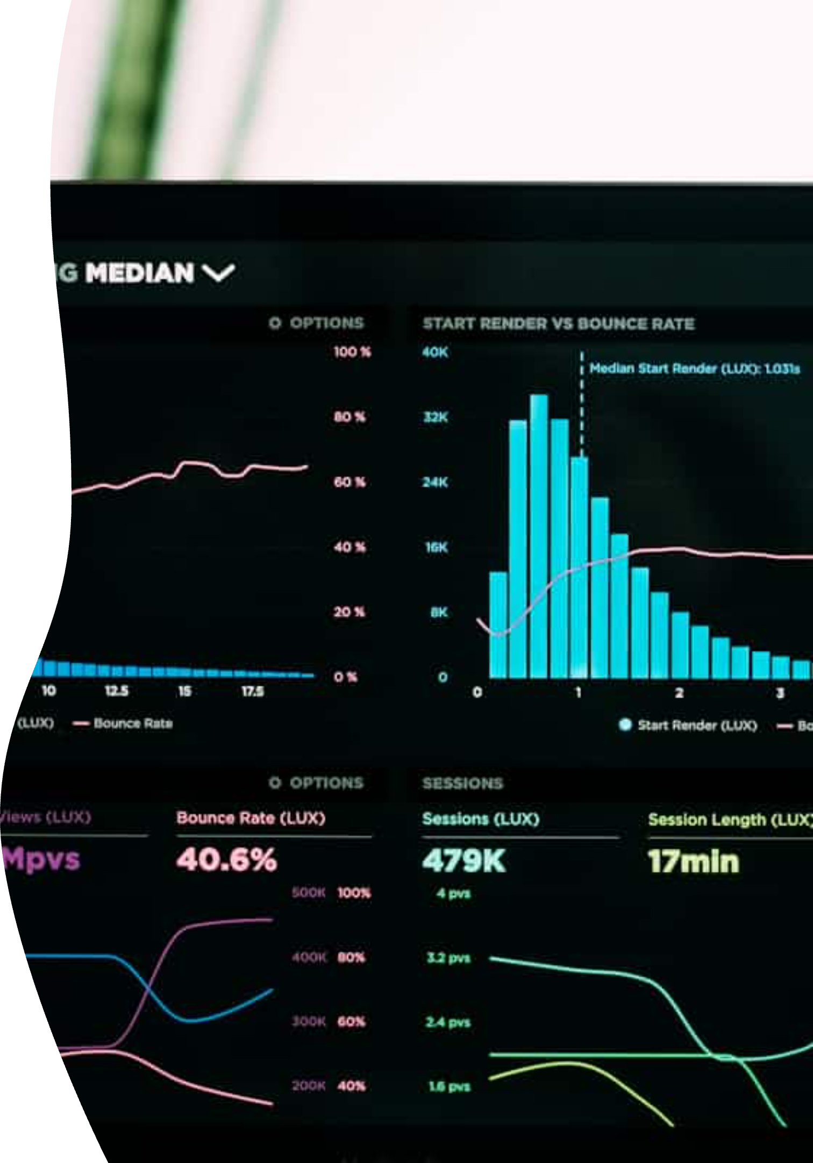
Prediction Module
Objective: Predict theory marks in Semester 3 & detect potential academic decline.
Workflow:
01
Mark Prediction:
Subjects: Math-3, DE, FSD, Python
Features: Past marks, attendance, percentile trends
Models: Ridge, Lasso, ElasticNet (Voting Regressor)
02
Risk Classification:
Condition: Drop ≥10 percentile points vs. Sem 2
Classifier: Stacked Model (CatBoost, LGBM, ExtraTrees → Logistic Regression)
Tuning: BayesSearchCV, Repeated K-Fold CV
Output: 📉 Flags students at risk of significant academic drop — before Semester 3 begins.

Slide 4




Analysis Module
Objective: Correlate subject-wise attendance with academic performance to guide improvements.
Features:
Correlation Reports:
Statistical Analysis:
Attendance vs. Marks (Theory + Practical)
Skewness, Std Dev, IQR, Mean-Median
Diagnostic Output:
Insight Visuals:
Actionable feedback on attendance impact
Histograms, heatmaps, and distribution plots
Outcome: Reveals hidden trends that may affect marks and enables faculty to take evidence-based actions.

Slide 5





Impact & Exploration
What PredictGrad Enables:
Forecast future academic performance
Detect early signs of risk
Guide interventions before results fall
Correlate attendance with outcomes
Visualize trends through dashboards
Try It Live: ThePredictGrad
Result: A complete academic support tool to protect students from unexpected decline — before it's too late.

