Slide 1

SMART INDIA HACKATHON 2026
Problem Statement ID – 26087
Problem Statement Title- AI & LMS-Enabled Cooperative Capacity Building, ERP & Employment Ecosystem
Theme- Smart Education
PS Category- Hardware
Team ID- [Enter your Team ID]
Team Name (Registered on portal)- Code2Scale

Slide 2
IDEA TITLE: SAHAKARSETU
Code2Scale
One Sahakar ID • Train → Learn → Certify → Employ
Proposed Solution
How it addresses the problem
Innovation and uniqueness of the solution
Manual, fragmented systems
Single cloud ERP for 20 NCCT institutes
1
ERP
Nominate • Attend • Hostel
Sahakar Edge Box
Offline local learning gateway: cached LMS content + offline attendance + local sync
Duplicate records, limited tracking
One Sahakar ID, unified trainee profile
2
LMS
Learn • Test • Offline
Voice-first multilingual AI
BHASHINI provides speech and language services
SAHAKAR ID
Unified trainee profile
Paper / manual attendance
Face + rotating-QR attendance
AI
Chatbot • Analytics
3
Low / unstable connectivity
Offline-first Edge Box + PWA app
Skill Passport
QR/digitally-signed, employer-verifiable
CERTIFY
QR Skill Passport
4
Cooperative Skill Graph
Maps roles (PACS secretary, dairy accountant) to skills & jobs
Manual certificate verification
QR-signed Skill Passport
EMPLOY
Employment • Entrepreneurship • Track
Limited employment linkage
Employer dashboard + AI matching
5
Outcome loop
Job & income data feeds next programme planning
Runs on: Central Cloud ERP + Moodle, with Sahakar Edge Boxes at participating institutes / learning hubs for offline access and sync
WORKING UI DEMO
Click to open website
PROTOTYPE VIDEO
Click to watch video

Slide 3
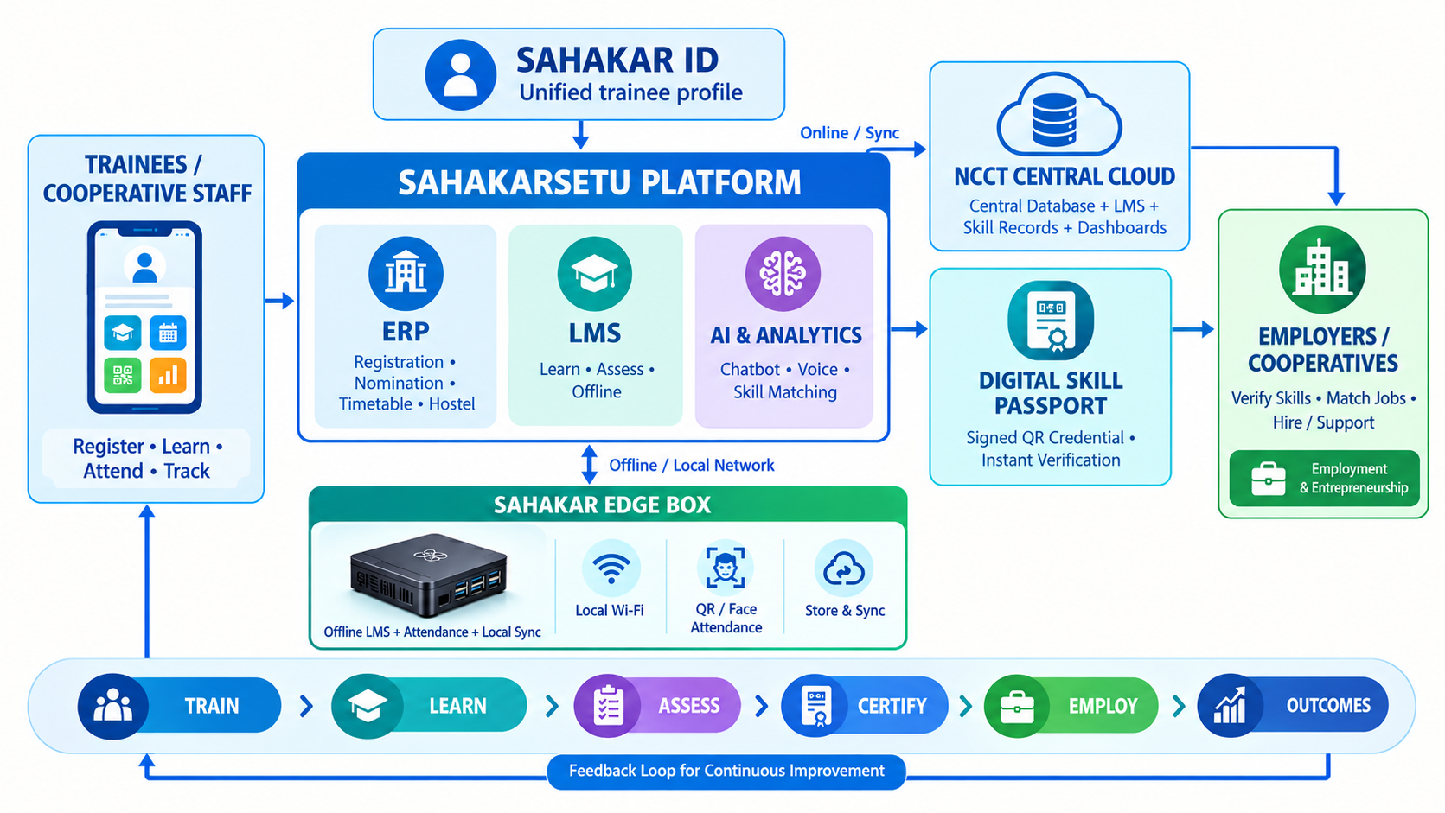

TECHNICAL APPROACH
Code2Scale
Technologies to be used
Methodology and process for implementation
🔄 Methodology Flow
📱 APPS & WEB
React PWA & Flutter for offline-first, multilingual trainee access.
1
Register & Nominate
Online form → Sahakar ID issued
2
Approve & Allocate
Seat, timetable, hostel, travel
☁️ CLOUD ERP & LMS
Django, PostgreSQL, & Moodle core running on secure servers.
3
Verify & Attend
Face/QR, geo-fenced, liveness
4
Learn
🤖 AI PIPELINE
ArcFace + liveness (attendance), BHASHINI (voice/language), & XGBoost Ranker (skill-job ranking).
Multilingual, online + offline
5
Assess
Automated quiz scoring + rubric-assisted project evaluation
🔧 HARDWARE CORE
Raspberry Pi 5 Edge Box + QR/attendance terminal
Local learning + store-and-forward sync.
Certify
6
QR Skill Passport issued
7
Match & Place
🔒 SECURITY
DPDP-aligned privacy • encryption • audit logs
Jobs + entrepreneurship opportunities
TECHNICAL REPORT & SOURCE CODE
Architecture, implementation & code · GitHub repository
8
Track & Improve
CLICK HERE
6-month outcome analytics

Slide 4
FEASIBILITY AND VIABILITY
Code2Scale
Analysis of the feasibility of the idea
Potential challenges and risks & Strategies for overcoming these challenges
✓
Low / no internet at PACS & ICMs
Offline-first Edge Box; auto-sync when online
Technical
Open-source, established components
✓
Low digital literacy of trainees
Voice-first UI, local language, trainer-led first session
Operational
Proposed pilot pathway through NCCT institutes
✓
Face-data privacy concerns
Consent + minimal retention + secure biometric templates + QR fallback + audit logs
Economic
Indicative prototype deployment cost
✓
Staff resistance & legacy paper data
Train-the-trainer, bulk Excel import, phased rollout
Legal / Policy
DPDP-aligned privacy design
Est. cost: Edge Box ≈ ₹25k, face terminal ≈ ₹15k per unit
Proxy attendance / fake certificates
Liveness check + rotating QR; signed, verifiable passports
Hardware cost & upkeep at scale
Shared Edge Boxes, potential CSC partners, remote monitoring
Reference Scale – NCCT FY 2023-24: 3,759 programmes, 2,27,177 participants, 20 institutes
Proposed Phased rollout
P1 0-3 mo Proposed pilot: VAMNICOM + 2 RICMs
P2 3-9 mo Proposed scale-up: 5 RICMs + 14 ICMs
P3 9-18 mo Proposed PACS, dairy, SHG outreach
P4 18 mo+ Proposed Employment & startup network

Slide 5



IMPACT AND BENEFITS
Code2Scale
Potential impact on the target audience
Benefits of the solution (social, economic, environmental)
Rural Youth
SOCIAL
• Inclusion of women & remote rural youth
• Voice-first multilingual access via BHASHINI
• Near-home training, lower travel burden
• Easier credential verification for employers
1
CURRENT CHALLENGE
Internet-dependent learning • Limited employment linkage
WITH SAHAKARSETU
Offline learning • Verified Skill Passport • Employment & Entrepreneurship opportunities
PACS / SHG Members
2
CURRENT CHALLENGE
Limited local-language support • Distant training access
WITH SAHAKARSETU
Local-language, voice-first learning • Access through nearby learning hubs
ECONOMIC
• Lower admin effort per trainee
• Training-to-job & entrepreneurship linkage
• Improved pathways to earning opportunities for rural youth
• Timely data for policy & programme planning
NCCT Institutes & Trainers
3
CURRENT CHALLENGE
Paper/Manual attendance • Limited centralized tracking
WITH SAHAKARSETU
Centralized ERP • Face + QR attendance • Centralized trainee tracking
ENVIRONMENTAL
• Paperless registers & certificates
• Fewer travel-related emissions
• Low-power Edge Box
• API-ready integration with National Cooperative Database
Employers & Cooperatives
4
CURRENT CHALLENGE
Manual certificate verification • Limited skill visibility
WITH SAHAKARSETU
Verified skill profiles • QR-based verification • Skill-fit ranking
Expected outcomes – to be validated in pilot
↓ Manual admin turnaround
Paperless, automated workflows
↑ Offline learning access
Offline access + queued sync when connected
↑ Verifiable skill profiles
QR-based credential check
↑ Training-to-job matching
Skill-based opportunity ranking

Slide 6




RESEARCH AND REFERENCES
Code2Scale
DOMAIN & GOVERNMENT
AI, SKILLS & DATASETS
⚙️ TECHNOLOGY & PRIVACY
NCCT — Ministry of Cooperation
🔗 cooperation.gov.in/en/ncct
Role Radar — Job-Profile Matching Dataset
🔗 huggingface.co
Moodle LMS Core
🔗 moodle.org
Training ecosystem, institute network and cooperative-sector context
2,500 Indian jobs • 640 candidate profiles • 22,465 labelled pairs
Prototype dataset; includes synthetic profiles and automated labels
Proven open-source LMS foundation and modular assessment engine
National Cooperation Policy 2025
🔗 pib.gov.in
ESCO v1.2.1 Taxonomy
🔗 esco.ec.europa.eu
BHASHINI Speech & Language
🔗 bhashini.gov.in
Sector scale (8.44L+ coops, 30+ Cr members) and digitalization priorities
Occupation-skill relationships for skill normalization and Skill Graph
Government AI language services for multilingual voice & translation
National Cooperative Database
🔗 cooperatives.gov.in
O*NET 31.0 Database
🔗 onetcenter.org
InsightFace / ArcFace
🔗 github.com
Reference architecture for centralized cooperative data and future API integration
Occupation, skill categories and software-skills reference data
ArcFace face recognition + liveness detection for attendance
National Career Service (NCS)
🔗 ncs.gov.in
XGBoost Learning-to-Rank
🔗 xgboost.readthedocs.io
DPDP Act 2023 & Rules 2025
🔗 meity.gov.in
Government employment and career-counsellor ecosystem reference
Ranking objective (rank:ndcg / pairwise) for skill-to-job matching
Privacy & data-protection framework; consent logging and biometric-template security
ML DATA STRATEGY
ESCO Taxonomy
Cooperative Skill Graph
Pilot Interaction Data (consented)
XGBoost Ranker (rank:ndcg)
Evidence Base: NCCT operates 20 institutes and reported 3,759 training programmes covering 2,27,177 participants in FY 2023–24. Public datasets bootstrap the prototype; future deployment can incorporate consented SahakarSetu interaction and outcome data.
LIVE WORKING PROTOTYPE
Try the deployed SahakarSetu
CLICK HERE

